Slide 1
Guide to Computer Forensics and Investigations
Sixth Edition
Chapter 10
Virtual Machine Forensics, Live Acquisitions, and Network Forensics
Notes:
Guide to Computer Forensics and Investigations Sixth Edition
Chapter 10
VIRTUAL Machine Forensics, Live Acquisitions, and Network Forensics

Slide 2
Objectives
Explain standard procedures for conducting forensic analysis of virtual machines
Describe the process of a live acquisition
Explain network intrusions and unauthorized access
Describe standard procedures in network forensics and network-monitoring tools

Slide 3
An Overview of Virtual Machine Forensics (1 of 2)
Virtual machines are common for both personal and business use
Investigators need to know how to analyze them and use them to analyze other suspect drives
The software that runs virtual machines is called a “hypervisor”
Two types of hypervisor:
  Type 1 - loads on physical hardware and doesn’t require a separate OS
  Type 2 - rests on top of an existing OS

Slide 4
An Overview of Virtual Machine Forensics (2 of 2)
Type 2 hypervisors are usually the ones you find loaded on a suspect machine
Type 1 hypervisors are typically loaded on servers or workstations with a lot of RAM and storage

Slide 5
Type 2 Hypervisors (1 of 4)
Before installing a type 2 hypervisor, enable virtualization in the BIOS before attempting to create a VM
Virtualization Technology (VT) - Intel’s CPU design for security and performance enhancements that enable the BIOS to support virtualization
Virtualization Machine Extensions (VMX) - instruction sets created for Intel processors to handle virtualization

Slide 6
Type 2 Hypervisors (2 of 4)
Most widely used type 2 hypervisors:
  Parallels Desktop - created for Macintosh users who also use Windows applications
  KVM (Kernel-based Virtual Machine) - for Linux OS
  Microsoft Hyper-V - new hypervisor built into Windows 10
  VMware Workstation and Player - can be installed on almost any device, including tablets
    Can install Microsoft Hyper-V Server on it
    Can create encrypted VMs
    Can support up to 16 CPUs, 8 TB storage, and 20 VM

Slide 7
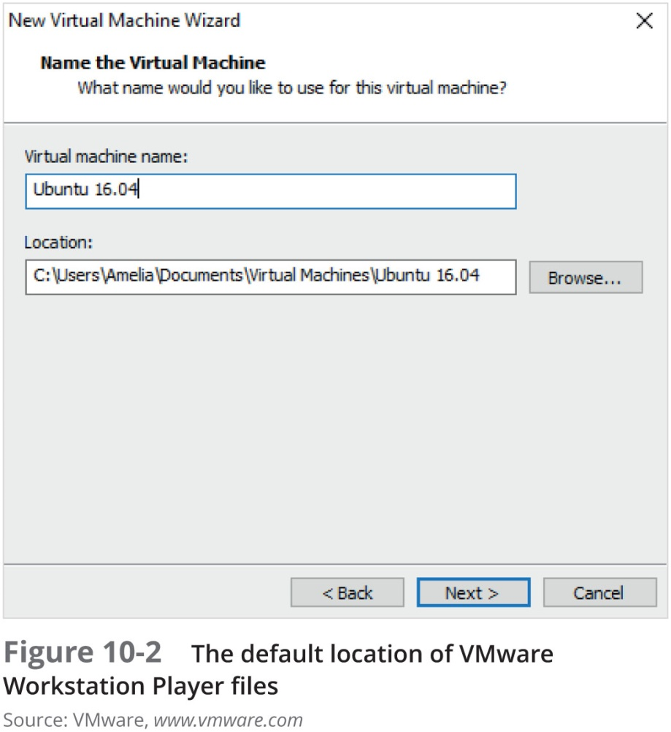
Type 2 Hypervisors (3 of 4)

Slide 8
Type 2 Hypervisors (4 of 4)
Most widely used type 2 hypervisors (cont’d):
  VirtualBox - supports all Windows and Linux OSs as well as Macintosh and Solaris
    Allows selecting types associated with other applications, such as VMware VMDK type or the Parallels HDD type
Type 2 hypervisors come with templates for different OSs

Slide 9
Conducting an Investigation with Type 2 Hypervisors (1 of 9)
Begin by acquiring a forensic image of the host computer as well as network logs
  By linking the VM’s IP address to log files, you may determine what Web sites the VM accessed
To detect whether a VM is on a host computer:
  Look in the Users or Documents folder (in Windows) or user directories (in Linux)
  Check the host’s Registry for clues that VMs have been installed or uninstalled
  Existence of a virtual network adapter

Slide 10
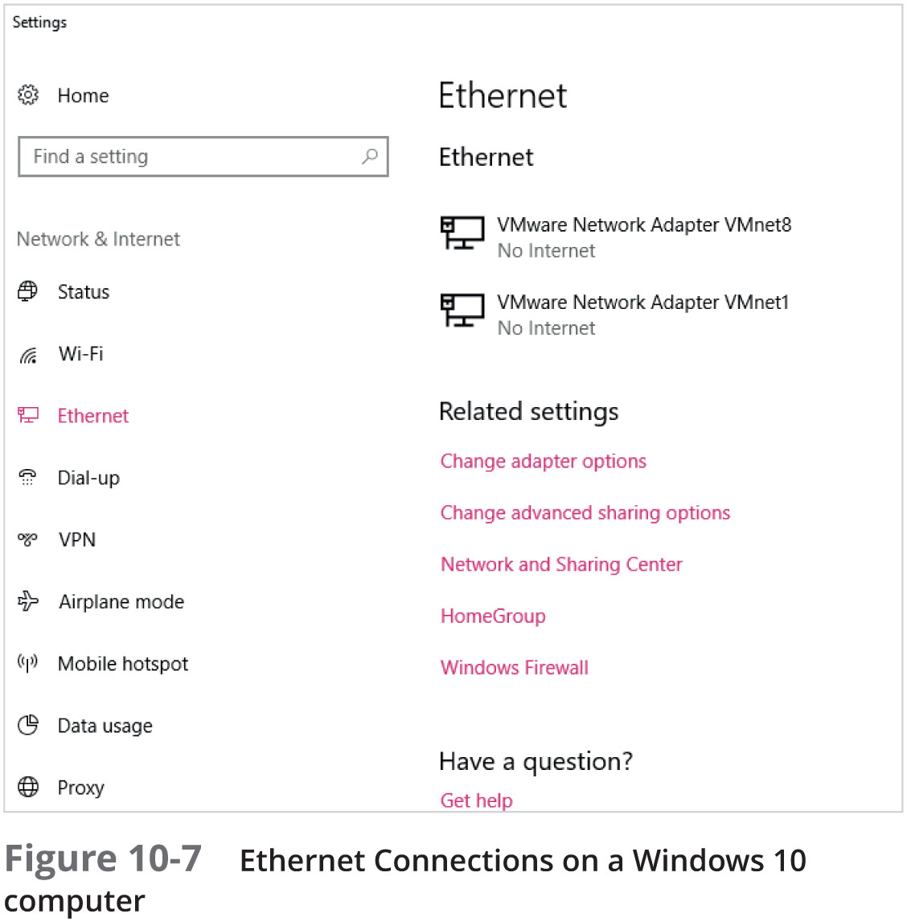
Conducting an Investigation with Type 2 Hypervisors (2 of 9)

Slide 11
Conducting an Investigation with Type 2 Hypervisors (3 of 9)
In addition to searching for network adapters, you need to determine whether USB drives have been attached to the host
  They could have live VMs running on them
A VM can also be nested inside other VMs on the host machine or a USB drive
  Some newer Windows systems log when USB drives are attached
  Search the Windows Registry or the system log files

Slide 12
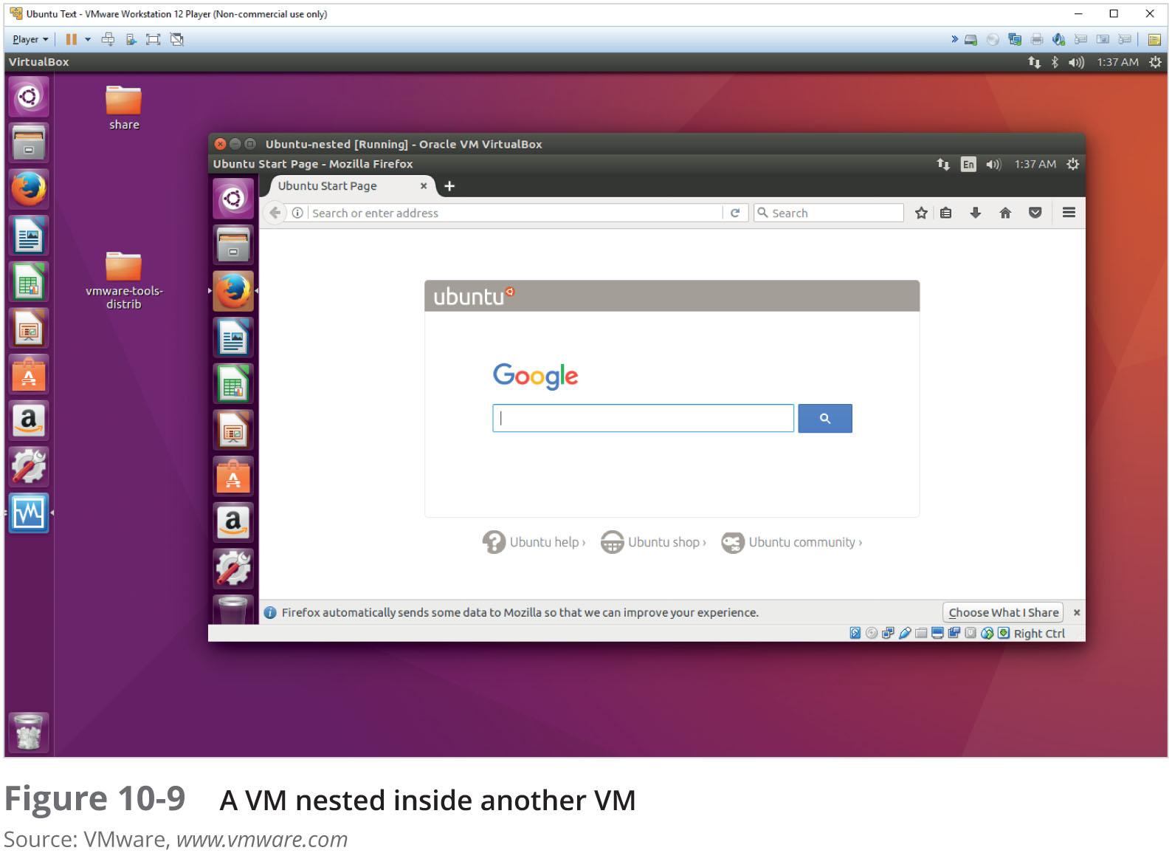
Conducting an Investigation with Type 2 Hypervisors (4 of 9)

Slide 13
Conducting an Investigation with Type 2 Hypervisors (5 of 9)
Follow a consistent procedure:
  1. Image the host machine
  2. Locate the virtualization software and VMs, using information learned about file extensions and network adapters
  3. Export from the host machine all files associated with VMs
  4. Record the hash values of associated files
  5. Open a VM as an image file in forensics software and create a forensic image or mount the VM as a drive

Slide 14
Conducting an Investigation with Type 2 Hypervisors (6 of 9)
Live acquisitions of VMs are often necessary
  They include all snapshots, which records the state of a VM at a particular moment (records only changes in state, not a complete backup)
When acquiring an image of a VM file, snapshots might not be included
  In this case, you have only the original VM
Doing live acquisitions of VMs is important to make sure snapshots are incorporated

Slide 15
Conducting an Investigation with Type 2 Hypervisors (7 of 9)
Follow the steps in the activity on page 426 to see how to examine your own system for evidence of a VM
Follow the steps starting on page 427 to acquire an image of a VM

Slide 16
Conducting an Investigation with Type 2 Hypervisors (8 of 9)
Other VM Examination Methods
  FTK Imager, Magnet AXIOM and OSForensics can mount VMs as an external drive
    By mounting a VM as a drive, you can make it behave more like a physical computer
    Allows you to use the same standard examination procedures for a static hard drive
  Make a copy of a VM’s forensic image and open the copy while it’s running
    Start it as a live VM so that forensics software can be used to search for clues

Slide 17
Conducting an Investigation with Type 2 Hypervisors (9 of 9)
Using VMs as Forensic Tools
  Investigators can use VMs to run forensics tools stored on USB drives
Follow steps starting on page 430 to see how to set up a VM on a USB drive

Slide 18
Working with Type 1 Hypervisors (1 of 2)
This section is meant to help you understand the impact Type 1 hypervisors have on forensic investigations
  Having a good working relationship with network administrators and lead technicians can be helpful
Type 1 hypervisors are installed directly on hardware
  Can be installed on a VM for testing purposes
  Capability is limited only by the amount of available RAM, storage, and throughput

Slide 19
Working with Type 1 Hypervisors (2 of 2)
Common type 1 hypervisors:
  VMware vSphere
  Microsoft Hyper-V 2016
  XenProject XenServer
  IBM PowerVM
  Parallels Desktop for Mac
Follow steps starting on page 433 to install XenServer as a VM in VirtualBox

Slide 20
Performing Live Acquisitions (1 of 2)
Live acquisitions are especially useful when you’re dealing with active network intrusions or attacks
Live acquisitions done before taking a system offline are also becoming a necessity
  Attacks might leave footprints only in running processes or RAM
Live acquisitions don’t follow typical forensics procedures
Order of volatility (OOV)
  How long a piece of information lasts on a system

Slide 21
Performing Live Acquisitions (2 of 2)
Steps
  Create or download a bootable forensic CD or USB drive
  Make sure you keep a log of all your actions
  A network drive is ideal as a place to send the information you collect
  Copy the physical memory (RAM)
  The next step varies, depending on the incident you’re investigating
  Be sure to get a forensic digital hash value of all files you recover during the live acquisition

Slide 22
Performing a Live Acquisition in Windows
Several tools are available to capture the RAM.
  Mandiant Memoryze
  Belkasoft RamCapturer
  Kali Linux (updated version of BackTrack)
GUI tools are easy to use
  But they often require a lot of system resources
  Might get false readings in Windows OSs
Command-line tools give you more control

Slide 23
Network Forensics Overview
Network forensics
  Process of collecting and analyzing raw network data and tracking network traffic
    To ascertain how an attack was carried out or how an event occurred on a network
Intruders leave a trail behind
  Knowing your network’s typical traffic patterns is important in spotting variations in network traffic
Can also help you determine whether a network is truly under attack

Slide 24
The Need for Established Procedures
Network forensics examiners must establish standard procedures for how to acquire data after an attack or intrusion
  Essential to ensure that all compromised systems have been found
Procedures must be based on an organization’s needs and complement network infrastructure
NIST created “Guide to Integrating Forensic Techniques into Incident Response” to address these needs

Slide 25
Securing a Network (1 of 2)
Layered network defense strategy
  Sets up layers of protection to hide the most valuable data at the innermost part of the network
Defense in depth (DiD)
  Similar approach developed by the NSA
  Modes of protection
    People
    Technology
    Operations

Slide 26
Securing a Network (2 of 2)
Testing networks is as important as testing servers
You need to be up to date on the latest methods intruders use to infiltrate networks
  As well as methods internal employees use to sabotage networks
Small companies of fewer than 10 employees often don’t consider security precautions against internal threats necessary
  Can be more susceptible to problems caused by employees revealing proprietary information

Slide 27
Developing Procedures for Network Forensics (1 of 2)
Network forensics can be a long, tedious process
Standard procedure that is often used:
  Always use a standard installation image for systems on a network
  Fix any vulnerability after an attack
  Attempt to retrieve all volatile data
  Acquire all compromised drives
  Compare files on the forensic image to the original installation image

Slide 28
Developing Procedures for Network Forensics (2 of 2)
In digital forensics
  You can work from the image to find most of the deleted or hidden files and partitions
In network forensics
  You have to restore drives to understand attack

Slide 29
Reviewing Network Logs
Network logs record ingoing and outgoing traffic
  Network servers
  Routers
  Firewalls
Tcpdump and Wireshark - tools for examining network traffic
  Can generate top 10 lists
  Can identify patterns

Slide 30
Using Network Tools
Variety of tools
  Splunk
  Spiceworks
  Nagios
  Cacti

Slide 31
Using Packet Analyzers (1 of 5)
Packet analyzers
  Devices or software that monitor network traffic
  Most work at layer 2 or 3 of the OSI model
Most tools follow the Pcap (packet capture) format
Some packets can be identified by examining the flags in their TCP headers
Tools
  Tcpdump
  Tethereal

Slide 32
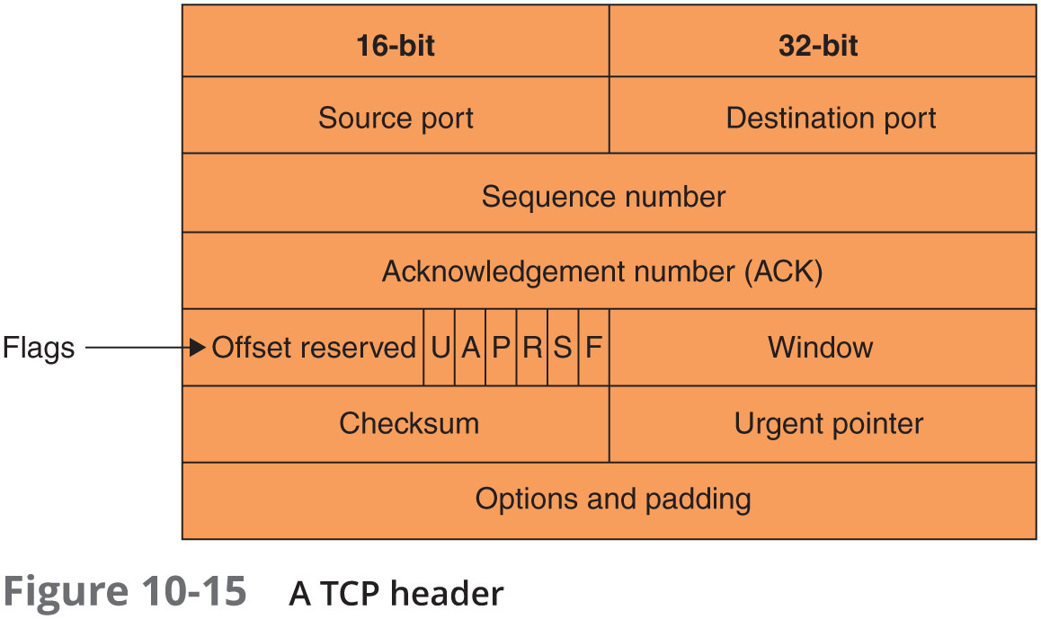
Using Packet Analyzers (2 of 5)

Slide 33
Using Packet Analyzers (3 of 5)
Tools (cont’d)
  Tcpslice
  Tcpreplay
  Etherape
  Netdude
  Argus
  Wireshark
    Follow the steps starting on page 442 to see how the Wireshark tool works

Slide 34
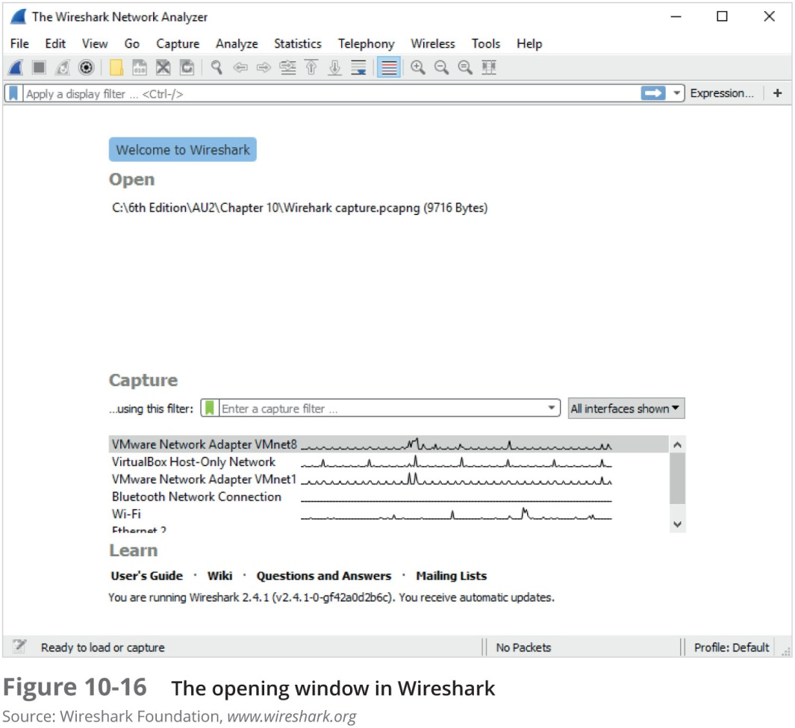
Using Packet Analyzers (4 of 5)

Slide 35
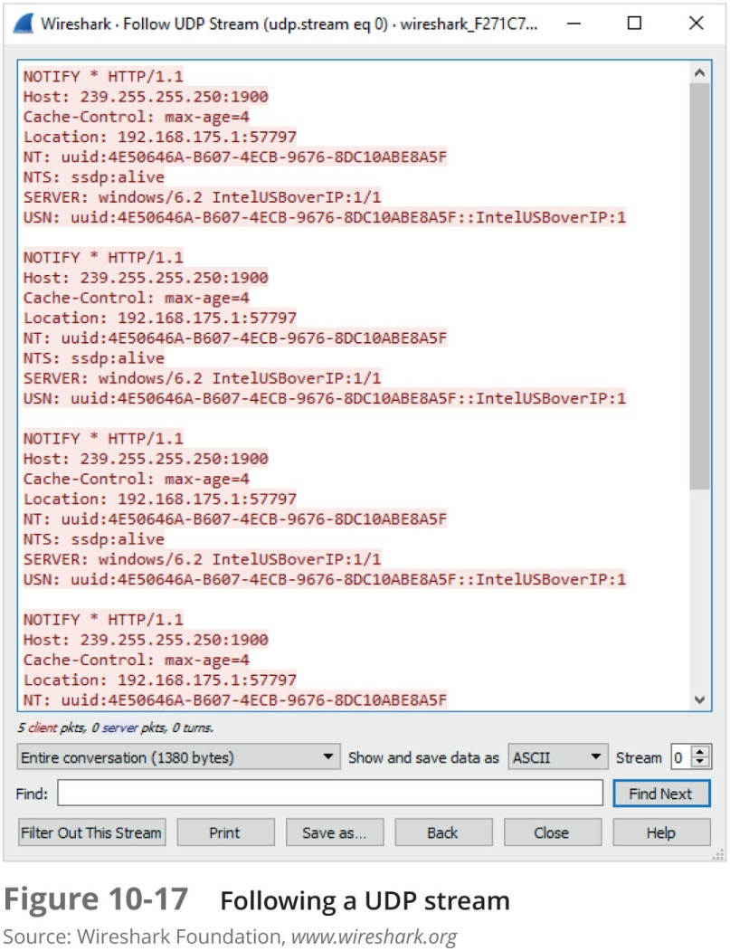
Using Packet Analyzers (5 of 5)

Slide 36
Investigating Virtual Networks
Virtual switch is a little different from a physical switch
  There’s no spanning tree between virtual switches
Additional complications
  Hypervisors can assign MAC addresses to virtual devices
  Devices can have the same MAC address on different virtual networks
  Cloud service providers host networks for several to hundreds of companies
Tools
  Wireshark
  Network Miner

Slide 37
Examining the Honeynet Project (1 of 2)
The Honeynet Project was developed to make information widely available in an attempt to thwart Internet and network attackers
  Provides information about attacks methods and how to protect against them
Objectives are awareness, information, and tools
Distributed denial-of-service (DDoS) attacks
  A major threat that may go through other organizations’ networks, not just yours
  Hundreds or even thousands of machines (zombies) can be used

Slide 38
Examining the Honeynet Project (2 of 2)
Zero day attacks
  Another major threat
  Attackers look for holes in networks and OSs and exploit these weaknesses before patches are available
Honeypot
  Normal looking computer that lures attackers to it
Honeywalls
  Monitor what’s happening to honeypots on your network and record what attackers are doing

Slide 39
Summary (1 of 3)
Virtual machines are used extensively in organizations and are a common part of forensic investigations
There are two types of hypervisors for running virtual machines: Type 1 and Type 2
Virtualization Technology is Intel’s CPU design for security and performance enhancements that enable the BIOS to support virtualization
Forensic procedures for VMs start by creating an image of the host machine, and then exporting files associated with a VM

Slide 40
Summary (2 of 3)
Live acquisitions are necessary to retrieve volatile items, such as RAM and running processes
Network forensics is the process of collecting and analyzing raw network data and systematically tracking network traffic to ascertain how an attack took place
Steps must be taken to harden networks before a security breach happens
Being able to spot variations in network traffic can help you track intrusions

Slide 41
Summary (3 of 3)
Several tools are available for monitoring network traffic, such as packet analyzers and honeypots
The Honeynet Project is designed to help people learn the latest intrusion techniques that attackers are using

