Slide 1
PLEASE SIT WITH YOUR groups Please submit your Reading Summary and Case Assignment

Slide 2
MIS 5302 Managing Technology and Systems Week 3

Slide 3
IT ASSIGNMENTS GRADING 1. I USE THE GRADING SCALE IN THE SYLLABUS, A exceeds expectations/B meets expectations/C fails to meet expectations 2. Assessed on quality of the answers and INSIGHTS. 3. Grades listed in the Community Gradebook: no grades on papers

Slide 4
WEEKLY SUMMARY GRADING 1. GRADED PASS (100%), FAIL (60%) OR MISSING (0%) 2. Assessed on quality of the answers and all components provided (make sure you follow guidelines and provide ALL elements – don’t forget the sentence “learning as a whole” or question!) 3. Grades listed in the Community Gradebook: no grades on papers

Slide 5
What did you learn this week?
?

Slide 6
Discussion : Weekly Reading Summary 1. One key point you took from each assigned reading, including the case/assignment: one sentence per reading. 2. One key point you learned from the readings/case as a whole: one sentence maximum. 3. One discussion question that you would ask your fellow classmates: one sentence maximum.

Slide 7
Case #1: Google, Inc. The case describes several of Google’s “products” (their search engine, Gmail, Google Earth, etc.). What do they have in common? How would you describe the line of business Google is in? What is Google’s revenue model (how do they make money)? Who are its customers? With this in mind, what is Google’s real product? Based on the material in the case, how would you describe Google’s strategy? Do they have one? The last section of the case is titled “What Should Google Do?” What do you think Google should do (it doesn’t have to be one of the options described in the case)? Make sure you explain why you chose that course of action. How has Google created an organizational structure that encourages and enables innovation? Give specific examples.
?

Slide 8
Breakout Session: google 1. Pair up with another group. 2. Present your case to each other. 3. Briefly critique each others work. 4. Strategize how you will present to the class. 10 min present / 5 min Q+A

Slide 9
Presentations: google 10 min present / 5 min Q+A

Slide 10
Discussion: Disruptive INNOVATION

Slide 11
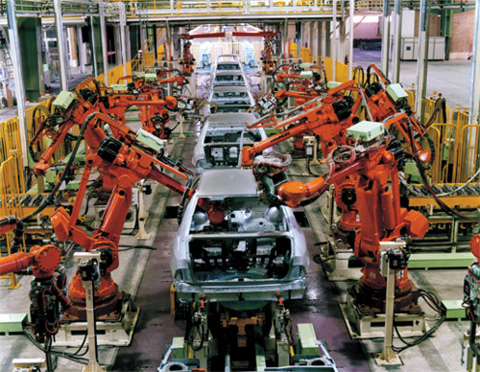
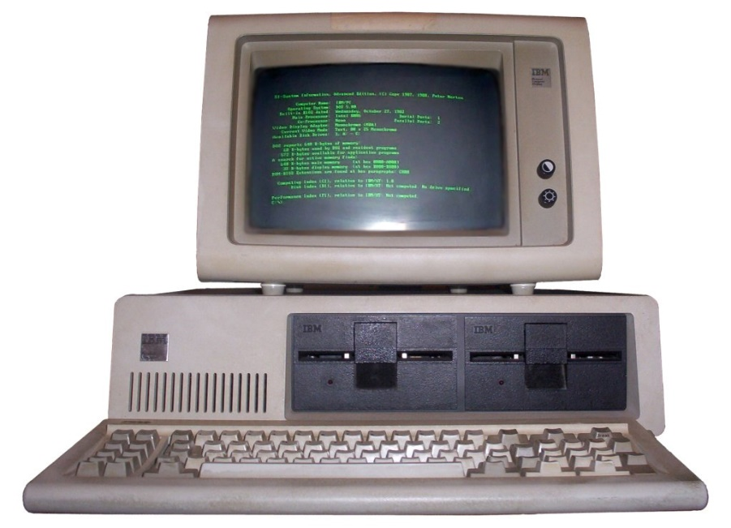
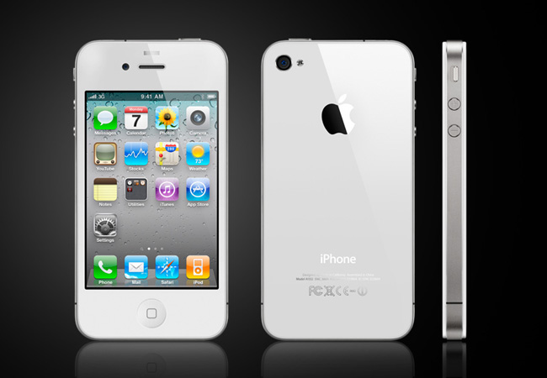
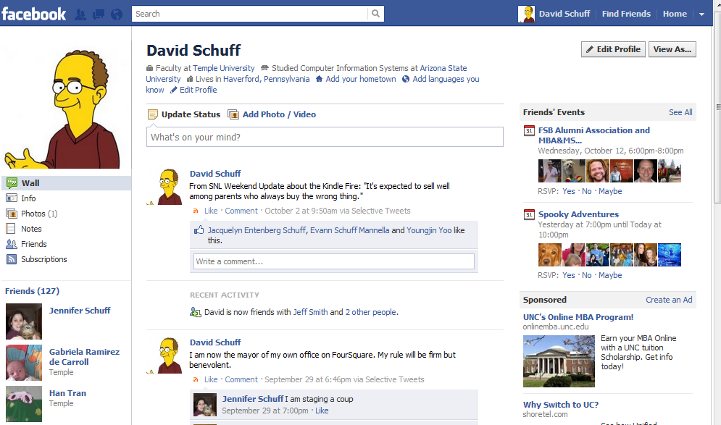
What do these have in common?

Slide 12
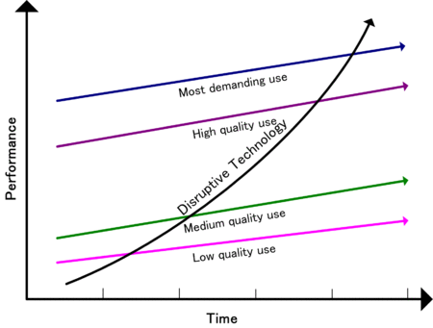
Disruptive Innovation Theory
Low-end
Quality increasing faster than need
Opportunity for low-cost entrant
New-market
Fits an emerging segment with an unmet need
http://en.wikipedia.org/wiki/Disruptive_technology
HOW DOES THIS WORK?

Slide 13
Responding to Disruptive Innovations
Your existing position
What’s going on in the environment
What to do
1-Compete directly
2- Serve a different market
3- Create a new market

Slide 14
So how do companies innovate?
New products for high-margin customers
Cheap alternatives to existing products
New products for “non consumers”

Slide 15
Resources, Processes, Values
Resources
Assets
Processes
Way of working
Values
Criteria used to make decisions
People, cash, products
Hiring, budgeting, product development
Customer demands, ethics, cost structure
HOW do these determine whether a company embraces or ignores a disruptive innovation?
Source: Christensen, C., Anthony, S., and Roth, E. “Seeing What’s Next: Using the Theories of Innovation to Predict Industry Change.” Harvard Business School Press, 2006, p.6.

Slide 16
Understanding Signals of Change
Undershot Customers
Overshot Customers
Non Consumers
Nonmarket Contexts
When companies are filling up-market need
When companies are filling down-market need
When new markets are being created
Barriers to innovation are changing
i.e., Government regulation
i.e., Facebook, iPad
i.e., Netbooks, Kindle Fire
i.e., new data analytics software to handle “big data”
Source: Christensen, C., Anthony, S., and Roth, E. “Seeing What’s Next: Using the Theories of Innovation to Predict Industry Change.” Harvard Business School Press, 2006, p.2.

Slide 17
What is the next disruptive technology?
Electric car?
Virtual reality gaming? Learning?
Artificial Intelligence?
Robot greetings you at the hotel desk?
Autonomous car?
???

Slide 18
Next week : Learn IT Assignments #2 Activity: You too can code Objective The objective of this activity is to demystify programming by learning the basics of a popular programming language (JavaScript & HTML). Activity Requirements In this assignment you will work through a simple tutorial and learn the very basics of what a program is (refer to the link provided on our class site). Prepare a 1 page document answering the following questions: 1. Has your view of computer programming changed after completing an hour of code? 2. Some people say that every student should learn to code. Do you agree or disagree? 3. What are 3 key things you learned? 4. Are you likely to use this resource again? Would you recommend it to others? Why or why not? Submit a hard copy of your 1 page summary (4 questions above) and a hard copy of your screen print showing your name and your achievement badges.

