Slide 1
PLEASE SIT WITH YOUR groups Please submit your Reading Summary

Slide 2
MIS 5402 Managing Technology and Systems Week 6

Slide 3
THE PARTY IS OVER. TODAY IS THE LAST CLASS!

Slide 4
Reminder: REFLECTION JOURNAL DUE BY MIDNIGHT FRIDAY Send to mcmartin@temple.edu

Slide 5
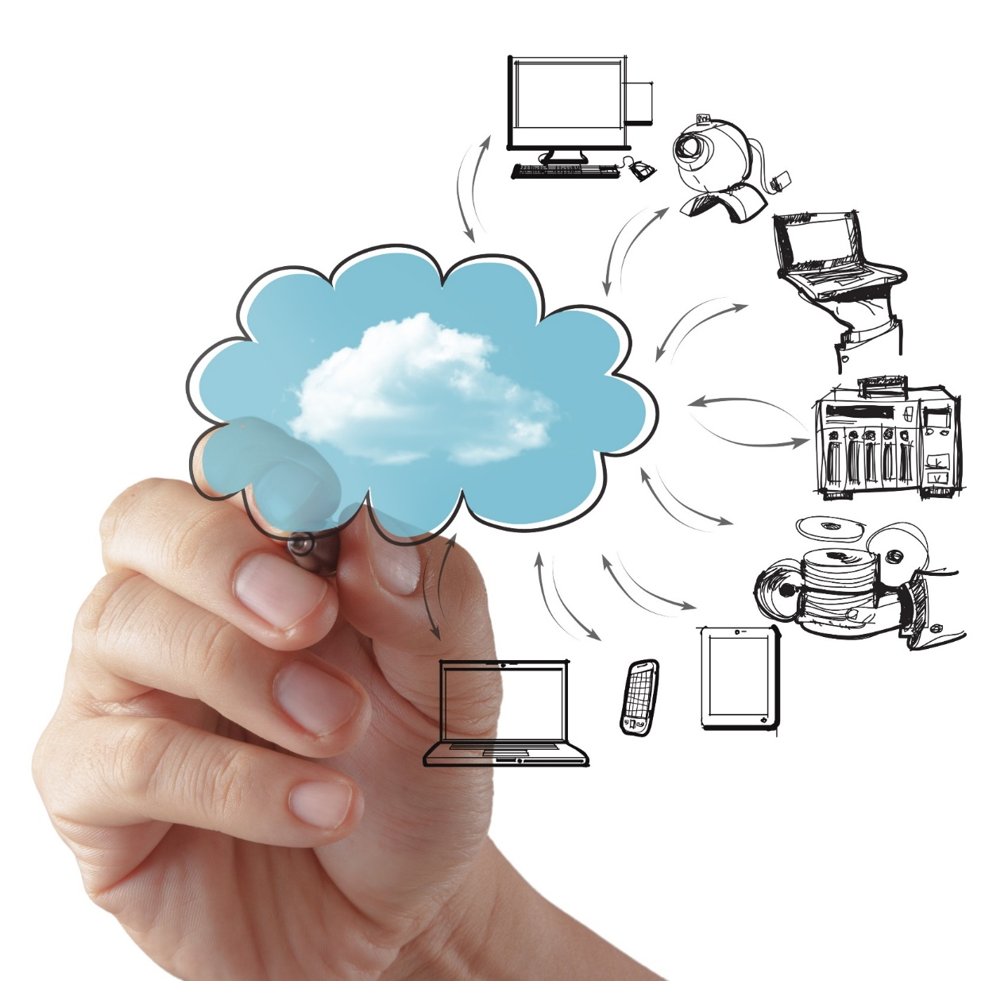
Enterprise Cloud Computing
Computing On Demand

Slide 6
Enterprise Cloud Computing
Cloud computing refers to the delivery of computing services over a proprietary network or the Internet. Those services mainly include infrastructure (i.e. servers, storage devices, etc.), development platforms, and software applications.
Technology as a “utility” (pay-as-you-go)
Capital Expenditures become Operating Expenditures
Enables universal, global, & mobile collaboration
Source: http://www.dailytech.com/Cloud+Computing+Changing+IT+in+Small+Business+World/article33635.htm

Slide 7
Cloud Computing
Benefits
Less expensive
Fewer staff people with greater focus and more time
Increased Agility/Scalability
Remote access
Disaster Recovery
Easier to Use
Improved service and performance
Pitfalls
Downtime
Device security
Data integrity
Privacy & confidentiality of data
Compliance

Slide 8
Big Players in Cloud Computing
Amazon Web Services (AWS)
Google Cloud Platform
Oracle
And many others

Slide 9
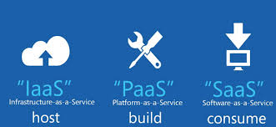
Cloud Computing Models
IaaS: Infrastructure as a Service
PaaS: Platform as a Service
SaaS: Software as a Service
Various other models exist (XaaS) / hybrid

Slide 10
IaaS, PaaS, SaaS Explained
IaaS: “host” – you pay for the infrastructure but you are responsible for all application development and deployment and support activities.
PaaS: “build” – you pay for the infrastructure and for a developing platform that supports many areas of deployment so you can just focus on programming your application.
SaaS: “consume” – you pay for an entire solution that is fully built, deployed, and distributed over the web for you to consume on demand. You have no infrastructure, development, deployment, or support responsibilities.

Slide 11
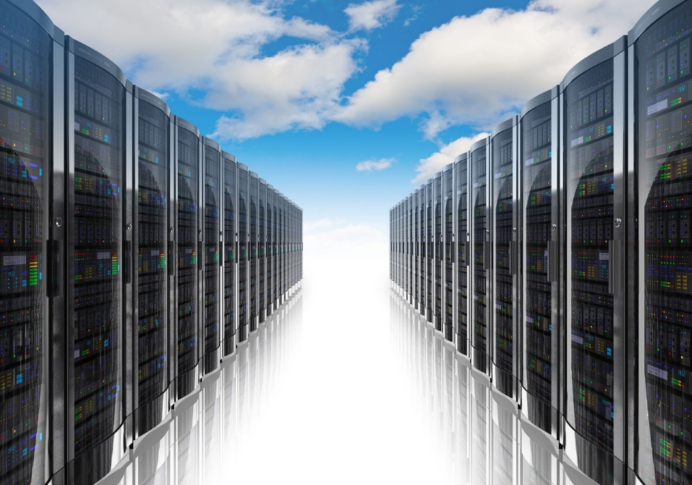
IaaS (Infrastructure as a Service)
“Online services that abstract user from the detail of infrastructure like physical computing resources, location, data partitioning, scaling, security, backup, etc.”
The user is responsible for installing and maintaining the operating system and the application software.
Pay for resources allocated and consumed, much like a utility service.

Slide 12
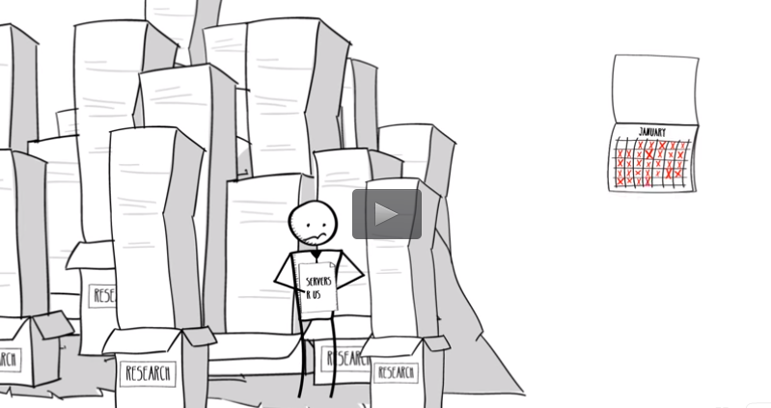
IaaS: Amazon Web Services: EC2
The gold standard in IaaS
Many services you use run on AWS
Hundreds of success stories
Click image to watch demo

Slide 13
AWS Case Study: Johnson & Johnson
Click image to watch video

Slide 14
AWS Case Study: Johnson & Johnson
What we learned from watching the video:
What are J&J main product offerings (pharmaceuticals and medical devices)
How J&J have achieved global growth (M&A)
Forces in the competitive landscape: demand for efficiency, transparency, healthcare reform, emerging markets
What AWS did for J&J’s technology architecture (hard and soft benefits?)
Servers on demand & Virtualization
Compliance with FDA, HIPPA, CMS
Insights (how does big data create value by providing insights?)
BYOD trend

Slide 15
AWS Case Study: Netflix
<< Click image to watch video
Questions based on the video:
How has AWS solved Netflix’s technology needs?
What are virtualization instances?
What are the benefits of scalability in architecture?
What are some other potential uses for web services?

Slide 16
Google Cloud Platform: Compute Engine
Built on the same infrastructure as Google search engine, Gmail, YouTube: “Powered by Google”
Scalable virtualization on demand
Pay per consumption, like a utility, cents per hour of usage
Each virtual machine instance is equipped with resources like disk, network, firewall, etc.

Slide 17
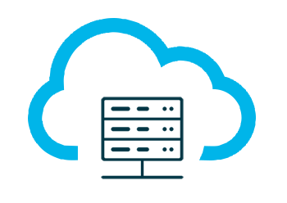
PaaS (Platform as a Service)
Build and deploy applications to the web quickly and without the significant capital expenditures and complexity of investments in infrastructure and support layers
Platform includes security layers, databases, operating systems, and developing/execution environments
Rapid deployment
Automatic Scaling
Integration with developing tools
Pay for what your application consumes

Slide 18
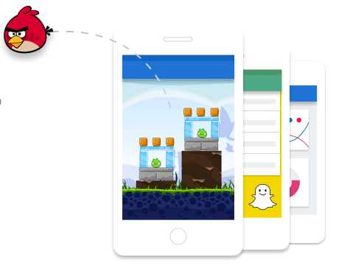
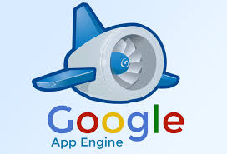
PaaS: Google App Engine (2008)
The gold standard in PaaS
Supports Python, Java, PHP, and Go
Includes free quotas
Pay per application consumption
Hundreds of apps built and deployed

Slide 19
GCP Case Study: Snapchat
<< Click image to watch video
Snapchat has been valued at ~$15 Billion
All it offers is an app to share temporary, fleeting images
Why is scalability so important?
How might demand surge during events like Superbowl, Academy Awards, Elections, etc.?

Slide 20
PaaS: AWS Elastic Beanstalk (2011)
Launched 3 years after (and in response to) Google App Engine
Supports more programming languages than Google
Uses similar quotas and pay per consumption model
Click image to watch demo

Slide 21
SaaS (Software as a Service)
Cloud based software
Central, multi-tenant or virtualization architecture supports scalability
Distributed via web browsers; available anywhere with an internet connection
Compatible with multiple operating systems and devices
Easy to use, collaborate, update, and sync
Revenue model is subscription based

Slide 22
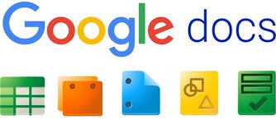
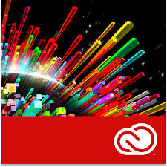
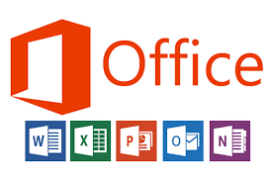
Examples of SaaS
SalesForce
CRM tool
NetSuite
CRM and ERP combined service
Constant Contact
Marketing automation tool
GoToMeeting
Conferencing solution
Google Docs
Collaboration tool
DropBox
Storage solution
Adobe Creative Cloud
Suite of creative solution
Microsoft 365
Suite of creative solutions

Slide 23
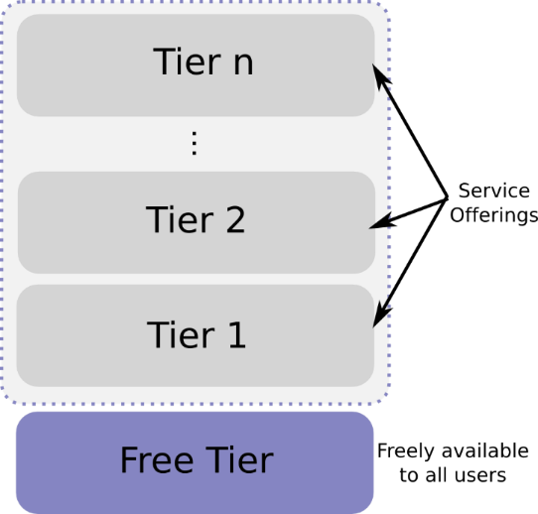
SaaS Subscription Types
Monthly billing
Term billing
Freemium: limited version free forever (usually very low conversion rate)
Free Trial: full version free for a period (conversion rates should be higher)
Paywall: similar to free trial, content blocked by quota
Freemium

Slide 24
Breakout Session + Discussion: PT1 VOLKSWAGEN OF AMERICA MANAGING IT PRIORITIES

Slide 25
VOLKSWAGEN OF AMERICA In groups, discuss the following questions: - Describe the problems with the way Volkswagen had been managing IT projects at the start of the case. - How did the new management system change their prioritization processes? - How is it possible that under this new system a “critical” project (the global supply chain system) was underfunded?
?

Slide 26
Breakout Session + Discussion: PT2 VOLKSWAGEN OF AMERICA MANAGING IT PRIORITIES

Slide 27
VOLKSWAGEN OF AMERICA Each group will discuss and prepare to present an EVIDENCE-BASED response to the following issue: Groups 1, 2, 3 and 4: - What did Volkswagen get RIGHT regarding its method of prioritizing IT projects? - How does it enable innovation? Groups 5, 6, 7, 8 and 9: - What did Volkswagen get WRONG regarding its method of prioritizing IT projects? - How does it hamper innovation? You may use relevant additional information outside of the case material.
?

Slide 28
THE END…. THANK YOU!

