Slide 1
Patient Experience & Workflow Analysis
For a Major Health System ~ Dashboard Presentation
Team 1
Team 2
Team 3
Anastasia Gelin
Roy Schofield
Averee Owens
Kevin Bates
Simone Praylow
Anyea Brittingham
Andy Yang
Janeine Viereekiss
Raziyah Jones
MiKayla Williams
Andy Wu
William Jackson
Ebony Love
Armani Maxwell
Lukius White

Slide 2
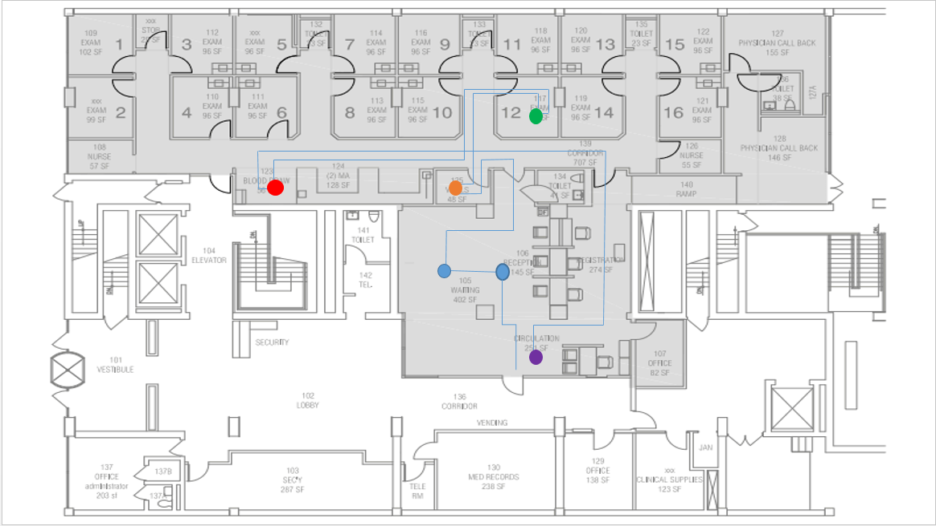
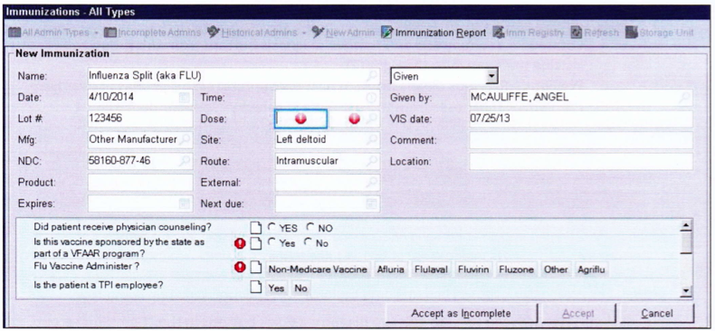
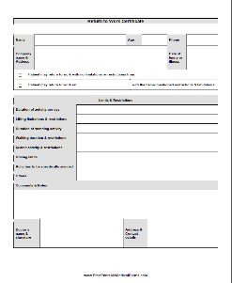
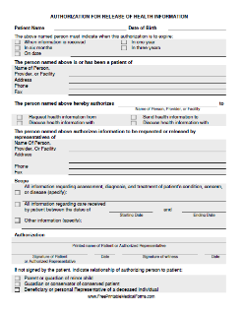
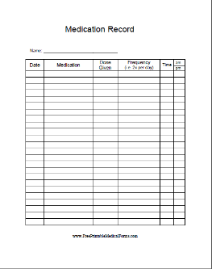
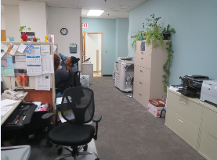
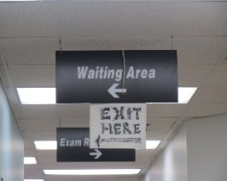
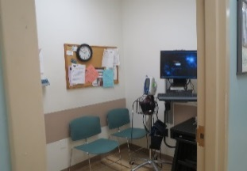
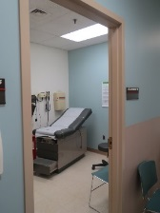
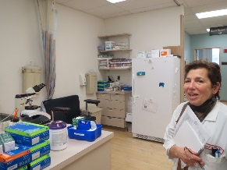
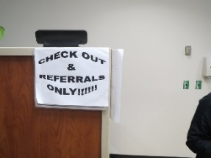
Actors
Time
Patient Experience & Workflow Analysis
For a Major Health System ~ Dashboard
EPIC View board
Doctor’s Forms
IDX Medical
Internal Medicine Clinic Inside Photos
Check In
Waiting Room
Able to be triaged
Exam Room
Blood Draw
Check Out

