Slide 1
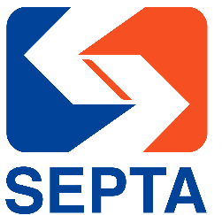
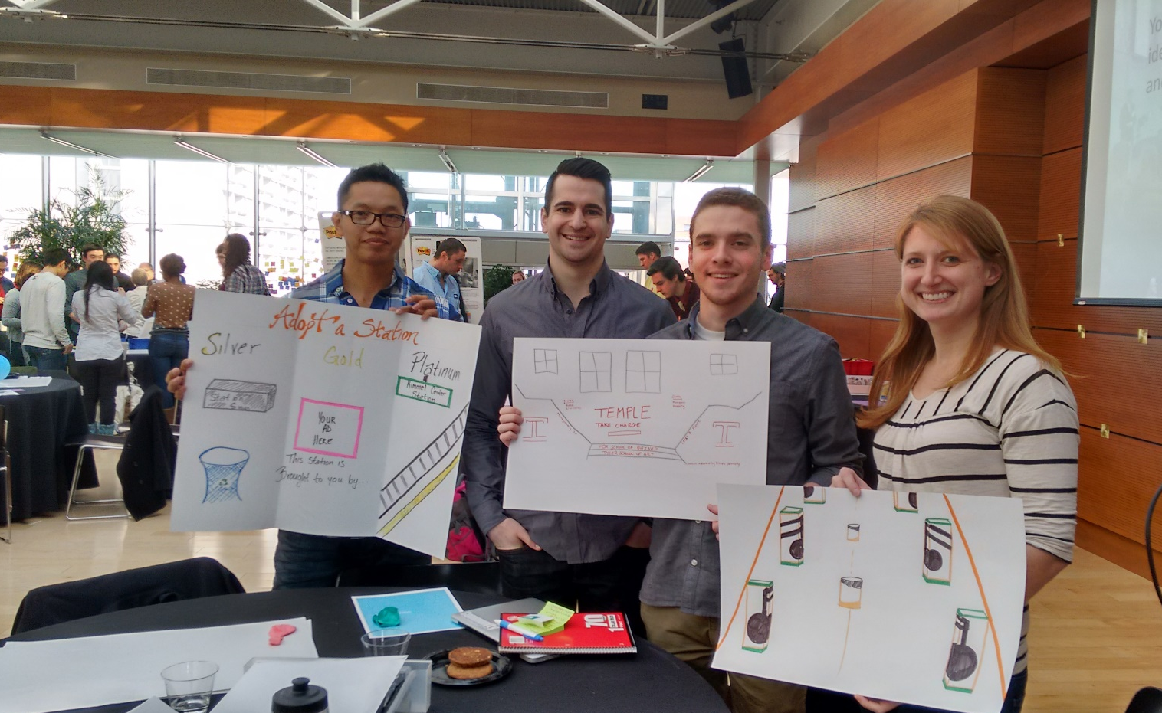
Team 3: Adopt a Station
Loi
Temple Sophomore;
MIS degree;
Was in the military prior to coming to school
Leigh
Temple Junior;
MIS Degree; Originally from Washington DC
Noel
Temple GMBA;
Healthcare Concentration; Has a dog named Pickles
Stephanie
Temple GMBA;
General Concentration;
Originally from Wisconsin
Design Challenge – February 25, 2015

Slide 2
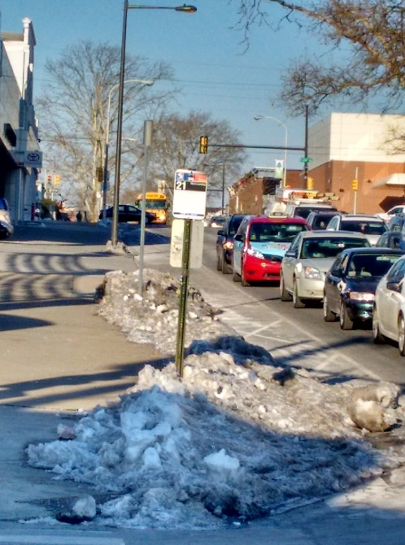
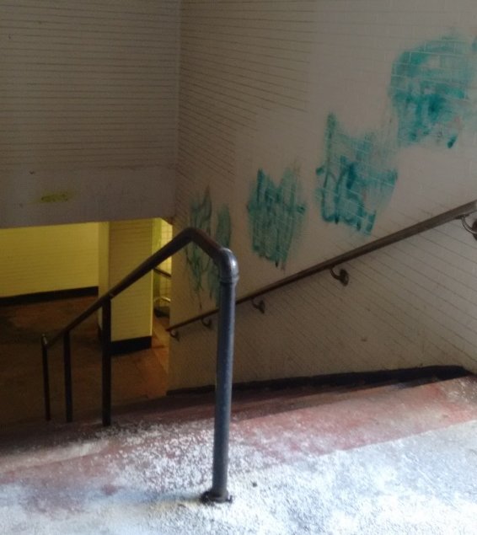
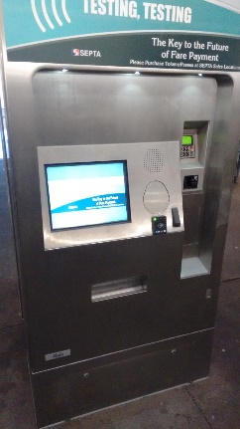
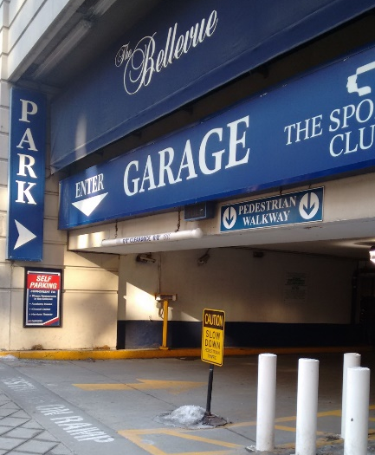
Discovering Septa
No Weather Protection
“…Any extra revenue we put towards increasing ridership… cleanliness comes second or third…”
– Byron Comati, Septa Director of Strategic Planning
Fieldwork
3 Septa Tours
40 Speed-dating interviews
4 Personal Septa Experiences
4 Competitor Experiences (Car, Uber, Taxi, Bike)
3 Comparison Experiences (Boston Subway, DC Metro, Chicago El)
Limited Arrival Notifications
Testing New Payment System
Icy Bus Stops
Most common customer service inquiries: Don’t know where to go to get transportation or don’t know the real-time location of transportation
– Customer Service Tour
Tokens or Cash; Not sold at every stop
Dirty Stations
Opportunities
Cleaner Stations
Real-time App
Bus Shelters
Community Art at Stations
Many City Parking Options
Station Art –
15th Street Station

Slide 3
Septa Stakeholders
Lou, a South Philly data processing employee
“Loves South Philly Living”
He takes the Broad Street Line every day for work and to pick up his kids from school.
Late trains are a primary source of frustration, as he depends on the subway for all of his needs. He hates using cash for tokens.
He needs the subway to be on time and frequent.
John, a city executive who lives on the Mainline
“Not enough time in the day”
He drives to the city every day, because it’s faster and more reliable.
He hates the traffic and it’s high stress to find parking.
He needs quick and easy transportation, as well as high frequency.
Septa “Wants”
Increased ridership
More loyal riders
More revenue
Updated fleet
Septa Stakeholders
Tourists
People who live in city
People who live in suburbs
Employees (in and out of city)
Insurance Agencies
Taxi Drivers
City/Suburb Businesses
Property Realtors
Bikers
Drivers
Septa Employees
Government
City Planning Agencies
Septa “Needs”
Cleaner stations
On-time Apps
More frequent stops
Better payment option
More station cameras (security)
Lou
John
Septa “Have”
Range of transportation options
Customer reliance
Infrastructure

Slide 4
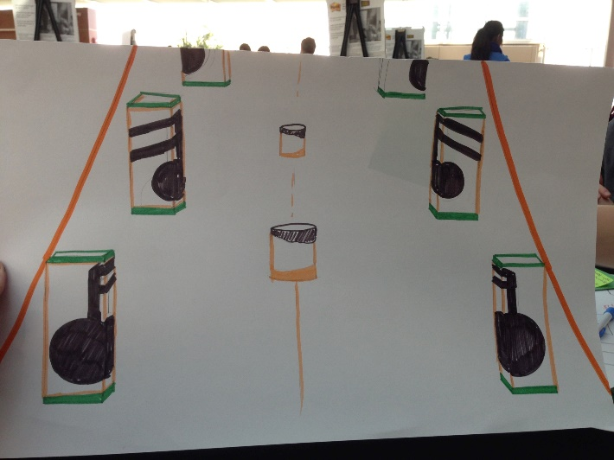
How Might We…
Adopt A Station
Many of the big ideas proposed by other teams (cell phone apps, station upgrades, bus stops, etc.) require significant financial investments.
Adopt a Station creates a sustainable revenue stream for Septa, giving Septa the financial support needed to pursue other organizational improvements.
For example, area organizations like Comcast or Penn Medicine adopt stations near their businesses, ensure the stations cleanliness, and in return are afforded significant advertising opportunities around the adopted station.
How might we create more sustainable revenue streams to make Septa cleaner, more efficient, and more desirable overall.
Silver Adoption Level
Includes:
Company advertisements throughout the station
Branded recycling bins throughout the station
Gold Adoption Level
Includes:
Silver adoption level, plus:
More significant branding elements like painted columns or murals
Company name displayed alongside station name plaques
Platinum Adoption Level
Includes:
Gold adoption level, plus:
Instead of station name plaques, the station will be renamed to include the name of the adopting company
Gold Adoption Example
All of the Centers for the Performing Arts along Broad Street sponsor the Walnut Locust Station.
The station’s columns are painted with musical notes representing the theatres’ missions.
Septa receives advertising revenue, which can go toward other improvements, and the theatres receive publicity.

Slide 5
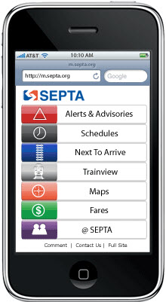
Value Proposition
Station Improvements Cost Money!
Adopt a Station creates a sustainable revenue stream for Septa, giving Septa the financial support needed to pursue other organizational improvements.
Septa Needs
Adopt a Station has low start up costs
Need a sales force to sell the idea to local businesses
This cost can be lessened by simply putting together information about the program on Septa’s website and allowing companies to come to Septa
Septa needs cornerstone company to champion the program – Comcast, Aramark, Penn Medicine
Once established, the program will inspire other companies to partner with Septa and the model will be self-sustaining.
No Weather Protection
Adopt A Station Benefits
Creates a sense of community
Encourages adopting company to keep station clean
Creates a sustainable source of revenue for Septa
Revenue can be used to pay for many of Septa’s other needs – clean stations, develop a better app, update token system, provide bus stop weather protection, etc.
Icy Bus Stops
The new “super stop” in Arlington, Va., has a stainless steel design, heated concrete floors, a state-of-the-art computerized bus schedule... and a price tag of $1 million.
The Washington Post, March 24, 2013

