Slide 1
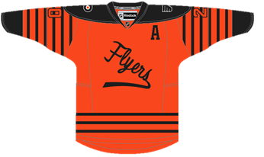
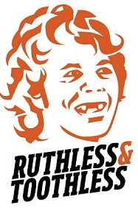
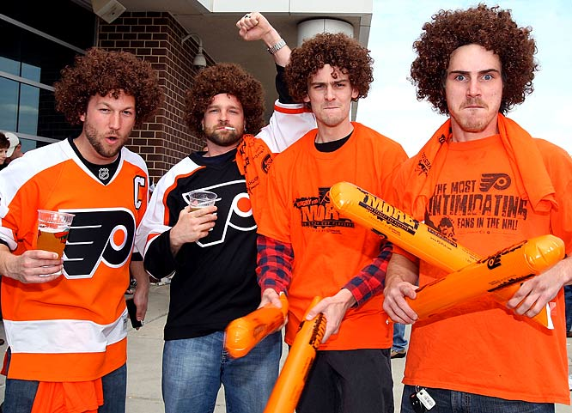
LOGO/LIKENESS USAGE STATUS
FAN APPAREL SYSTEM MAP
PERMISSION
INTERPRETATION
INFRINGEMENT
Asian Wholesalers
Street Vendors
Supply Drivers
FAN INTEREST DRIVES PRODUCTION DEMAND
DISTRIBUTION
Authentic can scale rapidly for a fixed number of designs
Replica
Imitation
SELLING
AUTHENTIC
Licensed
Nat’l Retailers
Team Store
League Website
Reproduction can scale rapidly, but lags demand in market
DISTRIBUTION
$
LOWEST QUALITY APPAREL
REPRODUCTION
Innovation maximizes design variants, but limits scalability
Inspired
Fusion
Local Boutiques
Parking Lot
Boardwalk
SELLING
DISTRIBUTION
$5 T-Shirt
<$100 Jersey
Demand Drivers
Original
Authentic demand driven by team success, inhibited by price
HIGHEST QUALITY APPAREL
SELLING
INNOVATION
Reproduction demand driven by pricing gap, inhibited by profile
MIXED QUALITY VENDOR DEPENDENT
Licensed: $30/$200+ Unlicensed: $15/$100+
Innovation demand driven by uniqueness, inhibited by copyright
$25 T-Shirt, $175+ Jersey
GREG EBBECKE

