Slide 1
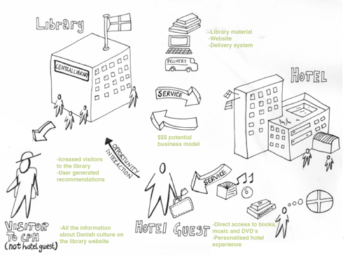
From http://www.servicedesigntools.org/sites/default/files/res_images/SYSTEM_MAP_03.jpg

Slide 2
the system
Master copy is sold to a pirate lab, 50 – 100 dollars per movie
Vendors sell DVDs to consumers,
4-5 dollars per unit
A camera recording of the movie is made
Movie is produced
Pirate lab sells DVDs to vendors,
1 dollar per unit
Pirate lab “warehouses” the DVDs
Pirate lab packages the DVDs
Pirate lab burns the master copy
Movie opens in theaters
The pirate lab provides the
most profitable portion of the system

Slide 3
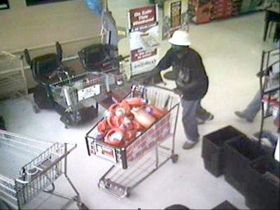
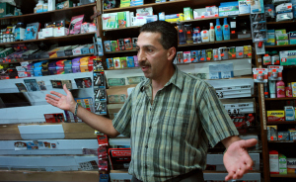
I’ll flip this in no time…easy money.
If my employees cared a little more about stopping theft, it would be a big help.
I can’t be held responsible for what falls off the back of my truck.
Meet me out back.
I do everything I can to give my kids as much as I can.
I buy for the lowest price I can get.

