Slide 1
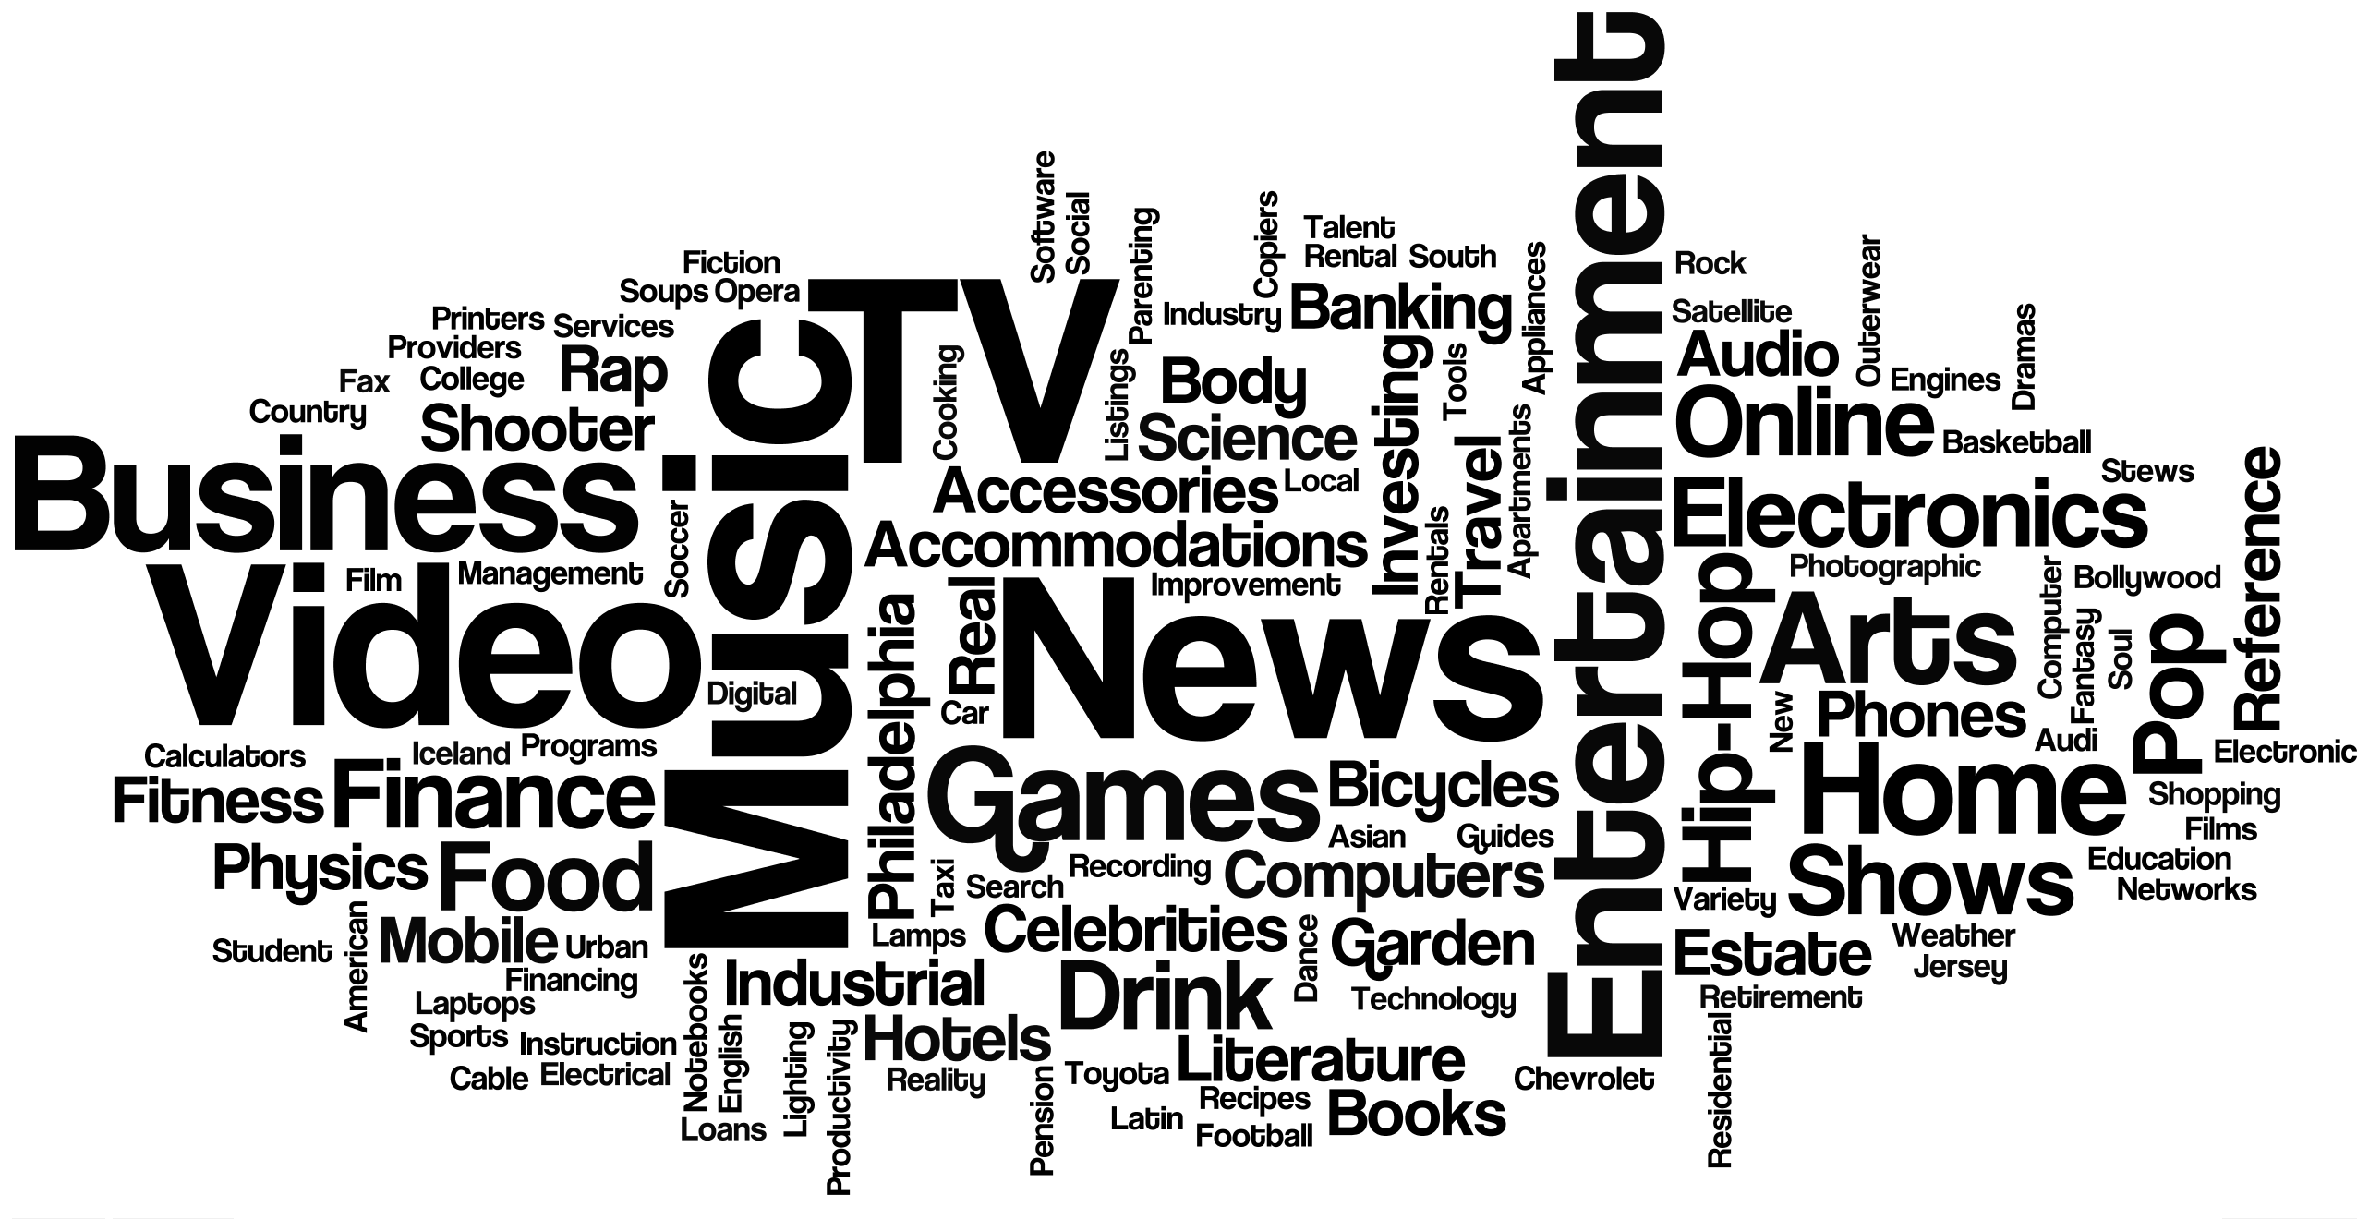
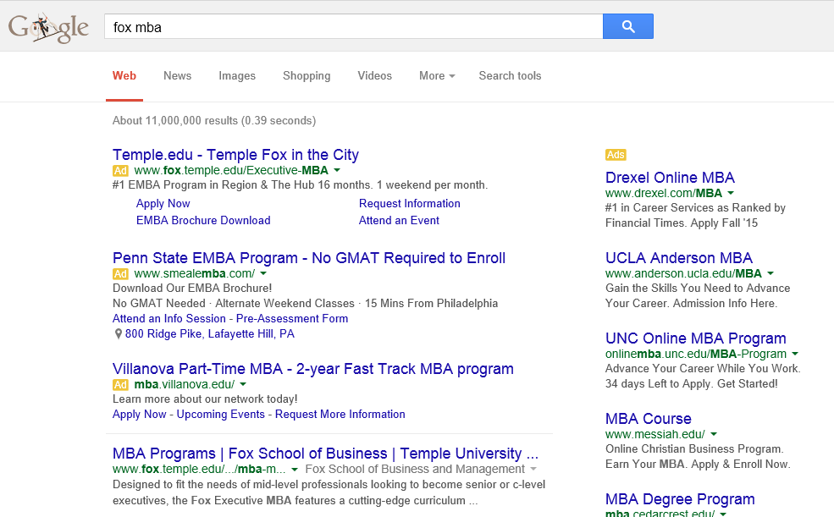
What is Google's Product?
Google Case Study – MIS 5402
Bryan Kissinger, Christopher Pope, Lesley Brown
Lora Zeanchock, Michael Schroeder, Sayanti Saha
Free Services
On the surface it may seem that Google’s products are what most of us use everyday: Gmail, Android, Chrome, Docs, Maps, etc.
Under the surface, Google has created a mutually beneficial ecosystem for both their users and advertisers where the data collected from free services help make advertising relevant and more useful to the individual.
Google’s real product is the data that they collect about their users and their business is in selling that information to advertisers in the form of advertisements.
Google is an advertising company
The word cloud (at right) is the demographic information that google has surmised about our group with the larger words being commonalities among our group members.
The Positive Feedback Loop: The more users they have in their ecosystem the more data they have on their users. The more data they have on their users the more individualized the services and the targeted advertising can be. This keeps users in their ecosystem and creates even more advertising impressions.
User Data
Advertisements in Free Services and on the Web
AD
AD
Search Result
(1) Google About Projects. http://www.google.com/about/products/
(2) Google Ads Settings. https://www.google.com/settings/u/0/ads
Notes:
(1) Google About Projects. http://www.google.com/about/products/
(2) Google Ads Settings. https://www.google.com/settings/u/0/ads

Slide 2
Google’s Customized Searching
Google’s is constantly expanding data sources to provide users with new and faster ways to fulfill their query.
Google Fiber ⁽¹⁾
Google Fiber offers fast internet service (thus improved searching speeds) for a fee or slower internet service for free. Google Fiber has now been introduced in eight cities.
Google Translate ⁽²⁾
Google Translate used for more than one billion translations per day in 80 languages. Allows searching of websites in other languages.
Google Directions and Traffic ⁽²⁾
Offers fastest routes to searched location.
Voice Search ⁽³⁾
Offers users the ability to search via voice recognition in 50 languages.
Personal Assistant ⁽²⁾
Searches emails and texts to add commitments to your calendar.
Auto Insurance comparisons ⁽⁴⁾
Google compares up to 14 services auto insurance policies and provides a quick comparison and expedited search for insurance.
Google tools offer an expedited means of finding a solution.
References
(1)Google Fiber Official Webpage. https://fiber.google.com/cities/kansascity/plans/
(2)CNN Money. August 20, 2014. 10 innovations That Made Google Great. http://money.cnn.com/2014/08/20/technology/innovationnation/google-search/
(3)Forbes. August 22, 2014. Google’s Voice Search for Android Now Recognizes 5 Different Languages At Once http://www.forbes.com/sites/amitchowdhry/2014/08/22/googles-voice-search-for-android-now-recognizes-5-different-languages-at-once/
(4)CTV News. March 5, 2015. Google’s Latest Venture Auto Insurance Comparisons. http://www.ctvnews.ca/business/google-s-latest-venture-auto-insurance-comparisons-1.2266651
Notes:
References:
Google Fiber Webpage. https://fiber.google.com/cities/kansascity/plans/
CNN Money. August 20, 2014. 10 innovations That Made Google Great. http://money.cnn.com/2014/08/20/technology/innovationnation/google-search/
Chowdry, Amit. August 22, 2014. Google’s Voice Search for Android Now Recognizes 5 Different Languages At Once http://www.forbes.com/sites/amitchowdhry/2014/08/22/googles-voice-search-for-android-now-recognizes-5-different-languages-at-once/
Liedtke, Michael. March 5, 2015. Google’s Latest Venture Auto Insurance Comparisons. http://www.ctvnews.ca/business/google-s-latest-venture-auto-insurance-comparisons-1.2266651

Slide 3
Google’s Search Product Drives Business Model
Google focuses on free, high-quality products (e.g. search, email) to engage and retain an active user base.
$10B in R&D annually ⁽¹⁾ leading to 1.2B monthly searchers ⁽²⁾, 500M gmail users ⁽³⁾
Engaged audience provides platform for Google to sell ads. Google’s customers are the purchasers of the ads.
$59B in ad revenue in 2014 ⁽⁴⁾
Google can command premium prices for their advertising space because they have tremendous amount of user data
Estimate are as high as 15 exabytes, or 15 million terabytes ⁽⁵⁾
Data enables ad buyers can more efficiently target their segment
Based on present user activity (e.g. ad for Audi if searching for cars)
Based on history of user activity (e.g. Nest thermostat if high-tech interest)
(1) CNET. October 30, 2013. Apple’s R&D up 32 percent in 2013, still dwarfed by rivals. http://www.cnet.com/news/apples-r-d-up-32-percent-in-2013-still-dwarfed-by-rivals/
(2) Search Engine Land. February 11, 2013. Google still world’s most popular search engine by far, but share of unique users dips slightly. http://searchengineland.com/google-worlds-most-popular-search-engine-148089
(3) CNN Money. April 1, 2014. Gmail at 10: How Google dominated e-mail. http://money.cnn.com/2014/04/01/technology/gmail/
(4) Google Investor Relations. https://investor.google.com/financial/tables.html
(5) Xkcd Blog. https://what-if.xkcd.com/63/

Slide 4
Scaling the Business Model
Google has leveraged technical strengths to continuously improve their search product⁽¹⁾, securing their primary revenue stream
E.g. auto-complete, search optimized for mobile, voice-based search
Google has tried to offset migration to the less fruitful mobile platforms ⁽²⁾ scale by deepening their role in user’s daily activities (e.g. Youtube, Chrome browser, Google Fiber, Android OS)
Explored hardware for deeper integration but will face major challenges ⁽³⁾
The prophesied “internet of things” revolution is a new opportunity to consume data about its users and translate it into improved ad placement ⁽⁴⁾
Google preparing now with acquisitions of Nest and Dropcam
(1) Search Engine Land. August 19, 2014. Google made 890 improvements to search over the past year. http://searchengineland.com/google-made-890-improvements-search-past-year-201065
(2) Marketing Land. December 22, 2014. 7 challenges facing Google with the rise of native mobile advertising. http://marketingland.com/google-search-mobile-native-ads-111819
(3) Business Insider. February 9, 2012. Google’s foray into hardware will be a total disaster – here’s why. http://www.businessinsider.com/googles-foray-into-hardware-will-be-a-total-disaster--heres-why-2012-2
(4) Mashable. March 9, 2014. Advertising’s next frontier: The Internet of everything - http://mashable.com/2014/03/09/advertising-internet-of-everything-sxsw/

Slide 5
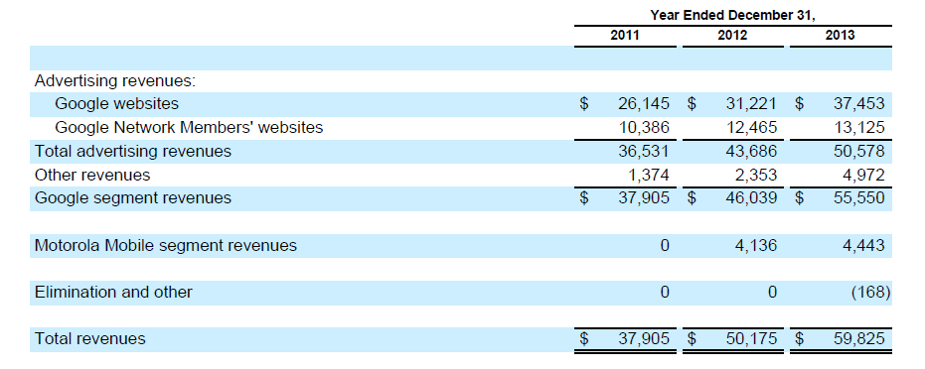
Monetizing the Platform How does Google make money?
Google’s primary revenue stream is advertising income as shown in the revenue data to the left. Advertising revenues are over 80% of Googles income. ⁽¹⁾
Adsense is Google’s contextual paid advertising software which matches user’s search content and data with advertisers.⁽²⁾
Google has “built a business model based on an alternative way of monetizing an activity for which we had been only too happy to stop paying”⁽³⁾
References:
Google’s 10K. https://investor.google.com/pdf/20131231_google_10K.pdf
Edelman, Benjamin. April 11, 2011. Harvard Business Review. Google Inc.
US News. June 25, 2013. Why Google’s Business Model Works.
http://www.usnews.com/opinion/blogs/economic-intelligence/2013/06/25/why-googles-business-model-works

Slide 6
What should Google do next? Case Suggestions & Present Day Results
More Targeted Advertising
Result: Google expanded on targeted advertising. In 2013, Google started using user endorsements in display ads.⁽¹⁾
Full portal, aggregated content & thematic channels
Result: iGoogle started in 2005 and discontinued in 2013. Per the Google announcement, iGoogle was not needed with widespread use of mobile applications.⁽²⁾
Expand Checkout function
Result: Google Checkout retired in 2013 to focus on new, multi-platform Google Wallet.⁽³⁾
Develop competing products with Windows and Office
Result - Google Drive/Google Documents is launched in April 2012. Google documents are free and able to be edited by multiple users, unlike Microsoft office products.⁽⁴⁾
References:
(1) CNET. October 11, 2013. Google Wants to Sell More Ads Using Your Name. http://www.cnet.com/news/google-wants-to-sell-more-ads-using-your-name-and-profile/
(2) Google Support. https://support.google.com/websearch/answer/2664197?hl=en
(3) Mashable. May 21, 2013. Google to Retire Checkout in November 2013. http://mashable.com/2013/05/21/google-to-retire-checkout-in-november-2013/
(4) CNN Money. November 13, 2013. Will Google Docs Kill Off Microsoft Office. http://money.cnn.com/2013/11/13/technology/enterprise/microsoft-office-google-docs/
Notes:
References:
(1) http://www.cnet.com/news/google-wants-to-sell-more-ads-using-your-name-and-profile/
(2) https://support.google.com/websearch/answer/2664197?hl=en
(3) http://mashable.com/2013/05/21/google-to-retire-checkout-in-november-2013/
(4) http://money.cnn.com/2013/11/13/technology/enterprise/microsoft-office-google-docs/

Slide 7
What should Google do next? Forward-thinking Possibilities
To date, Google has excelled in disruptive innovations including those detailed on the previous slide. Google’s innovations are encouraged by their unique governance and culture. Some examples of what Google should do next are as follows:
Mobile Devices
Develop a Google hardware option to compete with Apple in this increasingly mobile world.⁽¹⁾
Expand Google “modular” phone, first launching in Puerto Rico. ⁽²⁾ This option has great opportunities in the Western market by allowing people to choose which hardware components are relavant to them. This phone could also be used in emerging markets to reach a new set of customers. This phone used in conjunction Facebooks initiative ⁽³⁾ to bring internet to emerging markets could change advertising in these markets.
Bring Google Glass to market. Google glass is a next generation mobile device which offers the user additional flexiblity and features not offered with a mobile phone. Google needs to work to develop and market Google Glass before this futuristic device becomes a part of the past.
References (1) Paste Magazine. April 1, 2015. Companies That Google Should Buy Next. http://www.pastemagazine.com/blogs/lists/2014/01/5-companies-that-google-should-buy-next.html
(2) CNET Magazine. February 18, 2015. Project Ara: Everything we know about Google’s modular phone. http://www.cnet.com/news/project-ara-everything-we-know-about-googles-modular-phone/
(3) Wall Street Journal. March 27th, 2014. Facebook Initiative to Bring Internet to Remote Areas. http://www.wsj.com/articles/SB10001424052702304418404579465813963333866
Notes:
References ( 1 ) Paste Magazine. April 1, 2015. Companies That Google Should Buy Next. http://www.pastemagazine.com/blogs/lists/2014/01/5-companies-that-google-should-buy-next.html
( 2 ) CNET Magazine. February 18, 2015. Project Ara: Everything we know about Google’s modular phone. http://www.cnet.com/news/project-ara-everything-we-know-about-googles-modular-phone/
http://www.wsj.com/articles/SB10001424052702304418404579465813963333866
( 3 ) Forbes Magazine. April 30, 2012. Here’s Why Google and Facebook Might Completely Disappear in the Next 5 Years. http://www.forbes.com/sites/ericjackson/2012/04/30/heres-why-google-and-facebook-might-completely-disappear-in-the-next-5-years/
(4) http://www.gartner.com/newsroom/id/2614915

Slide 8
What should Google do next? Forward-thinking Possibilities (continued)
Entertainment/Gaming
Compete with Netflix/Amazon Streaming by expanding on online streaming platform (Android TV) and content. ⁽¹⁾
Become a larger player in gaming industry by utilizing Developer to create mainstream games available on multiple platforms. Mobile gaming is the fastest growing segment of the market. ⁽²⁾ Reaching this audience would increase Google’s base.
Transportation/Travel industry: Planes, Trains, Automobiles
Google is used Develop beyond Google Flights to offer discounts, hotel/travel arrangements, etc.
Explore creation of airlines and new technology to improve travel possibilities. ⁽³⁾
Develop Google Analytics into full-fledged marketing agency ⁽⁴⁾
Google Analytics Premium already helps businesses to understand and utilize data. Google use’s existing customer base to build business and expand to offer more agency-style assessments. Rather than just providing the data, Google could expand to provide more assistance for many businesses.
References
(1) Gartner. October 29, 2013. Gartner says World Wide Video Game Market to Total $93 Billion in 2013. http://www.gartner.com/newsroom/id/2614915
Forbes Magazine. April 30, 2012. Here’s Why Google and Facebook Might Completely Disappear in the Next 5 Years. http://www.forbes.com/sites/ericjackson/2012/04/30/heres-why-google-and-facebook-might-completely-disappear-in-the-next-5-years/
(2) BGR. January 9, 2015. What CES 2015 made clear: The cable industry has lost its power to control how we watch TV
http://bgr.com/2015/01/09/ces-2015-cable-tv/
(3) The NewsTeller. March 3, 2015. Google Aims Pilot-Free Passenger Planes. http://www.thenewsteller.com/tech/google-aims-pilot-free-passenger-planes/11263/
(4) Google Analytics Official Website. www.google.com/analytics

