Slide 1
WELCOME to MIS 5402 Managing Technology and Systems
Spring 2016
David S. McGettigan (mcget@temple.edu)
Adapted from material by James Moustafellos, Munir Mandviwalla and Steven L. Johnson

Slide 2
Introductions
Contact Information
Email (preferred):
david.mcgettigan@temple.edu
Work Phone (urgent issues only):
484-865-4418
Work Experience
Pfizer
Wyeth Pharmaceuticals
Exxon Mobil Corporation
DuPont Corporation

Slide 3
About the Course: Organizations that strategically select, manage, and deploy digital business models prosper in the global economy. Students will use systems and business process thinking to create and analyze strategies for technology-enabled organizational and industry transformation. - an introduction to the strategic role of IT in today’s digital centric world - learn how to apply systems thinking to analyze and understand organizational IT strategy and usage - learn how to apply theories of innovation to analyze the disruptive potential of technology.

Slide 4
General Course Objectives: - Understand the strategic role of IT in organization - Analyze and assess the technical and management foundations to lead successful IT initiatives - Differentiate between different types of organizational information systems and their usage and role - Analyze and assess the disruptive potential of new and emerging technologies - Understand the issues involved in managing information systems and technology in a global environment

Slide 5
ALL IN 6 WEEKS!
6

Slide 6
Grade Breakdown: - Preparation + Class Participation 25% - Learn IT Projects (2) 25% - Case Study Analyses (2) 25% - Reflection Journal 25%

Slide 7
Participation + Preparation (25%) Each week you will submit a brief summary of the readings assigned for that class period (see the course schedule). This includes the cases. Submit a hard copy at the beginning of class and bring a copy for your reference during the discussion. Your weekly summary should include the following: 1. One key point you took from each assigned reading, including the cases (even if you submitted a case analysis that week): one sentence per reading. 2. One key point you learned from the readings as a whole: one sentence maximum. 3. One discussion question that you would ask your fellow classmates: one sentence maximum. Graded pass/fail. If you do not fully complete the assignment, you will not receive credit for that week.

Slide 8
Learn IT Assignments: (25%) Information technology is pervasive in our personal and professional lives. Each of you certainly has had experience with multiple types of Information Technology and, equally, you are also each likely to have areas of opportunity to enhance your Information Technology knowledge. The goal of these assignments is to help you expand your areas of knowledge. Learn IT Assignment #1: An hour of Code Learn IT Assignment #2: Lynda.com software training

Slide 9
Case Study Analysis: (25%) In addition to preparing to discuss each of the assigned weekly case studies, you will work in groups to prepare an in‐depth analysis of 2 case studies during the semester. See the course schedule for due dates. Since we are discussing the material in class, cases must be completed on time in order to receive credit. Late submissions will receive a failing grade. Case 1: Kodak Case 2: Open Innovation at Siemens

Slide 10
We need to form groups You may self-select. 5 teams of 5

Slide 11
Assignment: Reflection Journal (25%) Individual assignment Submit via the shared Google drive A journal documenting the key ideas presented in each class. Evaluation: - your interpretation of the main ideas discussed in each session - the quality of the information that you provide. Focus on the following: - What were the major topics discussed in that class session? - What were the key management issues related to the topic? - What can be learned from the presentations and class discussions related to the topic? Requirements: 6 PowerPoint slides (approx one per class).

Slide 12
Required Readings: The materials for this course are drawn from multiple sources. 1. There is no required textbook for this course. You can purchase the required case studies online at https://cb.hbsp.harvard.edu/cbmp/access/47910545 (note: registration & login required to access and order the course packet. You must use this code to receive the student discount). 2. There are additional assigned readings throughout the course. These are available for free on the web. Web articles links are available on the course blog: http://community.mis.temple.edu/mis5402sec401s16/

Slide 13
Classroom Etiquette: Your behavior in class directly impacts the value you and your fellow students gain from the course. To that end, the following are rules of conduct in this class: - Do not arrive late or leave early. - Do not leave in the middle of the class. - Turn off all cell phones and pagers while you are in class. - You can use a laptop computer as long as it is related to the class (taking notes). Do not use your computer to check your email, browse the Internet, or send instant messages during the class. - Do not engage in side discussions while others are speaking.

Slide 14
Gaining Competitive Advantage from IT

Slide 15
How Can IT Impact the Bottom Line?
There’s really only two things:
Reduce Costs Increase profit
Increase Revenue
Everything else relates to one of these two things

Slide 16
Competitive Advantage From IT:
Barriers to Entry
Additional costs of creating an information system.
Distribution Channels
Prevent others from entering the industry.
Switching Costs
Consumers incur learning and data transfer costs

Slide 17
Competitive Advantage From IT:
Lower Production Costs
IT to cut costs
Product Differentiation
Add new features or create new products with IT
Quality Management
Monitoring production lines and analyzing data
Value Chain
Expanding forward or back the value chain to find greater profits

Slide 18
Search for Innovation: Marketing
Frequent buyer databases
Point-of-Sale and trends
Statistical analysis of data
Geographic Information Systems
Links to external marketing agencies
Multimedia development of promotions

Slide 19
Search for Innovation: Sales and Order Entry
Sales force automation, hand-held computers
Customer workstation access
Expert Systems for
product and option selection
configuration and shipping
Front-line support
expert systems, e-mail, work groups
CRM
shared data with Customer Service

Slide 20
Search for Innovation: Post Sale Service
Portable computers for service anywhere
Databases (e.g., customer service)
Location monitoring of service personnel
Product internal, automatic diagnostics
Expert Systems
diagnostic tools
CRM
Shared data with Sales

Slide 21
Search for Innovation: Manufacturing
Links to customers
Links to suppliers
Mass customization
Robotics
Diagnostic Expert Systems
Quality monitoring and control

Slide 22
Search for Innovation: Logistics and Supply
Just-In-Time Inventory and EDI
Configuration and design
Searching for availability, pricing, networks, et al.

Slide 23
IT Strategy Components:
Infrastructure
Applications
Service Level Targets or Agreements
Human Resources (skills, recruitment and retention strategies, et al.).
Processes
Organizational Structure

Slide 24
Video + Discussion: The filter bubble https://www.youtube.com/watch?v=B8ofWFx525s

Slide 25
- How does this change your perception of the web? - If you have a computer, make sure you are signed in and search on Google. Search for “Washington DC”. Do you all get the same results? - Is the web broadening our knowledge or reinforcing what we already know? - Is this “service” valuable to you? - How does this impact decision making in business?
?

Slide 26
First Assignment Due Next Week: 1 hour of code

Slide 27
Learn IT Assignments #1 Activity: You too can code Objective The objective of this activity is to demystify programming by learn the basics of a popular programming language (JavaScript). Activity Requirements Go to http://www.codecademy.com/ and create an account (“Sign up”). Go to https://www.codecademy.com/courses/hour-of-code/0/1 and complete the activity. When you are done, print the certificate as shown on the next page OR visit your site profile, click on the achievements tab, and make a screen print showing your name and achievement badges. Prepare a 1 page document answering the following questions: 1. Has your view of computer programming changed after completing an hour of code? 2. Some people say that every student should learn to code. Do you agree or disagree? 3. What are 3 key things you learned? 4. Are you likely to use this resource again? Would you recommend it to others? Why or why not? Submit an electronic copy of your 1 page summary and a screen shot of your achievement badges via email to instructor BY 6PM THURSDAY MARCH 24TH.

Slide 28
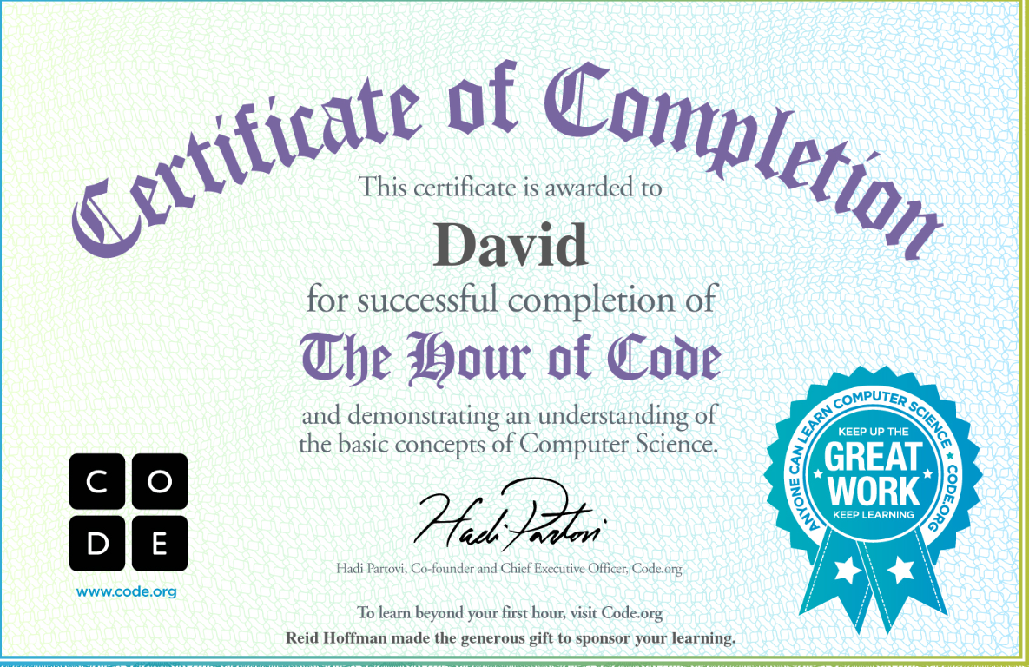
Learn IT Assignments Example (Click on “report your success back” to generate certificate upon completion

