Slide 1
MIS 5402 Managing Technology and Systems Week 4: Disruptive Innovation
Spring 2016
David S. McGettigan
Adapted from material by James Moustafelos, Munir Mandviwalla and Steven L. Johnson

Slide 2
PLEASE SIT WITH YOUR groups Please submit your Reading Summary and Case Assignment

Slide 3
Key Concepts from Last Week: 1. Systems vs Process Thinking and the ability to capture complex business issues 2. Strategic vs Operational IT leadership and the alignment of IT leadership with company strategy 3. An Hour of Code presented the discipline required for coding as well as a simplified sample of coding itself

Slide 4
Weekly Reading Summary Disruptive Change & Technology / Kodak 1. One key point you took from each assigned reading, including the cases: one sentence per reading. 2. One key point you learned from the readings as a whole: one sentence maximum. 3. One discussion question that you would ask your fellow classmates: one sentence maximum.

Slide 5
Case #1: Kodak, Inc. 1. Evaluate Kodak’s strategy in traditional photography. Why has the company been so successful throughout the history of the industry? 2. Compare traditional photography to digital imaging and outline the main differences. How has value creation changed in digital photography relative to traditional? 3. Evaluate Kodak’s response to Sony’s introduction of the Mavica in 1981. Was it appropriate? Why / why not? 4. Explain why Fisher’s attempt to transform Kodak failed. 5. Would Kodak’s position be different had the company adopted a different strategy in the 80s and 90s, or was the actual outcome inevitable?
?

Slide 6
Breakout Session: Kodak 1. Pair up with another group. 2. Present your case to each other. 3. Briefly critique each others work. Approx. five minutes each group

Slide 7
Lecture and Discussion: Disruptive INNOVATION

Slide 8
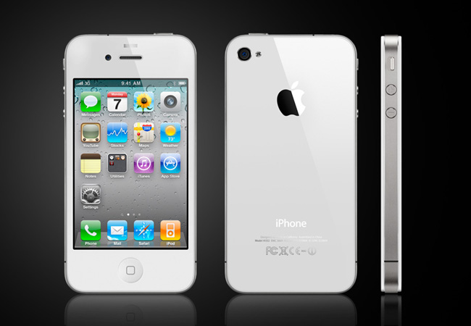
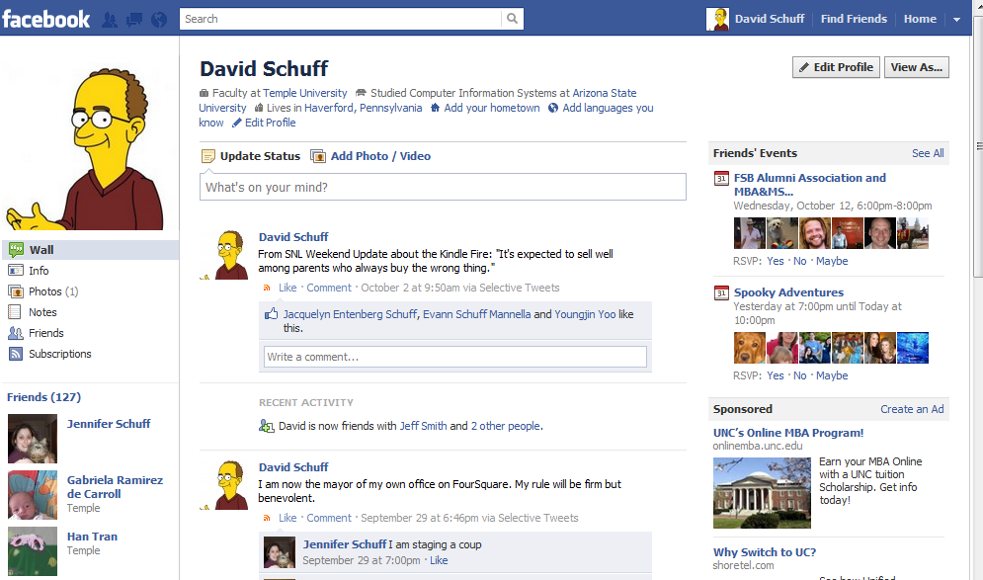
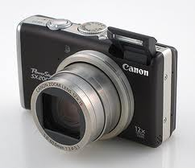
What do these have in common?

Slide 9
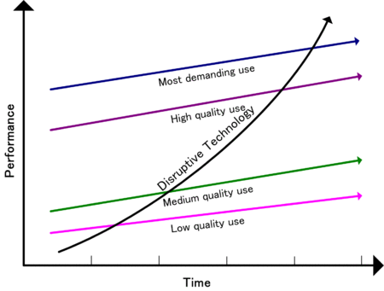
Disruptive Innovation Theory
Low-end
Quality increasing faster than need
Opportunity for low-cost entrant
New-market
Fits an emerging segment with an unmet need
Low-end disruption
http://en.wikipedia.org/wiki/Disruptive_technology
HOW DOES THIS WORK?

Slide 10
Responding to Disruptive Innovations
Your existing position
What’s going on in the environment
What to do
Options
Compete directly
Serve a different market
Create a new market

Slide 11
So how do companies innovate?
New products for high-margin customers
Cheap alternatives to existing products
New products for “nonconsumers”

Slide 12
Resources, Processes, Values
Resources
Assets
Processes
Way of working
Values
Criteria used to make decisions
People, cash, products
Hiring, budgeting, product development
Customer demands, ethics, cost structure
HOW do these determine whether a company embraces or ignores a disruptive innovation?
Source: Christensen, C., Anthony, S., and Roth, E. “Seeing What’s Next: Using the Theories of Innovation to Predict Industry Change.” Harvard Business School Press, 2006, p.6.

Slide 13
Understanding Signals of Change
Undershot Customers
Overshot Customers
Nonconsumers
Nonmarket Contexts
When companies are filling up-market need
When companies are filling down-market need
When new markets are being created
Barriers to innovation are changing
i.e., Government regulation
i.e., Facebook, iPad
i.e., Netbooks, Kindle Fire
i.e., new data analytics software to handle “big data”
Source: Christensen, C., Anthony, S., and Roth, E. “Seeing What’s Next: Using the Theories of Innovation to Predict Industry Change.” Harvard Business School Press, 2006, p.2.

Slide 14
Systems Thinking Versus Process Thinking
Process Thinking
Considering the system as a collection of independent processes
Decompose and optimize
Systems Thinking
Considering the system as a collection of integrated processes
Synthesize and optimize
For what types of problems is each best suited?

Slide 15
Let’s revisit the question … Would Kodak’s position be different had the company adopted a different strategy in the 80s and 90s, or was the actual outcome inevitable?
?
Notes:
EXAMPLE – KINDLE and how it affected publishing industry

Slide 16
From the reading assignment … Describe the disruptive innovation at ABB. Where was ABB on the curves outlined on slide 9? Does their innovation create a strategic advantage? If so, how can it be sustained in the long term?
?
Notes:
EXAMPLE – KINDLE and how it affected publishing industry

Slide 17
Next Week: Learn IT Assignments #2 Activity: Lynda.com Software Training Overview As a student at Temple University you have access to the technology training materials at lynda.com Activity Requirements Login at lynda.com Select one or more training modules (target 45-90 minutes of content length) IMPORTANT: Find a topic of interest to you or that aligns with a business need in your job. Complete the module(s) Prepare a 1 page document answering the following questions - What module(s) did you complete? - Why did you make this selection? - What are 3 key things you learned? - Are you likely to use this resource again? Would you recommend it to others? Why or why not? Submit a hard copy of your 1 page summary by the assigned due date.

Slide 18
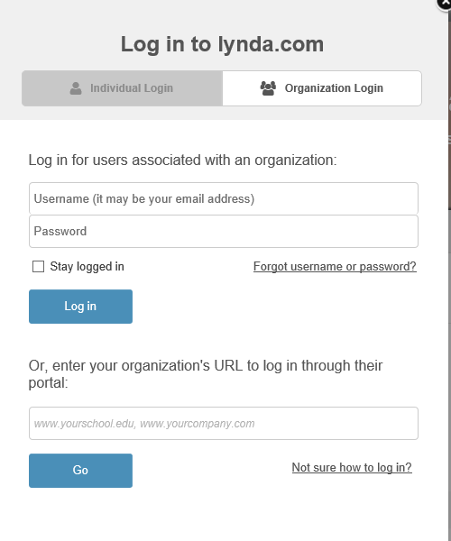
Logging Into Lynda.com Select Organization Login Enter Temple.edu here → Enter Temple credentials on next page Create a Lynda account with Temple email

Slide 19
Next Week: Apple in 2015 Contemporary Case – Sustainable Competitive Advantage 1. What historically have been Apple’s competitive advantages? 2. Analyze the dynamics of the personal computer industry. Are they advantageous or problematic for Apple? 3. How sustainable is Apple’s competitive position in PCs? 4. How sustainable is Apple’s competitive position in smartphones? 5. What is your assessment of Apple Watch and how does it fit into Apple’s overall approach for maintaining competitive advantage? Forecast success, failure or indifference.
Adapted from “Apple 2015” Harvard Business Review Teaching Note

