Slide 1
MIS 5402 Managing Technology and Systems Week 7: Global Management and Platform Strategies
Spring 2017
David S. McGettigan (mcget@temple.edu)
Adapted from material by James Moustafellos, Munir Mandviwalla and Steven L. Johnson

Slide 2
Reminder: REFLECTION JOURNAL Due 10pm on 4/28 as outlined in syllabus

Slide 3
Key Concepts from Last Week: 1. Knowledge Management and scenarios the potential for generating novel ideas and competitive advantage within the company. Also the capability to retain knowledge, as a consulting company would do. 2. Portfolio and Program Management and the information and tools required for decision making at the enterprise / “chief” level of the organization. 3. Leadership and the Financial Measured, used to assign quantitative value to programs. Also enables decision making and the portfolio process noted above.

Slide 4
Supplemental topics Role of the CIO Info tech in M&A Database technology Real world analytics

Slide 5
Role of the CIO
Most Time Spent
Collaborating with CXOs
Making Strategic Decisions
Working on Strategic Business Planning
Obstacles to Success
Overwhelming Project Backlog and Requests
Ability to Execute Remains a Top Concern
Focus on Cost Cutting
Opportunities
Using IT to Enable / Standardize Business Processes
Measuring Success and Proving Business Value
A Modern CIO
Deputies Run Operations
Focus on Strategy and Execution
Discuss compensation model
Source: www.cio.com: “State of the CIO”

Slide 6
Info Tech in M&A
Due Diligence
Cost estimation relative to overall deal
Major strategic platforms
Major audit findings
Likely not germane
Pre-Integration Planning
Strategic selection (best of breed vs incumbent)
Cost / synergy revisions
Implementation timeline
High level organization
Day One – Change in Control
High level integration (communications)
Org chart / interim leadership
Post Day One
Plan implementation – detailed level
Synergy attainment
Recommended article: http://www.cio.com/article/2440630/mergers-acquisitions/success-factors-for-integrating-it-systems-after-a-merger.html

Slide 7
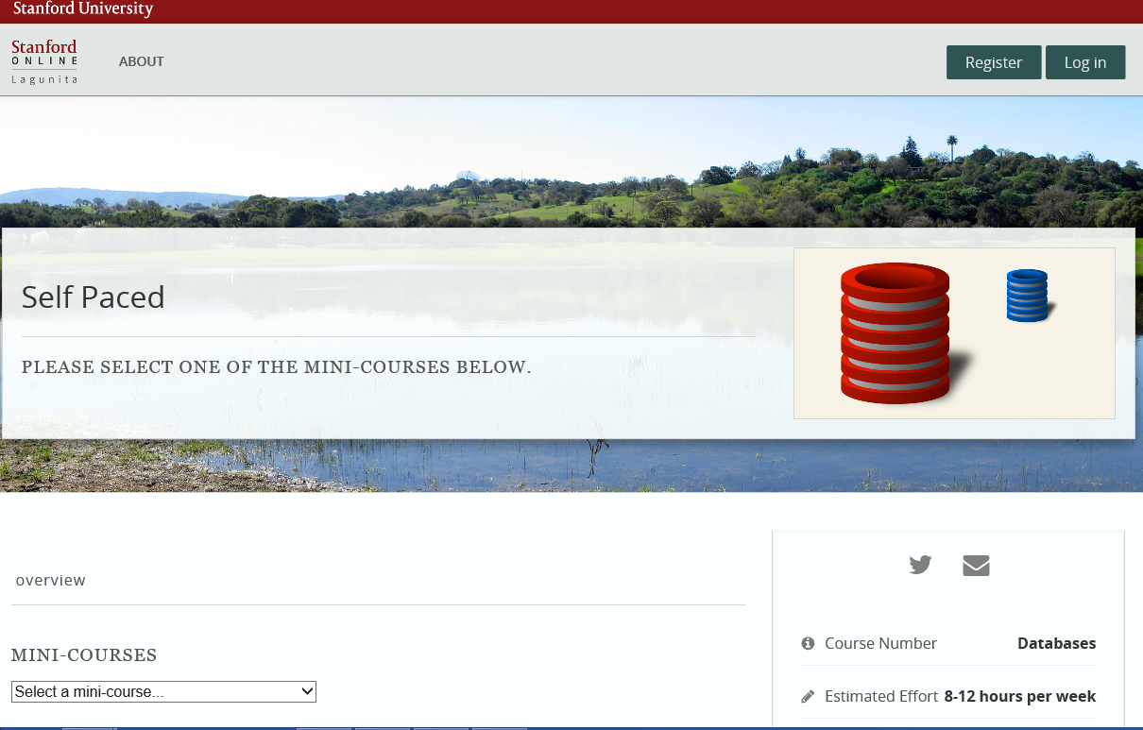
Database Overview
Stanford Course

Slide 8
Real World Analytics
Google Video:
Where do your customers checkout
Success Stories:
Google Premium Analytics Success Stories
Domino’s used Google to quickly implement an on-site targeting tool that captured and realized an immediate 6% increase in monthly revenue…
… connecting CRM data with digital analytics data provided Domino’s with greater visibility into how marketing efforts influence
customers. This has enabled the Domino’s marketing team to make better budget allocation decisions and further improve ROI …
The team can also customize powerful reports and dashboards to communicate its
successes to business stakeholders.

Slide 9
Weekly Reading Summary Google and Volkswagen 1. What is one key point you took from each assigned readings? 2. What is one key point you learned from the readings as a whole? 3. What is one discussion question you would ask your fellow classmates?

Slide 10
Google

Slide 11
Google Background Based upon your knowledge, outline Google’s “products” (their search engine, Gmail, Google Earth, etc.). What do they have in common? How would you describe the line of business Google is in? What is Google’s revenue model (how do they make money)? Who are its customers? With this in mind, what is Google’s real product? Based on the material in the case, how would you describe Google’s strategy? Do they have one?
?

Slide 12
Google Analysis What do you think Google should do going forward? How does disruption apply to Google? What industries is it disrupting? What other disruptive innovations can you identify? What are their secondary impacts on society?
?
Notes:
EXAMPLE – KINDLE and how it affected publishing industry

Slide 13
VOLKSWAGEN OF AMERICA MANAGING IT PRIORITIES

Slide 14
VOLKSWAGEN OF AMERICA Background - Describe the problems with the way Volkswagen had been managing IT projects at the start of the case. - How did the new management system change their prioritization processes? - How is it possible that under this new system a “critical” project (the global supply chain system) was underfunded?
?

Slide 15
VOLKSWAGEN OF AMERICA Analysis - What did Volkswagen get RIGHT regarding its method of prioritizing IT projects? - How does it enable innovation? - What did Volkswagen get WRONG regarding its method of prioritizing IT projects? - How does it hamper innovation?
?

Slide 16
THANK YOU! I wish you much continued success with your mba and look Forward to your Feedback david.mcgettigan@temple.edu

