Slide 1
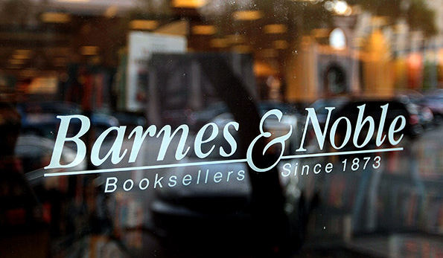
Managing the eBook Revolution
Gerson | Coforio
Managing Information in the Enterprise
Temple University EMBA
October 4, 2014

Slide 2
Overview
What We’ll Review
Original information industry… ripe for change
We’ll lay out its evolution and where it stands today
Key Questions
Should B&N operate both brick-and-mortar and digital businesses under the same roof, or spin off the digital?
Should B&N pursue a proprietary e-book solution or collaborate more with industry players (Apple, Google)?

Slide 3
Case Timeline
1873
Barnes and Noble founded
1987
B&N purchases
B. Dalton
1996
B&N is world’s largest bookstore
1997
B&N launches
online store
1993
Opens first location with an in-store Starbucks
Goes public and trades higher than anticipated at $29.25 instead of $17
2006
Sony releases PRS-500 to read e-books in proprietary format
2009
Barnes and Noble begins selling the nook in time for holiday season
2010
Google scans 12MM in and out of print books to open source Android platform
2007
Amazon releases new Kindle that can download e-books in Kindle format directly from device
Books sold at discount – raises concern
2010
Apple releases iPad, books sold exclusively through Apple’s iBookstore
Apple introduces Agency compensation model
2012
Microsoft invests $300MM in B&N digital and college bookstores
Microsoft includes preloaded Nook app in Windows 8 operating system

Slide 4
Key Information Technology
Format Standards:
Refers to the way a piece of content is digitally encoded into an electronic file
To read a particular format, a user needs software capable of interpreting the format
Digital Rights Management:
Refers to any of a number of systems by which a content owner can restrict third-party access to owned content
Can be an integral part of a file format, or can be added to formats that permit it
Content with DRM can be restricted in many ways: only readable on devices registered to the same individual
Sony Reader
BBeB | Broadband E-Book Format
Amazon Kindle
Kindle E-Book Format
iPad
Apple ePub Format
Nook
Barnes and Noble ePub Format

Slide 5
Competitive Position
B&N Main Bookselling Business Advantages:
Their technology allows lending ebooks
They create a book reading experience
Offer online author chat sessions
Provide book reviews
In store coffee shops and comfortable reading spaces
Relationships in the book industry – publishers, authors
Pros to producing an eBook reader:
Typical benefits of vertical integration
Greater control over product quality
Additional profitability
Cons to producing an eBook reader:
Hyper competitive tech market
Price wars with larger firms, such as Amazon and Apple
Intellectual competency to produce technology
Necessary infrastructure to produce technology
Cost competition, requires efficient supply chain
Fleeting profitability

Slide 6
Final Considerations
B&N differentiates itself from Amazon by providing the ultimate improved library experience
Customers can enjoy that same book lover experience while purchasing books electronically
Smaller stores with same store features
Stores and coffee shops offer access to unlimited electronic content for a fee
Author meet and greets, exclusive content
Book reviews and other expert advice
Hardware is a commodity with fleeting profits | Barnes and Noble should evaluate corporate identity of “book selling” vs. “content delivery”
Remember those key questions:
Split brick-and-mortar and digital bookselling businesses?
Compete with own ebook device or collaborate?

