Slide 1
Digital Transformation of Governance Models
MIS5801
Sunil Wattal
Adapted from material by Munir Mandviwalla, Steven L. Johnson, and David Schuff

Slide 2
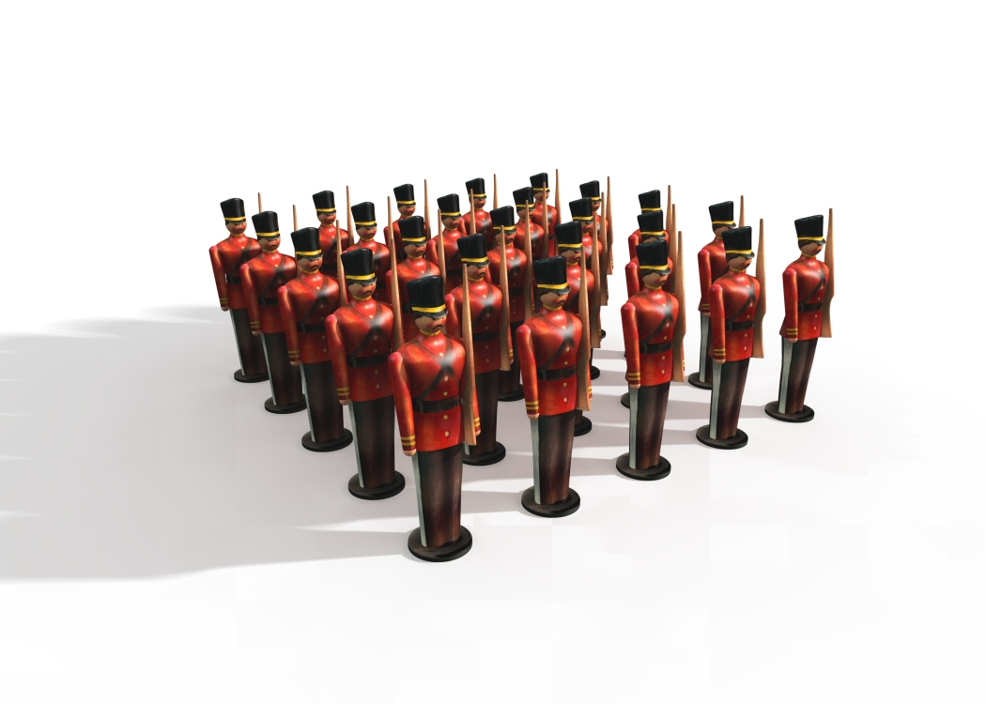
Centralization versus Decentralization

Slide 3
The Hybrid Approach
Shared Services
Business-Unit Services

Slide 4
Comparing the Models
Centralized
Control
Decentralized
Innovation
Customization
Agility
Reliability
Scale

Slide 5
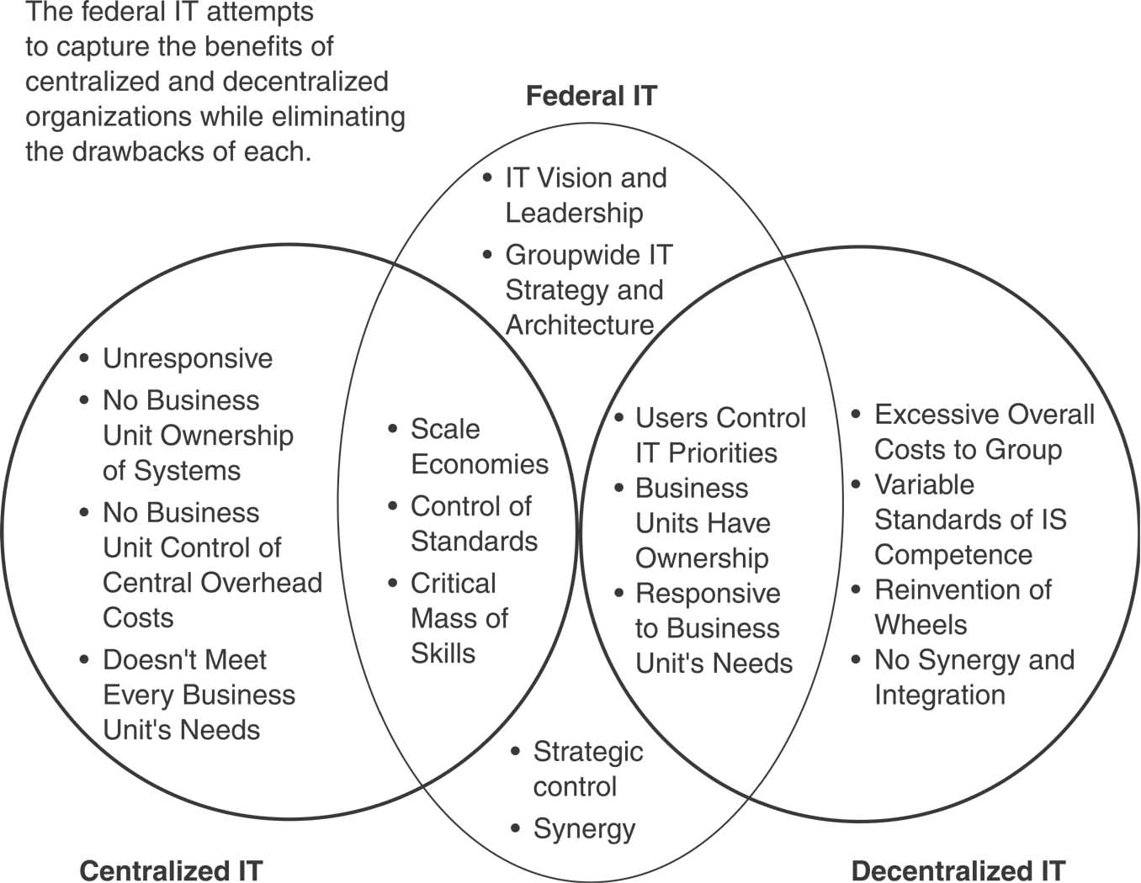
Figure 8.5 Federal IT

Slide 6
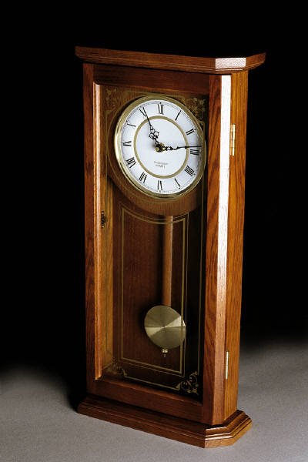
Why Does the Pendulum Swing?
What is the governance model in your organization?
Is your governance model a good fit for your organization?

Slide 7
How can technology support a hybrid approach?
The Cloud
Enterprise Systems
Web 2.0
Knowledge Management
Business Intelligence
Governance Model

