Slide 1
Sunil Wattal
Data Analytics
MIS 5801

Slide 3
40%
61%
Say this is because there is “no good data”
72%
Want to increase their organization’s use of business intelligence
Of decisions by managers are made by using their “gut”
Source: http://advice.cio.com/thomas_wailgum/to_hell_with_business_intelligence_40_percent_of_execs_trust_gut

Slide 4
Data Analytics
Big Data market size ~ $7billion in 2012
40% growth rate
McKinsey Report
shortage of 1.5 million analytics individuals in US

Slide 5
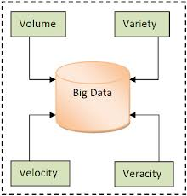
Big Data
What is a quintillion?
90% of world’s data generated in last 2 years

Slide 6
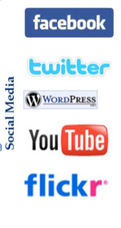
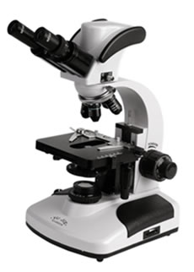
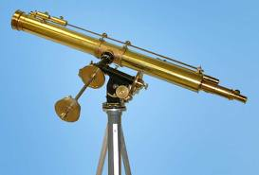
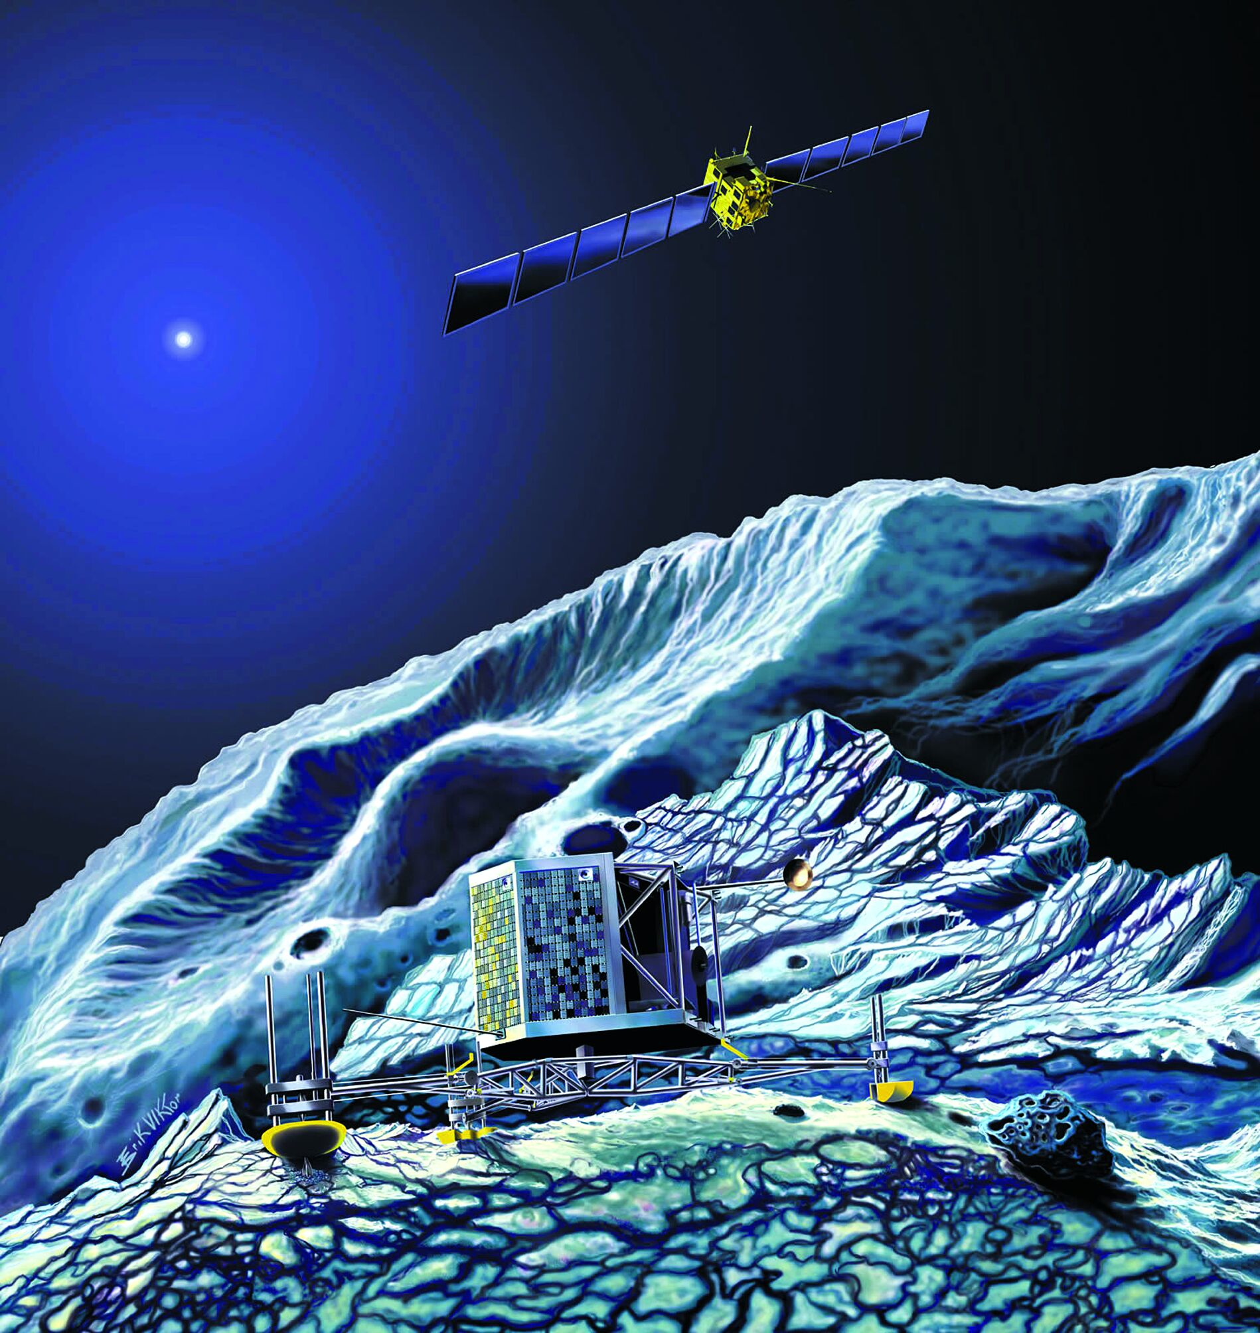
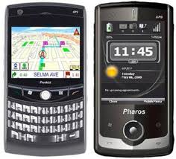
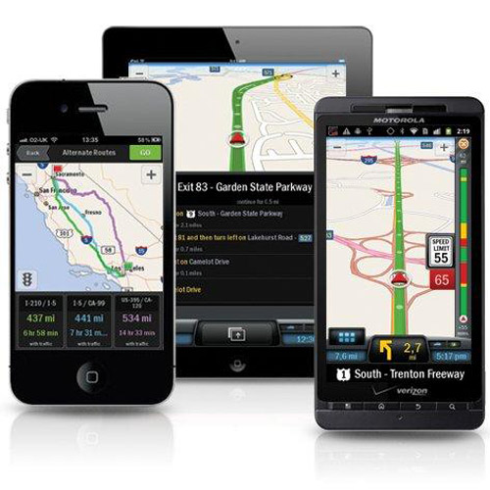
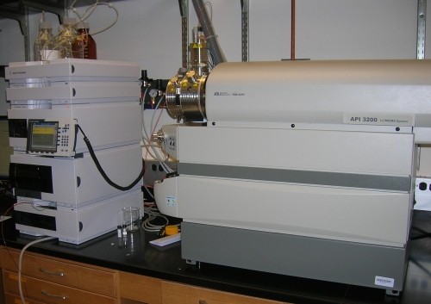
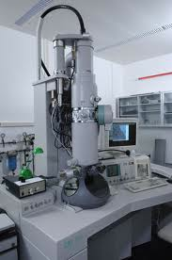
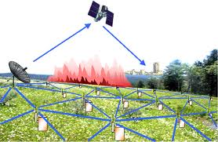
Who’s Generating Big Data
Mobile devices
(tracking all objects all the time)
Social media and networks
(all of us are generating data)
Scientific instruments
(collecting all sorts of data)
Sensor technology and networks
(measuring all kinds of data)

Slide 7
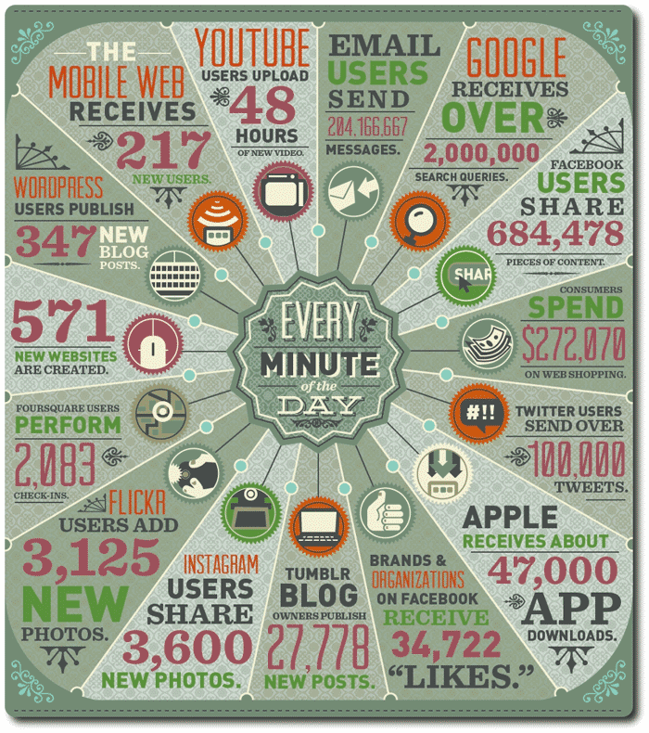

Slide 8
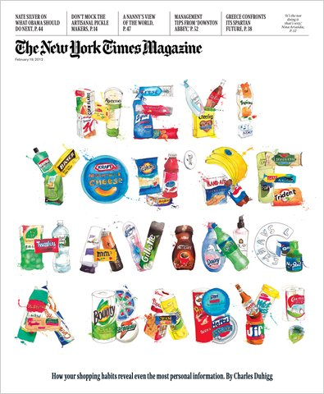

Slide 9
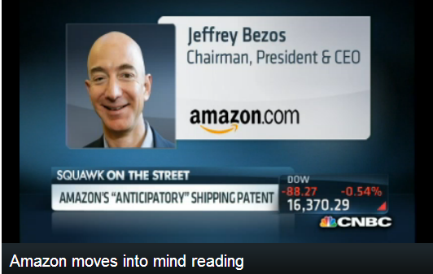

Slide 11
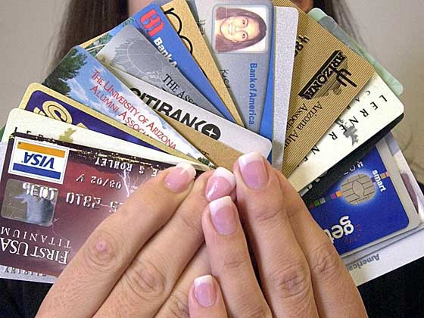

Slide 12
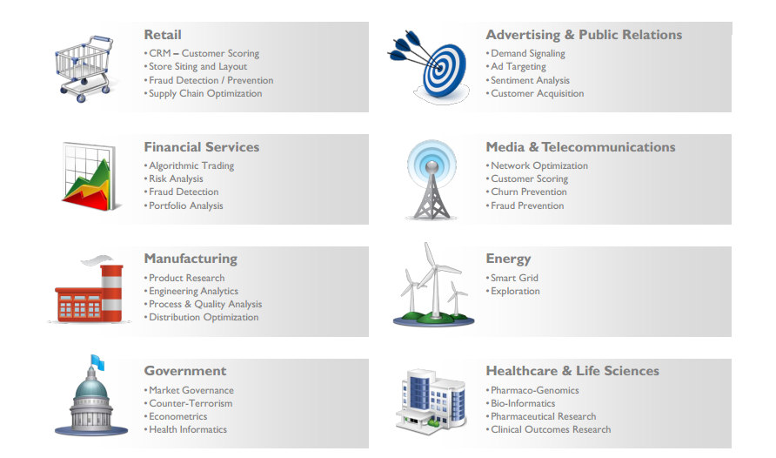

Slide 13
Manufacturers are monitoring minute vibration data from their equipment, which changes slightly as it wears down, to predict the optimal time to replace or maintain. Replacing it too soon wastes money; replacing it too late triggers an expensive work stoppage
Manufacturers are also monitoring social networks, but with a different goal than marketers: They are using it to detect aftermarket support issues before a warranty failure becomes publicly detrimental.
Financial Services organizations are using data mined from customer interactions to slice and dice their users into finely tuned segments. This enables these financial institutions to create increasingly relevant and sophisticated offers.
Advertising and marketing agencies are tracking social media to understand responsiveness to campaigns, promotions, and other advertising mediums.
Insurance companies are using Big Data analysis to see which home insurance applications can be immediately processed, and which ones need a validating in-person visit from an agent.
Hospitals are analyzing medical data and patient records to predict those patients that are likely to seek readmission within a few months of discharge. The hospital can then intervene in hopes of preventing another costly hospital stay.
Web-based businesses are developing information products that combine data gathered from customers to offer more appealing recommendations and more successful coupon programs.
Sports teams are using data for tracking ticket sales and even for tracking team strategies.

Slide 14
Pause: what other examples can you think of?

Slide 15
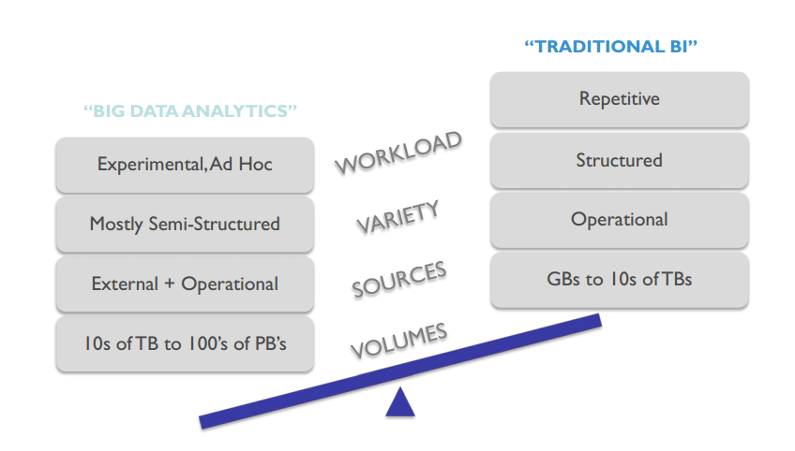
From ‘what happened’ to ‘what is likely to happen’

Slide 16
DATA ANALYTICS Trends

Slide 17
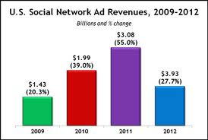
Social Media Analytics

Slide 18
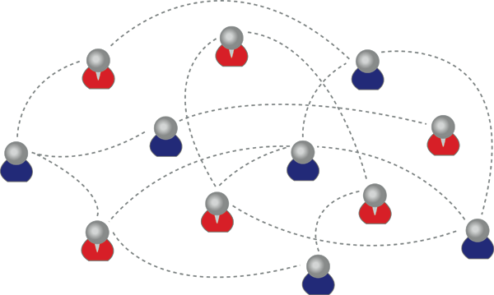
Social Network ANALYSIS
Man is known by the company he keeps
Product recommendations, online advertisements
Are online reviews unbiased?

Slide 19
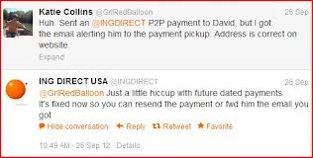
Tweets can get you instant response!

Slide 20
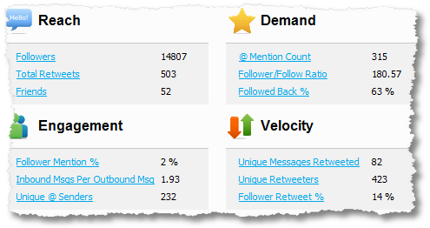
Example : Twitter Analytics
Quantitative Insights : Klout
Notes:
Klout – can be used to identify influencers

Slide 21
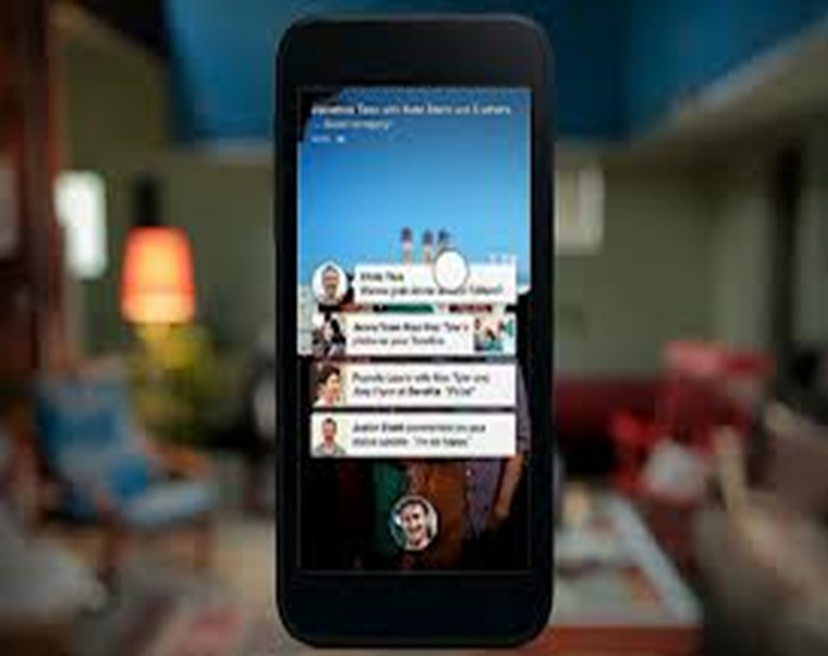
Mobile Analytics
Diffusion of mobile devices
100 million smartphones by 2012
multi-functional / multi-purpose use
Geolocation
Different from web analytics
Mobile web analytics vs mobile app analytics
Challenges in tracking customers
Speed of response

Slide 22
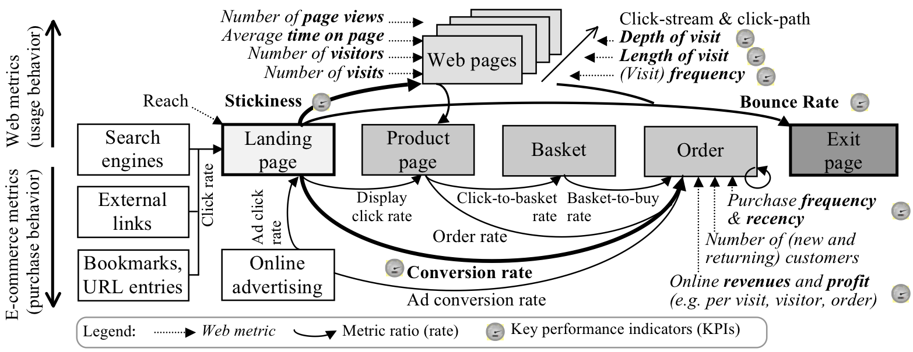
Is your website working Hard enough?

Slide 23
Data Driven Organization
Organizational Buy-In
Strategic Alignment
Multi-channel analytics
Technology & Infrastructure

Slide 24
Data driven managers
When Walmart can use weather predictions to send supplies, why not FEMA?

Slide 25
Data Asset can easily turn into a liability

Slide 26
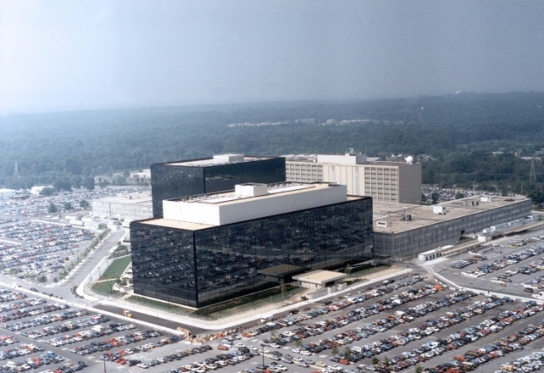
And data management is more than just technology
The 2008 Housing Bubble
Careless record keeping and complex bundling led to unclear mortgage ownership.
http://www.cbsnews.com/8301-504803_162-20049744-10391709.html
Electronic Medical Records
Only 24% of consumers are using their EMR because most don’t know how to access them.
http://blogs.wsj.com/cio/2013/08/02/electronic-medical-records-go-largely-unused-survey
The 2013 NSA Spying Scandal
Collection of “telephony metadata” will continue even after proposed PATRIOT act reforms.
http://www.salon.com/2013/08/09/obama_nsa_reforms_still_allow_metadata_collection/

Slide 28
Are You Ready For DatA ANALYTICS!

Slide 29
Questions?

