Slide 1
User Generated Content and Crowdsourcing
MIS5801Sunil Wattal
Adapted from material by Munir Mandviwalla, Steven L. Johnson, and David Schuff

Slide 2
EVOLUTION OF INTERACTIVITY
Web 1.0
Web 2.0
Web ?
Non interactive
One-way flow
Interactive
User generated
Notes:
Web 3.0 - “The semantic web”

Slide 3


WHAT WEB 2.0 MEANS
  New ways to communicate
    Personal
    Professional
Individuals
  Internal
    Locate expertise and knowledge sharing
  External
    Public relations, product promotion
Organizations

Slide 4
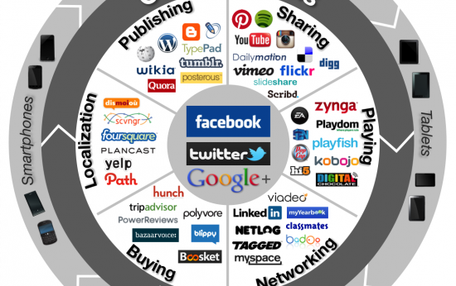

Slide 5
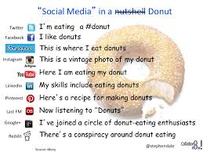

Slide 6


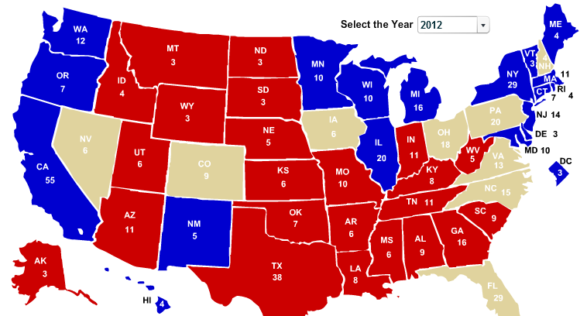

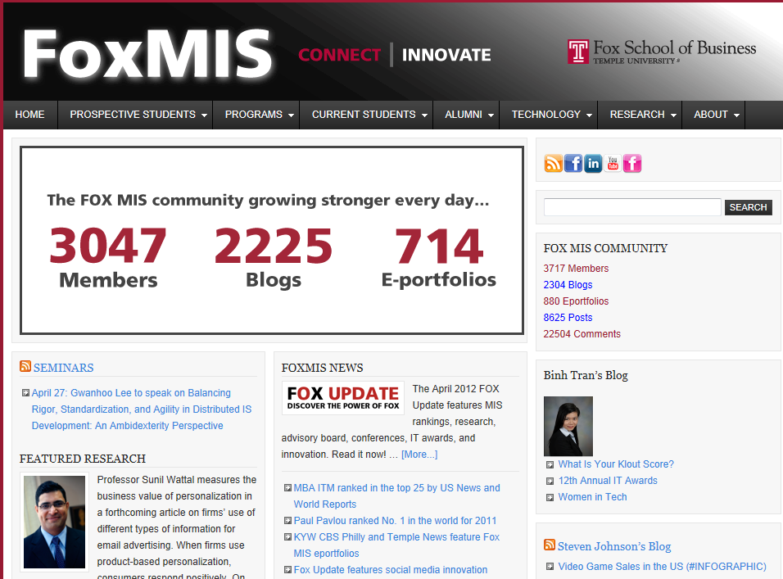
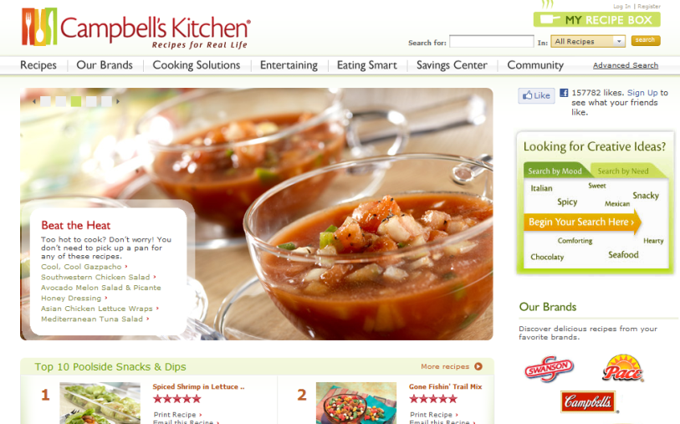
2012 ELECTIONS

Slide 7


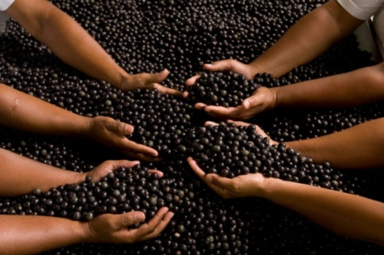

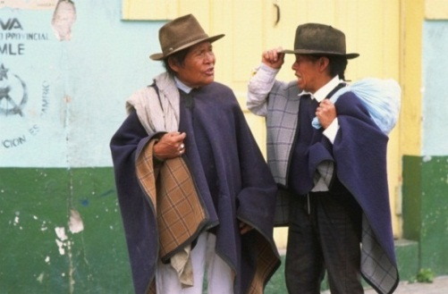

Listen & Brand | Mine & Decide | Converse & Share| Co-create & Innovate

Slide 8
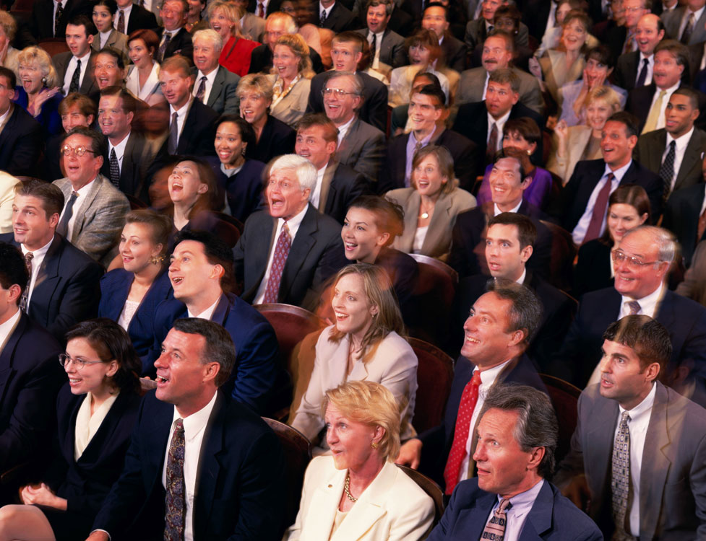
LISTEN AND BRAND

Slide 9
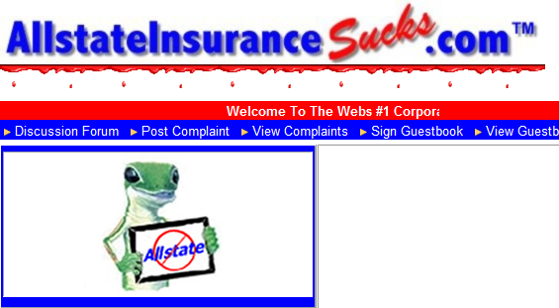

LISTEN AND BRAND
Reviews/Votes | Likes | Friends | Blogs
CONCEPTS
STRATEGIES
Marketing vs. Public relations
Brand as a social construct
Build | Manage | Protect
Engines
  Word-of-mouth & Network effect
  Social networking
Partner: Marketing, Legal
Risk management
  Monitoring
  Mission control
Web metrics
RISKS
KEY QUESTIONS
Discount/deals only focus
Compliant box
Free-for-all
Listen only or Listen and Brand?
What is the ROI for your industry?

Slide 10

MINE AND DECIDE

Slide 11

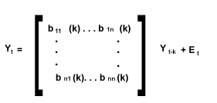
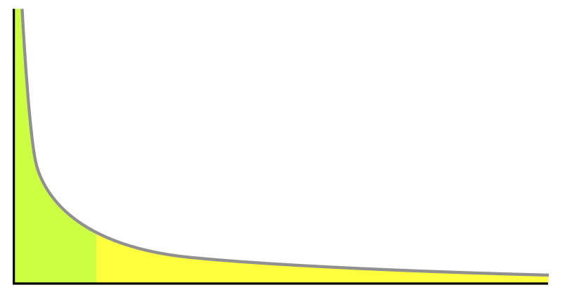
MINE AND DECIDE
Text | Membership | Demographics | Friends
CONCEPTS
STRATEGIES
Structured vs. Unstructured data Search | Taxonomy | Algorithms
Visualizations | Types
Big data: Velocity | Variety | Volume
Engines
  Power distribution
  Social network analysis
Enterprise BI + Social
Universities and Analytics
Data warehousing
RISKS
KEY QUESTION
Data: Quality | Reliability | Size
Regulations
Causality and large data sets
Which topic should you invest in first (and which should be deferred)?
Source: http://en.wikipedia.org/wiki/File:Long_tail.svg)

Slide 12
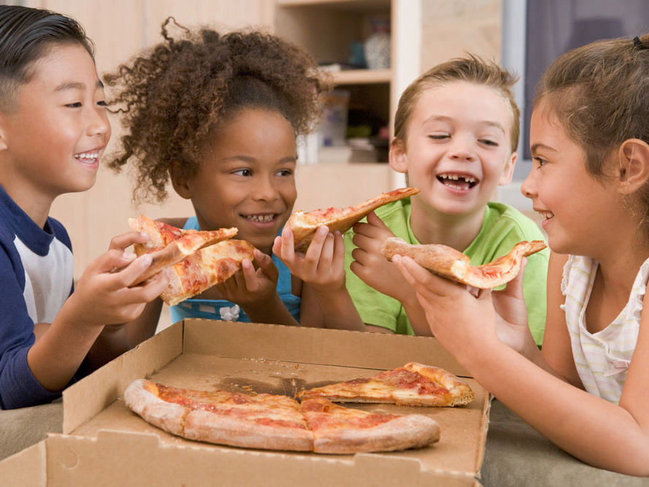
CONVERSE AND SHARE

Slide 13

CONVERSE AND SHARE
Networks | Knowledge | Ideas | Community
CONCEPTS
STRATEGIES
Many-to-many
Speed | Formality | Control
Community
Stages | Light vs. full
Engines
  User generated content
  Network effects
  Social capital
Partner: R&D, HR, C-suite
Community managers
Incentives
RISKS
KEY QUESTION
Culture
Sustain critical mass
Security and privacy
What is the right platform?
How do you sustain the conversation and sharing?
Notes:
Concepts
Many to many: New dynamic (in contrast to one to many and one to one) – speed – formality - control
Community Stages: Hierarchy, emergent (ad hoc, pilot), community (explicit, chartered, staffed, measurable), network (strategy is driven by a networked market perspective)
Community: Reputation | Reciprocity | Norms |
Community light: Initiate a search and end up at a discussion forum
Community full: Commitment a ‘micro society”
Community is larger than social media and will take 2-3 years.
Risks
Culture: Resistant to sharing.
Channeling – helping individual jump to the right channel – social – phone – email etc.
Child’s privacy…
FTC regulates testimonials
Strategies
Incentive: Explicit rewards (points) can backfire because people will game. Soft rewards – appointed titled – seem to work better.
Knowledge management: Knowledge retention is primarily about diffusion not archival
Model
Network effects are the easiest to encourage and measure. Network externalities arise when the value of participating in a network increases as more people participate in the network.
Social capital is the richest (but also the most complex) model – useful to fully understand what is going on
Social exchange and social influence are more traditional concepts which have been tested in other domains and have shown moderate to no effects
Social influence (Deutsch and Gerard)
Informational influence (when an individual witnesses benefits firsthand from others’ adoption and use)
Normative influence (when an individual is obligated to use the system if others use the same).
Social exchange
Direct reciprocity
Indirect reciprocity (through others)
Network effects
Networks effects do predict use
stronger for younger generations.
stronger for women than for men.
stronger when managers use
strongest for relational networks (not so much positional and spatial – which is against the ‘weak ties’ hypothesis)
Relational – department, Positional – similar level in the organization, Spatial – similar physical location
Impact of age on blog usage in not linear.
Rewards
Feedback or appreciation from others is associated with higher blog usage by an individual.
Non-financial incentives are key
Age
One employee suggested, what is important is not age itself but when a person went to college. Older employees, who went to college when email and instant messaging were emerging as popular communication tools, are more comfortable with those technologies, whereas individuals who went to college in the ‘Facebook era’ are more comfortable using social computing technologies.
The coefficients suggest that compared to the ‘Boomer’ generation (the reference category), blog usage of GenX and Millenials is higher (p<0.05); however the blog usage of Millenials is not higher than that of GenX, which suggests that the relation between age and blog usage is non monotonic.
Millennial (born after 1980) GenX (born between 1965 and 1980) Boomer generation (born before 1965).
Social capital
1. Structural
Impersonal configuration of linkages between people
The overall pattern of connections; who you reach and how you reach them
2. Relational
Personal relationships developed through history of interactions
Respect and friendship
3. Cognitive
Shared language and codes
Resources providing shared representations, interpretations, and systems of meaning among parties
Cites
Armano, D. http://www.slideshare.net/rhappe/the-2011-state-of-community-management
COPPA – Children’s online privacy protection act http://www.ftc.gov/ogc/coppa1.htm
FTC Regulation of Testimonials
FINRA Guidance for Financial Service Companies – record keeping

Slide 14
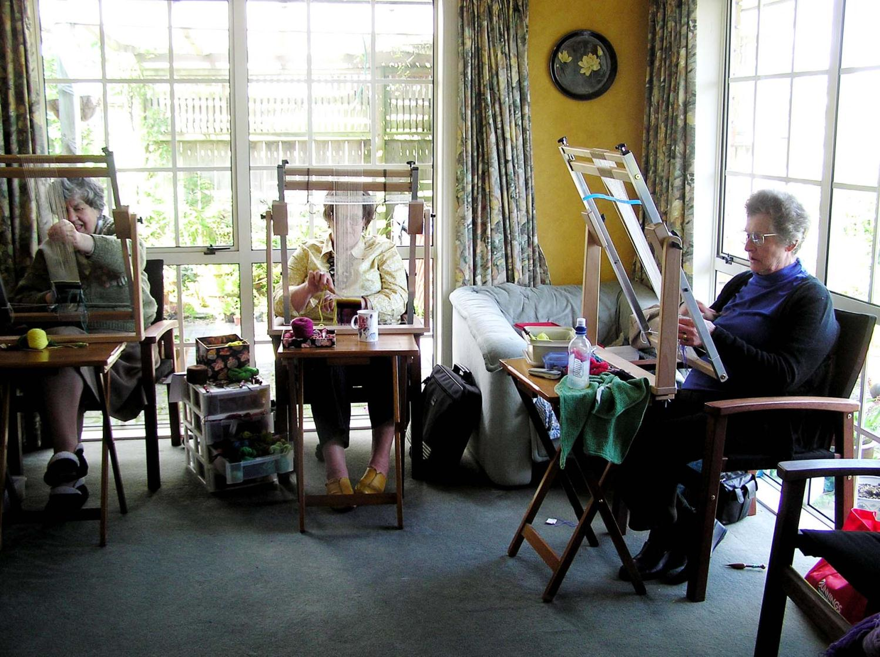
CO-CREATE AND INNOVATE
Notes:
http://www.tapestry.co.nz/blog/
Marilyn’s Blog

Slide 15
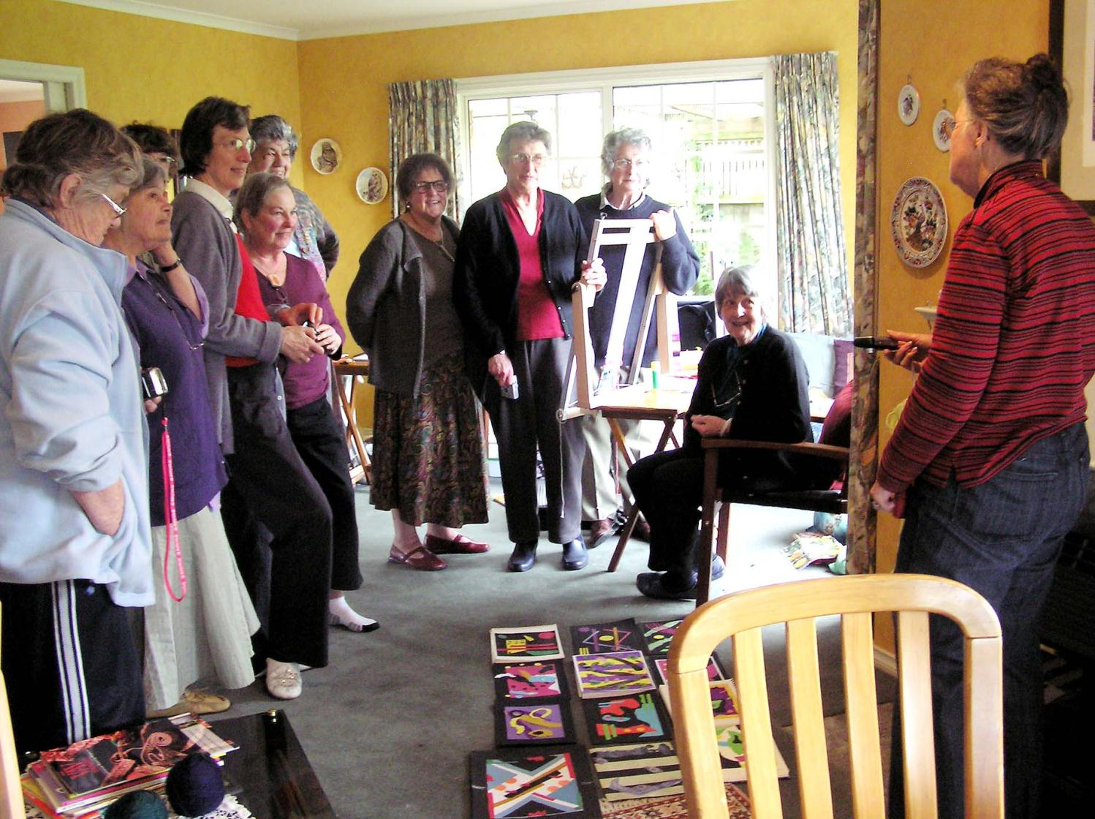
CO-CREATE AND INNOVATE
Notes:
http://www.tapestry.co.nz/blog/
Marilyn’s Blog

Slide 16

CO-CREATE AND INNOVATE
Crowd source| Ratings| Reviews | Achievements
CONCEPTS
STRATEGIES
Open Innovation: Types | Control
Web 2.0: Flatness | Interactivity
Engines
  User generated content
  Sourcing
  Content | Tags |Reviews | Prediction | Funding
One-off vs. sustained
Partner: External consultant, C-suite
Project management
RISKS
KEY QUESTIONS
Ideas vs. opinions
Intellectual property
Costs
Startup | Quality | Scale |Manage
Co-creation or innovation?
How do you ensure ROI?
Notes:
Co-creation leads to innovation
Open Innovation: With the help of information technology, distributed individuals can contribute to complex innovations without necessarily being part of, or controlled by, a hierarchical firm.
Types
Open-source (Linux): Participate in an open source community to access knowledge. The many to many transactions of knowledge are governed by internally generated and policed rules and norms.
Open platform (iPhone): Encourage unanticipated extensions of to a “platform” by making open part of your intellectual property under a open-standard license regime. Results in many to one to many transactions: Two-sided market - third-party suppliers who create new products - customers who purchase the platform and the third-party products.
Crowd sourcing (Innocentive): foster many to one transactions through economic and social incentives to encourage external actors to provide knowledge and solutions that helps the focal firm develop or modify specific products.
Openness vs. control
Determines the ability to charge or create unique value.
Crowd source vs. open source
Open source is a cooperative activity initiated and voluntarily undertaken by members of the public. In crowdsourcing the activity is initiated by a client and the work may be undertaken on an individual, as well as a group, basis. Other differences between open source and crowdsourced production relate to the motivations of individuals to participate. Competition as a motivator for participation or performance.
Engines
User as in employee or contracted worker.
The Age of Stupid film raised $1.2 million via crowd funding, and also used crowd sourcing to distribute and exhibit it around the world
Risks
added costs to bring a project to an acceptable conclusion.
Increased likelihood that a crowdsourced project will fail due to lack of monetary motivation, too few participants, lower quality of work, lack of personal interest in the project, global language barriers, or difficulty managing a large-scale, crowdsourced project.
Below-market wages or no wages at all. Barter agreements are often associated with crowdsourcing.
No written contracts, non-disclosure agreements, or employee agreements or agreeable terms with crowdsourced employees.
Difficulties maintaining a working relationship with crowdsourced workers throughout the duration of a project.
Susceptibility to faulty results caused by targeted, malicious work efforts.
Citations
Managing Open Innovation: How and What to Open. Youngjin Yoo and TL Hill. The IBIT Report, Temple University, 2010. ISSN 1938-1271.
http://en.wikipedia.org/wiki/Popular_Science_Predictions_Exchange
http://en.wikipedia.org/wiki/Crowdsourcing

Slide 17
Crowdsourcing
Condorcet's jury theorem (i.e., Sunstein, 2006)
If each voter is right more than half of the time, then adding more people greatly increases accuracy of majority decision.

Slide 18
Listen & Brand | Mine & Decide | Converse & Share| Co-create & Innovate

Slide 19
SOCIAL MEDIA STRATEGIC COMPARISON
 | Skill sets
Listen and Brand | Digital Marketing
Mine and Decide | Econometrics Analytics Visualization
Converse and Share | Community management Knowledge curation
Co-create and innovate | Digital entrepreneur

Slide 20
SOCIAL MEDIA FRAMEWORK IN HIGHER EDUCATION
Listen & Brand
Identity management
Mine & Decide
Search
Tags
Google analytics
Converse & Share
Site wide activity
Profile fields
Co-create & Innovate
Co-author
Comments and ratings
E-Portfolio
Open content
All users have sites
Comment alerts
Knowledge aggregation
Peer-to-peer

Slide 21

REFLECTION
What would you like to remember about SM and Crowdsourcing?
What do you have questions about?

