Slide 1
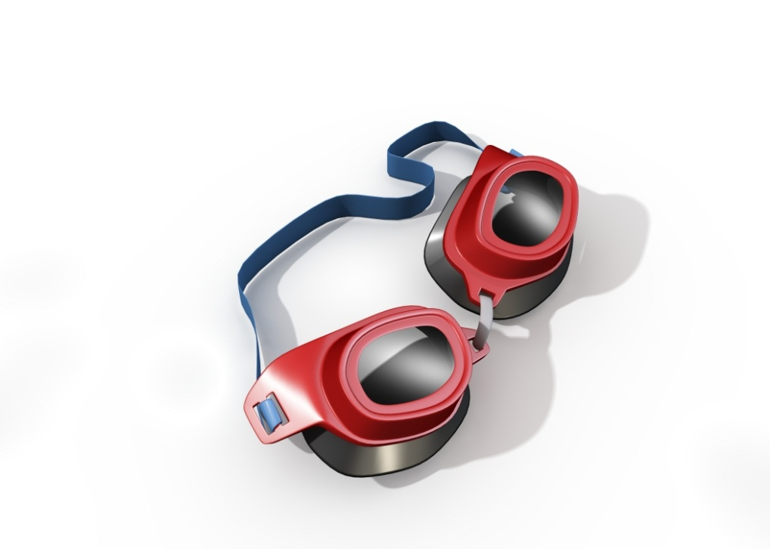
MIS 5801
PROCESSES | SYSTEMS
Sunil Wattal

Slide 2

LENSES

Slide 3
FOR TODAY
Organizations
Systems
Processes
Organizations are dependent on key organizational systems.
Organizational systems comprise of key business processes.

Slide 4

LENSES

Slide 5
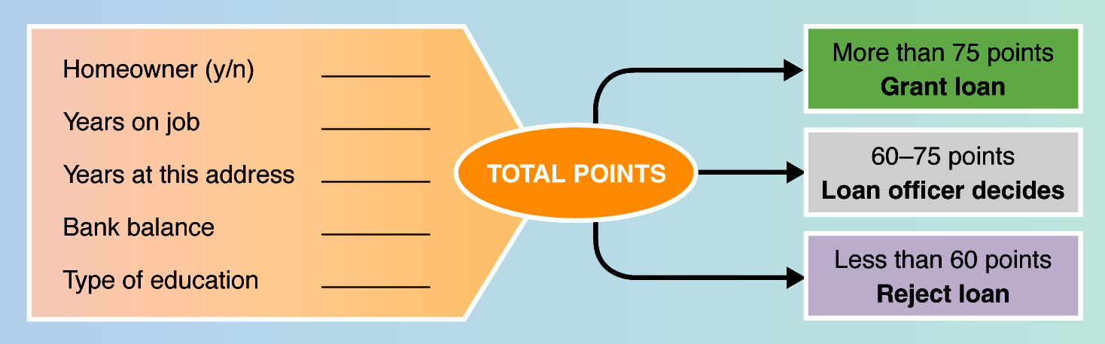
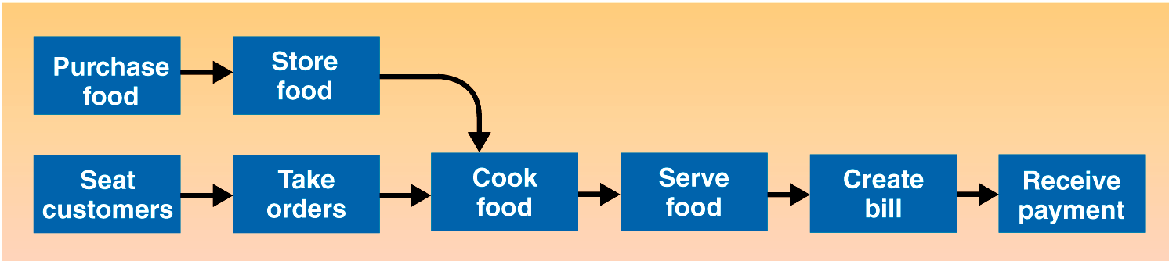
BUSINESS PROCESSES
Source: Alter (2006)
a structured, measurable set of activities designed to produce a specific output ... It implies a strong emphasis on how work is done within an organization, in contrast to a product focus’s emphasis on what... A process is thus a specific ordering of work activities across time and space, with a beginning and an end…Processes are the structure by which an organization does what is necessary to produce value ...
Source: Davenport (1993)
Notes:
Source: Alter, S. (2006) The Work System Method: Connecting People, Processes, and IT for Business Results,” Larkspur, CA: Work System Press.

Slide 6
Basic Process Components
Processes are:
A set of Activities and Tasks, which are performed by Participants in Roles, organized in a particular Sequence, directed and measured by Time and Events / Triggers
Activities / Tasks
A single unit of work, can be performed by a person or system
Participants
People or systems that provide input to, or perform work steps within a process
Roles
A layer of abstraction that creates the link between participants and activities / tasks
Sequence
The logical order in which work steps are performed
Time
Average or desired durations for work items
Events / Triggers
Occurrences that cause a process to start, direct a process sequence, or cause a process to end

Slide 7
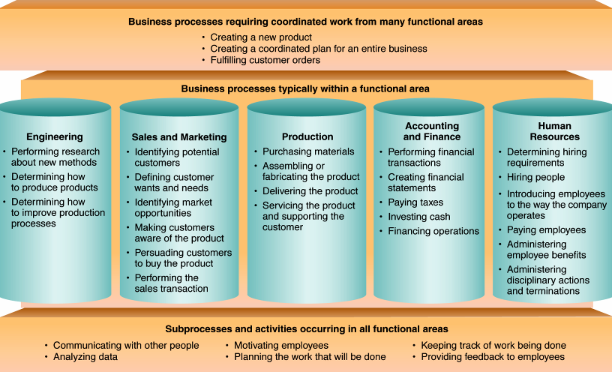
MORE BUSINESS PROCESSES
Source: Alter (2006)
Notes:
Source: Alter

Slide 8
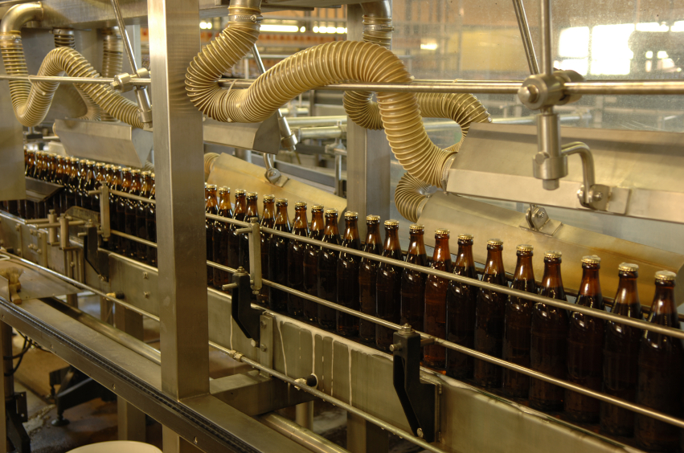
BUSINESS PROCESSES SUMMARY
What are they?
Why are they important?
How do they relate to IT?

Slide 9

LENSES

Slide 10
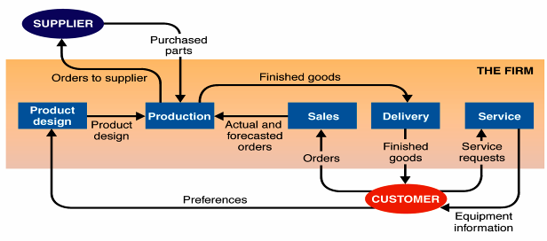
SYSTEMS
  Purpose – its reason for existence
  Boundary – where it begins and ends
  Components – the pieces that make up the system
  Environment – things outside the system boundary
  Inputs – objects and information that enter system
  Outputs – objects and information that leave system
A system with five subsystems
Source: Alter (2006)

Slide 11

What is an Information System?
INFORMATION SYSTEM
IF SSNO <> 9 Char THEN
Error
END IF
Hardware
Software
Networking
Business Processes
People
Data
A set of interrelated components that collect (or retrieve), process, store, and distribute information to support decision making and control in an organization
Source: Laudon, K., & Laudon, J. Management Information Systems. 8/e

Slide 12
SYSTEMS THINKING VERSUS PROCESS THINKING
Process Thinking
A series of steps and flows
Decompose
Systems Thinking
Collection of processes and technological components
Synthesize
Feedback loop

Slide 13

ACTIVITY: SYSTEMS THINKING
Please stand and for the duration of the exercise you are not allowed to talk or use hand signals!
Each person will silently choose two other people in the room as their points of reference.
Stand in a place which is equidistant from the 2
Don’t reveal who your points of reference are to the others .
It doesn't make any difference how far apart you are – they key is to be equidistant from both your points of reference.
Notes:
Typically, after a lot of initial movement, the group will start to settle
down a bit and then more movement will get triggered, and it just keeps
going. There are some good lessons about the complexity of systems and the
interdependency of various elements within a system, the delays inherent in
reactions, etc.
http://www.albany.edu/cpr/gf/resources/Systems-Thinking-Exercises.htm

Slide 14

LENSES

Slide 15
PROCESS MAPPING: EXAMPLE
Process maps can be developed to varying levels of detail to serve different design needs
Process mapping provides a representation of who does what and in what order
Process
Confirm Strategy with Executive Users
Define Project Scope
Define Organization
Build Business Case
Sub-Processes
Confirm Sub-Processes/ Activities with Users
Define Automated/ Manual Activities
Define Application Scope
Define Jobs/roles
Define Benefit Areas
Activities
Confirm Activities/ Tasks with Users
Define User Requirements
Define Information Needs
Define Skills
Define Procedures
Tasks
Notes:
How do you determine what level of process you are discussing?
It’s easy, different people describe processes in different ways
A VP describes the world at the Process and Sub- process level
A Director describes the world at the Sub- process and Activity level
A Manager describes the world at the Activity and Task level
Line Staff describes the world at the Task level

Slide 16
ACTIVITY: PROCESS MAPPING - SYMBOLS
Process Start / End
Internal Process / Activity
External Process / Activity
Decision
Connectors
On-page Connector
Off-page Connector
Source; Joseph Wootten, BPM Process Mapping Course
Notes:
Instructor Prompt:
Briefly explain the use of any additional symbols which you did not explain on the prior slide.
Explain that while these are widely used and accepted symbols, different projects may need additional, or different symbols to portray their processes. There is no right or wrong set of symbols, what is important is that everyone involved in a project uses their chosen set

Slide 17
Business process 1 – Process expense claim
1.1 Fill out expense form
1.2 Submit expense form
1.4.1 notification to employee
1.8.1 notification to employee
Employee
m
m
No
1.3 Receive expense form
1.4 Expenses
Valid?
1.5 Submit authorised expense form
Yes
m
m
m
Supervisor
1.6 Receive expense form
1.8 Make payment
m
sol
1.7 Log expense form
Administration
sol
M = manual
Sol = facilitated by solution

Slide 18
PROCESS MODELLING
  Process modeling is a technique for organizing and documenting the structure and flow of data through a system’s PROCESSES and/or the logic, policies, and procedures to be implemented by a system’s PROCESSES.
  A systems analysis process model consists of data flow diagrams (DFDs).
    A data flow diagram (DFD) is a tool that depicts the flow of data through a system and the work or processing performed by that system. Synonyms include bubble chart, transformation graph, and process model.

Slide 19
Data Flow Diagram: EXAMPLE LEVEL 0
public/
zoo visitors
zoo booster
members
animal requests and health research
donors
needs and budgets
other zoos
& breeders
PR data, receipts, etc.
money and requests
4
animal
care
animal requests & and health research
1
donor and
public relations
public requests
employee schedule
receipts/
accounting reports
3
manage
human
resources
specialist request
Maintenance and building requests
animal status
hours and benefits
Maintenance schedule
2
produce
management
reports
specialist request
employees
5
manage
zoo
facilities
management reports
Pay data, requests
employee schedule
management
usage reports
certification
agencies

Slide 20
Data Flow Diagram: EXAMPLE LEVEL 1
public/
zoo visitors
donors
zoo booster
members
money and requests
PR data, receipts, etc.
money and requests
PR data, receipts, etc.
money and requests
PR data, receipts, etc.
1.1
produce PR
& outreach
programs
1.2
handle
donor
requests
1.3
org. booster
services &
meetings
donor lists
needs and plans
booster requests
money, data, and visitor statistics
needs and plans
donor requests
1.5
produce
accounting &
reports
1.4
track needs
and donor
programs
public requests
receipts/
accounting reports
needs and budgets
expenses and budget
2
produce
management
reports
animal needs
public requests
4
animal
care
“Adopt an animal” database

Slide 21
ACTIVITY: BUSINESS PROCESSES
Choose a business process in which one of you has experience with and map it out
Who owns the process? What are its boundaries?
Where are the opportunities for improvement?
Where are the opportunities for transformation?

Slide 22

REFLECTION
What would you like to remember about processes and systems?
What do you have questions about?

