Slide 1
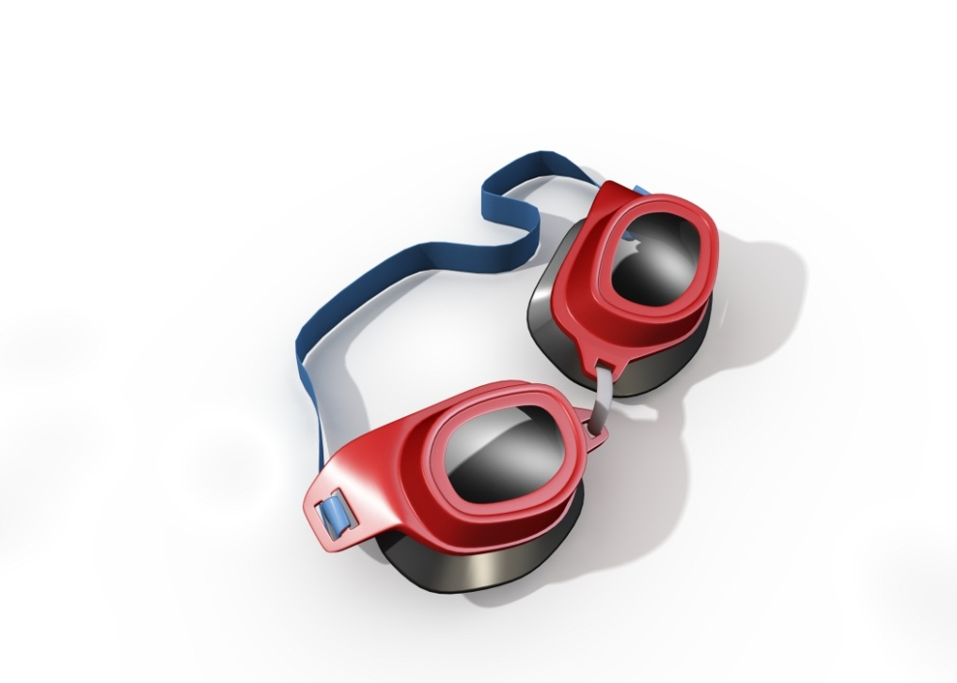
DISRUPTION | INNOVATION
Sunil Wattal

Slide 2
Digital Business Models
Platform competition
Cost structure – facilitates, versioning bundling
Installed base– lock in, switching cost, lifetime value
Network effects – metcalfe’s law – total value of a network is proportional to n*(n-1)
Long Tail – power law
First mover advantage; winner takes all
Inferior product can get adopted

Slide 3
Why bother with disruption?
Defense of business
Significant potential return
These technologies can be disruptive
To you
To your competition

Slide 4
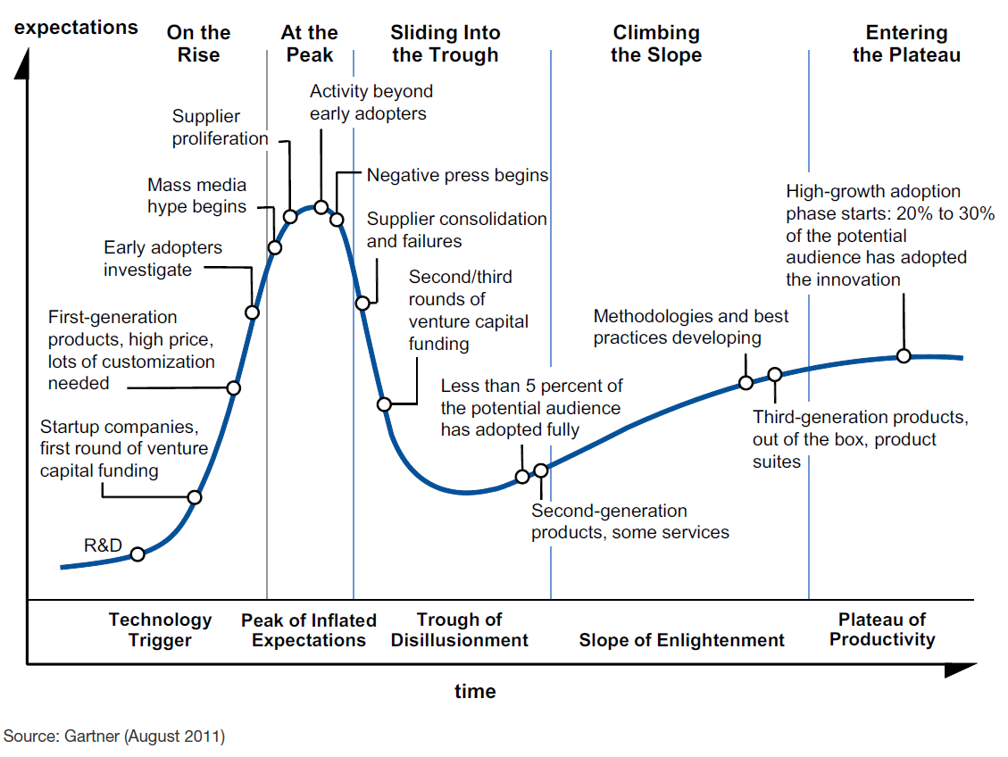
The Gartner Hype Cycle

Slide 5
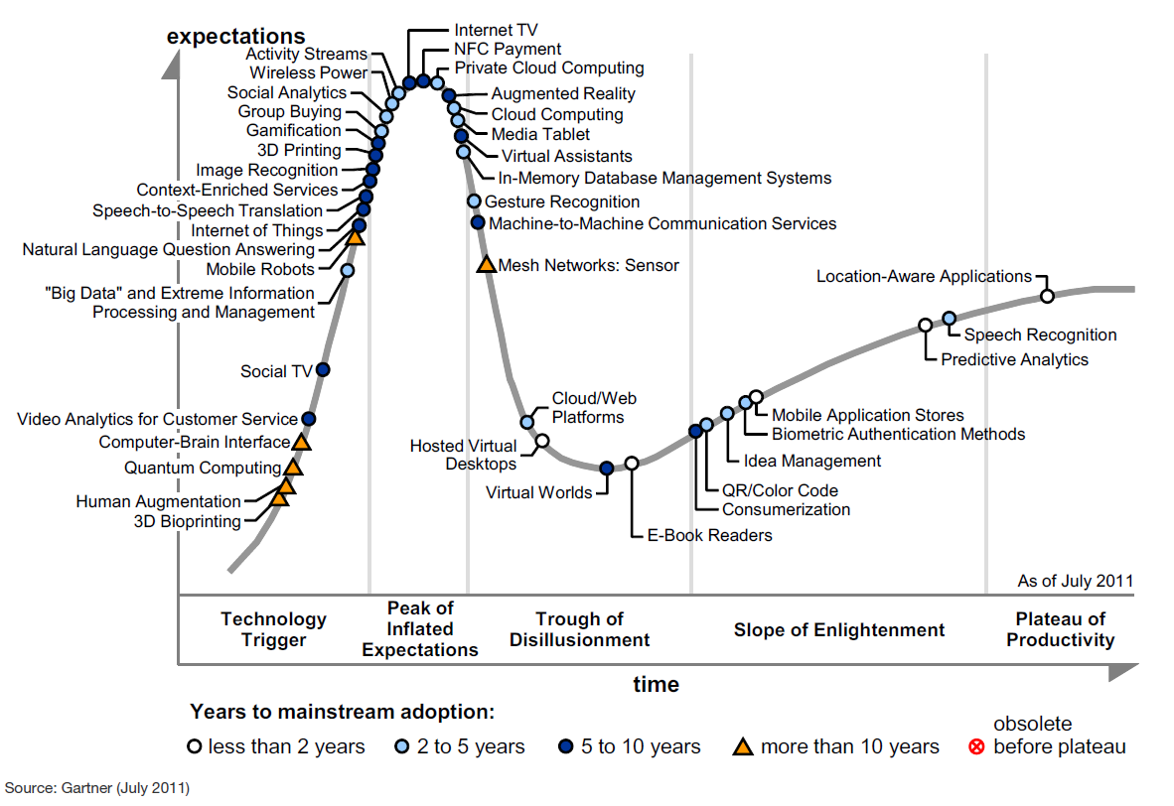
Hype Cycle for 2011

Slide 6
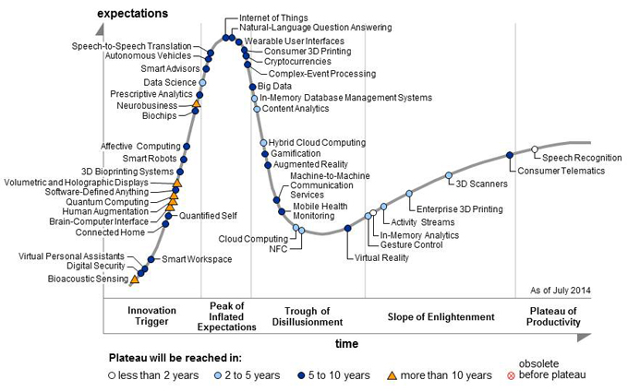
Hype Cycle for 2014

Slide 7
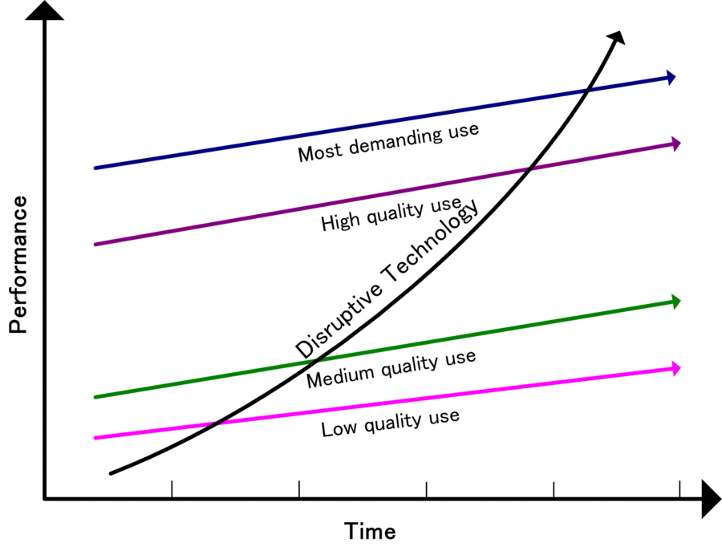
http://en.wikipedia.org/wiki/File:Disruptivetechnology.gif

Slide 8
Mistakes Incumbents Make
Affected by an organization’s
Delayed Participation
Sticking with the Familiar
Reluctance to Fully Commit
Lack of Persistence
Resources
Processes
Values
Source: Day, G. and Schoemaker, P. (2000). Avoiding the Pitfalls of Emerging Technologies. California Management Review. (42)2. pp. 8-33.

Slide 9
DISRUPTIVE INNOVATION STRATEGY
Your existing position
What’s going on in the environment
What to do
Options
Compete directly
Serve a different market
Create a new market

Slide 10
ENVIRONMENT: UNDERSTANDING SIGNALS OF CHANGE
Undershot Customers
Overshot Customers
Non-consumers
Nonmarket Contexts
When companies are filling up-market need
When companies are filling down-market need
When new markets are being created
Barriers to innovation are changing
i.e., Government regulation
i.e., Facebook, iPad
i.e., Netbooks, Kindle Fire
i.e., new data analytics software to handle “big data”

Slide 11
WHAT TO DO: DISRUPTIVE INNOVATION THEORY RUBRIC
WHAT IS THE NEW TECHNOLOGY INNOVATION? (you must be able to specify this, otherwise Christensen is likely not applicable)
A single new feature or a bundle of new features
A new attribute/representation/bundling that simplifies previously complex features
A new kind of product/service
A mix of other innovations
WHAT WILL THIS NEW INNOVATION COST?
It will be much lower cost than what you spend to get the capabilities >> ‘low end’
It will cost quite a bit more or it will be a new cost that cannot be compared >> ‘new market’
HOW EASY TO USE IS THIS NEW INNOVATION?
Much easier to use >> ‘low end’ or ‘new market’
It will do something entirely new which will require a learning curve >> ‘new market’
HOW DOES THE ABOVE COMPARE TO EXISTING SIMILAR PRODUCTS/SERVICES?
Significantly better >> ‘new market’ or ‘low-end’
Slightly or somewhat better >> ‘sustaining’
WHO IS USING THE EXISTING PRODUCTS / SERVICES?
(describe the customers, their demographics, size of market, etc.) >> ‘sustaining’ or ‘low-end’
WHO WILL USE THE NEW INNOVATION?
Consumers who use similar products/services >> ‘sustaining’
Consumer who use adjacent or completely different products/services will migrate over >> ‘low end’ or ‘sustaining’
Hard to assess >> ‘new consumers >> ‘new market’
WHERE WILL THE INNOVATION BE USED?
Where existing similar products/services are used >> ‘sustaining’ or ‘low-end’
In a new location/time/context >> ‘non-consuming context’ >> ‘new market’

Slide 12
Things You Can Do
Attend to signals from the periphery
Invest in a learning capability
Maintain flexibility through an options perspective
Maintain organizational separation
Would these actions be more effective when the innovation is…
Low-end?
New-market?
Source: Day, G. and Schoemaker, P. (2000). Avoiding the Pitfalls of Emerging Technologies. California Management Review. (42)2. pp. 8-33.

Slide 13
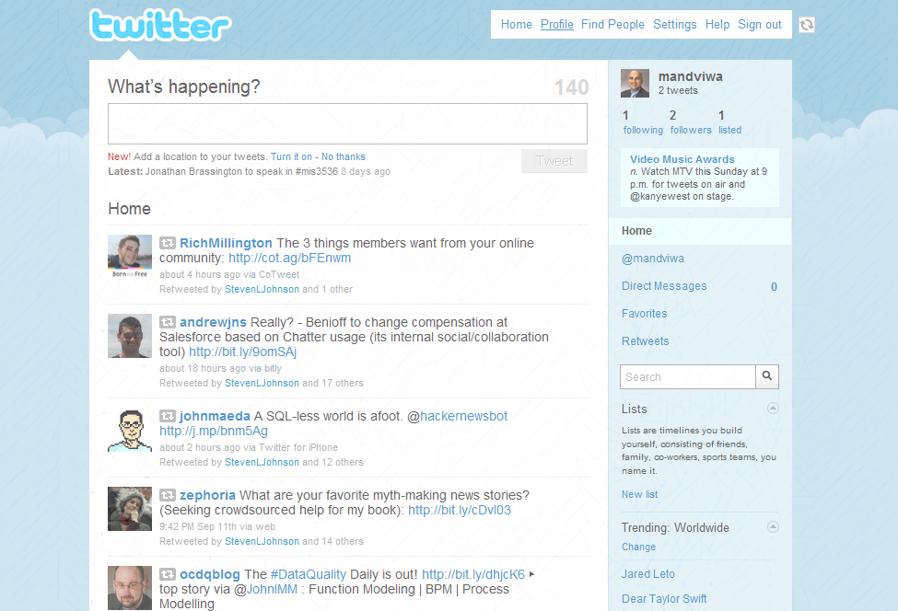

Slide 14
ACTIVITY: COMPARE DISRUPTION
Process
Question
Form 4 groups
As a group, discuss the following
5± minutes discussion per question
One person reports out the group’s answer
Is Twitter a disruptive technology? How? To whom?

Slide 15
REFLECTION
What would you like to remember about disruption and innovation?
What do you have questions about?

