Slide 1
Enterprise Applications
MIS5801
Sunil Wattal
Adapted from material by Munir Mandviwalla and Steven L. Johnson

Slide 2
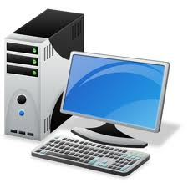
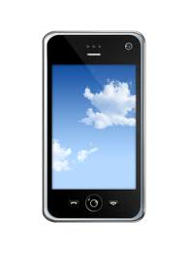
ENTERPRISE ARCHITECTURE COMPONENTS
ERP
CRM
Devices
Network
Applications
Data
ENTERPRISE ARCHITECTURE LEGEND

Slide 3
Two Competing Models
Enterprise Approach
Distributed Approach
Organization
Accounting
Finance
Human Resources
Marketing
Manufacturing
Information Technology
Enterprise System (ERP/CRM)
Accounting
Finance
Human Resources
Marketing
Manufacturing
Information Technology
Organization

Slide 4
Enterprise Systems
Enterprise Resource Planning (ERP)
Customer Relationship Management (CRM)
What are the key goals?
What are the benefits?
What are the problems?

Slide 5
Enterprise Systems and Innovation
Do enterprise systems encourage or discourage innovation?
Are they compatible with an “agile” organization?

Slide 6
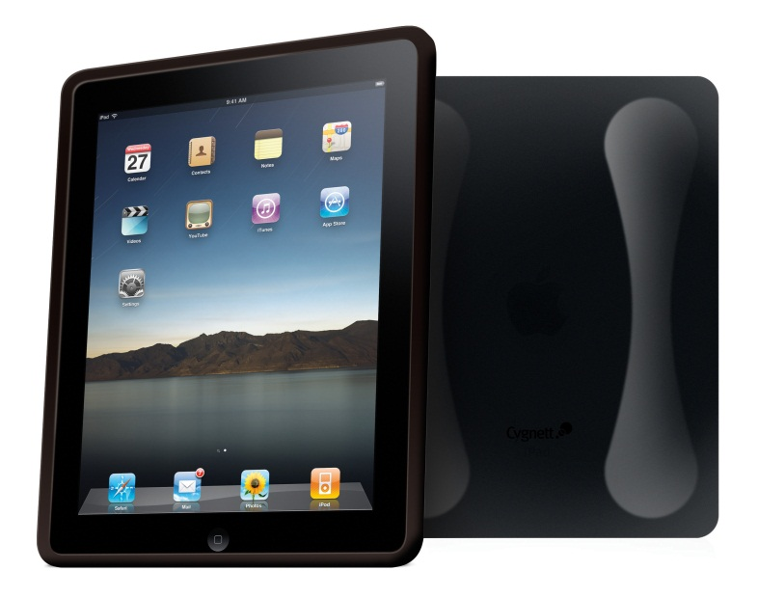
Enterprise Systems and the Modern Organization
Are enterprise systems consistent with changes in...
Mobile technology?
Social media?
A “flat” world?

Slide 7
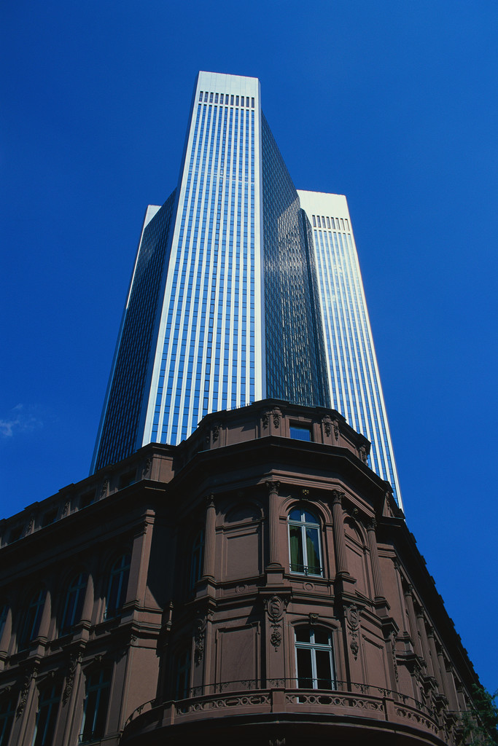
The Future?
How do you think enterprise systems will evolve?

