Slide 1
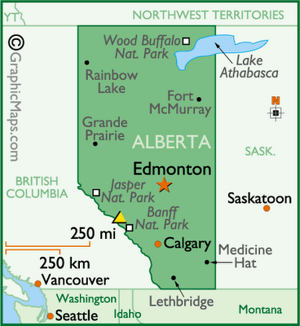
STARS Air Ambulance: An Information Systems Challenge
Case Analysis by:
Joseph Jones and Huamin Liu

Slide 2
Facts & Problems
72 page STARS Critical, Strategic and Operational Plan -- technology only merited a single paragraph
Individual departments had created their own “silos” with regard to IS
Need for better communication regarding the importance of information systems to other STARS managers and gain their buy-in for improving the IS function in STARS.
Staffing – consultant heavy:
IS group at STARS: 7 internal full-time people, three full-time consultants, and one manager -- supplemented with additional consultants

Slide 3
More . . .Facts & Problems
Departments used outside consultants and vendors to do maintenance; consultants used own systems development methodologies -- lacking uniformity throughout organization.
Internal technology staff unsure of their roles; outside consultants are not well managed in terms of their scope of work
Old technology; too many servers (each server handling only a single application); equipment out of warranty; infrastructure needs; concern about security of network and systems
Unable to determine the total IS costs for the organization. “I can’t manage what I can’t control.”

Slide 4
Broader Applications
The value of a understanding strategic planning and the INTEGRATION of technology throughout the plan
The value of those who lead technology having business savvy
The importance of project planning and moving away from simply reacting to problems
The need to maintain infrastructure
The critical importance of integrating the various information technology systems

Slide 5
Application to class material
Sambamurthy & Zmud
Chapter 1: Strategic Roles of IT
Automation, Empowerment, Control, and Collaboration.
Chapter 4: Enterprise Resource Planning Systems
enterprise database, timely data, standardize processes, integrated process, and lower IT costs. [also: ERP Definition and Solutions (Wailgum)]
King, Amazon
How Cloud Computing Is Changing the World
Concept of using cloud storage in place of servers on site

Slide 6
Recommendations
Work to integrate IS across the organization.
Develop relationships with department managers to facilitate integration of technology.
Pursue the development of an IS Project Management Office.
Significantly reduce the reliance on consultants.
Pros | Cons
Enhanced functionality between departments and more efficient, well-planned projects | Department managers lose of control over IT decisions
Reduced cost | Loss of department relationships with outside consultant
Technology becomes a source for enabling new business strategies | ?
Response
Strong communication/relationships; effective response to technology needs; improved overall quality of service.
Threat
Challenge from other department managers.

