Slide 1
Social Strategy @American Express
Sidney Johnson
Suketu Amin
Madan Mohan

Slide 2
Initiatives
Value Proposition:
Directly acts as a middle man between customers and merchants unlike other major competitors
This allows them to establish relationships with customers and merchants
Harness customer database using API
Open Forum
A platform to get small businesses together to discuss issues
Live Conferences > Webcasts > Blogs
Idea Hub
Connectodex
Members Project/TakePart.com
Cause related projects voted by cardmembers on American Express website
Allowed members to submit ideas through Facebook, Twitter, and Youtube
Permitted them to develop social ecosystem
Members Know
Online travel community on American Express website for card members

Slide 3
Social Media Outlets
Twitter (@AmericanExpress, @AskAmex)
# Announcements of events
# Higher re-tweet rates than average
# Answer service questions
# “very authentic and very connected to the community”
Facebook
Company news updates
Card communities
Redeem points for
Gifts – Customers
Facebook Ad – Merchants
Small Business Saturday: Shopping holiday on Saturday following Thanksgiving.
Holiday initiated by AmEx in 2010
Meant to promote local small brick and mortar businesses.
Link, Like Love
Foursquare
Enhanced customer experience
SWSX

Slide 4
OPTIONS
Broad
Focus on building more partner ships with social platforms like Twitter, Yelp, and LinkedIn.
vs.
Deep
Deepening the existing partnerships with Facebook and Foursquare.

Slide 5
Broad
Pros
By choosing to use a broad strategy Amex will be able to reach their target market.
Amex has fewer customer with higher spend per customer.
Access to card members through multiple channels.
Ability to be agile in the evolving social media market.
Cons
Amex must be very careful on which companies it chooses as a partners. Social Media companies crop up quickly, and you have to be judicious on which you choose to invest in.
Deep
Pros
Global reach with 700 million users on Facebook.
Ability to control the message with one channel.
Cons
By choosing go with this strategy we limit ourselves to existing social media that may become obsolete quickly. (FourSquare)

Slide 6
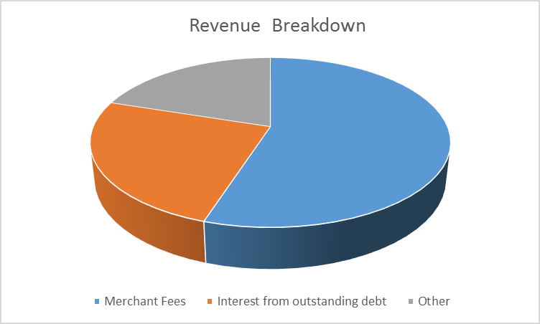
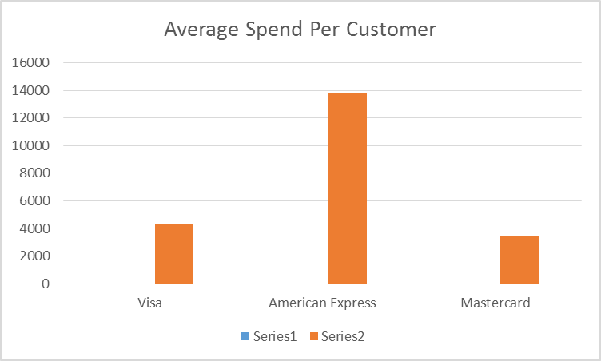
Recommendations:
Engage in broad and targeted social media
Engages future customers
Prevents obsolescence
Utilize end to end customer visibility to enable merchants to advocate on your behalf
Competitive differentiation point
Creates a 3 way partnership between AX, merchants, and customers

