Slide 1
In The Age Of Social Surveillance: The Role of Social Media in Reducing Mismanagement of Government Assets
Shuting (Ada) Wang
Management Information Systems

Slide 2
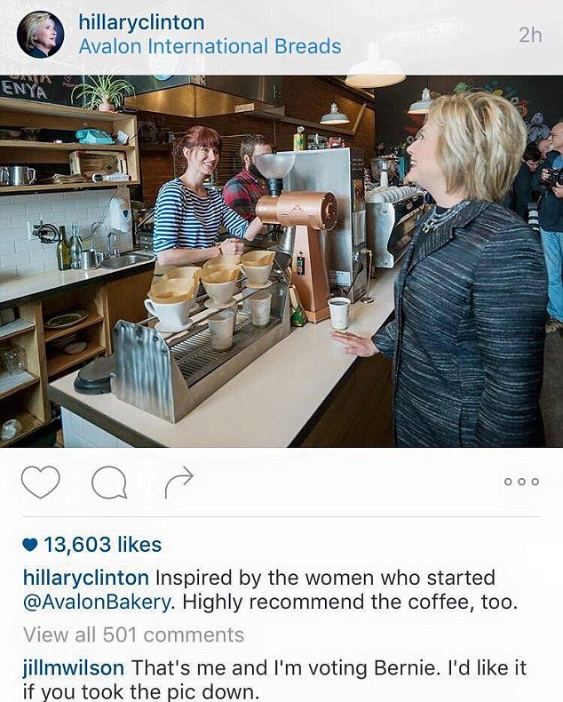
Background
“Transparency is scary, unpredictable and risky. But, at this point, there really is no choice about whether to be transparent.”
(From Filmmaker Morgan Spurlock’s ted talk)

Slide 3
Motivation
While social media presents concerns for personal privacy, it also poses opportunities to reduce government mismanagement.

Slide 4
Motivation
Governments across the world have an estimated $75 trillion worth of commercial assets -- roughly 50 percent more than the $54 trillion in global public debt -- and these assets are typically quite poorly managed.
(From The Public Wealth of Nations)

Slide 5
Motivation
In 2009, the operation of underutilized federally-owned buildings cost taxpayers $1.7 billion, and another $134 million for excess buildings.
(According to the Government Accountability Office of U.S.)
Americans think the federal government wastes 51 cents of every dollar they pay in taxes .
（ From Gallup's latest Social Series Survey ）

Slide 6
Motivation
Recently government agencies have begun to see the benefits of social media.
USA
Europe
China
Japan
Philippines

Slide 7
Research Questions
How social media reduces mismanagement of government assets?

Slide 8
Context and Data
We mainly focused on one type of mismanagement of government assets---private use of government vehicles;
Data source:
Sina Weibo, the biggest microblogging website in China;
Baidu, the biggest search engine in China;

Slide 9
Hypothesis
Social media helps to identify private use of government vehicles:
H1: The number of posts exposing private use of government vehicles is positively correlated with the number of punishment;
The surveillance power of social media helps to prevent private use of government vehicles:
H2: The penetration degree of social media is negatively correlated with the number of punishment of private use of government vehicles.

Slide 10
Identification Strategies
An Exogenous Shock:
In 2012, the main social media websites all made an announcement that only those users who offer identification credentials can post public blogs;
We believe this policy change would significantly affect the number of posts on social media, especially for those posts exposing illegal issues; and the impact would vary across provinces and depends on the penetration degree of social media.

Slide 11
Contributions
Academia:
Our study is the first to empirically examine the role of social media in mismanagement of government assets;
Our empirical research contributes to the emerging literature on the IT value for government;
Government Management:
Our findings could shed light on the value of IT for government when considering other types of government mismanagement as well as cases in other countries.

