Slide 1

Does IT Use by the Police Keep the City’s Finest Safer?
– WISE 2015
Min-Seok Pang and Paul A. Pavlou
Management Information Systems
Fox School of Business, Temple University
minspang@temple.edu
Dec. 12th, 2015

Slide 2


Officer Daniel Ellis of Richmond, KY, Police
shot and killed by robbery suspects on Nov. 5
http://www.lex18.com/story/30435080/three-charged-after-richmond-police-officers-shooting
https://www.supportingheroes.org/memorial/agency.php?agency_id=810

Slide 3
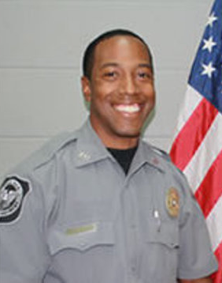
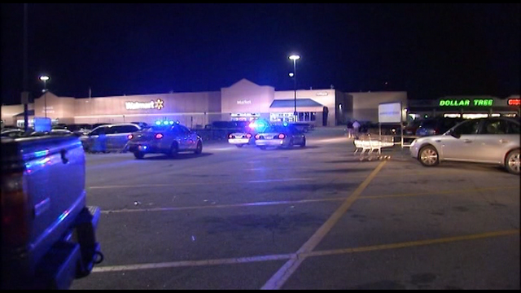

Officer Micahiah Swain of Villa Rica, GA, Police
assaulted and injured by larceny suspects on Nov. 20
http://www.fox5atlanta.com/news/51841713-story
https://www.odmp.org/agency/4035-villa-rica-police-department-georgia

Slide 4
Officer Deaths and Assaults in the U.S.
Could IT have saved them?

Slide 5
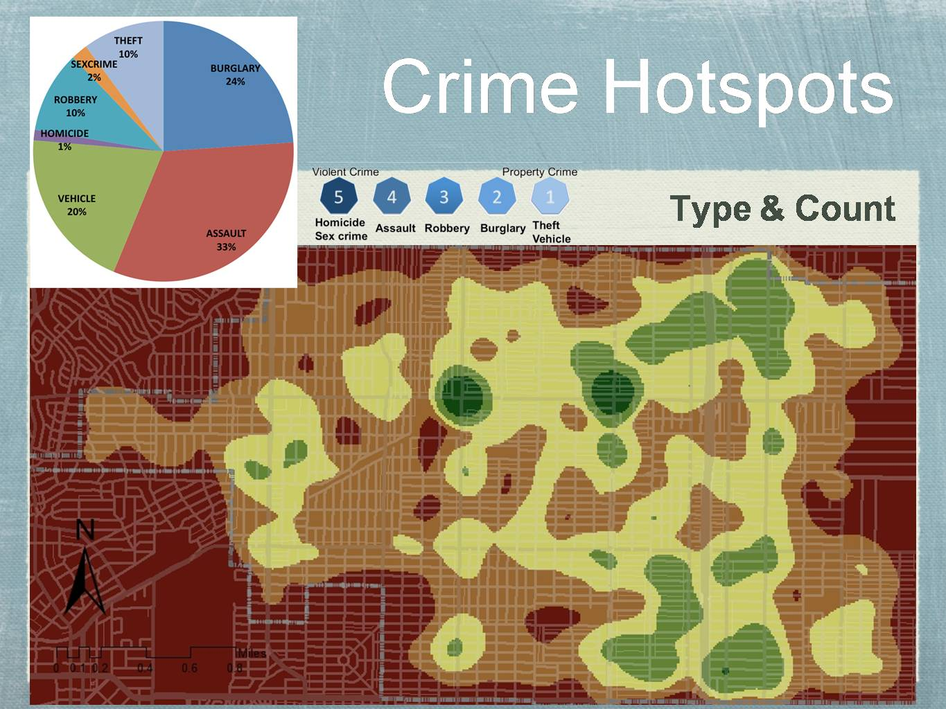
http://gis.yohman.com/up206a/author/jiegao/

Slide 6
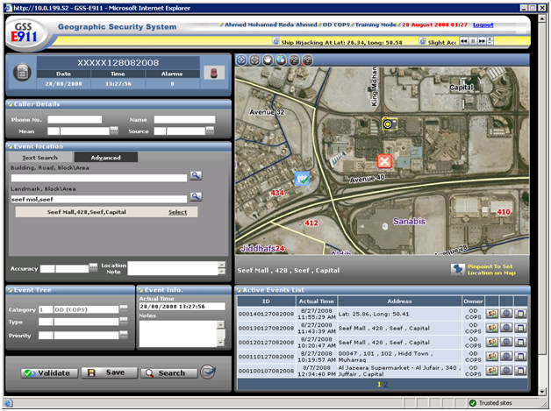
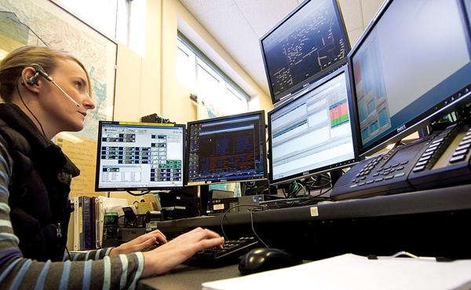
Computer-Aided Dispatch
http://www.weeble.net/iphone-ipad-computer-aided-dispatch-app/
http://peninsulaclarion.com/news/2011-10-04/911-center-gets-computer-aided-dispatch-program

Slide 7


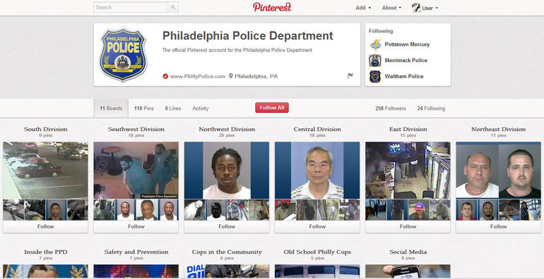
http://www.govtech.com/public-safety/Catching-Criminals-on-Pinterest.html

Slide 8
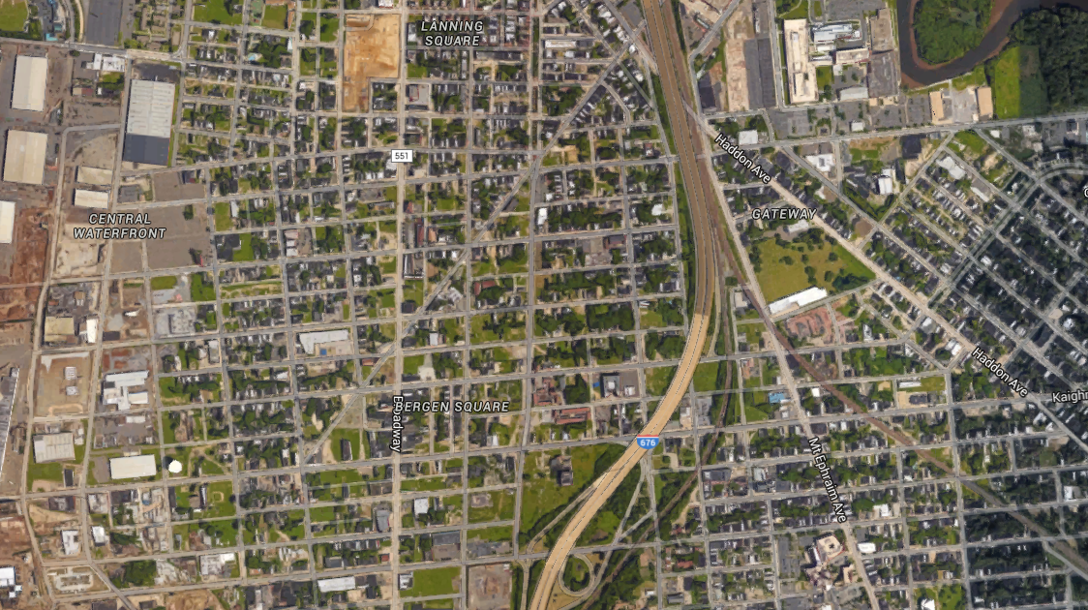
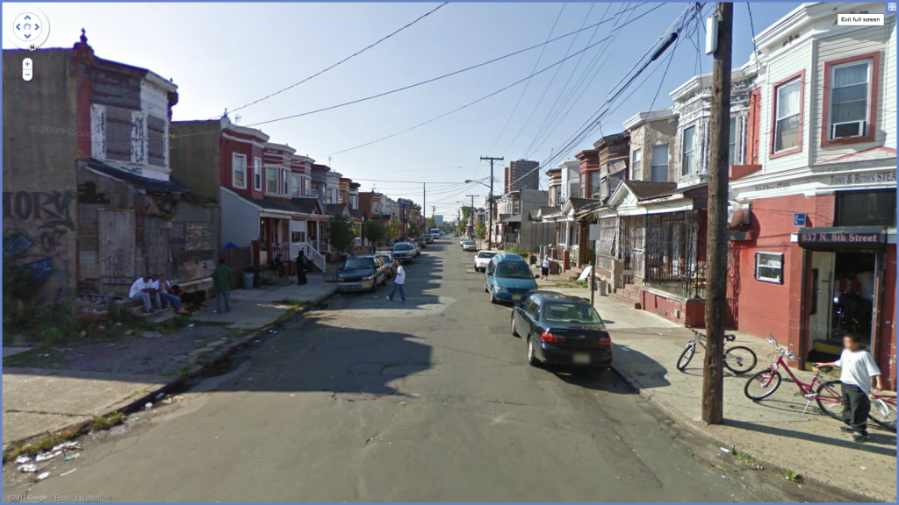
Intelligence-Led Policing
Where is the bad guy?
Intelligence on perpetuators helps apprehend criminals with less violence.
https://www.google.com/maps/@39.932551,-75.1149441,2036m/data=!3m1!1e3?
http://forum.davidicke.com/showthread.php?t=181433

Slide 9
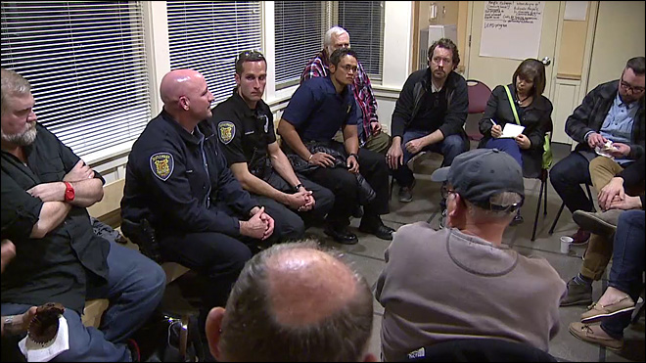
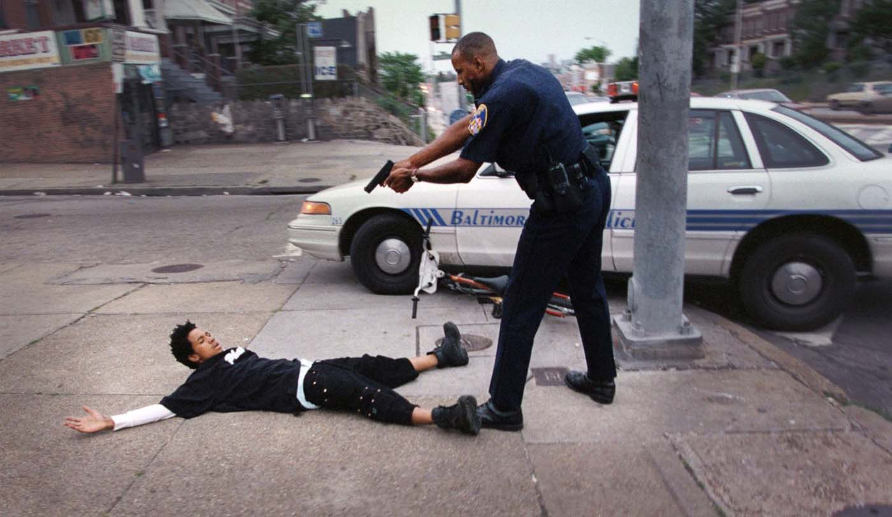
Community-Oriented Policing
http://darkroom.baltimoresun.com/2012/08/double-exposure-photo-of-arrest-provides-lasting-image-for-teens-family/
http://www.komonews.com/news/local/Police-community-gather-to-discuss-Cal-Anderson-violence-228290481.html

Slide 10
Research Model
Police IT Use for
Crime analysis
Crime mapping
Hotspot
Dispatch
In-field communication
In-field report writing
Internet
Law Enforcement
Capabilities
Intelligence-led policing
Community-oriented policing
Violence against Police
# of officers killed
# of officers assaulted

Slide 11
Police Departments in the Sample (3,921)
Population | Number of departments
> 500,000 – 1,000,000 | 121
200,000 – 500,000 | 189
50,000 – 200,000 | 828
20,000 – 50,000 | 863
< 20,000 | 1,920
Urban/Rural | Number of departments
Urban | 2,221
Rural | 1,691
Share of White population | Number of departments
> 90% | 1,437
70% - 90% | 1,529
50% - 70% | 609
< 50% | 337
Median Household Income | Number of departments
> $70,000 | 499
$50,000 - $70,000 | 999
$30,000 - $50,000 | 2,124
< $30,000 | 290

Slide 12
Data Sources
Uniform Crime Reports (FBI)
- Officer deaths and assaults
- Crime statistics
Law Enforcement Management and Administration Survey (DOJ)
- Police IT use
- Police personnel, operation, policy
N = 4,950
(2003, 2007)
American Community
Survey (Census Bureau)
- demographic, economic, societal indicators

Slide 13
Measures
Dependent Variable
Officer Killed | # of officers killed in the line of duty for 3 years
Officer Assaulted | # of officers assaulted in the line of duty for 3 years
Felon Killed | # of felons killed by police for 3 years
Independent Variables – Police IT Use
Crime Analysis | 1 = Agency uses computer for crime analysis; 0 = otherwise
Crime Mapping | 1 = Uses computer for crime mapping
Hotspot Identification | 1 = Uses computer for hotspot identification
Dispatch | 1 = Uses computer for dispatch
In-Field Communication | 1 = Uses computer for in-field communication
In-Field Report Writing | 1 = Uses computer for in-field report writing
Internet | 1 = Uses computer for Internet

Slide 14
Controls and Estimation
Control for
  basic locality information (population, area size)
  crime occurrence and clearance rates
  police size, personnel, operation, policies
  demographic indicators (gender, age, education)
  economic indicators (income, poverty, inequality)
  societal indicators (mobility, public transportation, family)
Random-effects estimation with state, metropolitan, and year fixed-effects

Slide 15
Dependent Variable | Log(Officer Killed + 1) | Log(Officer Assault + 1)
Method | Random Effects
Crime Analysis | -0.0154***(0.0035) | 0.0167 (0.0403)
Crime Mapping | 0.0077* (0.0041) | 0.0716 (0.0442)
Hotspot Identification | 0.0139** (0.0064) | 0.0375 (0.0470)
Dispatch | -0.0103***(0.0035) | -0.1035** (0.0402)
In-Field Communication | 0.0048 (0.0055) | 0.0775* (0.0433)
In-Field Report Writing | -0.0039 (0.0050) | -0.1033***(0.0365)
Internet | -0.0103* (0.0060) | -0.0663 (0.0521)
Crime Occurrence | 0.0068***(0.0020) | 0.1993***(0.0210)
Crime Clearance | -0.0118 (0.0124) | 0.4189***(0.1216)
Population | 0.0114***(0.0033) | 0.2904***(0.0303)
Miles | 0.0034***(0.0013) | -0.0240* (0.0123)
MSA Core | 0.0150* (0.0087) | 0.4552***(0.0698)
Operational Budget | 0.0178***(0.0039) | 0.1871***(0.0328)
Male | 0.0081 (0.0737) | 0.0759 (0.6978)
White | 0.0168 (0.0185) | 0.0550 (0.1645)
Young | -0.0946** (0.0475) | -0.0354 (0.4779)
High School | 0.0718 (0.0440) | 1.0022** (0.4623)
Income | -0.0005***(0.0002) | -0.0059***(0.0017)
Controls | State, MSA, Year | State, MSA, Year
Overall R² | 0.1209 | 0.6467
Wald | 174.20** | 14387.58***
*p < 0.1, **p < 0.05, ***p < 0.01; N = 4,950; # of Groups = 3,921; Robust standard errors are in parentheses.

Slide 16
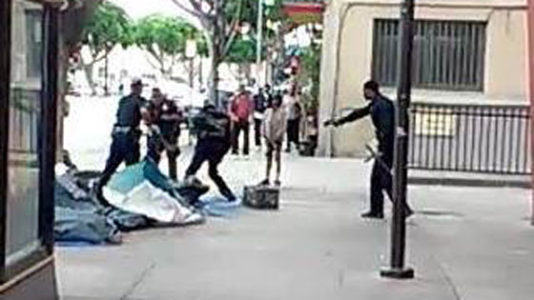
Dependent Variable | Log(Felons Killed + 1)
Method | Random Effects
Crime Analysis | -0.0268***(0.0100)
Crime Mapping | 0.0205* (0.0113)
Hotspot Identification | 0.0703***(0.0160)
Dispatch | -0.0750***(0.0105)
In-Field Communication | -0.0011 (0.0132)
In-Field Report Writing | 0.0008 (0.0118)
Internet | -0.0311** (0.0155)
Crime Occurrence | 0.0329***(0.0057)
Crime Clearance | -0.0332 (0.0293)
Population | 0.0581***(0.0086)
Miles | 0.0052 (0.0033)
MSA Core | 0.1749***(0.0225)
Operational Budget | 0.0663***(0.0102)
Male | 0.1982 (0.1749)
White | -0.0925* (0.0506)
Young | -0.1412 (0.1266)
High School | 0.2138* (0.1178)
Income | -0.0009** (0.0004)
Controls | State, MSA, Year
Overall R² | 0.3696
Wald | 874.75***
http://www.wrcbtv.com/story/28236918/dramatic-video-shows-fatal-police-shooting-on-skid-row

Slide 17
Good News and Bad News
Police IT use for crime analysis, dispatch, and Internet is associated with fewer deaths of both police officers and felons.
IT use for dispatch and in-field report writing is related to fewer assaults to police officers.
Crime mapping and hotspot identification are associated with more deaths of officers and felons.
  Predictive analytics seems to discover more violent crimes that otherwise would have not been reported.

Slide 18
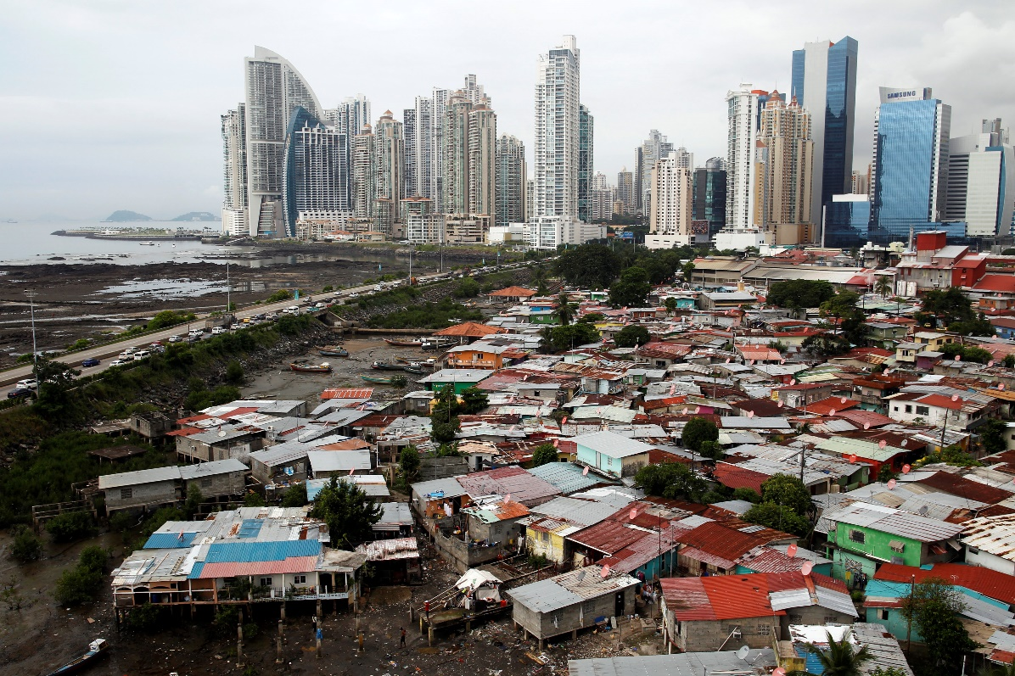
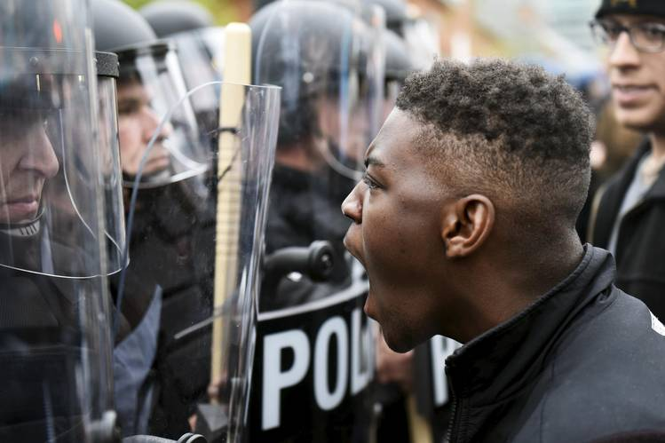
Income Inequality and Racial Disparity
The impact of crime analysis, hotspot identification, and Internet becomes stronger when
http://www.ibtimes.com/richest-1-will-have-more-wealth-remaining-99-2016-oxfam-study-1787200
http://www.wsj.com/articles/police-work-to-balance-crime-fighting-with-protecting-citizens-rights-1434332407

Slide 19
Robustness Checks
Sub-samples limited to large cities or large metropolitan areas
Estimation with spatial autoregressive model
Negative binominal estimation
One-year and two-year window for dependent variables
Alternative control variables

Slide 20
Potential Contributions
The role of IT for occupational safety in organizations that operate in turbulent and violent environments
  Our results could be applicable in other occupations such as military, firefighters, or workers in nuclear plants.
IT helps organizations identify, avoid, and mitigate risks to human resources
Unexpected impacts of predictive analytics
Moderating effects of political and economic divisions in society

Slide 21
THANK YOU
Min-Seok Pang
Fox School of Business
Temple University
Dec. 12, 2015
Notes:
21

Slide 22
Dependent Variable | Log(Officer Killed + 1) | Log(Officer Assault + 1) | Log(Felon Killed + 1)
Method | Random Effects
 | (1) | (2) | (3)
Crime Analysis | -0.0154***(0.0035) | 0.0167 (0.0403) | -0.0268***(0.0100)
Crime Mapping | 0.0077* (0.0041) | 0.0716 (0.0442) | 0.0205* (0.0113)
Hotspot Identification | 0.0139** (0.0064) | 0.0375 (0.0470) | 0.0703***(0.0160)
Dispatch | -0.0103***(0.0035) | -0.1035** (0.0402) | -0.0750***(0.0105)
In-Field Communication | 0.0048 (0.0055) | 0.0775* (0.0433) | -0.0011 (0.0132)
In-Field Report Writing | -0.0039 (0.0050) | -0.1033***(0.0365) | 0.0008 (0.0118)
Internet | -0.0103* (0.0060) | -0.0663 (0.0521) | -0.0311** (0.0155)
Crime Occurrence | 0.0068***(0.0020) | 0.1993***(0.0210) | 0.0329***(0.0057)
Crime Clearance | -0.0118 (0.0124) | 0.4189***(0.1216) | -0.0332 (0.0293)
Population | 0.0114***(0.0033) | 0.2904***(0.0303) | 0.0581***(0.0086)
Miles | 0.0034***(0.0013) | -0.0240* (0.0123) | 0.0052 (0.0033)
MSA Core | 0.0150* (0.0087) | 0.4552***(0.0698) | 0.1749***(0.0225)
Operational Budget | 0.0178***(0.0039) | 0.1871***(0.0328) | 0.0663***(0.0102)
Education Requirement | -0.0052** (0.0026) | -0.0217 (0.0232) | -0.0092 (0.0072)
White Officer | -0.0396** (0.0160) | -0.2089 (0.1364) | -0.0613 (0.0394)
Female Officer | 0.0288 (0.0275) | -0.1281 (0.2342) | 0.0865 (0.0650)
Training | 0.0031 (0.0057) | 0.0794** (0.0343) | 0.0413***(0.0136)
Weapon | 0.0004 (0.0012) | 0.0320***(0.0087) | 0.0018 (0.0032)
Policy | 0.0009 (0.0025) | -0.0215 (0.0246) | -0.0054 (0.0066)
Community | -0.0017 (0.0013) | 0.0009 (0.0098) | -0.0119***(0.0034)
Male | 0.0081 (0.0737) | 0.0759 (0.6978) | 0.1982 (0.1749)
White | 0.0168 (0.0185) | 0.0550 (0.1645) | -0.0925* (0.0506)
Young | -0.0946** (0.0475) | -0.0354 (0.4779) | -0.1412 (0.1266)
High School | 0.0718 (0.0440) | 1.0022** (0.4623) | 0.2138* (0.1178)
Income | -0.0005***(0.0002) | -0.0059***(0.0017) | -0.0009** (0.0004)
Poverty | 0.0555 (0.0444) | 0.2509 (0.4424) | 0.1871* (0.1112)
Vacant Homes | -0.0005 (0.0091) | 0.1851 (0.1386) | 0.0601* (0.0327)
Inequality | 0.1179** (0.0468) | 0.5297 (0.4285) | 0.1075 (0.1205)
Controls | State, MSA, Year | State, MSA, Year | State, MSA, Year
Overall R² | 0.1209 | 0.6467 | 0.3696
Wald | 174.20** | 14387.58*** | 874.75***

