Slide 1
Are consumers happy with the high-tech equipped league?
An Application of Technology acceptance model
Yiran Su

Slide 2
Motivation
Information technology is marching into the heart of sports.
“ Across industries, the trend is toward mobile, rich and instant data. Sports are no exception.”
The professional sport leagues (NFL, NBA, NHL, and MLB) began experimenting with analytics to improve their teams.
e.g. The NBA installed SportVU cameras throughout arenas, which allow the movements of the basketball and player to be tracked and recorded.
How technology would influence consumers’ satisfaction is less investigated.
An exploratory study linking organization level and individual level of innovation adoption.

Slide 3
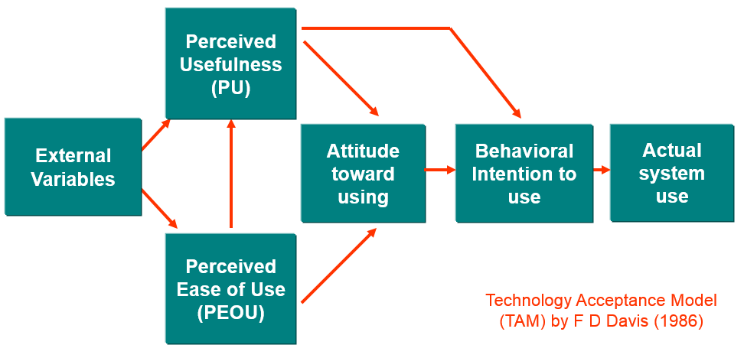
Background theory
Technology Acceptance Model

Slide 4
Conceptual Model
Consumer Perceived Usefulness
Employee
Perceived
Resource
IT innovation
Adoption in the league
Consumer satisfaction with the league
Employee
Perceived Usefulness
Perceived Relative Advantage
Employee Perceived ease of use

Slide 5
Hypotheses
H1: Employers’ perceived resource of a league has a positive influence on IT innovation adoption in the league
H2: Employers’ perceived usefulness of IT innovation has a positive influence on IT innovation adoption in the league
H3: Employers’ perceived ease of use of IT innovation has a positive influence on IT innovation adoption in the league
H4: IT innovation adoption in the league has a positive influence on consumers’ perceived advantage of the league through perceived relative advantage of the IT innovation.
H5: Consumer Perceived Usefulness of the IT innovation will moderate the effect of IT innovation adoption in the league on consumers’ satisfaction

Slide 6
Possible Data Sources.
Survey Data
Items modified from exiting literature
Secondary data of IT investments of the leagues and teams. (rare public source)
SEM method

Slide 7
Variables
Employee Perceived Resource |  | Mathieson et al. (2001)
Employee Perceived Usefulness |  | Davis (1989)
Employee Perceived ease of use |  | Davis (1989)
IT innovation Adoption in the league | Information technology infrastructure Strategic alignment | Sircar et al.(2000); Bharadwaj (2000) Venkatraman (1989); Palmer & Markus (2000); Reich & Benbasat (1996)
Consumer Perceived Usefulness |  | Davis (1989)
Relative Advantage |  | Premkumar et al. (1994)
Consumer satisfaction with the league |  | Hayes, B. E. (1998).

