Slide 1
NOLA Life Security Policy
Matthew Oberst, Matthew Leaver, Rhea Prabhu, Samantha Sederstrand, Thompson Nguyen

Slide 2
NOLA Life Background
Nola Life is a mutual insurance company that offers clients whole life insurance and annuities.
It currently faces the problem of providing its field agents with the electronic tools they need to acquire new customers and better serve existing customers.
CURRENTLY
NOLA Life agents follow sales leads to potential new clients and manually process the respective paperwork.
Paper trail
Medical technician
PROJECT PLANS
NOLA Life agents will be equipped with secure tablets to collect client information.
Quickly and accurately process claims
Eliminate added costs/time
Notes:
It currently faces the problem of providing its field agents with the electronic tools they need to acquire new customers and better serve existing customers.
Use UPS to get all the completed forms and other information to NOLA Life’s home office
Medical technician conducts exam that typically consists of taking a medical history, getting a heart ECG, documenting the client’s weight, and taking a blood sample.
Eliminate the need for a medical technician visit by equipping agents with a new automated medical device that communicates via Bluetooth with the tablet
When collecting client information, software on the tablet will prompt for only the information needed for the insurance or annuity policy or claim, and then error check all the information

Slide 3

Hello!
I am Rhea Prabhu
I’ll be discussing Hardware and User Processes & Training

Slide 4
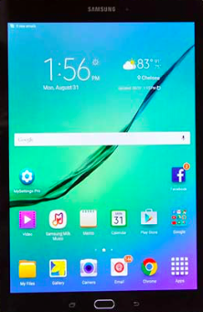
Samsung S2 Galaxy Tablet
Place your screenshot here
Bluetooth
OCR
Smart card reader
KNOX security and mobile management suite
$499.99 (32GB)
Notes:
Our hardware recommendation is the Samsung Galaxy S2 Tablet because it is cost effective, in that it is equipped with the functions needed for data integrity but also less costly than its competitors. Some key features that this tablet offers is bluetooth capability, as well as OCR, to support employee data entry of sensitive client information. Additionally, the Samsung tablet has a smart card reader and KNOX security, which is a multi-layered hardware and software security management suite that protects the integrity of the entire device, from the hardare to the application later.
--------------
Software: The Galaxy Tab S2 9.7 runs Android 5.1.1 Lollipop, the latest version of Google’s OS for tablets and phones
KNOX (its security ad mobile deivce management suite):
* Multi-layered hardware and software security: KNOX protects the integrity of the entire device, from the hardware to the application layer. This multilevel approach to security includes tamper-evident fuses built into the device from the factory, combined with Trusted Boot, TrustZone based Integrity Measurement Architecture (TIMA), and Security Enhancements for Android™ providing real time protections throughout the entire device lifecycle.
* KNOX offers integration with the most popular Mobile Device Management (MDM), SSO, and VPN solutions in market, allowing you to preserve your existing infrastructure investment. Samsung KNOX devices also support the Android™ for Work program to deliver the most secure* Android™ solution in the marketplace.
* Designed for government and regulated industries with advanced security needs, KNOX Workspace offers an advanced data separation solution (container) with expanded IT policies and controls. It’s our award winning, government-certified security solution meeting the needs of organizations that are serious about mobile security.
* My KNOX is a free security app for Android™ that creates an encrypted space on your personal Galaxy mobile device to bring a degree of BYOD security to your everyday professional life.
*
Our hardware recommendation is the Samsung Galaxy S2 Tablet because it is cost effective, in that it is equipped with the functions needed for data integrity but also less costly than its competitors. Some key features that this tablet offers is bluetooth capability, as well as OCR, to support employee data entry of sensitive client information. Additionally, the Samsung tablet has a smart card reader and KNOX security, which is a multi-layered hardware and software security management suite that protects the integrity of the entire device, from the hardare to the application later.

Slide 5
Our Users & Training Process
Initial, extensive workshop
Certification
Annual assessment and re-training
Biometrics & passwords
Secure file transfer
Employee controls & measures
Notes:
Employees will be required to attend an initial, comprehensive workshop that details the reason for transition, as well as the new controls put in place to comply with the new security policy. Upon completion of the initial workshops, each employee will be deemed a certified agent and will be allowed to operate in the field to collect information from clients. After a thorough explanation of all these concepts, employees will be re-evaluated on an annual basis to re-obtain certification. Without obtaining certification annually, employees will be unable to work with clients.
The protocols in place to ensure safety of data being collected by employees includes biometrics and passwords on the tablet and secure file transfer protocols such as VPN to make sure that all internet communication is encrypted and secured from eavesdropping. Lastly, employees must abide by a set of rules surrounding tablet

Slide 6

Hello!
I am Thompson Nguyen
I’ll be discussing our software and telecommunication protocol recommendations.

Slide 7

Good Technology
Enterprise mobility management (EMM)
Enhance security for tablets
Centralize administration and management of mobile devices
Mobile device management (MDM)
Manage devices
  Register & track devices
  Set configurations
  Remote data wipe
Access control policies
  access based on roles
Enforce encryption
Detect and prevent rooted devices
Mobile application management (MAM)
Manage applications
  Blacklist or whitelist application
App wrapping
  Segregates corporate apps from other apps
  Set policy for each app
  enable or disable data storage of app
Why Good Technology?
Strong relationship with device manufacturers
Integrated with Samsung Knox
Compatibility with Samsung Knox’s platform

Slide 8
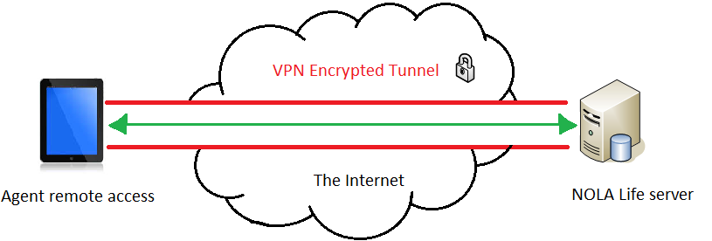
VPN TLS Telecommunication Protocol
VPN with TLS protocol
Creates an encrypted connection
Identification and authentication
remote access to web, client, and server applications

Slide 9

Hello!
I am Samantha Sederstrand
I’ll be discussing the Overview of the Threat Model and Ingress Threats.

Slide 10
NOLA Process
Data is
Without
Once
Agent
Card data
Agent
Agent
Agent
stored on
internet
collects
logs
records
Device
NOLA
connection,
transferred,
client
is instantly
logs off of
onto
client
connects
network
data
data is
payment
transferred
device &
device
data
to VPN
using cloud
temporarily
wiped from
information
with
stores
technology
stored on
device
with Square
Square
safely
device

Slide 11
Threat Model Overview
Determined Potential Risks
Identified as Ingress or Egress Threats
DREAD Threat Model
Established the Level of Risk

Slide 12
Ingress Threats
Threat | Threat Level
Tablet Security | Low
OCR Scan | Low
Galaxy S2 Technology | Medium
Insecure Data Transfer | Medium
Network Vulnerability | Medium
Unauthorized Employee VPN Access | High

Slide 13
Key Ingress Threats
Threat | Threat Level
Galaxy S2 Technology | Medium
Network Vulnerability | Medium
Unauthorized Employee VPN Access | High

Slide 14
Galaxy S2 Technology
Who’s affected?
Agents & Clients
What’s the risk?
Possible data breach with backdoor permission access from unauthorized user.
How do we combat the risk?
Good for Samsung KNOX will protect rooting of the NOLA devices.
Notes:
Attack Technique: If the tablet is rooted, it will be vulnerable to virus threats that may contain malicious files that would harm the device and patient data.

Slide 15
Network Vulnerability
Who’s affected?
NOLA networks & Client Data
What’s the risk?
Attacker may obtain an unauthorized connection and access to company data.
How do we combat the risk?
Using VPN connections, SSL encrypting all data remotely transferred, TLS, firewalls, antivirus, and SFTP.
Notes:
Attack Technique: Viruses resulting in corrupt data, deleted data, network failure, or more.

Slide 16
Unauthorized Employee VPN Access
Who’s affected?
NOLA networks
What’s the risk?
An unauthorized agent may retain access to tablet after losing credentials opens up the network to data manipulations, unwanted access, and malicious measures.
How do we combat the risk?
Strict protocol revoking unauthorized agents of their authentication and utilizing remote wipe.
Notes:
Attack technique: An ex-employee may retain access to the tablet and use credentials to access the network

Slide 17
Hello!
I am Matthew Leaver
I’ll be discussing Egress Threats

Slide 18
Egress Threats
Threat | Threat Level
Client Data Security | Medium
Lack of Internet Access | Low
Data Breach Vulnerability | High

Slide 19
Key Egress Threats
Threat | Threat Level
Client Data Security | Medium
Data Breach Vulnerability | High

Slide 20
Data Breach Vulnerability
Who’s affected?
Company & Client data
What’s the risk?
Insecure connection could leave company liable to theft of client data and sensitive information
How do we combat the risk?
VPN, SSL, SFTP, firewalls

Slide 21
Client Data Security
Who’s affected?
Client Data
What’s the risk?
Sensitive information may be extracted off of a misplaced tablet by a malicious user
How do we combat the risk?
Store all data on company network using cloud technology

Slide 22

Hello!
I am Matthew Oberst
I’ll be concluding our presentation

Slide 23
Conclusion
4
Why NOLA Life Should Take Our Recommendations

Slide 24

HIPAA Compliance
Software Recommendation - Good Technology
  Architected to align with the firewall, transmission, and smart-device security required by HIPAA’s Security
Data Transmission
  Implement a mechanism to encrypt electronic protected health information (telecommunication protocols)
Data Wipe Policies
  Electronic media that contains electronic protected health information (EPHI) should be rendered “unusable and/or inaccessible”
    Physically damage the hard drive beyond repair (making data inaccessible)
    Wiping the data from device after uploading to server
  Document the removal of hardware and electronic media that contains EPHI

Slide 25
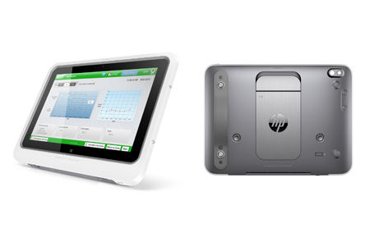
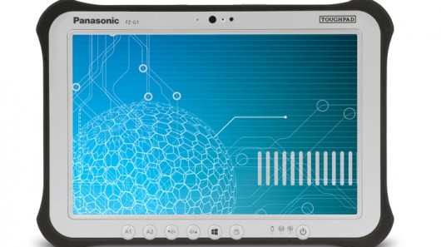
Hardware Comparison
HP ElitePad Healthcare Tablet
$1,449+
Smart Card Reader
Full disk encryption
Bluetooth
Windows 10 OS
Panasonic ToughPad
$1,750+
Smart Card Reader
Mobile Device Management
Bluetooth
Windows/ Android OS

Slide 26
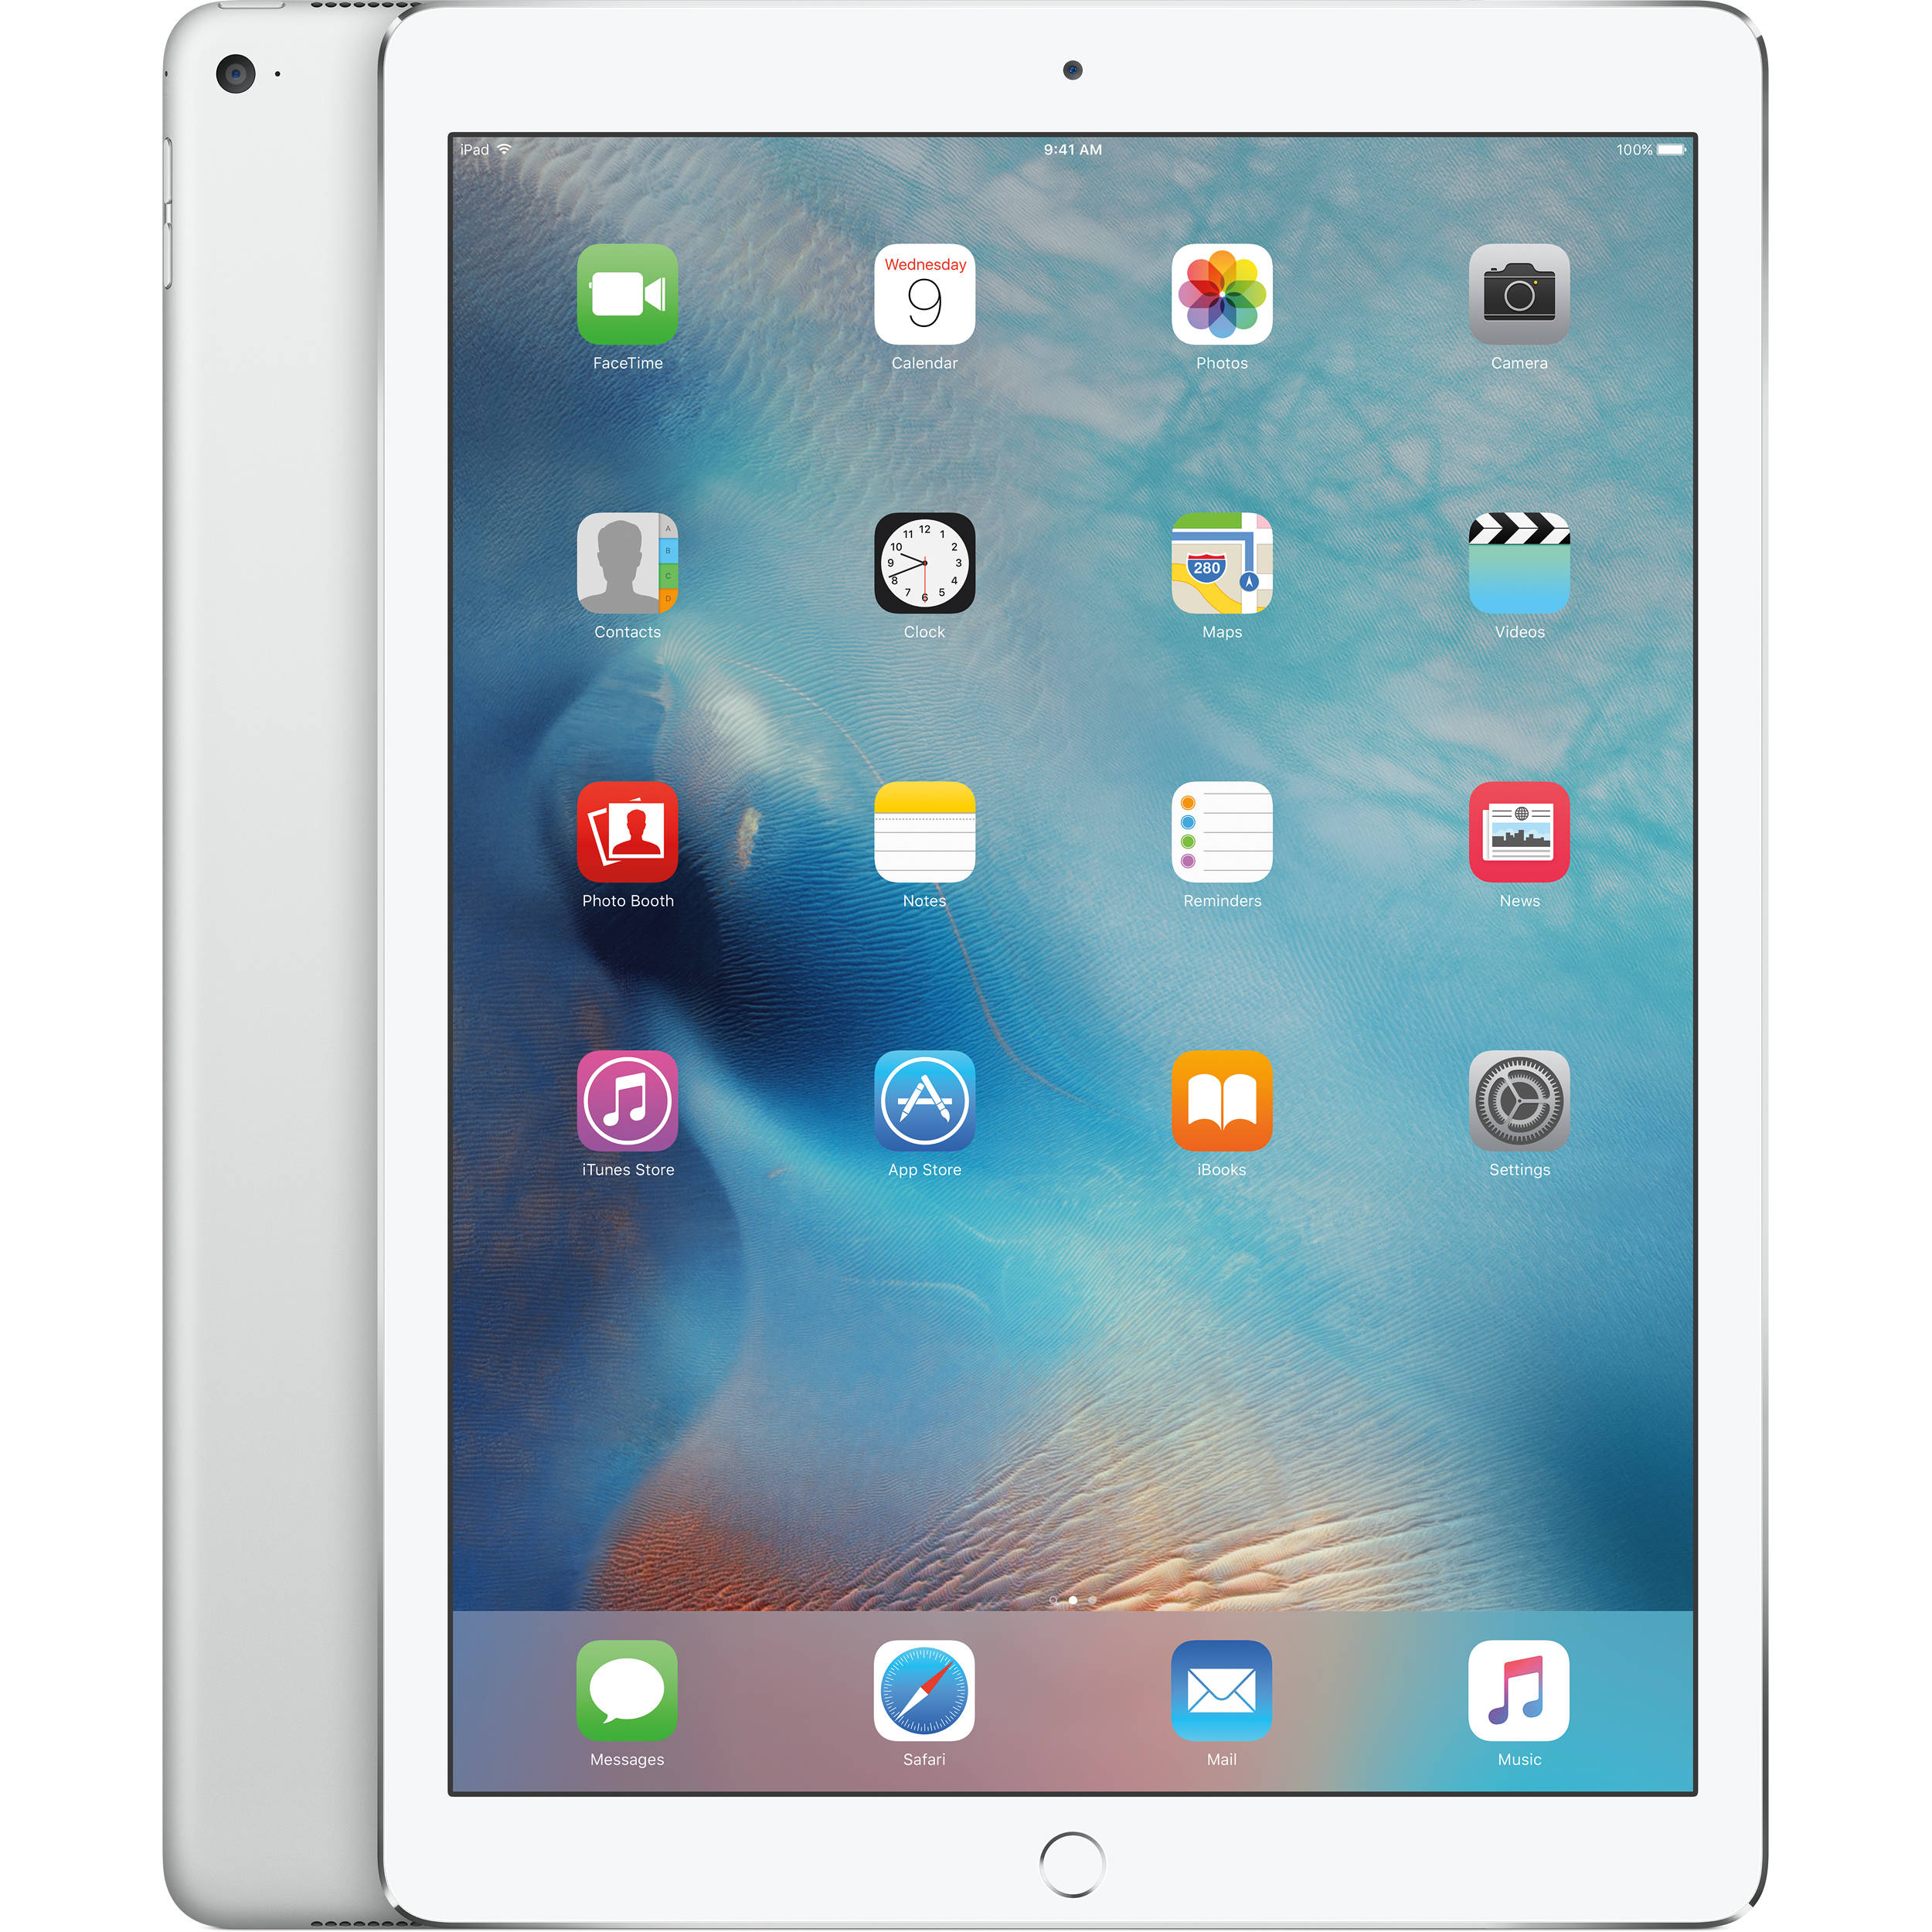
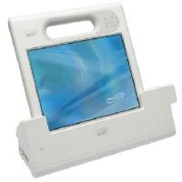
Hardware Comparison
Motion Computing C5m
$2,000-$4,000
Smart Card Reader
Integrated Fingerprint Reader
Complete Security & Anti-Theft Software
Bluetooth
Windows 10 OS
iPad Pro
$799-$949
Touch ID
Bluetooth
Windows 10 OS

Slide 27
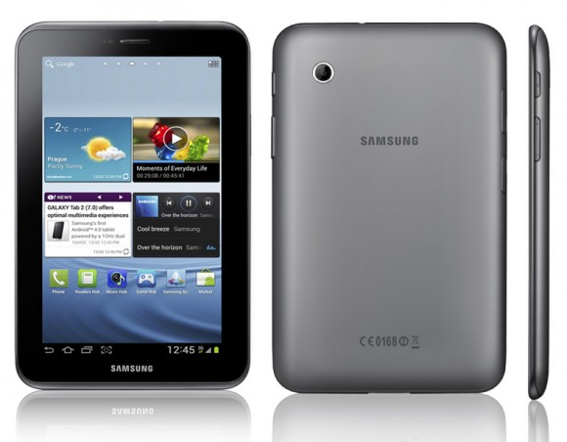
Hardware Recommendation - Samsung Galaxy Tab 2
$499
Smart card reader
OCR
Samsung Knox Security
Biometrics - Fingerprint Scanner
Bluetooth
Android OS

Slide 28

Cost and Time Savings
Samsung Galaxy Tab 2 - $369-$469 per tablet
  Fast and accurate data collection
  Seamless communication via Bluetooth
Good Technology - $10 per month
  Compatible with Samsung products
  Free demo available
VPN with SSL/TLS Protocol
  Cost effective to secure data

Slide 29
A Better Customer Experience
High quality experiences throughout process
  Reduced waiting times
  Accurate collection of client information
Barcodes containing patient medical history
  Smoother customer experience
Biometrics
  Saves customers’ time and gives peace of mind
Only necessary information inputted

Slide 30
Giving Agents the Necessary Tools
Implementation of biometrics and strong passwords
Storage on external NOLA server
Samsung Galaxy Tab 2 and Good Technology
  Accurate results
  Seamless communication
  Compatible with credit card (smart card) readers
    Verification via OCR

Slide 31
Thanks!
Any questions ?

