Slide 1
Instagram: How Weather Data Could Help the Social Media Giant and its Brands
By: Matthew Oberst
Fox School of Business - MIS

Slide 2
Background: A Brief Overview of Instagram
History:
Founded and launched by Kevin Systrom and Mike Krieger in Fall 2010
Purchased by Facebook in 2012
Reached 100 million users in 2013
Instagram Today:
The #1 photo social platform in the world
150 million monthly active users
16 billion photos shared
1.2 billion likes every day
55 million photos per day
Mike Krieger (pictured left) and Kevin Systrom
Notes:
(End) “You can see that Instagram is one of the most prominent social media sites out there today…”

Slide 3
Making Money Off Mother Nature: Instagram and Weather Data
The Benefits for Instagram:
See how the changing weather affects their business
Learn from Facebook and Twitter
Use it for their own messaging
Make automatically available filter, emojis, etc for specific weather events and seasons
Attract brands to their platform
Notes:
“… and now we are going to see how weather data can help Instagram rise even more by looking at how weather analytics can benefit Instagram.”
“We know that good weather has positive effects on sales for restaurants, durable goods, automotive and apparel, but Instagram would know how weather affects how their users use Instagram. What are people posting during a snowstorm vs in a drought. It may be different than even Facebook”
“Cute emojis and filters draw people in”
“Instagram could do better than them and come up with new ways to utilize weather data”
“Instagram wants to make money, and here are a few ways they can use weather data to do so.”

Slide 4
Notes:
“This helps Facebook, and thus potentially Instagram, tailor their content” “Instagram users might react differently than Facebook users because it is a different beast all together. Using weather data is the only way to know.”

Slide 5
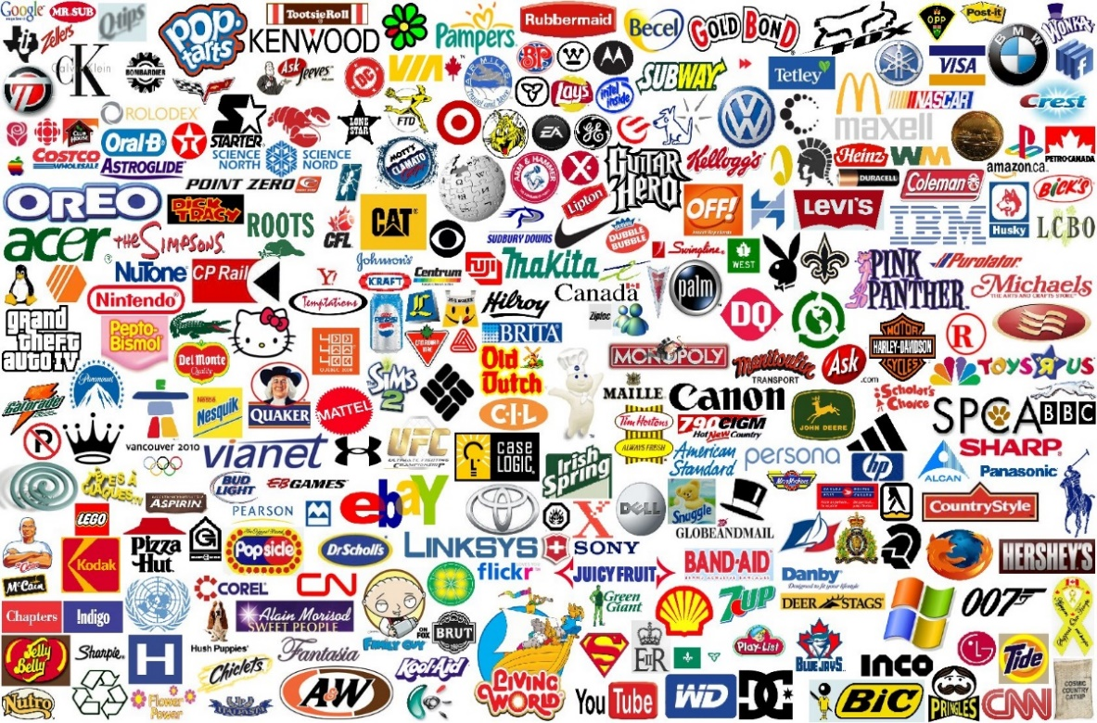
Making Money Off Mother Nature: Instagram and Weather Data (Continued)
Instagram, Brands, and the Weather:
Brands could utilize weather data
Share their message on Instagram at right time
Boost social marketing and ROI
Publish content on Instagram
Buy social advertising automatically as the weather events unfold based on pre-established rules
Minimize risk
Having pre-approved and well thought-out material for Instagram for when the weather dictates it
Notes:
“Once Instagram recognizes the benefits of having someone analyze weather data for them, the brands utilizing Instagram will realize the benefits for themselves.”
“Brands could use the results they get from the weather data to… (each main bullet)

Slide 6
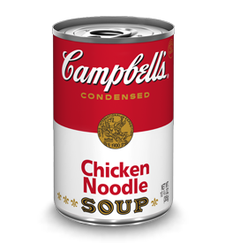
Making Money Off Mother Nature: Instagram and Weather Data (Continued)
Example of Using Weather Data on Instagram:
This weekend’s forecast for Seattle is abnormally heavy rain, so Campbell’s would publish this post at 4pm on Friday:
Weather this weekend got you down? Boost yourself up with a nice can of Campbell’s Chicken Noodle Soup!
Notes:
“I just wanted to give a quick example of what using big data weather analytics on Instagram would look like.”
“Not wasting anyone’s time” “No need to target sunny San Diego this weekend, or if you want to target them…then use a different ad targeted at their weather-specific condition for that weekend”
“As you will see next, ROI is potentially huge because it’s targeted at a weather-specific audience”

Slide 7
Don’t Take My Word For It... (Beyond Instagram)
Stella Artois
Molson Coors
2 degree temperature rise above the monthly norm triggered sales rise
Ads activated with 2 or more degree temperature rise
Results:
65.6% increase in YOY sales
Ads only shown during optimum conditions (no wasted impressions)
Created a lot of buzz, generating over £15,000 ($23,000) in earned media value
Weather-triggered campaign that targeted ads to mobile Facebook users
Activated by specified local weather conditions
Two types of ads
Weather-specific
Generic
Results:
Users who interacted with ‘Weather Specific’ ads were:
89% more likely to click a link
50% more likely to mention the brand page
33% more likely to comment
Notes:
“But Instagram won’t just take my word for it, so to prove to them the effectiveness of weather analytics, I could show them 3 case studies with ROI stats demonstrating the effectiveness of using weather-based data.”
By mapping historical weather data, discovered that 2 degree temperature rise above the monthly norm triggered sales rise
“Ran campaign on cost-per-minute basis (activating only when conditions were right to induce purchase intent)”
Deployed weather-triggered campaign…
Results:
“89% more likely to click a link then users who clicked on generic ads”

Slide 8
Don’t Take My Word For It... (Beyond Instagram) (Continued)
La Redoute
Live weather billboard with weather sensors
Sensors detected changes in temperature and precipitation
Model on billboard changed clothes accordingly
Results:
34% traffic uplift to website (despite campaign being deployed offline)
17% increase in online sales when it ran
Notes:
Created live billboard…
Live sensors detect..
17% sales increase when it ran
“They would not have known this had they not used these weather billboards”

Slide 9
Conclusion
Weather Data
Great ROI for Instagram
Great ROI for brands using Instagram
Utilizing Weather Data has a proven track record
Notes:
“In regards to using weather data…”
“There would be a great ROI for Instagram by using weather data”
“Brands would want to use Instagram because of the great ROI for them, which helps both the brands and Instagram”
“I know that on the Planalytics site there are success stories like Sonic and Coca-Cola, and the three case studies you just saw prove this fact further.”
“It’s a win-win scenario for everyone!”

Slide 10
Works Cited
"10 Instagram Marketing Tips to Make People." WordStream. N.p., 6 Jan. 2015. Web. 10 Aug. 2015.
"Announcing a New Suite of Business Tools for Brands on Instagram." Instagram for Business. Instagram, Sept. 2014. Web. 10 Aug. 2015.
Berry, Lauren. "Facebook Engagement Rate: How One Little Metric Got So Tough To Nail Down." Simply Measured RSS. N.p., 19 Feb. 2014. Web. 10 Aug. 2015.
Bowden, Jason. "The Infusion of Brand Marketing and Big Data Analytics." Social Media Today. N.p., 03 Sept. 2014. Web. 10 Aug. 2015.
"Brand Engagement on Instagram Is High-for Now - EMarketer." EMarketer. N.p., 6 Aug. 2015. Web. 10 Aug. 2015.
"Facebook & Twitter Advertising Solutions | Ampush." Ampush. N.p., n.d. Web. 19 Aug. 2015.
Geoff. "The Complete History of Instagram." We Are Social Media. N.p., 03 Jan. 2014. Web. 10 Aug. 2015.
Protalinski, Emil. "Instagram Announces Account Insights, Ad Insights, Ad Staging." TNW Network All Stories RSS. N.p., 21 Aug. 2014. Web. 10 Aug. 2015.
"Weather Analytics | Weather Intelligence | Planalytics, Inc." Planalytics Inc. N.p., n.d. Web. 16 Aug. 2015.
"Weather-based Campaign Management." Google Developers. N.p., n.d. Web. 19 Aug. 2015.
"What's Buzzing: Weather-Based Ads, Catalog Remixes & More - 360i Digital Agency Blog." 360i Digital Agency Blog. N.p., 13 June 2014. Web. 19 Aug. 2015.
"What If Your Social Media Content Could React to the Weather?" Social Pulse • Real Time Marketing Tool for Social Media Content. N.p., n.d. Web. 16 Aug. 2015.
"Which Brands Are Taking Advantage of Instagram?" EMarketer. N.p., 6 Apr. 2015. Web. 10 Aug. 2015

