Slide 1
Naan bread pizza
Nicole Marino

Slide 2

agenda
Naan Bread
Variety
Benefits
Displays
KBS Demo
Grilling Technique
Sales/Results
Financial Impact
Notes:
Today we are going to talk about:
Naan Bread
Benefits of Naan Bread Pizza
Variety we offer
Nutritional Information
Grilling Technique
Display
KBS Demo
Sales/Results
Contribution

Slide 3
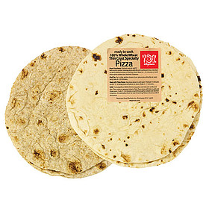
naan bread
Origin: India, Persia, & Central Asia
Leavened, oven-baked flat bread
Resembles pita bread
Notes:
One of the consistent questions we received while demoing was What is Naan Bread?
Naan Bread originated in India, Persia, and Central Asia.
It is a leavened, over-baked flat bread that resembles pita bread.
Thinner, lighter alternative to regular pizza crust

Slide 4
Variety
Cheese
Cheese & Pepperoni
White Cheese & Garlic
Spinach Ricotta
Margarita
Neapolitan
Veggie w/ Red or White Sauce
Pesto, Tomato, & Spinach
Bruschetta
Italian Sausage & Hot Peppers
Buffalo Chicken
Chicken, Pesto, & Bruschetta
Barbecue Chicken
Chicken, Bacon, & Ranch
Caramelized Onions & Bacon
Roasted Mushroom & Ricotta
Notes:
As you can see we have a wide variety of Naan Bread Pizzas that we can offer to our customers.
Each pizza has a corresponding production guide to ensure accuracy and consistency throughout all stores.
This allows our customers to trust the product they are buying will always be the same each time they get it.
It was imperative to ensure our customers could pick from various types of pizzas. This product is unique to the Wegmans and it sets us apart from our competitors.
I had to work daily with the pizza team to ensure the openers would create a variety.

Slide 5
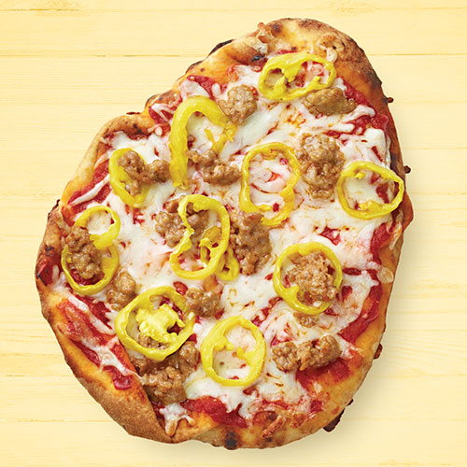
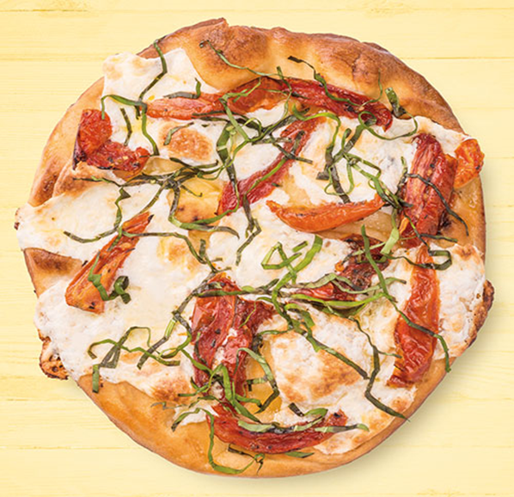
Benefits
Light, thin crust pizza
Affordable
Easy meal option
High quality ingredients
Made fresh daily
Notes:
Naan Bread Pizza has many benefits.
It is a light, thin crust pizza
At a very affordable price of $6.49 for traditional cheese and $6.99 for any specialty Naan
This is a very easy meal option because of the convenience of already being prepared.
The pizzas are made with high quality ingredients and made fresh daily in store.
This ties right into our priority of freshness and high standards of our products for our customers.

Slide 6
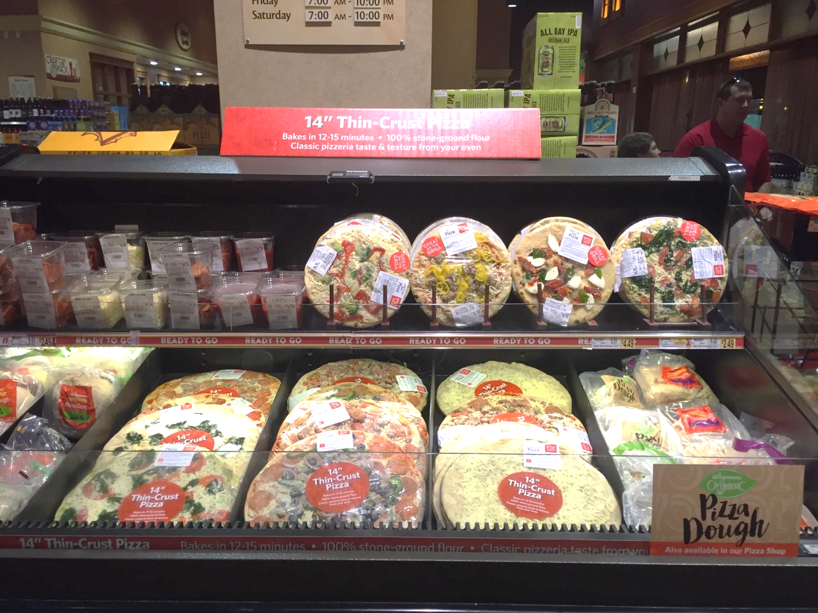
DISPLAYs
Notes:
This is the Original Display 6 foot case near Beer Department Entrance.
Hidden and inconvenient
Not a lot of space for Naan Bread Pizzas because of all the pizza toppings, dough balls, and 14” pizzas.

Slide 7
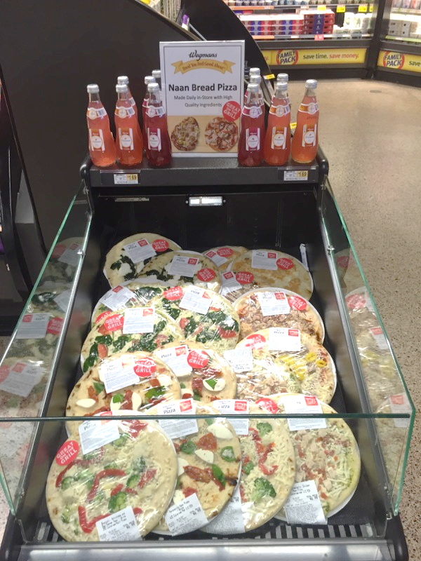
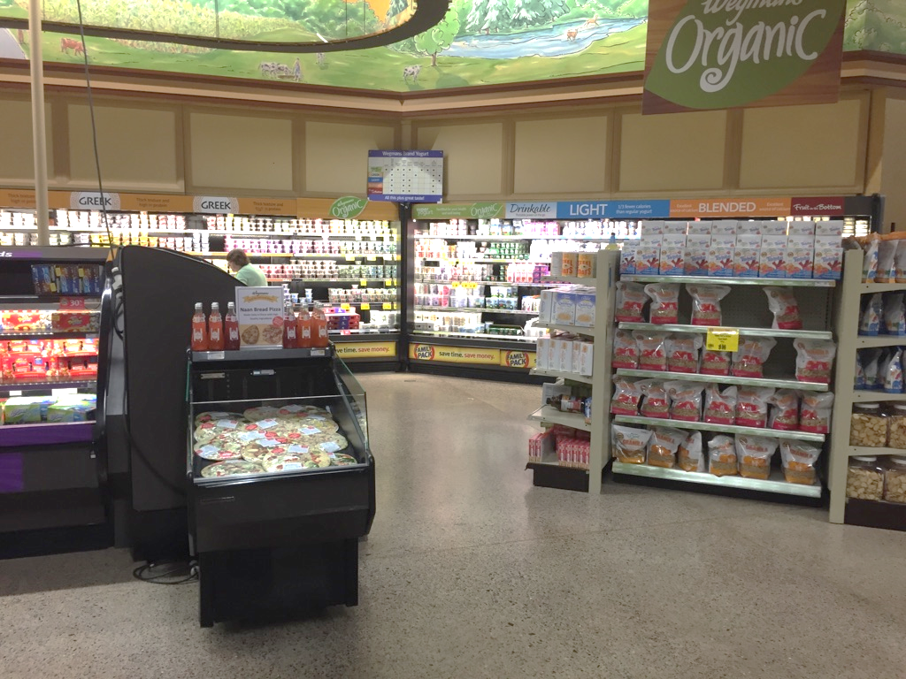
Displays (Cont.)
Notes:
New Display: Dairy Department near the yogurts
Meal Solutions on the grocery side of the store

Slide 8
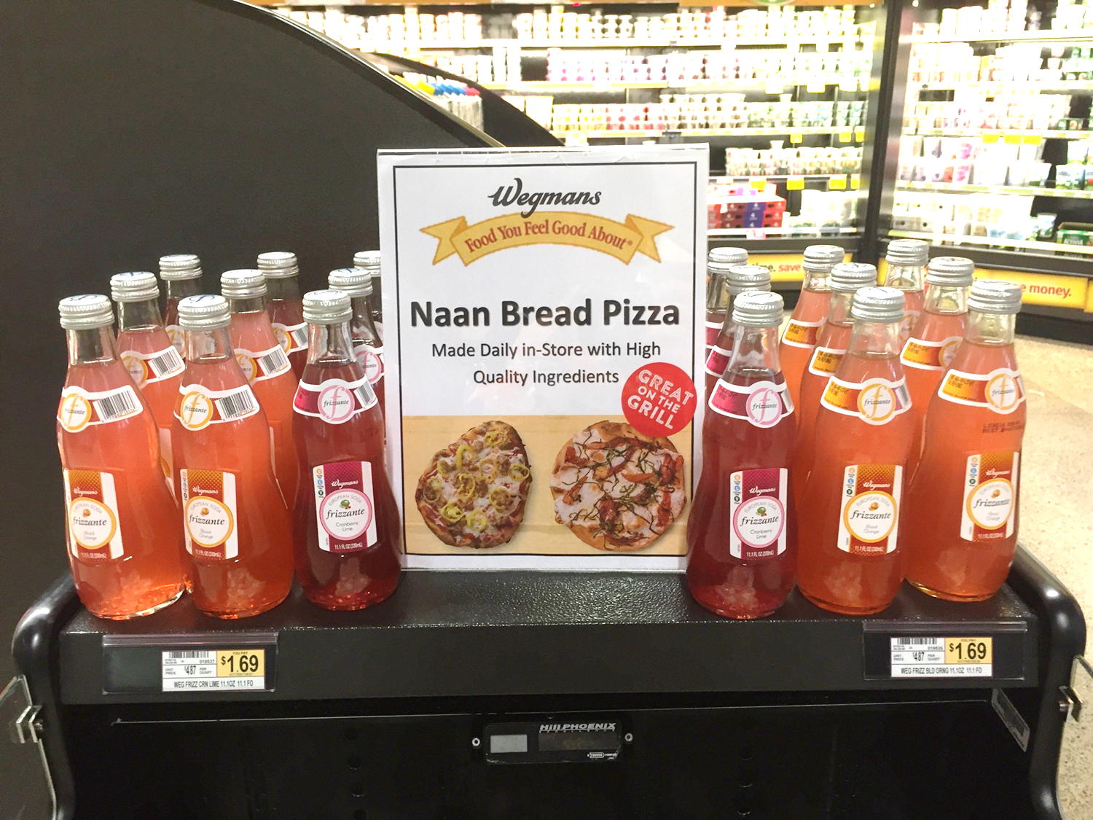
Displays (cont.)
SureCheck
Cross Merchandising
Proper Pricing
Product Attributes Signage
Notes:
As many of you know, SureCheck is a system we use to check product and ensure it is safe for customers to buy and consume.
Since this product is kept cold, the new case had to be added into the system for the pizza team to temp every four hours.
This ensures we are providing our customers with the high quality products we promise to bring to them.
In addition, a way to create a great display is by cross merchandising another product that would complement the product being displayed.
This soda is sold at $1.69 per bottle; therefore, the proper pricing had to be displayed for the customer. Since the pizzas vary in price, the price of each pizza is displayed on the package of the product.
This sign was made to provide a description of the product to intrigue customers into buying it.

Slide 9
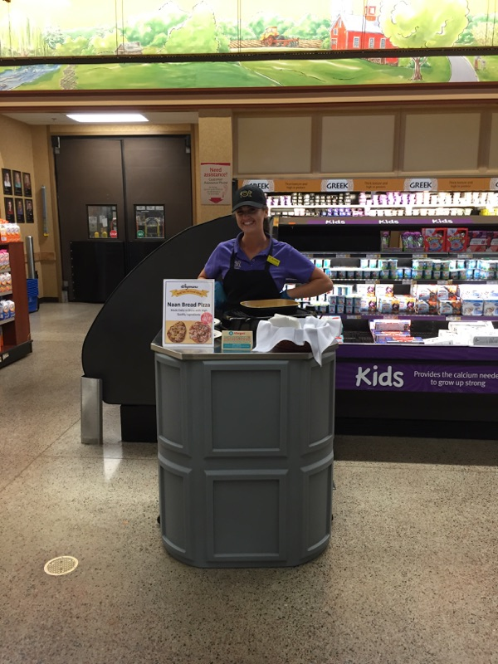
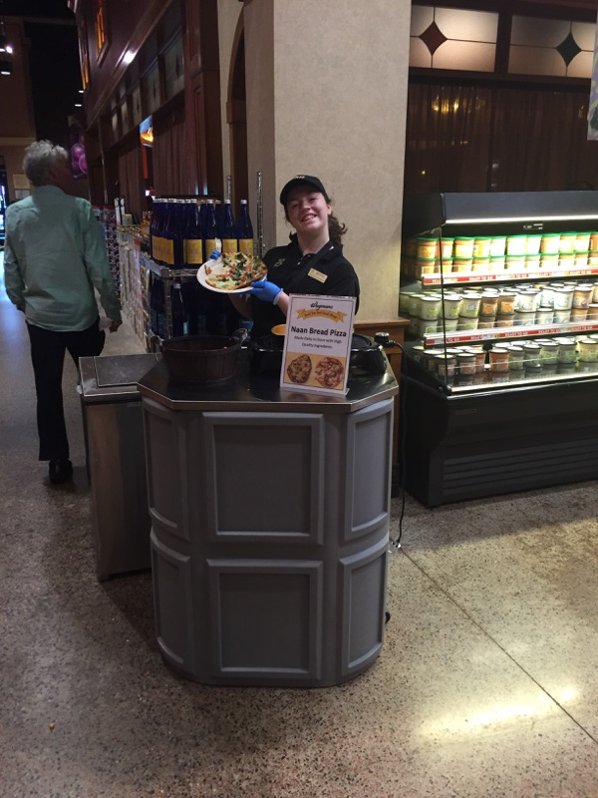
KBS DEMO
Notes:
We demoed in two different places throughout the month.
Maria on the left was by the Pizza Department.
Alaina on the right was in the Dairy Department.

Slide 10
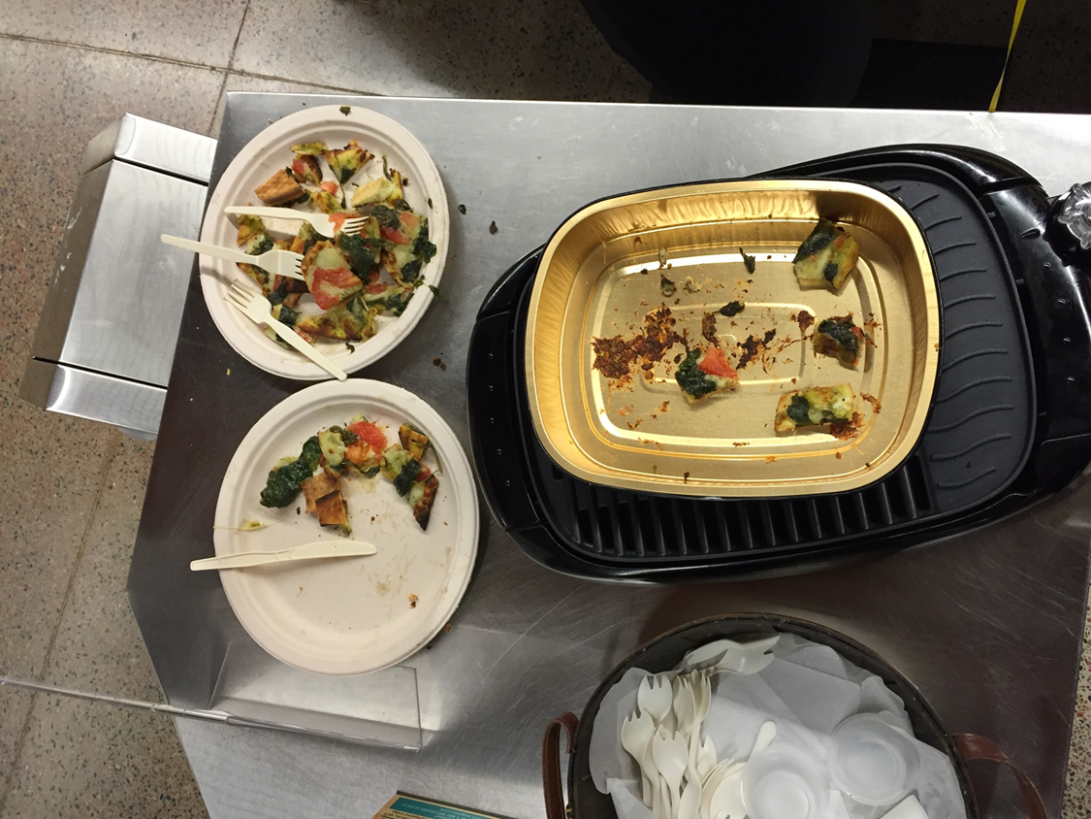
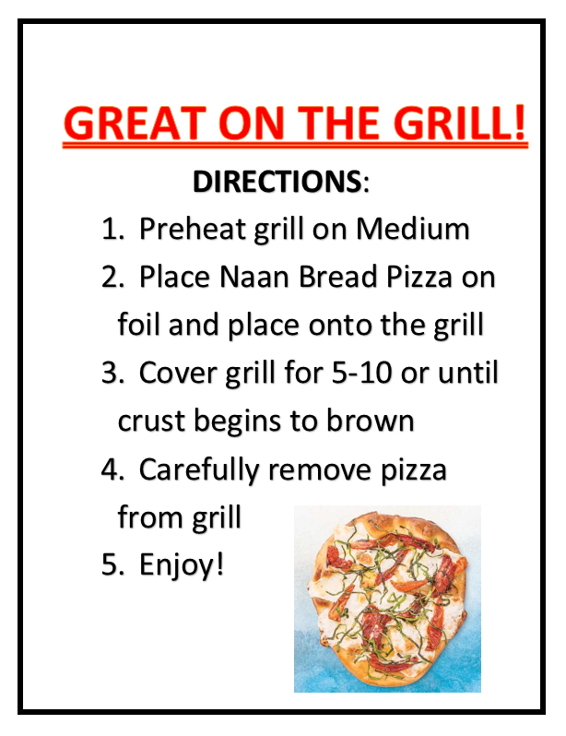
GRILLING TECHNIQUE
Notes:
Part of the KBS Demo was coaching customers on the grilling technique.
Directions: given to KBS employee as a reference and to share with the customers.
To prepare the pizza for the demos we would just use the ovens; however, the grill was used during the demo to keep the pizza warm.

Slide 11
SALES/RESULTS
Notes:
This is an overall review of how the sales went throughout the month.
The weeks in red did not reach the goal of $1,000 and the weeks in green did reach the goal.
The difference between the weeks ending in red and green was the place where the KBS Demo took place.
The week ending June 14th, there was demo at all.
The week ending June 25th, the demo began by the Pizza Department.
The weekend July 9th, all the KBS demos took place in the Dairy Department and as you can see the goal of $1,000 was met.

Slide 12
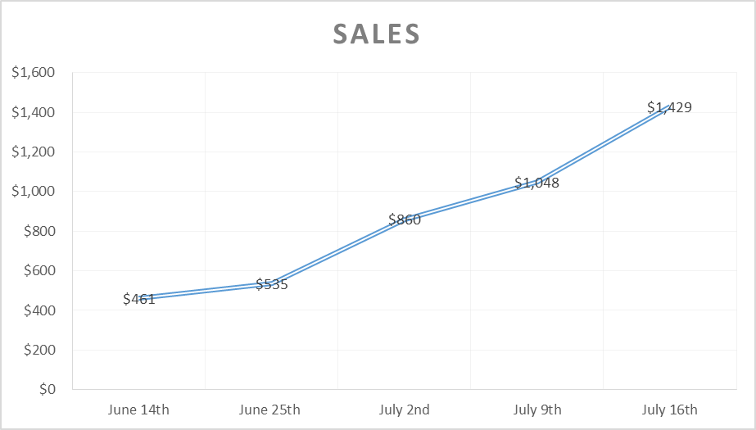
Notes:
Week ending sales

Slide 13
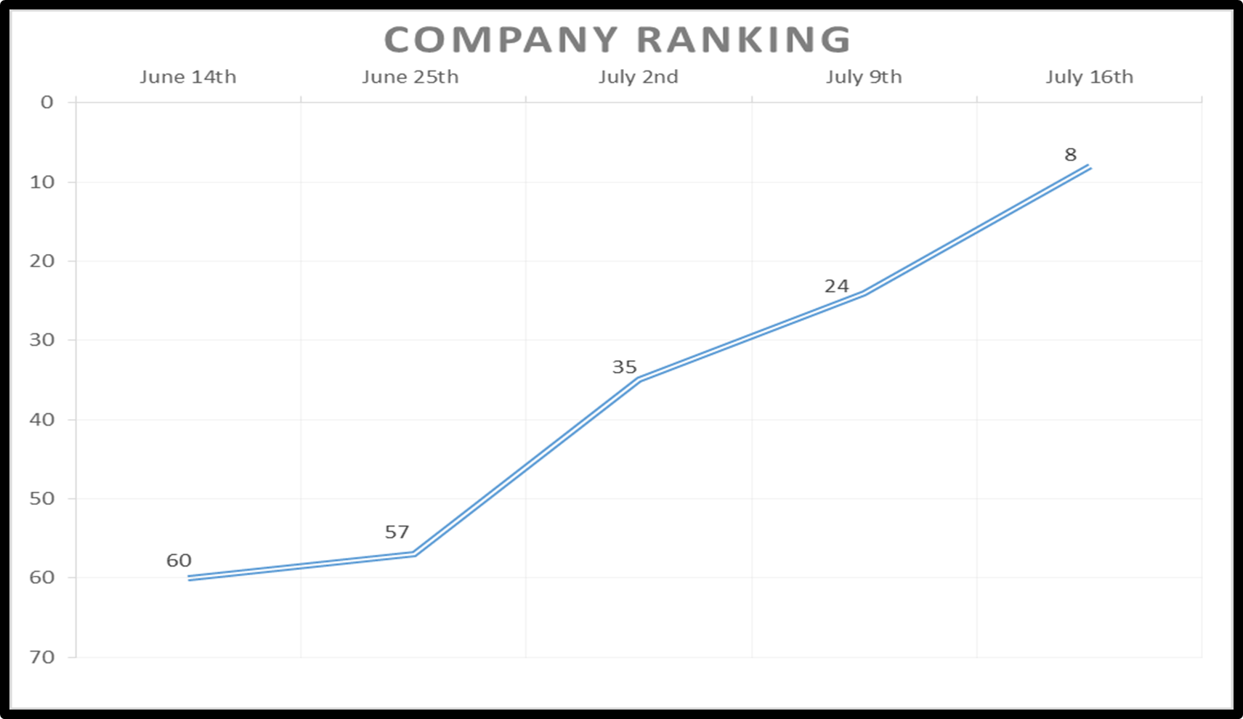
Notes:
Week ending division

Slide 14
Financial impact
Sales: Increase by $450/wk
Gross Profit: up 56.88% or $1,027
Average Labor: average labor 40.63% as a percent of sales
Contribution: about $600/wk
Notes:
The demoing had a huge financial impact.
We increased naan sales from an average of $550 a week to $1000 a week by July 23rd
The gross profit for Naan Bread Pizza is up 56.88% from last year or $1,027. This means compared to this time last year we are making $1,000 per month more on the Naan Pizzas.
Labor: The labor for preparing the pizzas accounts for about 41% of sales.
So all together, Naan Bread Pizza accounts for about $600 per week of the Pizza Department’s Contribution compared to last year’s when it only accounted for about $250 per week of the Contribution.

Slide 15
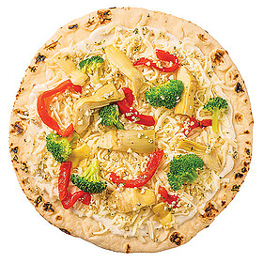
Thank you…
Mike Wolf
Brooke Flannery
Jackie DeCloe
Pizza Team
KBS Team

