Slide 1



Daniel Vessal • Courtney Wise • Jess Cracchiolo • Brett Leftwich • Melissa Aguilar-Ramirez

Slide 2

Pet Owner Challenges
My pet is sick!
What do I do!?
Where can I get my pet
groomed?
I need a sitter for my dog!
Notes:
This (and next slide) need to be more “defined”, but we do this while talking in the actual presentation

Slide 3

Pet Business Owner Challenges
How can we be more marketable?
How do we get more business?
How can I better serve my customers?
Notes:
Pet Business Owner Challenges

Slide 4
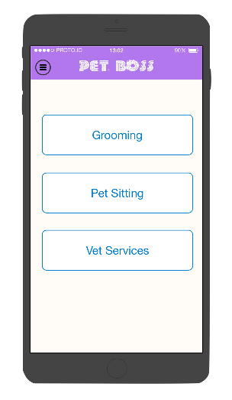
Solution
All-in-one Pet Service Platform
On-demand appointments
Refined searches

Slide 5
Prototype

Slide 6





Competitive Advantage & Market
Market:
Pet Services & Classifieds/Referrals
Clients:
Pet Owners & Business Owners (of Pet Services)
Notes:
YELP: AT LEAST 88% of Yelp is non-pet related (http://localvox.com/blog/5-fascinating-yelp-facts/) rest, shopping, home services
GOOGLE: too broad, not specialized, search engine ranks based on Google+ reviews and payments/ads (corrupted)
CARE.COM: NO vet services (they DO have grooming and sitting, though), NO established businesses..only works with registered users; pet services make up ONLY 25% of all services → child/senior care is prioritized & more profitable (can’t find statistics)
YELLOWBOOK: about 70% of Americans “rarely or never use the phonebook” (http://readwrite.com/2011/01/20/study-confirms-death-of-phone-books)
BOOKER: 1.95/5 total rating on Google Play, terrible UI, not specific enough, can’t use to search listings
SOCIAL MEDIA: not all businesses have facebook/other accounts..hard to filter through search results
social media?
PET BOSS WILL FOCUS ON NICHE MARKET
pet niche, convenience of choice of service (icons), guaranteed ratings/community (can only rate if paid through app)

Slide 7




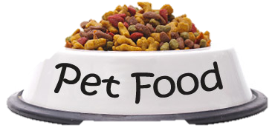

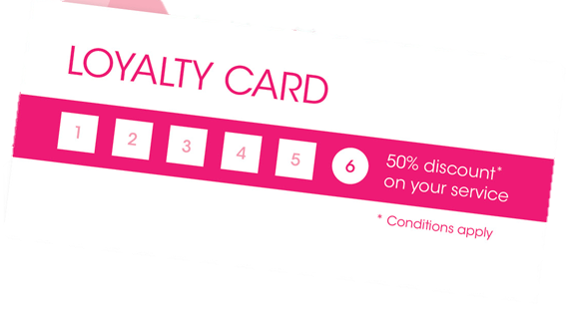


Go-To-Market Strategy
VERMONT - 55
Year 3:
Increased Value
NEW YORK
WEST VIRGINIA – 30
Year 2:
Retention
Year 1:
Promotion
PHILADELPHIA - 10
Notes:
Promotion: heavy marketing expenses, have existing businesses advertise to customers WHO HAVE NO REASON NOT TO USE THE APP BC OF NO COST AND HIGHER VISIBILITY (for long run benefit; spreading word of mouth..think Uber example [REFER A FRIEND]..booking through app, rating afterwards..becomes its own community with trust), FB ad campaigns, Groupon/Amazon Local, have people go around to existing businesses
DOG SHOWS/EVENTS? Mom and pop shop mutually beneficial referrals (coupon feature)
Early Adopters: New pet owners (referrals from adoption agencies), tech savvy people
Retention: Instagram hashtags (hope to trend) , customer loyalty, superior service, businesses liaison, value/convenience (searching by time)
Increased Value: new services (ex. pet supplies), more customers for businesses adds validity for future businesses,
TALK ABOUT NUMBER OF COMPLETED TRANSACTIONS PER YEAR
CUSTOMERS, MARKETING, OPERATIONS

Slide 8
Financials
*In Thousands | Year 1 | Year 2 | Year 3
Gross Income | 74 | 446 | 1,226
Expenses
Sales, Marketing, Advertising | 17 | 25 | 39
Salaries & Taxes | 163 | 367 | 699
Hosting, App Dev., Maintenance | 12 | 3 | 7
Rent & Traveling | 48 | 51 | 63
Total Expenses | 240 | 446 | 807
Net Income | -166 | -0.3 | 419
TOTAL # OF COMPLETED TRANSACTIONS:
YEAR 1: 8,000
YEAR 2: 23,000
YEAR 3: 41,000
Notes:
672 , 2016, 3696
, 13737, 25184.5
, 6804, 12474
7519, 22557, 41355

Slide 9
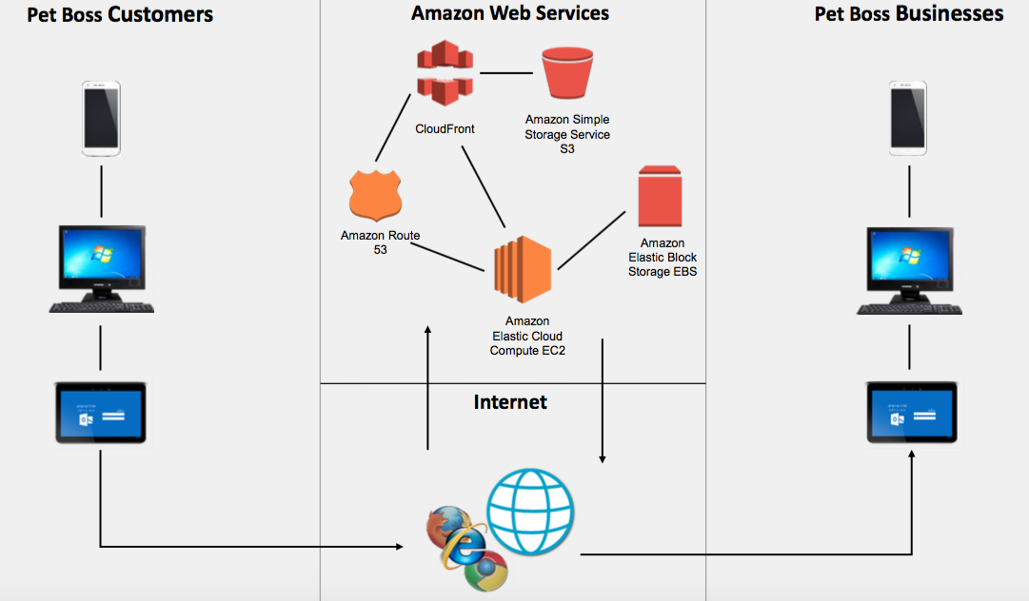
System Architecture

Slide 10
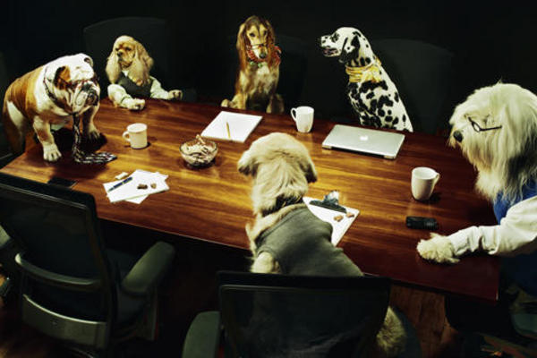
Be Your Own Boss.
Pet Boss.

