Slide 1
Owl Explore
Shihao Fei, Nicholas Gormley, Thomas Murphy, Ryan Tempestini

Slide 2
Status Update
Drafting prototype
Created a map in Google Map
Built a couple of filters
Process model
System Architecture Diagram
Project Site

Slide 3
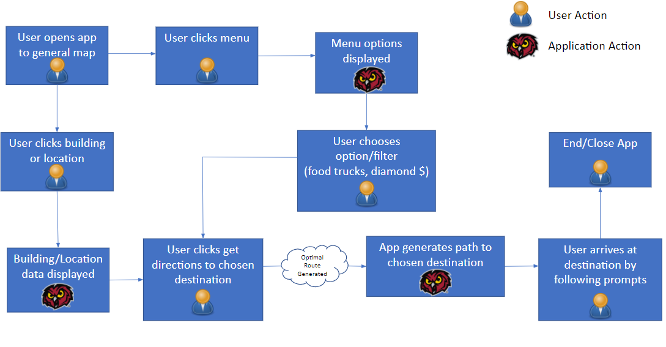
Process Model

Slide 4
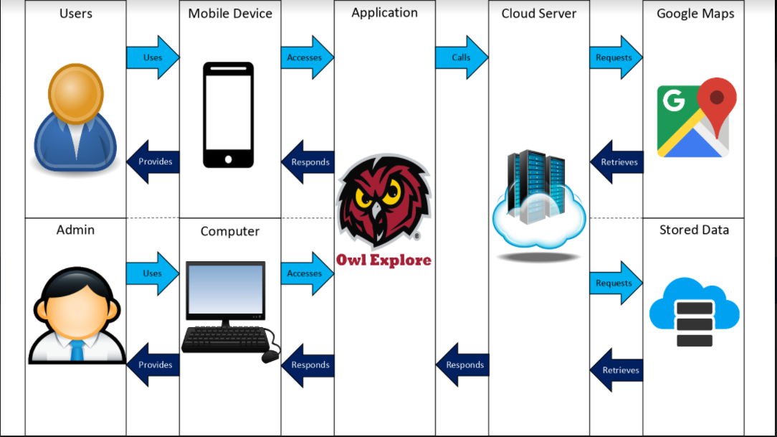
System Architecture

Slide 5
Prototype

Slide 6
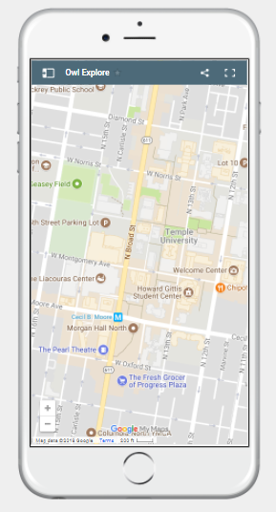
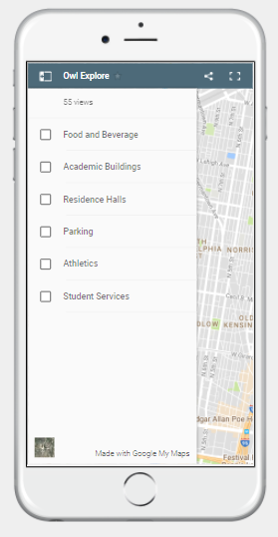
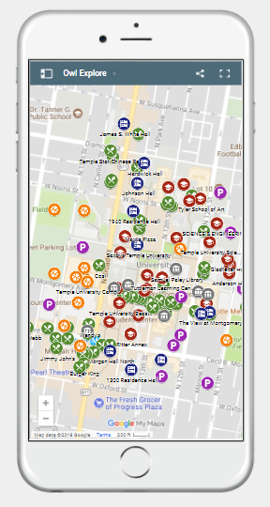

Slide 7
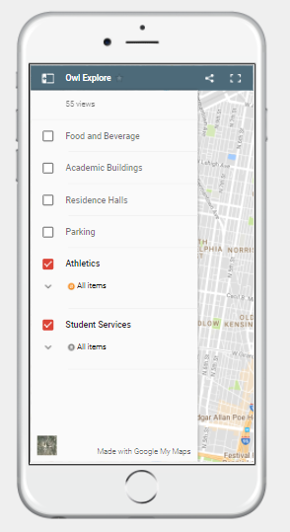
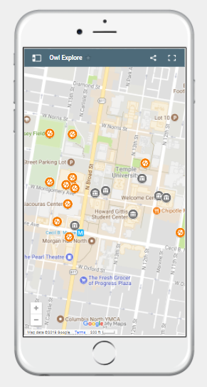
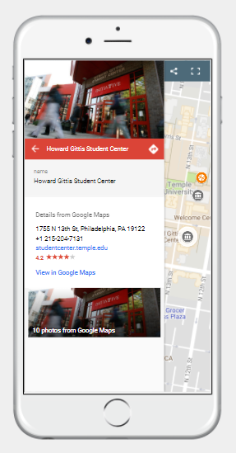

Slide 8
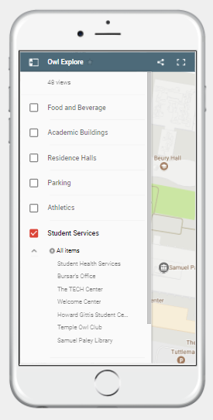
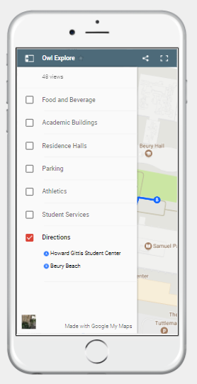
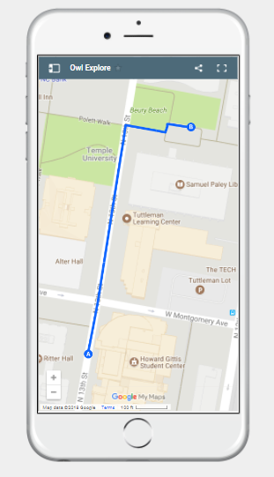

Slide 9
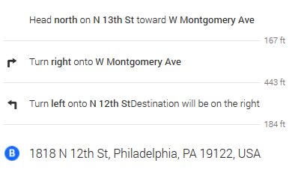
What we’re Working on
Step By Step Directions
Diamond Dollar Filter
Building Layout
More Details about each location

