Slide 1
Owl Explore
Shihao Fei, Nicholas Gormley, Thomas Murphy, Ryan Tempestini

Slide 2
Why?
Temple Computer Services initiative
Existing resources outdated
Expanding student body
Constantly evolving campus
Notes:
Ryan
Give background on his job with Computer Services and the department’s recent proposal
Experience with students at beginning of semesters asking for directions
Talk about how new students, transfer students, and international students have trouble finding buildings
Increasing number of students
Talk about how the current maps Temple offers (website and application) are outdated and not very useful
Leads to next slide

Slide 3
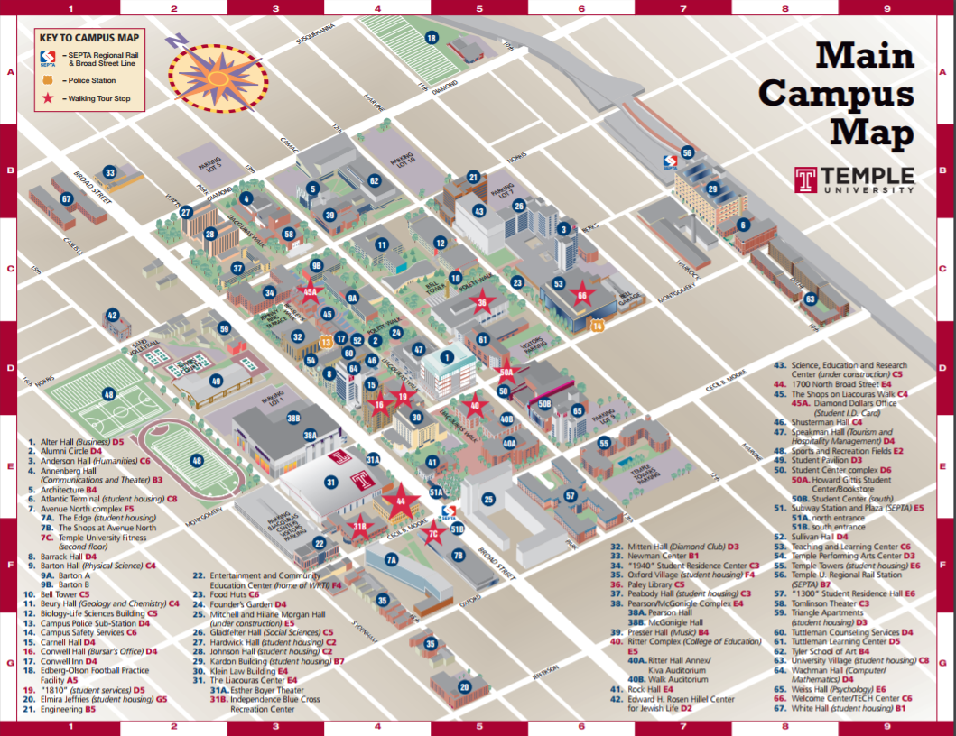
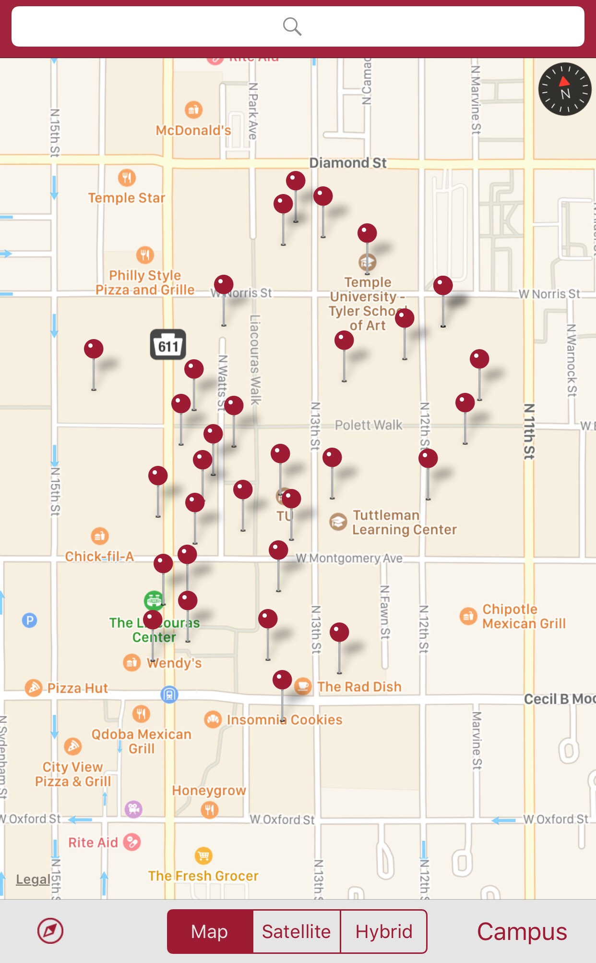
Existing Resources
Temple website
TUMobile app
Notes:
Ryan
Temple website PDF is not very useful
Not interactive, doesn’t give information
Map in TUMobile is basically just Google Maps

Slide 4
What?
Easy to use, interactive map
“You are here”
Navigation tool
Information on campus, surroundings
Web platform or potential mobile app
Notes:
Interactive map
Information on all campus buildings
Transportation info
Filterable locations (academic, administration, recreation, etc.)
Diamond dollar locations

Slide 5
Team Roles
Project Manager: Ryan Tempestini
Business Analyst: Shihao Fei
Developer: Nicholas Gormley
Utility: Thomas Murphy
Notes:
*Not set in stone
Ryan and Shihao will be more concerned with documentation
Nick and Tom will be more concerned with developing prototype
Team members will be collaborating throughout project and overseeing each activity

