Slide 1
Owl Explore
Shihao Fei, Nicholas Gormley, Thomas Murphy, Ryan Tempestini

Slide 2
Status Update
Completed prototype
Completed map
Completed Prototype recording
Updated Business Case
Updated charter
Project Site
Met with mentor

Slide 3
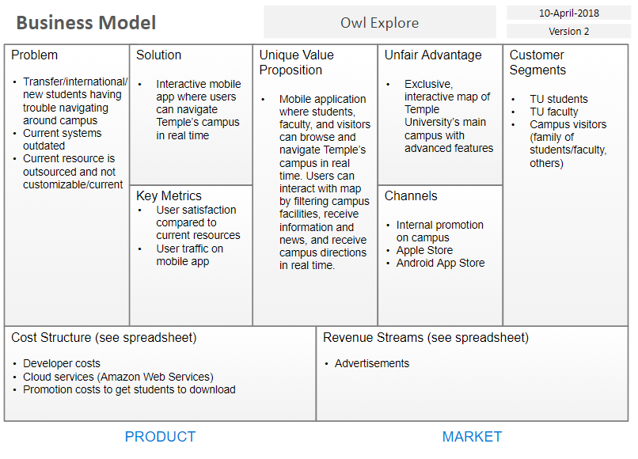
Business Model

Slide 4
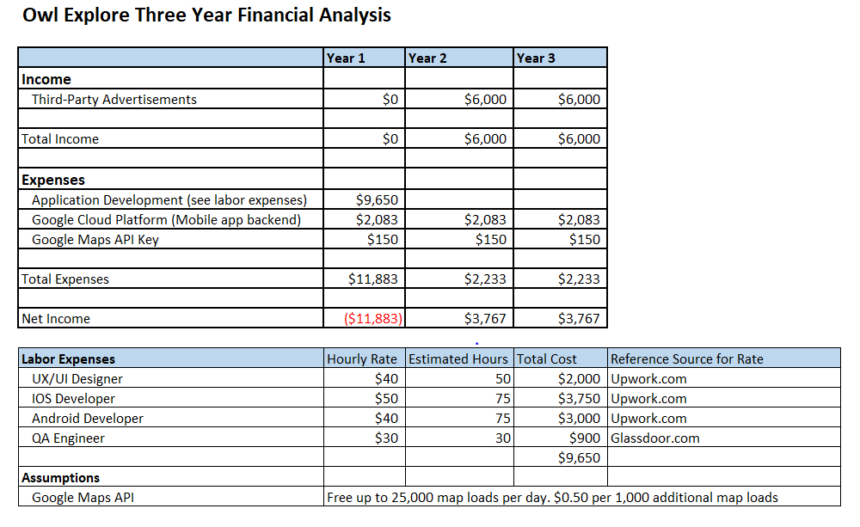
Financials

Slide 5
Prototype

Slide 6
