Slide 1
Owl Insider
Anthony Mignona, Rebecca Robinson, Nina Sjostrom, Lauren Soentgen

Slide 2
Project Charter Updates
Important Changes
Geolocation for Events
No Campus Map
Increased Ability to Find Other Students
Focused on Helping Students
Upcoming Project Items
Detailed Business Case
First Draft of Financial Analysis
Second Draft of Prototype

Slide 3
Business Case
Executive Summary
First introductions to “Owl Insider”
Finance
Detailed in our “Financial Analysis” Spreadsheet
Project Definition
All project information from Background Information to Purchasing Strategy
Project Organization
Includes Project Governance and Progress Reporting
Our Business Case goes into great detail for all of the subsections within these four larger sections.
Notes:
Click on Temple “T” to redirect to the actual Business Case for more information. It will appear as a download and you can open the file in Excel.

Slide 4
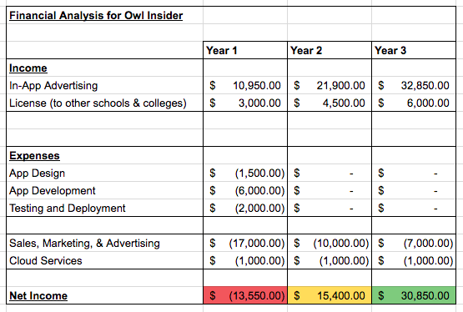
Financial Analysis
This is our working budget for Owl Insider.
We are still considering whether we want to incorporate “In-App Advertising.”
We also may consider outsourcing our App Development.

Slide 5
Prototype

