Slide 1
Owl Insider
Anthony Mignona, Rebecca Robinson, Nina Sjostrom, & Lauren Soentgen

Slide 2
Problem
Temple’s 4-Year Graduation Rate 45%
Nationwide 4-Year Graduation Rate 60%
A sample of 2000 non-completers from Temple, 1300 transferred.
How can Temple University be more successful for its students?

Slide 3
Student Survey Results
Randomly Sampled Student Body Survey
Increased social connectivity : 95%
Better access to academic resources: 98%
Better awareness of campus activities: 93%
How can Owl Insider help?

Slide 4
Solution
Temple needs to connect students with what will set them up for success.
We believe Owl Insider is the Temple’s future.
Owl Insider is the premier smartphone application for all Temple Students!

Slide 5
Prototype
Show app.

Slide 6
Prototype
Show app.

Slide 7
Prototype
Show app.

Slide 8
Prototype
Show app.

Slide 9
Competitive Analysis
App Capabilities | Suitable | Owl Connect | TU Mobile | Owl Insider
Easy to Use Phone Application | ✓ | ✖ | ✓ | ✓
Find/Create Student Events (ex: study group) | ✖ | ✖ | ✖ | ✓
Tailored Individuality | ✖ | ✖ | ✖ | ✓
Student Network Connection | ✖ | ✖ | ✖ | ✓

Slide 10
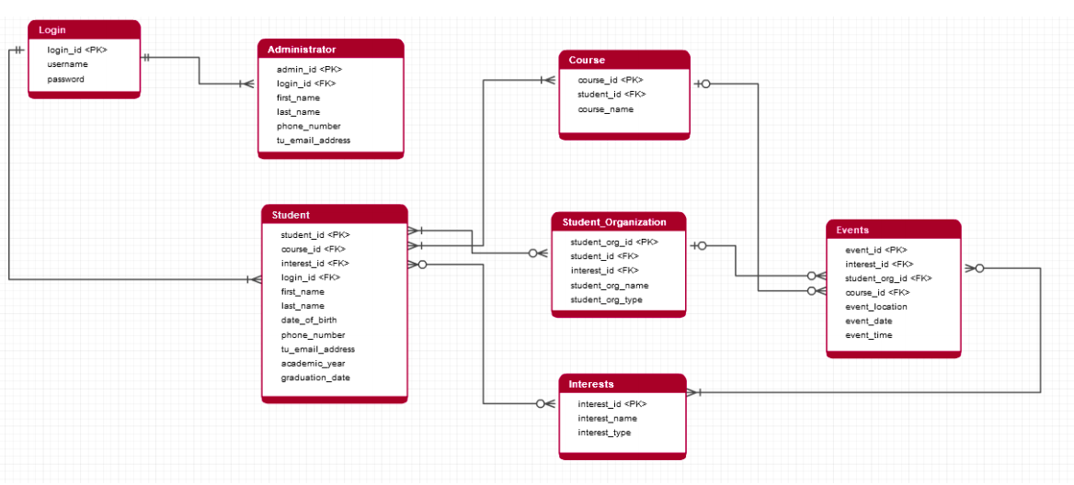
Data Model

Slide 11
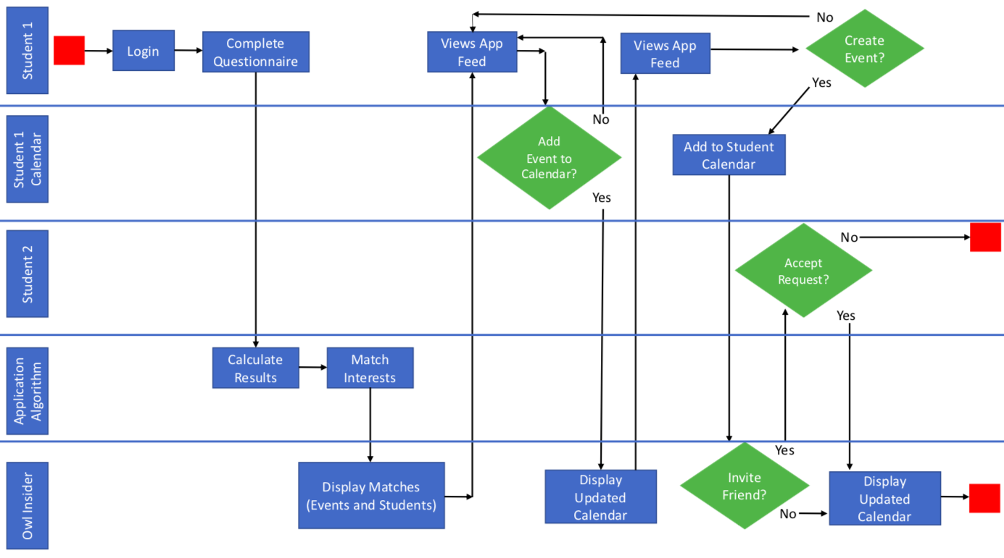
Process Model

Slide 12
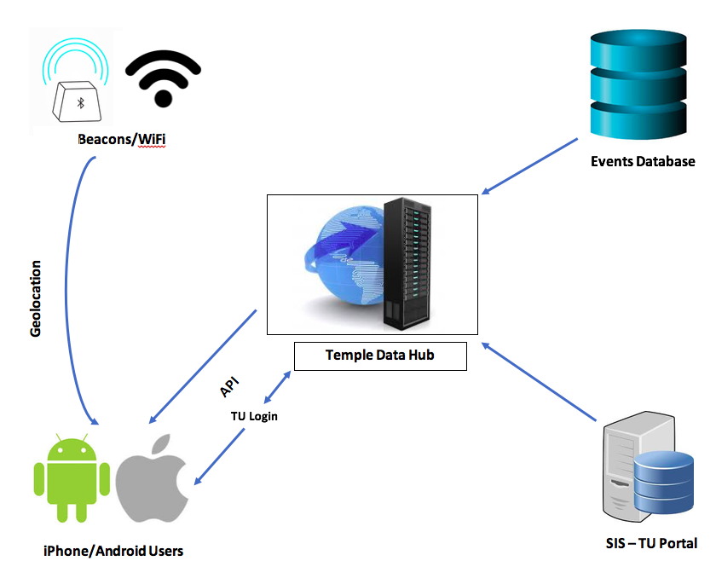
Systems Architecture
The beauty of Owl Insider is that it will be hosted throughout Temple’s Network.
The application setup will be cost efficient and easily introduced for Temple University.
Our key technology will be the beacons across campus that are geolocating anyone who walks into any building.

Slide 13
Financial Analysis
 | Semester 1 Hours | Semester 2 Hours | Semester 3 Hours
Planning and Design (16 week semester at 3.5 hours a week) | 56 | - | -
Building Owl Insider (16 week semester at 3.5 hours a week) | - | 56 | -
Implementation and Beta Testing of Owl Insider (16 week semester at 7 hours a week) | - | - | 112
Owl Insider would be free of charge for Temple University.
CIS Majors at Temple would use their CIS3296 and CIS4398/4397 capstone to plan, design, and create Owl Insider.
By hosting on Temple’s Network, there would be no outsourcing costs to make the application go live.
Because there are no costs, we will be tracking how many hours it will take to bring Owl Insider to life. Our team will include: Temple Computer Services, the CIS majors taking on our project for their class, and incoming students who will be beta testing our application.

Slide 14
Implementation Plan
Project Duration: three, 16-week semesters
Semesters One: Temple CIS majors use capstone class part 1 to research and plan what Owl Insider is going to look like.
Semester Two: Temple CIS majors use capstone class part 2 to create the working version of Owl Insider.
Semester Three: Temple Computer Services will implement a beta version of Owl Insider onto the Temple Network. A sample of incoming students will be using Owl Insider. We will track their success.
Key technology: Geolocation from Temple’s beacons located next to every building on campus.

Slide 15
Thank you. Questions?

