Slide 1
Owl Insider
Anthony Mignona, Rebecca Robinson, Nina Sjostrom, & Lauren Soentgen

Slide 2
Problem
Temple’s 4-Year Graduation Rate 45%
Nationwide 4-Year Graduation Rate 60%
A sample of 2000 non-completers from Temple, 1300 transferred.
How can Temple University be more successful for its students?
Notes:
Temple currently has a problem with retaining and graduating students. Temple’s 4 year graduation rate is only 45 percent which is 15 percent lower than the national average. We found that out of a sample of 2000 non-completers, 1300 of them transferred to different schools. Some of the reasons why Temple is having this problem is because of the diverse students that come to and attend Temple. Temple has a large number of commuter, non-traditional, and at risk students. All of these students have a harder time navigating through campus and fully acclimating to such a large school.

Slide 3
Student Survey Results
Randomly Sampled Student Body Survey
Increased social connectivity
Better access to academic resources
Better awareness of campus activities
How can Owl Insider help?
Notes:
We polled students in various schools and programs at Temple, and found that students want three things:
The first is better social connectivity so being able to meet and connect with peers in their classes and finding people to attend campus events with
The second is having better access to academic resources, being a public university with differing funding, Temple is not always able to contuing offering different academic support services, and also as students get to more advanced upper division courses, it’s harder for Temple as a university to offer support services, so giving students the ability to create these opportunities would better help students succeed and this goes back to better connecting students with each other to set these events up
And lastly they wanted a better awareness of campus activities to better connect with Temple as a whole

Slide 4
Solution
Temple needs to connect students with what will set them up for success.
We believe Owl Insider is the Temple’s future.
Owl Insider is the premier smartphone application for all Temple Students!
Notes:
SO we created a solution to these problems to better connect students with each other and for success, we truly believe that owl insider would help Temple achieve its future missions as a public university to better help diverse students
Owl insider will be the premier smartphone application for Temple students

Slide 11
Competitive Analysis
App Capabilities | Suitable | Owl Connect | TU Mobile | Owl Insider
Easy to Use Phone Application | ✓ | ✖ | ✓ | ✓
Find/Create Student Events (ex: study group) | ✖ | ✖ | ✖ | ✓
Tailored Individuality | ✖ | ✖ | ✖ | ✓
Student Network Connection | ✖ | ✖ | ✖ | ✓

Slide 12
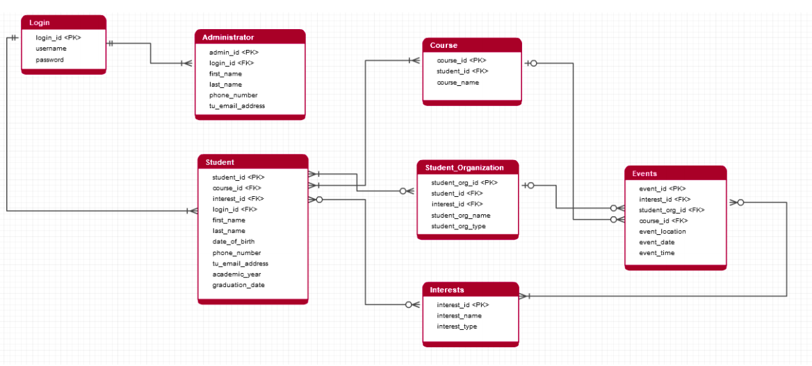
Data Model

Slide 13
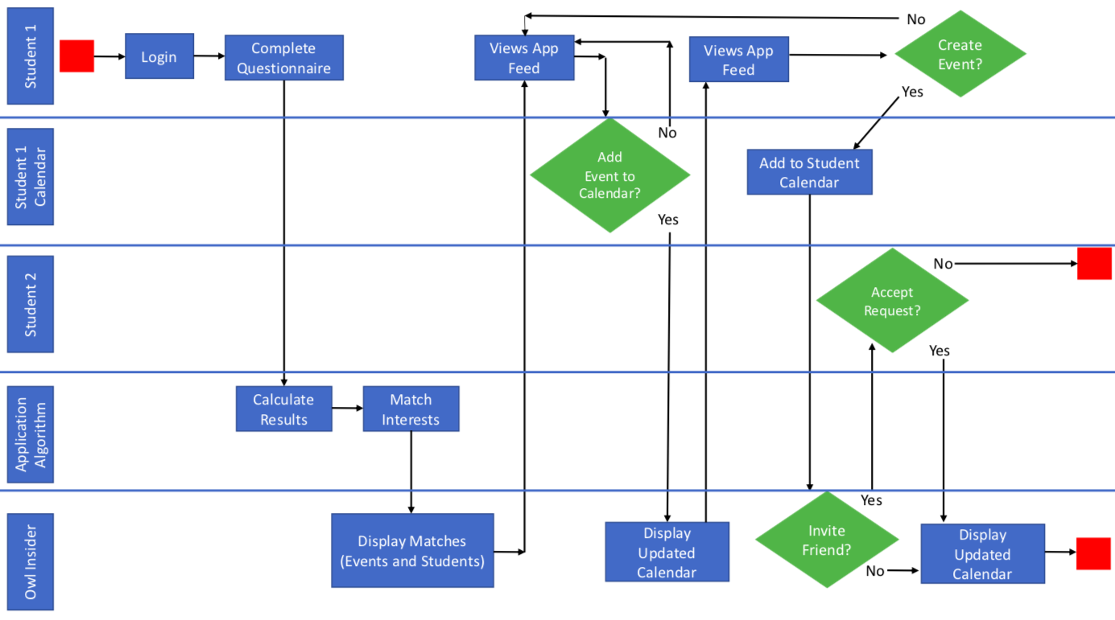
Process Model

Slide 14
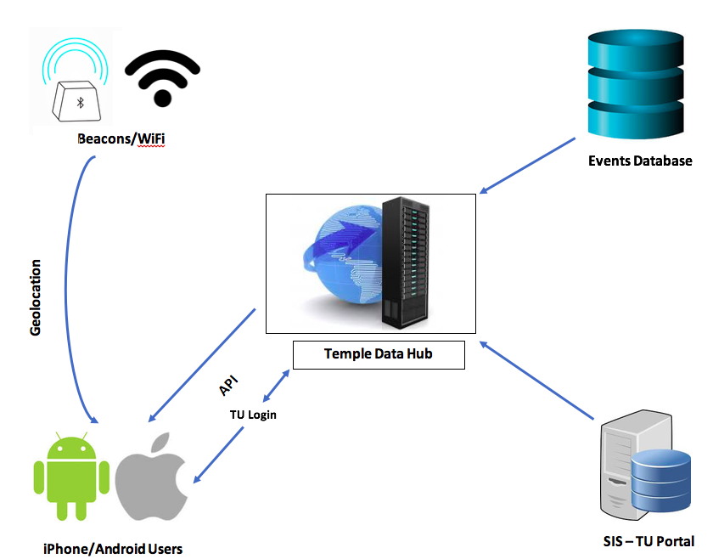
Systems Architecture
The beauty of Owl Insider is that it will be hosted throughout Temple’s Network.
The application setup will be cost efficient and easily introduced for Temple University.
Our key technology will be the beacons across campus that are geolocating anyone who walks into any building.
Notes:
As you can see, this is our systems architecture. We had the privilege to interview the CIO of Temple, Cindy Leavitt. She was very impressed with our idea. She even went as far to say she loved our idea and offered to host our application through the Temple network.
This systems architecture is Temple’s network. All data throughout Temple is sent through the Temple Data Hub, so when a student is logging into TU portal, there will be API’s sent back a forth through the data hub to verify the student is an active student. By having access to the data hub, we also have access to temple’s events database. Located by every building location on campus there are these objects called beacons. Beacons track movement every individuals movements in and out of each particular building. This will be the key technology to our geolocation.

Slide 15
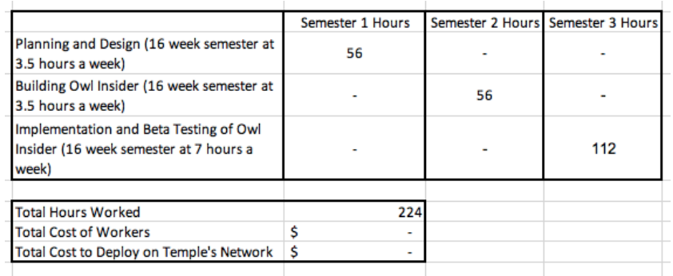
Financial Analysis
Owl Insider would be free of charge for Temple University.
CIS Majors at Temple would use their CIS3296 and CIS4398/4397 capstone to plan, design, and create Owl Insider.
By hosting on Temple’s Network, there would be no outsourcing costs to make the application go live.
To create Owl Insider, our team will include: Temple Computer Services, the CIS majors developing Owl Insider, and incoming students who will be beta testing our application.
In-house Cost
Outsourced Cost
Notes:
Another great help from Cindy Leavitt was that we would not have to outsource any labor to create our application. CIS majors have a two semester long capstone in which they plan, design, and create a working application. We will be able to give them our information for Owl Insider and they will be able to bring it to life. Because we will be hosting on temple’s network and CIS majors are making the application, Owl Insider will be free of charge for Temple University. With that being said, we tracked how many hours we estimate it will take to make Owl Insider a working app.
We also created a hypothetical cost breakdown if we had outsourced the labor to make Owl Insider. **Discuss the chart**. As you can see, by creating Owl Insider within Temple, we are saving almost $60,000.

Slide 16
Implementation Plan
Project Duration: three, 16-week semesters
Semesters One: Temple CIS majors use capstone class part 1 to research and plan what Owl Insider is going to look like.
Semester Two: Temple CIS majors use capstone class part 2 to create the working version of Owl Insider.
Semester Three: Temple Computer Services will implement a beta version of Owl Insider onto the Temple Network. A sample of incoming students will be using Owl Insider. We will track their success.
Key technology: Geolocation from Temple’s beacons located next to every building on campus.
Notes:
Our implementation plan is as follow. We will need 3, 16-week semesters for the project duration. Semester one will be part one of the CIS capstone class in which they will plan and design how Owl Insider will look and function, based off of our prototype. The second semester will be part two of the CIS capstone class, which is devoted to creating the working application.
Semester three is the most important semester. Here, Temple computer services will implement Owl Insider and we will beta test the application on a sample of the newest incoming students in that semester. We will then track their use of the app and how it is actually helping them be successful. We will gauge the actual use of the application. And as mentioned earlier we want to remind you all that our key technology will be the beacon located on campus that track movement in and out of every building on campus.

Slide 17
Summary
Continuing Temple’s mission statement
Promoting student success
Low cost platform for important results
Student created and student involved
Notes:
We now want to summarize some of our main points. We want to help Temple achieve its mission of “developing its campus of student scholars and providing the best educational opportunities for diverse students.” We believe Owl Insider does just this.
Second, we want to say that Owl Insider is truly promoting student success. We want to guarantee Temple doesn’t lose any students because they felt overwhelmed by a large university.
Next, we want to remind you all that because Owl Insider is being created solely within Temple resources, it will be a low cost platform that would hopefully lead to increased graduation rates and student success.
Lastly, Owl Insider is student created and student involved. This means that all students can design their own version of Owl Insider tailored specifically to their college experience. As “non-traditional” students we all feel Owl Insider could be the future of Temple University.

Slide 18
Thank you. Questions?

