Slide 1
parKING
Zack Bambary
Andrew Crerand
Dan Kovacs
Bakari Malik
Tyler Sliney
1

Slide 2
The Dilemma
Notes:
Have you ever been this frustrated while trying to find parking in Philadelphia? We like to think that you probably have.

Slide 3
2,500 HOURS
Notes:
The number of hours wasted looking for parking over the course of your life. Equates to over three months of time.

Slide 4
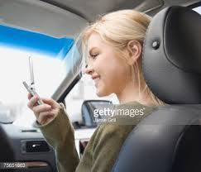
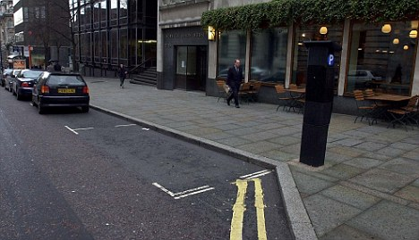
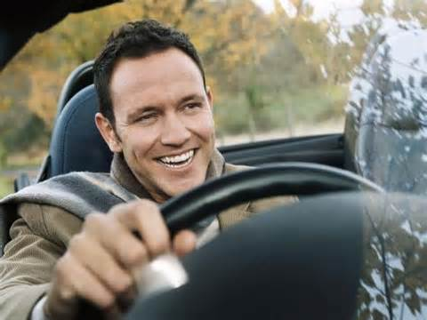
What is it?
Crowd-sourced, mobile application
Phase 1: Improve parking in Philadelphia
Inspired by Waze

Slide 5
Business partnerships
Establish relationships with local businesses
Goal: Help generate more sales
Provide an incentive system for individuals
Notes:
This is a huge piece of our ultimate goal of the application: to forge relationships with businesses. We want to help them generate sales by getting more foot traffic into their business. Additionally, by partnering with businesses, we can have an incentive system for individuals where they can redeem the points they earn for discounts across the city.

Slide 6
Systems Architecture
Cloud Hosted Servers & Storage
App Engine
Google Maps
API
Data Layer
parKING

Slide 7
Data Model
Customer & Business DB
Parking DB
Customer/Business ID
Name
Login info
Points
Offers redeemed
Offers available (biz)
Ads purchased (biz)
Block ID
Name
Spots available
ID of spot reporter
parKING

Slide 8
Three Year Plan
1
Create partnerships with businesses/tourist destinations
Establish the subscription service for businesses
Expand to areas outside of Philadelphia
2
3
Notes:
Besides getting the application out there for the individual user, we have additional plans which are highlighted above. It will take time to forge relationships with businesses and show them the impact of the application, but we believe that it will be met with a positive response. Everything is pretty straightforward. We also have a long-term strategy in place where we want to partner with the parking authority and gain access to the metered parking. This will allow us to utilize the sensors in the meters and increase the reliability of the application even further.

Slide 9
COSTS and revenue
Notes:
Our costs mainly stem from the development of the application. We believe that after the first year, costs will diminish and flatten out until we expand to more cities.
Our revenue is two tiered. The first piece is the subscription service, which we plan on implementing in Year 2. Any business that buys the subscription early will get it free for 6 months. The goal with the subscription service is to give businesses more control over reporting parking in their area. The other portion is the advertising. This allows businesses to promote themselves on the application.

Slide 10
Use Case
“I have been using parKING for months and it saves me time and eliminates frustration. I can finally enjoy driving into the city with my girlfriend!”
Cody, age 23
Notes:
For our use case we created the persona of Cody. He lives in Manayunk and can be considered a young professional. He has a girlfriend who likes to go out in South Philly, but Cody hates to drive since the parking is a nightmare. Thankfully, he has been using parKING for a while now and finally enjoys driving into the city to have dinner with his girlfriend.

Slide 11
QUESTIONS?

