Slide 1
MIS 4596 Capstone Presentation: PESTY
Team Red Fox:
Jack Farrow Gregory Krolikowski Mentor: Niraj Patel
Andy Lin Sean O’Neill
Notes:
Highlight 3 things:
→Business Value
→What Pesty Is
→Why Pesty is Important/Why you Care

Slide 2
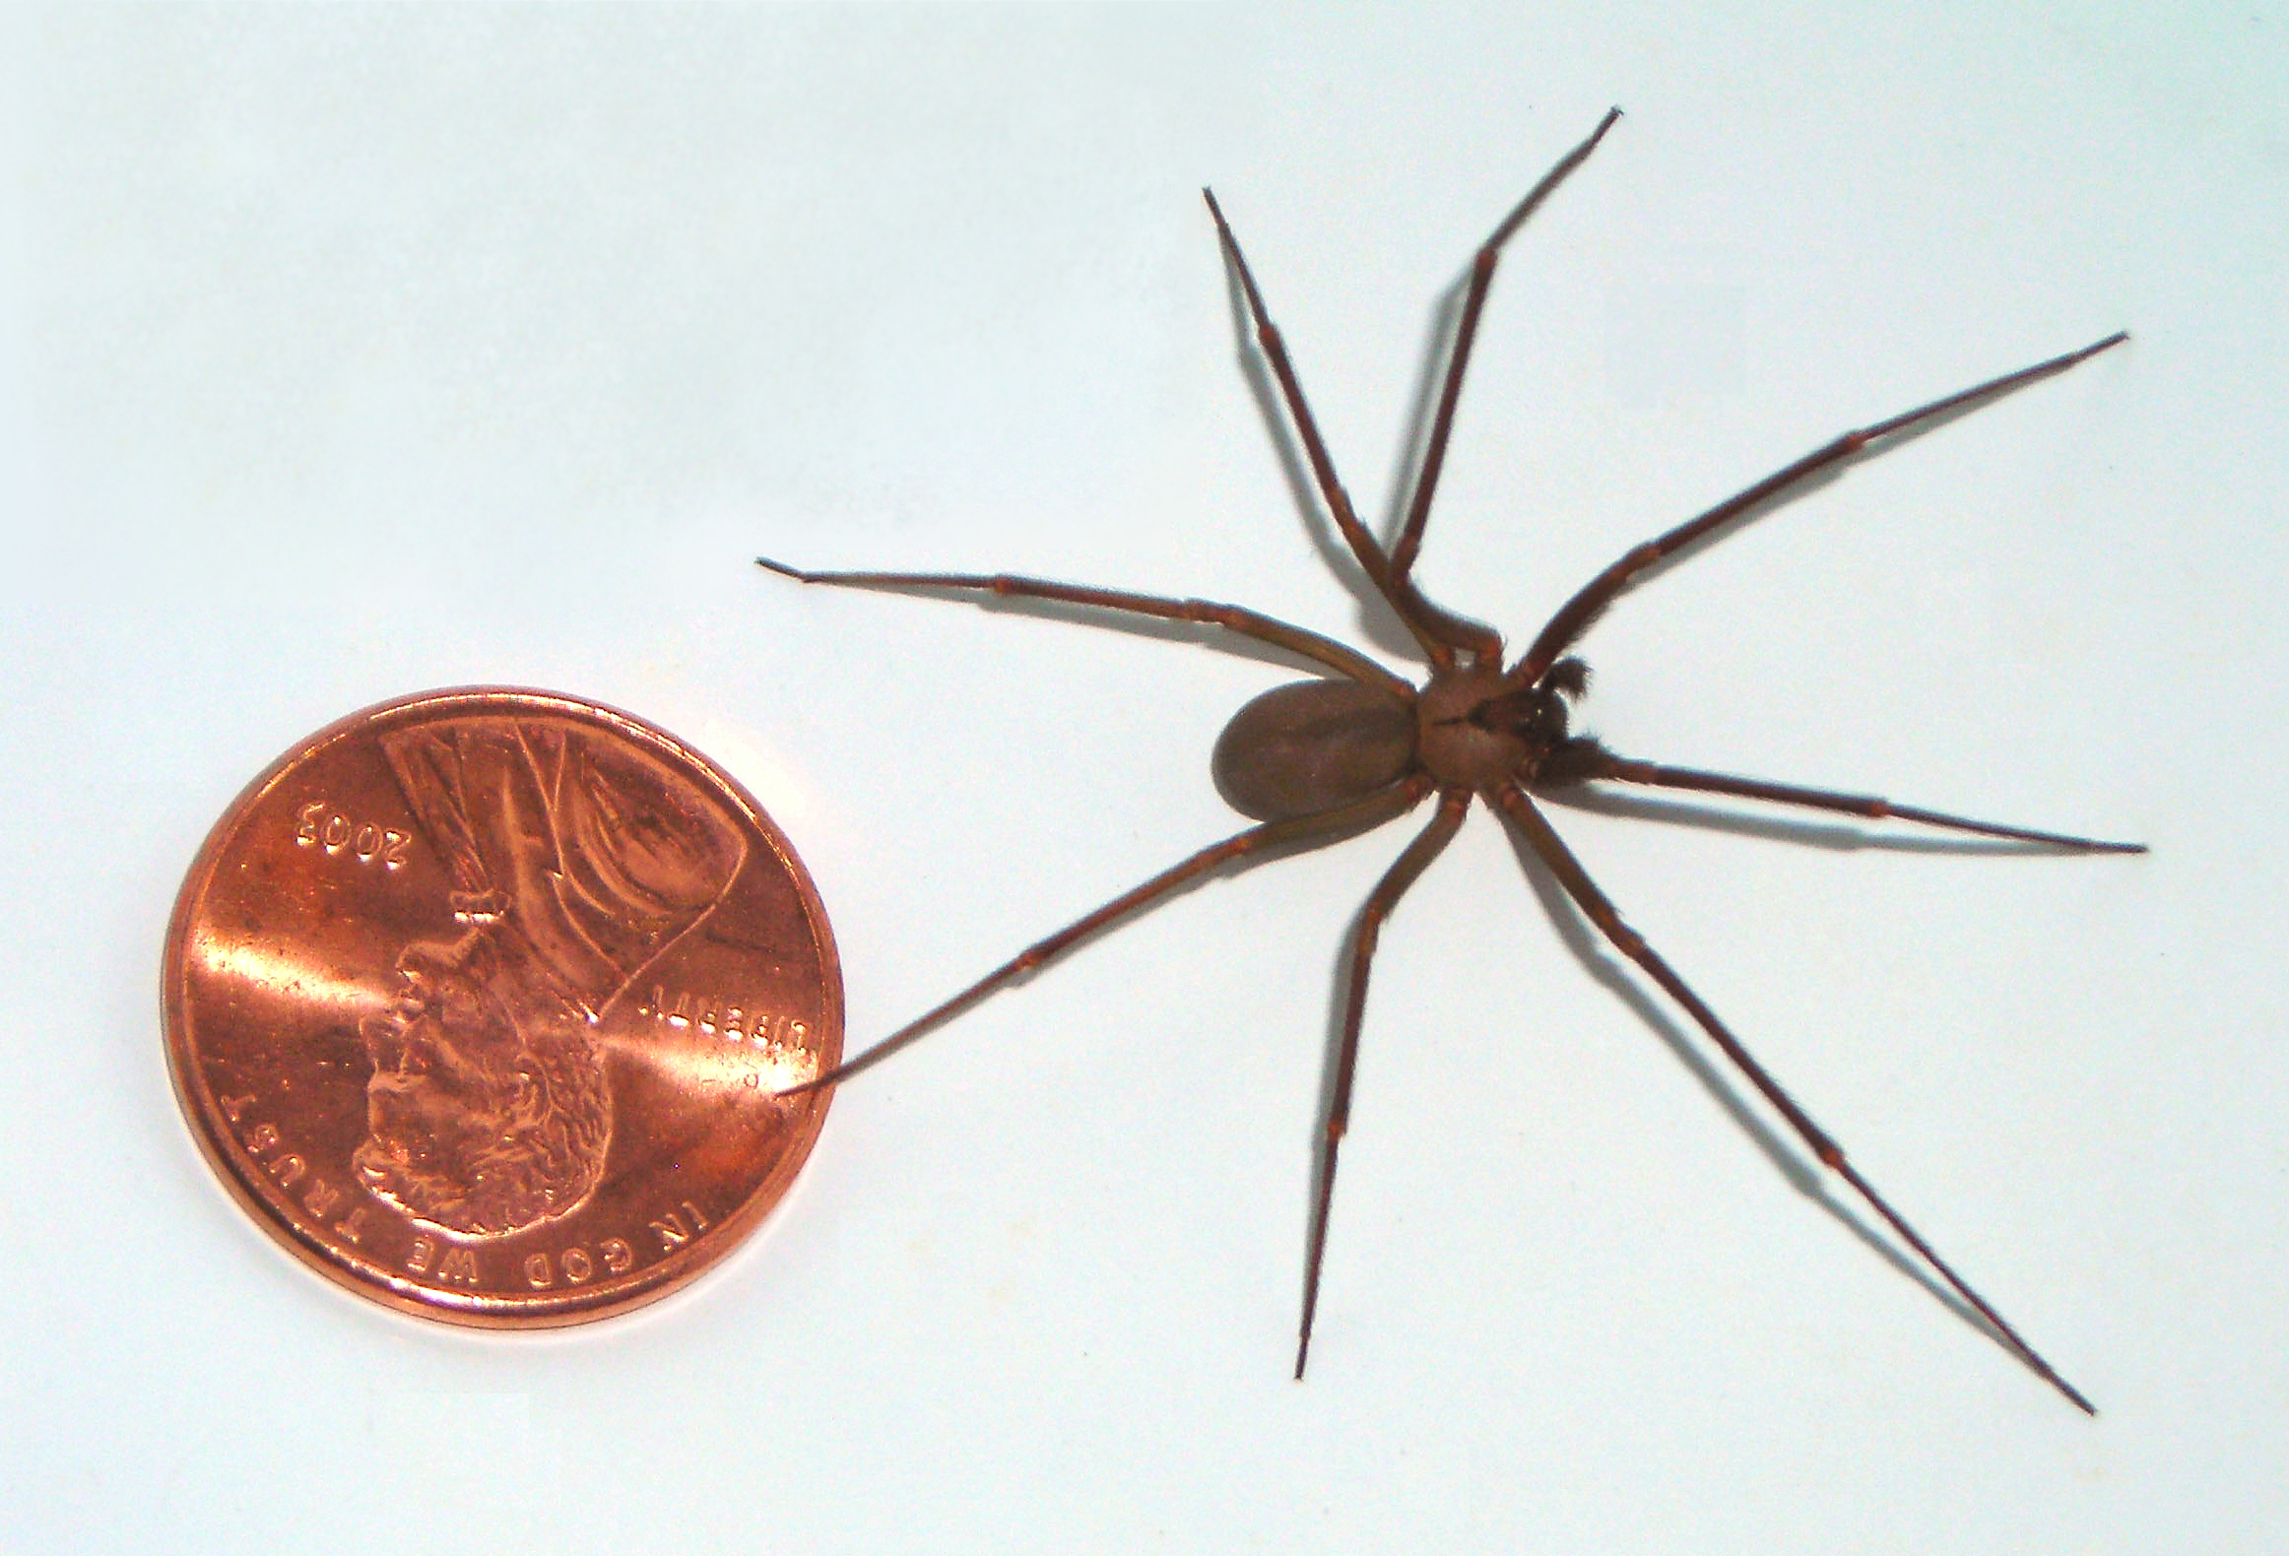
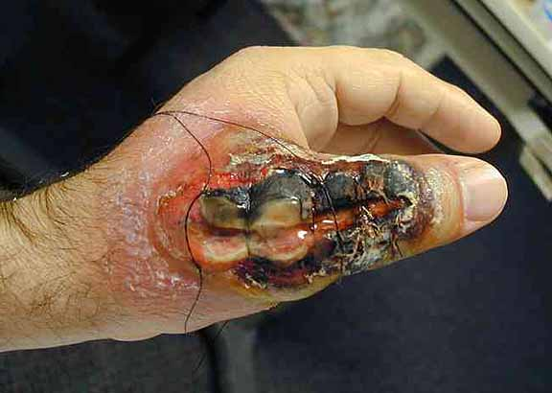
What’s the Problem?
Notes:
Scenario to Illustrate the Business Problem

Slide 3
The Solution: Pesty
Notes:
If you imagine Pesty as a combination of…you have a good idea of the concept.
We’ll go into deeper detail during the demonstration

Slide 4

Why Pesty? Because the Other Guys…
.
Are Too Slow
Don’t Sell to DIY-ers
Have Limited Reach
Are Hard To Find

Slide 5
Pesty Solution Demonstration

Slide 6

Pesty User Persona: Amy Chen
Persona Information
Name: | Amy Chen
Age: | 40
Gender: | F
Occupation: | Stay-at-home mom
Marital status: | Married
Children? | 2 children
City/state of residence: | Alpharetta, GA
Owns/rents: | Owns
Number of years at current residence: | 5
Do-it-yourself skills: | High
"Ick-factor" scale (1 to 10): | 4

Slide 7
Pesty Systems Architecture
Pesty: A THIN-CLIENT, WEB/MOBILE HYBRID Application
PaaS Hosted Architecture:
Database Servers
Secure Application Servers
Web Servers
Mobile Platforms:
Android
iOS
Windows 8.1+
Analytics
4G LTE /HTTP/HTTPS
Notes:
Application shell lives on Client’s device, app functionality delivered via Web Technologies

Slide 8
Revenue Model
PESTY REVENUE
Remote Diagnosis Fees
Amazon Affiliate Revenues
Customer Memberships
Extermination Contract Commissions
YouTube Channel Revenues

Slide 9
Execution Plan
Develop a Minimum Viable Product (MVP)
Roll Out MVP to Pest Control “Hot Spots”:
Southern, Western States & High-Bedbug Cities
Progressively Increase Marketing Spend to Encourage Customer Adoption
Update Product Annually or Semi-Annually
Coincides with Mobile OS Updates from Big Three
Notes:
Increase market share, target high-growth geographies, stay technologically relevant

Slide 10
Thanks for Viewing!
Team Red Fox
Temple University, Spring 2015

Slide 11
Appendix

Slide 12
The Business Environment
Strategy: One-Stop Instant Solution
Target Customer Groups
Industry Snapshot
Residential customers
Small Pest Control Operators (PCOs)
5% annual growth
Contracts linked to home sales
Major PCOs
Pest applications
Competition
Desired Attributes
Decision-making tool
Quick
Accurate

Slide 13
Pesty 3-Year Financial Pro Forma
Year | 2016 | 2017 | 2018
Total US Pest Control Spending | $ 8,936,346,375.00 | $ 9,684,093,250.00 | $ 10,671,521,500.00
Pesty Estimated Market Share (Total Homes Sold In U.S.) | 0.01% | 0.02% | 0.04%
Estimated # of Property Users | 6663 | 14440 | 23869
Projected Revenue | $ 98,712.93 | $ 202,812.66 | $ 332,141.34
Expenses | $ 160,204.71 | $ 172,204.71 | $ 215,204.71
EBIT | $ (61,491.78) | $ 30,607.96 | $ 116,936.63
Taxes | $ - | $ 2,662.89 | $ 10,173.49
TOTAL | $ (61,491.78) | $ 27,945.06 | $ 106,763.15

Slide 14
Pesty Revenue and Cost Projections
..\cost_projections\pesty_cost_estimates_v1.7.xlsx

Slide 15
Data Model
..\ERD_diagrams\pesty_ERD_v1.2.pdf

