Slide 1
IT Internal Audit
Class of Summer ‘16
Philip Tocci

Slide 2
Table of Contents
Canadian History
American History
How Does TD Generate Revenue?
Internal Audit’s Role at TD
My Experience as an Internal Auditor at TD
Skills I learned at Temple that allowed me to be successful
What I learned working at TD
Networking
Philanthropy
e-Portfolio
Q&A
Citations

Slide 3
Canadian History
TD stands for Toronto Dominion
Established in 1955 as a byproduct of a merger between Bank of Toronto (founded in 1855) and Dominion Bank (founded in 1859).
2nd largest bank in Canada

Slide 4
US History
TD acquired the following banks:
Banknorth in 2007
Commerce Bank in 2008
The South Financial Group, Inc. in 2010
Uniting under the TD Bank name, TD is the 9th largest US bank.
First foreign bank to pass the CCAR exam.

Slide 5
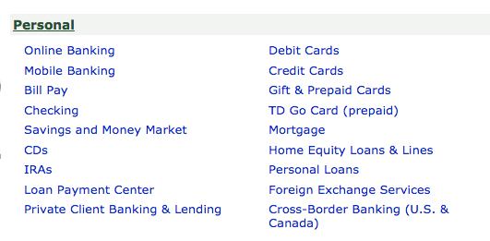
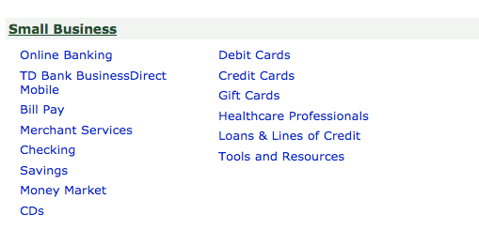
How Does TD Generate Revenue?

Slide 6
Internal Audit’s Role at TD
Third line of defense for the business.
We help mitigate risk through being separate from the business to objectively test controls on risks.
Allow C suite management to uphold TD’s guiding principle of “take only risks we understand and can manage.

Slide 7
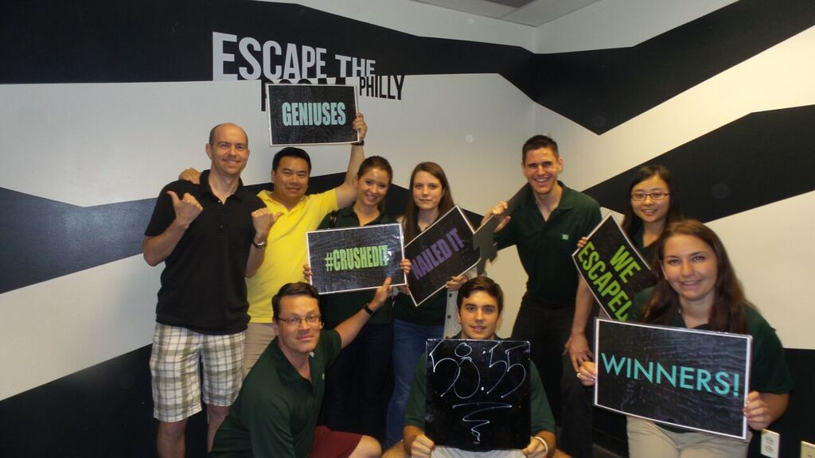
My Experience as an Internal Auditor at TD
I worked on the IT infrastructure Team
Worked on the Active Directory, Access Services, TDAF Change Management, and General SOX audits
Sat in walkthroughs, wrote walkthrough reports, performed testing, and documented my testing presenting any findings if any
Notes:
Will add a picture of either the team I was on or a picture of me working at my desk. Not sure which one yet, but will be in the final draft.

Slide 8
Skills I learned at Temple that allowed me to be successful
MIS 2501
Importance of technology controls
MIS 2502
MySQL
R and RStudio
Business Communications
How to write in a clear and concise manner

Slide 9
What I learned working at TD
How to make advanced Macros in Excel
How to complete an audit from start to finish and submit work that was accepted by our external auditor EY
How to escaped being locked in a bathroom stall (actually happened)

Slide 10
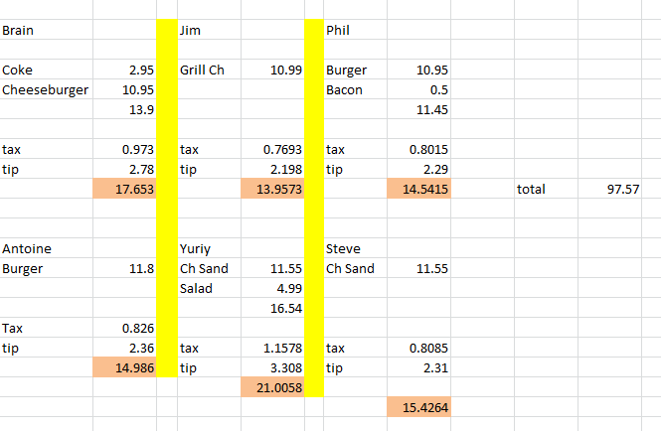
Networking
Got to meet with management in AML and other lines of business
Met with the head American Auditing Chief Stephan and Chief Auditor Kelvin Tran
Worked with 12 other interns from various universities and made good friends
Joined a lunch crew and got to learn from the one and only Steve Quinto
Notes:
Will add a picture of the interns together and a lunch crew picture once I take one.

Slide 11
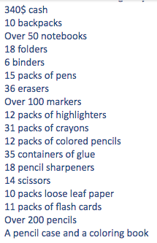
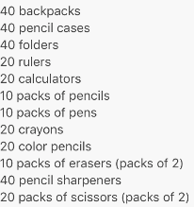
Philanthropy
Our charity we partnered with was Cradles to Crayons
We spend a day volunteering and sorted clothes in the morning and shopped in the afternoon helping over 225 children.
Notes:
Will add photos from our volunteering day once I receive them. Also, I will add more metrics from our school supplies drive once it concludes in a few weeks.

Slide 12
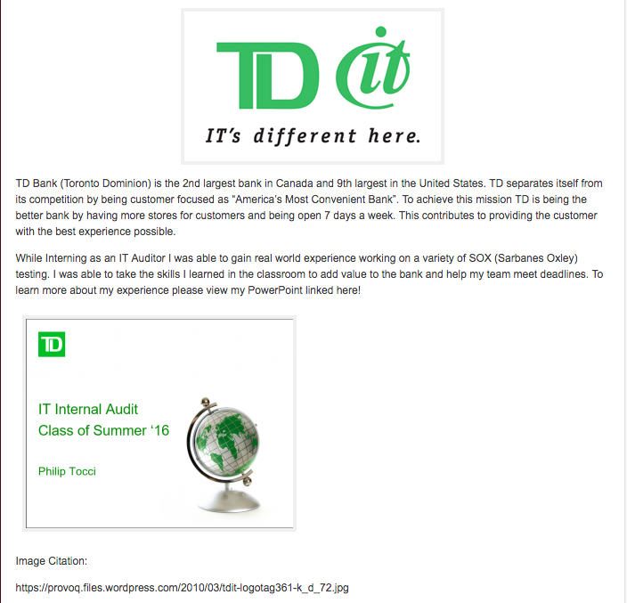
e-Portfolio
http://community.mis.temple.edu/philiptocci/summer-16-with-td-bank/
Notes:
Will take a screenshot once I create the page.

Slide 13
Q&A
“Question Everything” Brian Christiansen, Senior Auditor at TD Bank

Slide 14
Citations
https://www.td.com/popup/150/timeline/1955.html
https://en.wikipedia.org/wiki/Toronto-Dominion_Bank
https://www.tdbank.com/aboutus/company_history.html#
http://www.cbre.us/o/boston/properties/td-bank-dispositions/Pages/home.aspx
https://www.tdbank.com/net/banking.aspx
https://www.tdrewards.com/allcardfeatures&benefits
https://www.td.com/about-tdbfg/corporate-information/tds-guiding-principles/guidingprinciples.jsp
http://community.mis.temple.edu/annapalutis/academic-history/
http://www.juliansoft.com/cvtsplweb.htm

