Slide 1
Pig-e-Bank
“ ₵hange the way you $ave ”
Blake Ford, Thomas Huang, John Illuminati, Travis Spiecker, Jesse Worek
Notes:
Jesse

Slide 2
Problem
Saving large amounts of money is intimidating and stressful
Saving money as a group is complicated
How can friends better save money towards a common goal?
Notes:
Jesse
Quotes indicating poor saving habits
More market research!

Slide 3
Solution
Pig-e-Bank — a platform to help groups save
Create individual/group targets
Round up transactions to create “change”
Receive relevant promotions for your targets
Notes:
Blake
Giving money back?
Handling lump sums

Slide 4
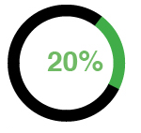
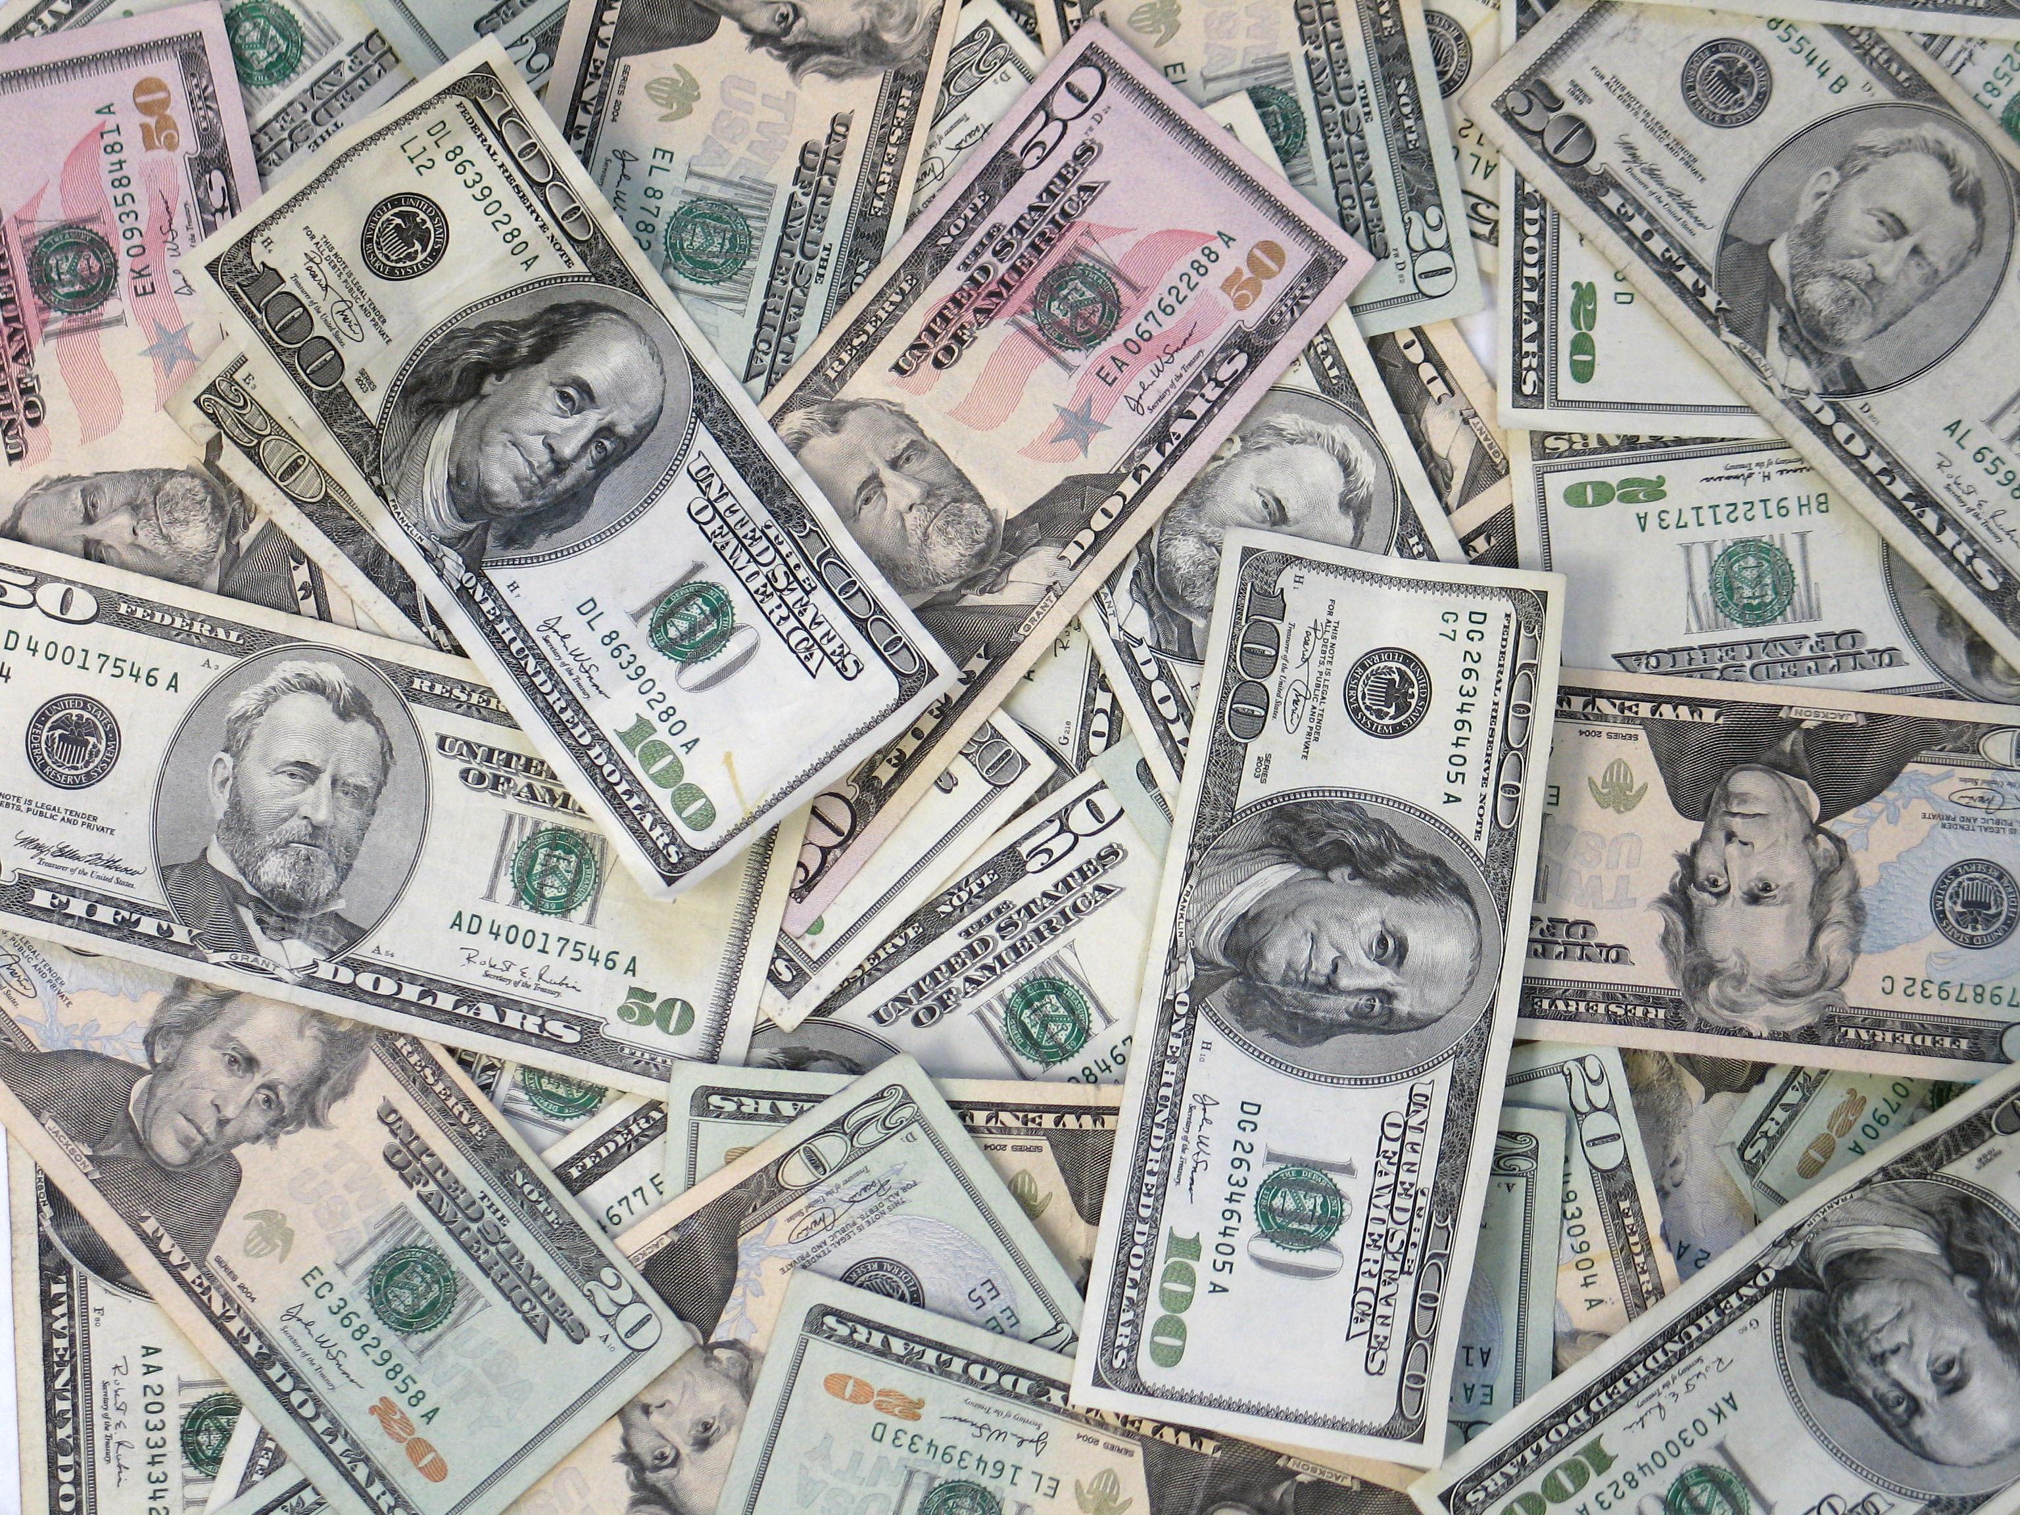
Solution Diagram
User
Transactions
Money Pool
Goals
Rounded “Change”
$3.75
$1.25
Notes:
Travis

Slide 5
Charging the User
John’s $1.25 goes towards a $5 “change” threshold
When threshold is reached, John is charged $5.25 (5% transaction fee)
$5
“Change” accumulating
$5
User charged $5.25
Notes:
Travis

Slide 6
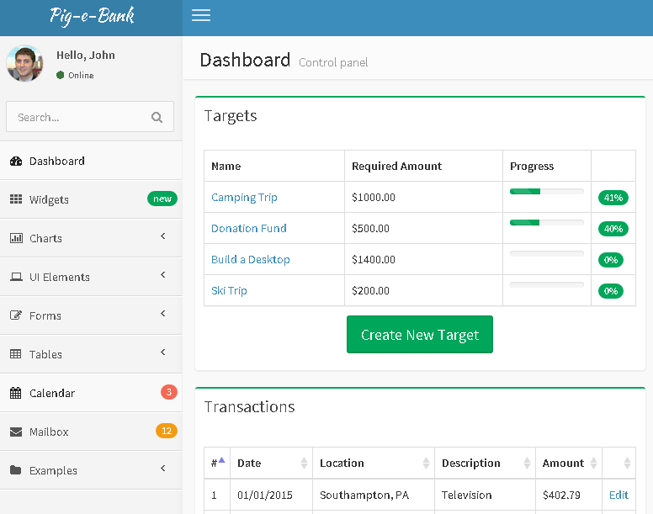
Prototype Demo
Notes:
John

Slide 7
Market/Competitive Analysis
Group Funding Platforms
Credit Card Reward Programs
Kickstarter
Indiegogo
GoFundMe
Acorns
Citi
Capital One
Bank of America
Chase
Pig-e-Bank is a lifestyle app to help friends save towards a common goal
Notes:
Blake
Lifestyle app to be used with friends to save towards a common target. This is not an application to try and get a new entrepreneurial endeavor off the ground. A group of friends could use this to save up to pay expenses for a start up essentially, but Pig-e-bank is not a place to get funding for a new start up.
Kickstarter – is used to gain funding from outsiders to pay expenses for projects. All of the funding for pig-e-bank comes from the users in the group that are saving towards their targets. They do not receive funding from anyone else and they are not necessarily saving for a project. In most cases, users are using the app to save for trips, tangible items, and fun activities.
https://www.kickstarter.com/hello
Indiegogo – is used for crowdfunding as well. You can use this for things other than entrepreneurial endeavors and start ups but the campaign you chose to save for is funded by others. Once again pig-e-bank is used with the users own money.
https://www.indiegogo.com/campaigns/new
Acorns – has a similar saving method as the remaining change from a transaction is allocated in the application, but these savings are used directly for investments. Acorn is not for saving or for trying to reach a goal.
https://www.acorns.com/
Gofundme – is used for crowdfunding and donations. By using gofundme you are receiving all of the funds from outside sources
http://www.gofundme.com/tour/
This app falls into the lifestyle application market.
Our clients are essentially anyone that wants to save towards a goal with friends, family, colleagues, etc. Our main target audience are college students ranging from ages 18 – 22 and young professionals from ages 24 – 30. We feel that these two groups will be attracted to our application the most and that is why we are targeting them. We feel that users at this age are very social and time can be hard to come by free time for planning.

Slide 8
Systems Architecture
Users’ PCs, tablets, phones
Virtual application server
Database server
Bank/credit card company
Notes:
Travis
As long as our users they have an internet connection, they can access Pig-e-Bank through their smartphones, tablets, or PCs.
The Pig-e-Bank application will be hosted on a virtual application server created on Amazon Web Services’s Elastic Compute Cloud. The application will access data stored on a database server created on Amazon’s Relational Database Service. Both EC2 and RDS services are Payment Card Industry Data Security Standard Level-1 certified.
However, we must also ensure that our application treats financial information in a PCI DSS-compliant manner, and also must establish a secure communication channel with credit card companies and banks from which users’ transaction data can be retrieved.
We prioritize our users’ financial safety and privacy, so security will be very important to us as we move forward with our implementation plan.

Slide 9
Implementation Plan
Year 1
Beta launch with press coverage
Year 2
Expansion/scaling
Year 3
Sponsorship emphasis
Notes:
Tom
See http://docs.aws.amazon.com/gettingstarted/latest/wah-linux/web-app-hosting-intro.html and previous slide
Year 1 - Beta Test – 50 invites + tech journalists who can each send out 2 invites to friends who can in turn invite 1 person. Approx. 250+ for beta test. NO charges for saving, so we’ll eat the costs in order to solicit feedback and figure out what users like the most, what needs improvement. EXCLUSIVITY
Purchase press coverage if organic coverage not what we expected. Purchase slots at tech festivals such as SxSW, TechCrunch Disrupt, Techweek. College campuses with hackathons, and similar events.
Reiterate Year 1 goal of 40% of targets started should be achieved to demonstrate user engagement. Reiterate expectation of 1,000 users 3 months after launch, not including beta test invites.
http://techcrunch.com/2012/01/05/does-your-startup-need-beta-testers-betabait-will-hook-you-up-now-on-email-the-web/
Year 2 – As we begin to attract a large enough user base, the company will need to be scaled up. As the company grows, we need to hire talented people which is expensive and making them productive is difficult. We would need accounting, public/investor relations, privacy, marketing, and a number of other departments which the 5 of us cannot handle. Even if these are outsourced, they represent significant costs. Essentially adding personal and establishing a leadership hierarchy. Figure out how best to organize individuals and groups when the company grows. Establish processes that standardize workflow, communication policies, and responsibilities.
http://www.inc.com/neil-patel/7-ways-to-prepare-your-startup-to-scale-up.html
Year 3 – We will have X users and therefore a compelling value proposition for businesses to advertise. Begin rollout of business partner platform to match them with user targets and potential sales opportunities. Cost of building separate platform for businesses.

Slide 10
Financial Forecast
(in thousands) | Year 1 | Year 2 | Year 3
Revenue
Fee Based | $125 | $352 | $656
Sponsorship | $50 | $150 | $300
Expenses
Transaction Fees | $50 | $141 | $264
Marketing/Advertising | $25 | $60 | $100
Development/Hosting | $100 | $125 | $150
Net Income | $- | $176 | $444
Notes:
Tom
Year 1 – Low sponsorship revenue as the app gains support
Year 2- Increasing costs to support the app and continue promotions
Year 3- Reach profitability due to sponsorship revenue

Slide 11
Conclusion
Easy group collaboration with promotions
Focus on growing user base and offering relevant promotions
Reach and sustain profitability in two years
Pig-e-Bank is a better way for groups to save
Use Pig-e-Bank and
₵hange the way you $ave!
Notes:
Jesse

