Slide 1
VULPINEANALYTICS
Derek, Eric, Erika, David

Slide 2
Overview
Vulpine Analytics
Software-as-a-Service
Productivity and wellness analytics
$24 per user, annually
Value Proposition
Individual employee productivity gains
Enterprise wellness initiative metrics

Slide 3
Website

Slide 4
Analytics Platform
Research
Optimal productivity factor weights
Individual Data
Initial factor weights based on demographics
Machine Learning
Pattern recognition and correlation
Productivity Score
Forecasted personal productivity
Factors
Activity, Sleep, Performance
Enterprise View
Aggregate raw and outputted data, parse by wellness initiative
User Input
Reflection and self reported feedback

Slide 5
IT Architecture
AWS CloudFront
AWS Machine Learning
Dell Boomi Data Integration Platform
AWS CloudHSM
AWS S3
Enterprise Data

Slide 6
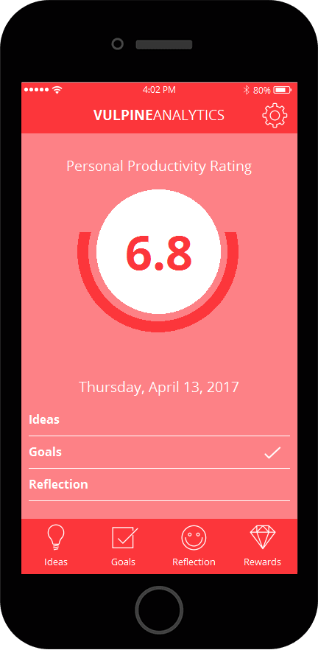
Mobile App

Slide 7
Financials
Completed Pro Forma
Wages
Cloud infrastructure
Market assumptions
Forecasts

