Slide 1
Pro Recommendation
Matthew Andrien, Joe Doyle, Jessica Margetich,
& Sara Rezaeian

Slide 2
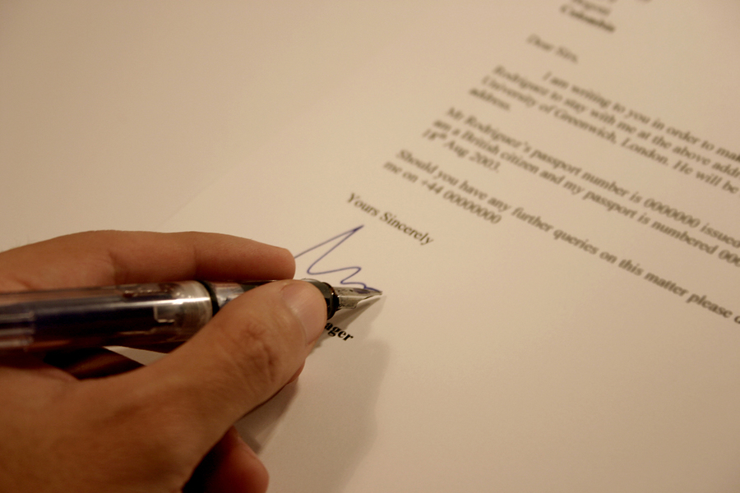
Letters of Recommendation
Notes:
Who here has written/needed a letter of recommendation?
Who enjoyed the process?
There is a problem of documents being re-used which lowers the value of a recommendation.
The current letter of recommendation process is perceived to be invaluable by many companies and organizations because they lack authenticity.

Slide 3
Our Solution
Pro Recommendation
Notes:
A central system where you can track and create Letters of Recommendation.
Upload Templates which adds personalization to the process.
Requires information from requester
Helps write a meaningful letter that covers all key points.
Tracking capabilities allow requestors to follow the status of the recommendation.
The Pro Recommendation system can change the way letters of recommendations are requested, written and submitted, and can help business- oriented social networking services to attract new subscribers, increase site traffic and ultimately bring in revenue. The system itself focuses on two types of users: business professionals/students requesting a letter of recommendation and business professionals writing letters of recommendations.

Slide 4
Steps Within the System
Fill out desired information using our system.
Send information to requestor.
Track to see if the Letter of Recommendation has been created yet.
Notes:
Fill out desired information using our system.
Send information to requestor.
Track to see if the Letter of Recommendation has been created yet.
First, the requestor sets up a profile, then the request is sent out to the professional actually completing the recommendation. When the request processes, tracking becomes a capability for the requester, allowing him/her to view the status of the requested recommendation. Next, the recommender/writer can accept/reject requests, and easily complete the recommendation upon acceptance through the Pro Recommendations System. The system itself is comprised of different letter of recommendation templates (including a feature for the writer to upload their own template), auto-populated tabs (full of the requestor’s academic/professional information and the company’s information for whom the letter is being written for), and tips for writing letters of recommendation. Once the recommendation has been submitted, the requestor would receive a final notification through the tracking capability that the process is complete.

Slide 5
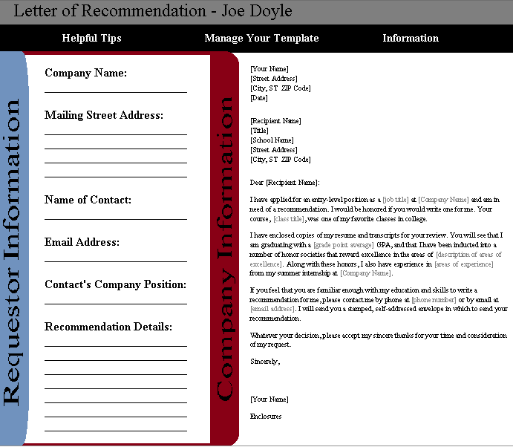
What our System will look like
Notes:
What It Is:
The main options in the system are listed at the top in the black bar (helpful tips, manage your template, and information). The vertical bars with horizontal writing are side tabs that can be minimized or extended to half of the screen at the writer’s leisure. They will each include information about the requestor and about the company that the requestor wishes the recommendation be sent to. This information will be auto-populated into the tabs via the required information for the requestor to submit with their recommendation request.
How It Helps:
Having these bars available will drastically improve the letter of recommendation writing process by providing information that a writer typically would not have available to them (such as student’s accomplishments or what the company requiring a letter is looking for). The top menu is more to benefit the structure of the recommendation by allowing the writer to select a template or upload their own, while also offering tips on content and style.

Slide 6
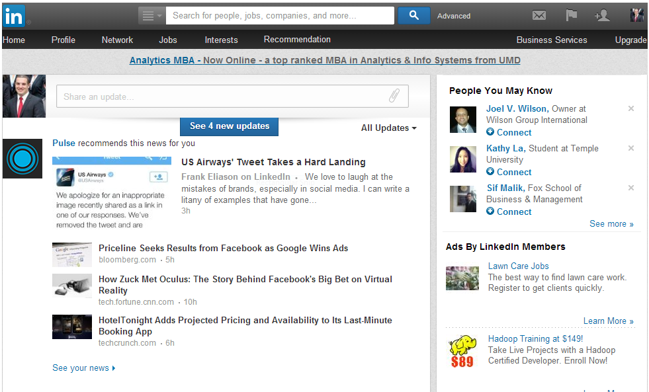
Ideal Position

Slide 7
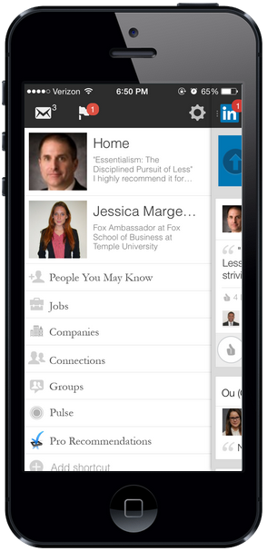
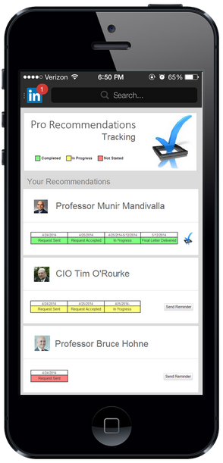
Mobile Screenshots

Slide 8
Financials
Costs
 | Year 1 | Year 2 | Year 3 | Year 4 | Year 5
Development Costs | $70,000 | - | - | - | -
Sales Personel | $50,000 | $50,000 | - | - | -
Total Annual Costs: | $120,000 | $50,000 | $0 | $0 | $0
Revenue
 | Year 1 | Year 2 | Year 3 | Year 4 | Year 5
Company 1 | - | $2,000,000 | - | - | -
Company 2 | - | - | $3,000,000 | - | -
Total Annual Revenue: | $0 | $2,000,000 | $3,000,000 | - | -
Total Annual Profits: | -$120,000 | $1,950,000 | $3,000,000 | - | -
Total Cumulative Profits: | -$120,000 | $1,830,000 | $4,830,000 | - | -
 |  | *Breakeven*

Slide 9
Alternative Position
Notes:
3rd party/ licensing
HR Departments (individual companies)
Individuals
Colleges/Universities.

Slide 10
Alternative Financials
Costs
 | Year 1 | Year 2 | Year 3 | Year 4 | Year 5 | Year 6 | Year 7 | Year 8 | Year 9 | Year 10
Development Costs | $70,000 | $5,000 | $5,000 | $5,000 | $5,000 | $5,000 | $5,000 | $5,000 | $5,000 | $5,000
Servers | $10,000 | $10,000 | $50,000 | $2,000 | $2,000 | $2,000 | $2,000 | $2,000 | $2,000 | $2,000
Domain Name | $4,000 | $20 | $20 | $20 | $20 | $20 | $20 | $20 | $20 | $20
Sales Personel | $250,000 | $250,000 | - | - | - | - | - | - | - | -
Regional Managers | $275,000 | $275,000 | $275,000 | $275,000 | $275,000 | $275,000 | $275,000 | $275,000 | $275,000 | $275,000
Total Annual Costs: | $609,000 | $540,020 | $330,020 | $282,020 | $282,020 | $282,020 | $282,020 | $282,020 | $282,020 | $282,020
Revenue
 | Year 1 | Year 2 | Year 3 | Year 4 | Year 5 | Year 6 | Year 7 | Year 8 | Year 9 | Year 10
# of Universities | 20 | 100 | 260 | 580 | 950 | 1,400 | 1,800 | 2,100 | 2,350 | 2,500
Students & Staff | 200,000 | 1,000,000 | 2,600,000 | 5,800,000 | 9,500,000 | 14,000,000 | 18,000,000 | 21,000,000 | 23,500,000 | 25,000,000
Users | 50,000 | 250,000 | 650,000 | 1,450,000 | 2,375,000 | 3,500,000 | 4,500,000 | 5,250,000 | 5,875,000 | 6,250,000
Total Annual Revenue: | $50,000 | $250,000 | $650,000 | $1,450,000 | $2,375,000 | $3,500,000 | $4,500,000 | $5,250,000 | $5,875,000 | $6,250,000
Total Annual Profits: | -$559,000 | -$290,020 | $319,980 | $1,167,980 | $2,092,980 | $3,217,980 | $4,217,980 | $4,967,980 | $5,592,980 | $5,967,980
Total Cumulative Profits: | -$559,000 | -$849,020 | -$529,040 | $638,940 | $2,731,920 | $5,949,900 | $10,167,880 | $15,135,860 | $20,728,840 | $26,696,820
 |  |  |  | *Breakeven*
Notes:
For schools and universities (subscription based)
Niche results in a Low Risk Investment

Slide 11
Future Value - Verifiability
Notes:
We hope to see this system become the central point for all Letters of Recommendation in 5 years.
Making sure that people are who they say they are.

Slide 12
Questions

