Slide 1
Repeator.co
Noah Berson
Aaron Ploucher
Joe Derer
Notes:
Good evening I’m __ ___ and ____

Slide 2
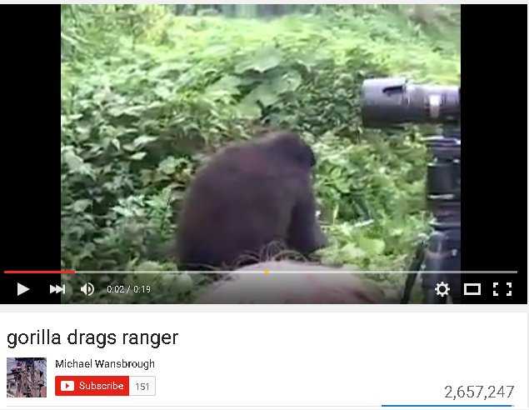
The Problem
Freebooting - the act of downloading someone else's copyright-protected material and uploading it as your own.
Freebooting results in lost revenue for content creators
Social networks have become bloated and less useful
Notes:
Aaron
Plagiarism
What is freebooting
A youtube video with only certain amount of views, vs gif with tons of hits
Solution is repeator, a short form video site that allows you to have a profile that can accept certain segments of video so you gain views
Easy solutions deters people from stealing content
Explain vine, twitter, snapchat - more niche than facebook, have one set purpose for existing

Slide 3
The Solution
Provide a social platform for Original Video Content Creators(OVCC) to post their videos in a .gif format to secure their following and advertising revenue.
Easy gif creator from web sources or from computer
Users create accounts to upload content, follow content creators and share gifs
OVCCs create accounts and link ad revenue with all their gifs already on the site
Advertisers create sponsored content and get views
One place to see videos without sound
Notes:
Aaron
SO this is how we plan to get the money back to the OVCC

Slide 4
The Prototype
Homepage - Front page of Repeator.co
Profile - Displays a user’s uploaded gifs and “repeated” gifs
Feed - Curated list of gifs from friends and suggested top repeators
Upload Page - How gifs are added to the site by each user
Gif example- A page showing a single gif
Notes:
Aaron
Here is an example of how the final site might look.

Slide 5
External Analysis

Slide 6
The PEST Model
Political - User generated content can be copyrighted Government wanting access to servers in U.S.
Economics - Advertisers investing more into Internet ads than ever before
Venture Capital money harder to obtain after gig economy failures.
Social - Millennials switch to sites only their friends use, causing migrations
Technological - Server technology cheap but funding on ads alone can prove difficult
Notes:
Noah
P - web 2.0 has several political problems built in. User generated content has to be evaluated for legality when being hosted on your site. The government may want access to the site if the servers are located in the U.S. to monitor communications.
E - Venture capital funding which is how many social networks get cash may be moving away from social network ventures.
S - Millennials do enjoy new things but are known to jump ship from failing sites. Myspace and Digg being a few examples of such.
T - gifs may become outdated due to some other format taking over as file formats have come and gone in computing history. The balance of funding servers for many users and obtaining profits from advertising has proven difficult for many defunct websites, even after they branch out into other revenue streams.

Slide 7
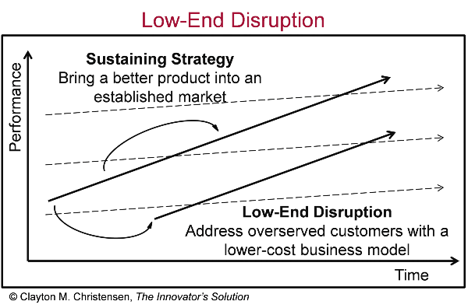
Disruptive Innovation
Repeator would be a low-end disruption in the social network market
Other networks bloated with features few customers asked for.
Repeator is by definition a niche site, aiming for select customers with specific need
Notes:
Noah
Those customers are the OVCCs who need to get a lost revenue stream back and users who want to just look at gifs

Slide 8
System Structure

Slide 9
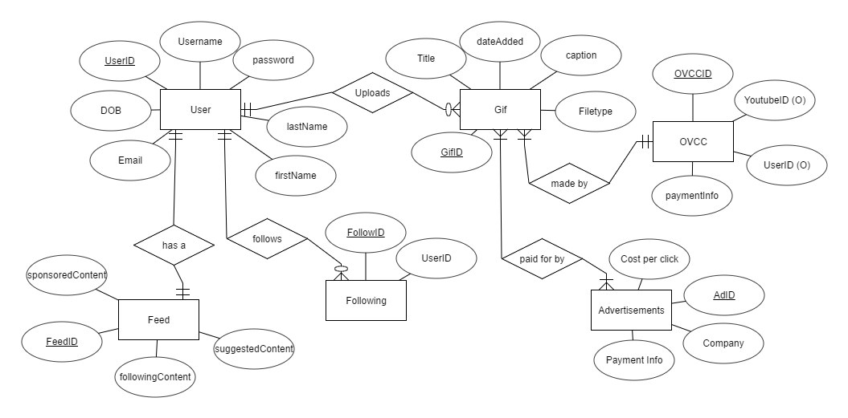
Data Model Overview
How our database would store information about Repeator.co users
Most data is linked to a user in some way
Advertisers can target certain users after Repeator.co takes off
Notes:
Noah

Slide 10
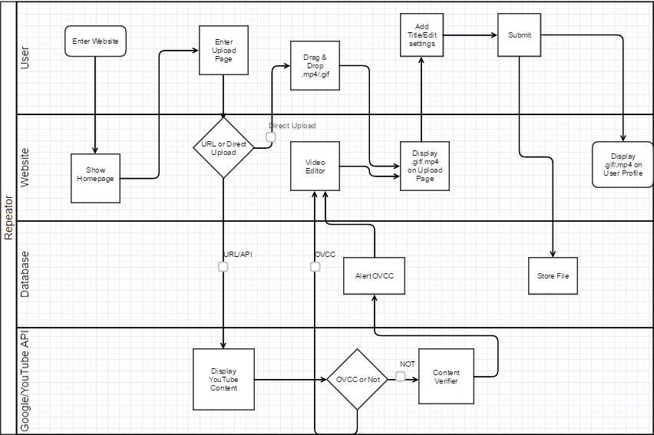
Process Model Overview
Uploading a gif to Repeator process
Entering the site
Direct Upload or URL
Verifying OVCC
Editing GIF
Notes:
Noah

Slide 11
System Architecture Overview
Database for user data on profiles
Server talks to database and website
Double firewall for increased security
Minimum architecture needed for our website
Notes:
Joe
This plan will hold us over for 1,000 users while offering scalability when we ultimately expand

Slide 12
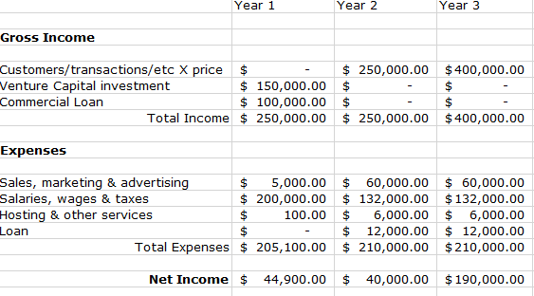
Financial Diligence
No viable income within first year
Loan/investment help in first year
Marketing plan starts in year 2
Amazon web services will be hosting
PM only needed for 6 months
Notes:
Joe
Venture capital investment and commercial loan to get us by in the first year
Hosting in year one is bluehost
Advertising year 2 we will charge for ads on our front page making it like a billboard
Will add a marketing coordinator for years 2 and 3
Amazon web services as hosting
PM only needed for 6 months (GD for 1 month)
Will start paying back the loan in year 2
Expect more users for year 3 which will allow for more income

Slide 13
Implementation Plan
Build up from prototype to functional website with AWS backing
Aggressively recruit OVCCs from Youtube to sign up and offer early adopting advantages
Fundraise to fuel a site expansion
Implement sponsored content
Implement advertising several years after launch
Notes:
Aaron

Slide 14
Questions?

Slide 15
Thank You

