Slide 2
LANCE armstrong: the face of “livestrong”
Lance Armstrong Commercial

Slide 3
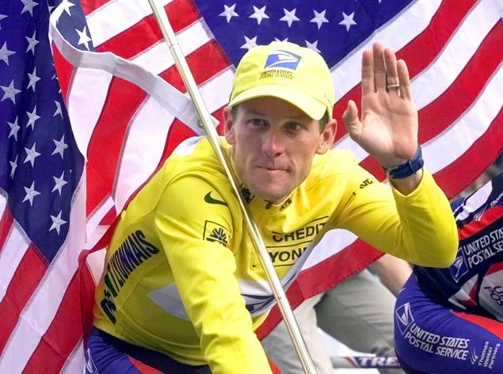
Biography of Lance armstrong
1992- Begins Career as Professional Cyclist
1996- Diagnosed with Testicular Cancer
1997- Established Lance Armstrong Foundation
2003- Partners with Nike to Launch “Livestrong”
2005- Wins Seventh Tour and Retires

Slide 4
Biography of Lance armstrong
2009- Returns to Cycling
2012- Stripped of Tour Wins, Charged for Doping
2013- Negative campaigns start

Slide 5
Initial crisis response

Slide 6
In conclusion
In conclusion

