Slide 1
Overcoming Your Negativity Bias
Ranya Hasan

Slide 2
Overview
Author: Tom Schwartiz
What is Negativity Bias
What is the cause

Slide 3
How Our Brain is Effected
From Psychology Today
“Our Brain’s Negative Bias”
Hara Marano
Study from Ohio State University
Brain’s electrical activities
Why this happens

Slide 4
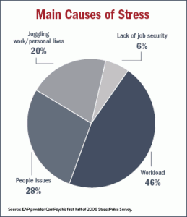
Cause of Stress
Stress.org

Slide 5
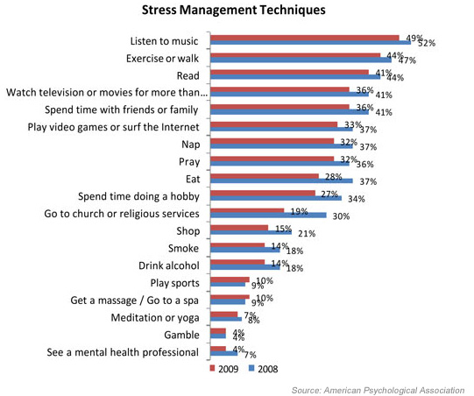
In the Article
How stress affects you
Work performance
Stopping Negativity Bias

Slide 6
Conclusion
Work in any environment
Controlling your stress
I agree, but…

