Slide 1
Audit and Security
Ryan Boyce + Maria Uniyat + Raymond Long

Slide 2



Who am I?

Slide 3
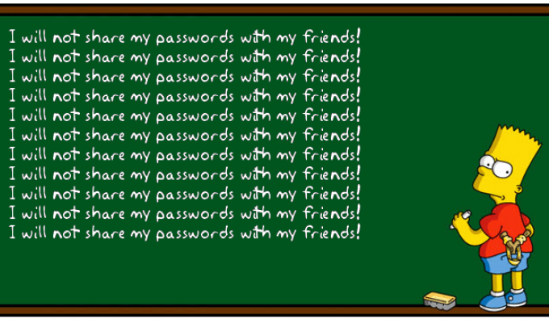

ITACS!

Slide 4

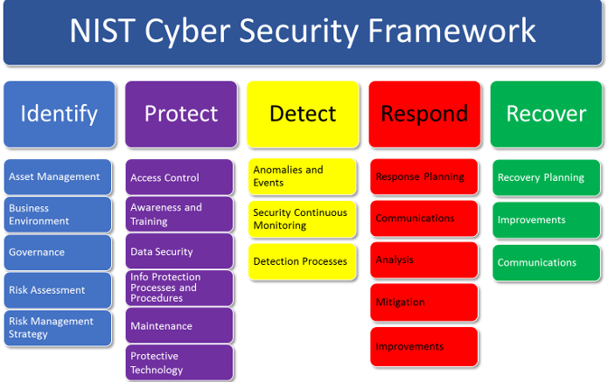
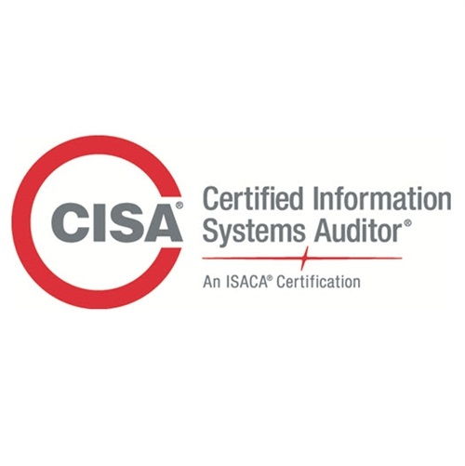

ITACS!
IT Auditing and Cyber Security

Slide 5
Your class/Our Project
Very typical of modern IT!

Slide 6
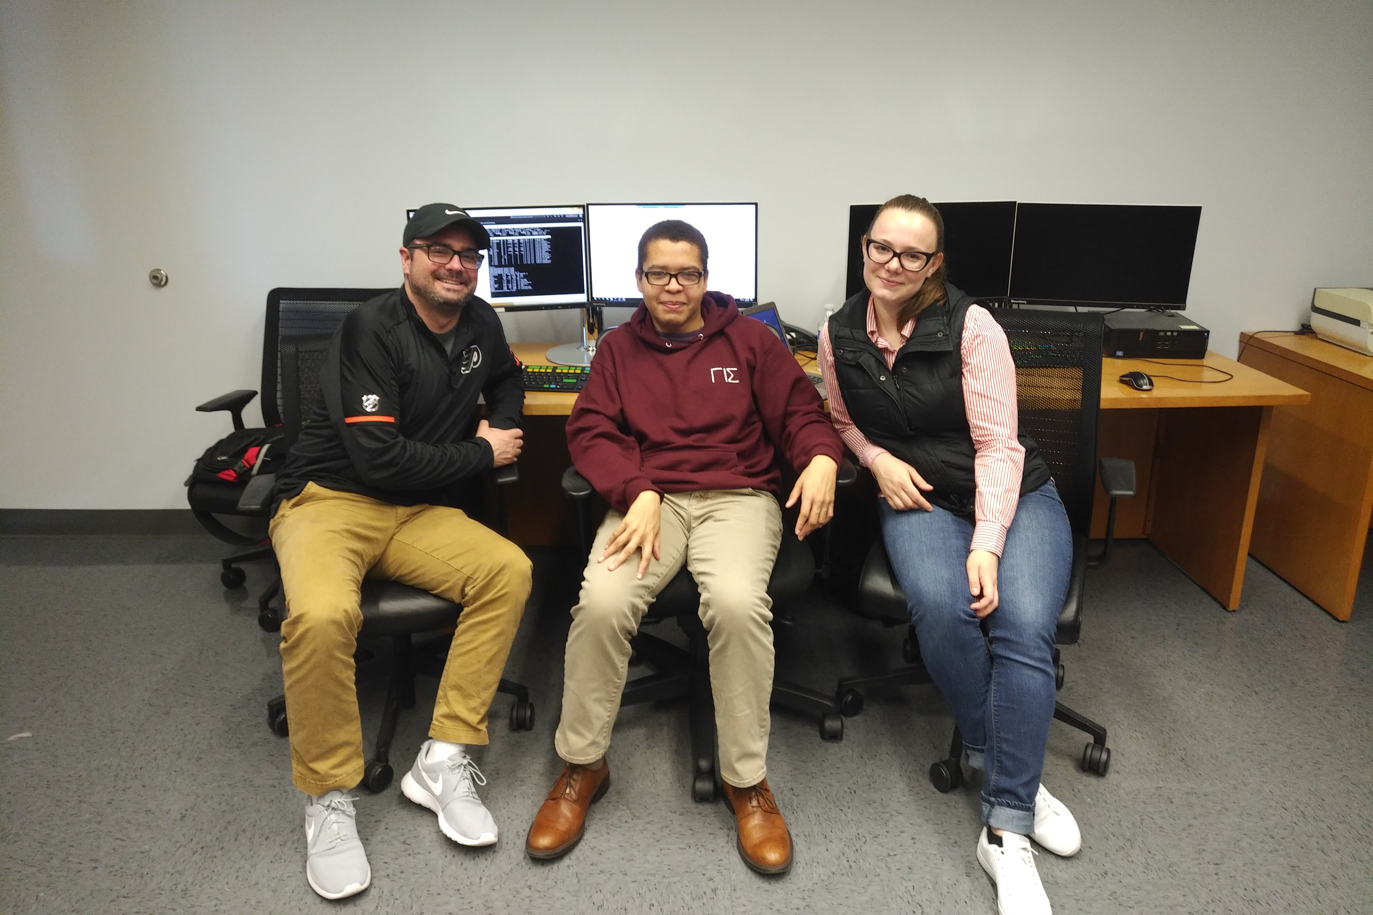
The A Team!

Slide 7
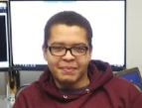
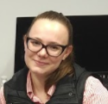

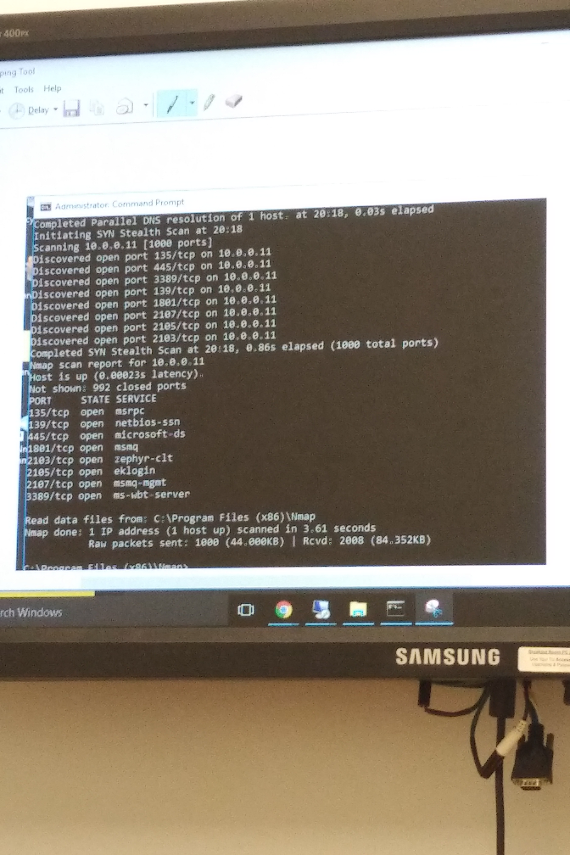
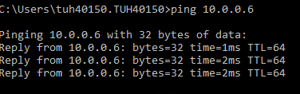
Process
1. Reconn!
2. Ping – start small
3. Dig deeper – nmap
4. Scan – auditor’s best friend!
5. Identify vulnerabilities
6. Exploit vulnerabilities
Iterate!

Slide 8

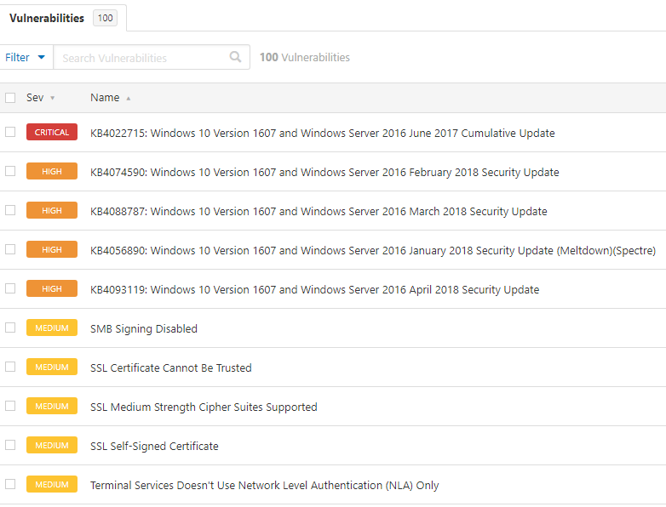
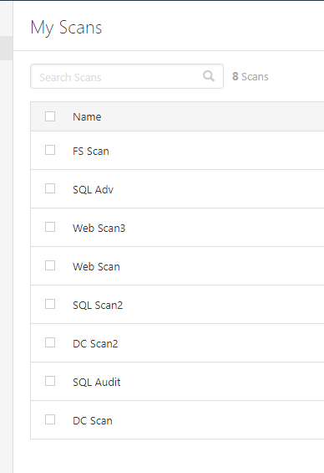


Slide 9


The juicy stuff!

Slide 10
