Slide 1
Aldi
A Move to the City

Slide 2
Theme
The socioeconomic urbanization of millennials provides an opportunity for ALDI to cater to a growing urban population, without facing its usual major competitors.

Slide 3
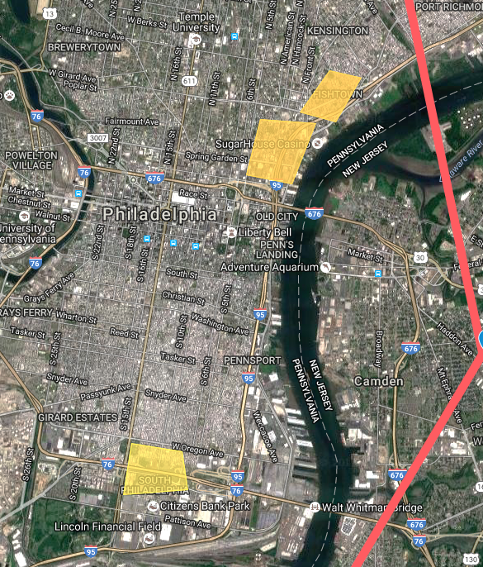
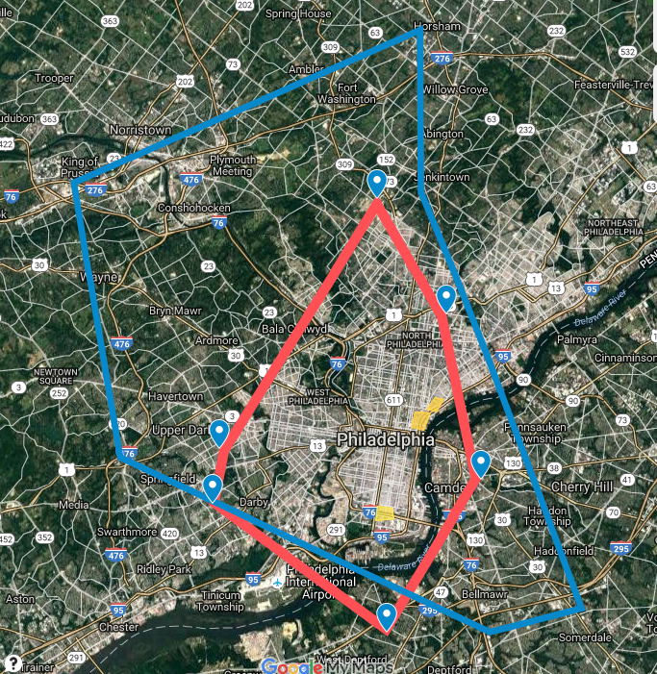

Slide 4
Reasons For Pursuing Urban Millennials
They fit ALDI’s value proposition and sales structure:
Current customers are price sensitive (Gasca, 2015)
Stores are minimalistic and small (Opray, 2016)
Quick shopping experience (Opray, 2016)
Build brand on customer loyalty (Vicky, 2016)

Slide 5
Reasons For Pursuing Urban Millennials
They are part of a growing segment that won’t hurt the brand (Carmichael, 2016)
There is an ongoing trend of millennials moving into cities (Sanicola, 2016)
The store’s brand will continue to be associated with suburban shopping (Yang, 2015)

Slide 6
Change In Marketing
Typical location is in a suburban shopping centers, and places with a lot of car traffic (ALDI corporation, 2013).
New focus will be on foot traffic and proximity to population (Cafourek, 2016).
Notes:
https://corporate.aldi.us/fileadmin/fm-dam/real_estates/ALDI_Real_Estate_Flyer_9.17.13.pdf
http://becomeanewyorker.com/grocery-shopping-in-new-york-city/

Slide 7
Location: Value Added
Demographics and incomes differ
New locations:
Fishtown:
Median Age: 34.5 years
Median Income: $39,382
Northern Liberties:
Median Age: 34.5 years
Median Income: $55,277
South Philadelphia:
Median Age: 37.5 years
Median Income: $37,741
Suburban Locations:
Abington:
Median Age: 40.6 years
Median Income: $74,736
Wyncote:
Median Age: 48.3 years
Median Income: $102,716
Stratford, NJ:
Median Age: 41 years
Median Income: $62,041
(City-Data.com , 2016)
Notes:
These statistics indicate a younger and more average-income consumer base
http://www.city-data.com/neighborhood/Fishtown-Philadelphia-PA.html
http://www.city-data.com/neighborhood/Northern-Liberties-Philadelphia-PA.html
http://www.city-data.com/neighborhood/South-Philadelphia-Philadelphia-PA.html
http://www.bestplaces.net/people/zip-code/pennsylvania/abington/19001

Slide 8
Location: Value Added
Aldi typically competes with big discounters like Walmart, club stores and dollar stores (Hurley, 2016)
All offer a selection of grocery essentials and attract price sensitive consumers.
Being in an urban environment means Aldi won’t be competing with these stores to the same extent.
Aldi will be competing with neighborhood grocery stores, dollars stores, and establishments that require a drive (Cafourek, 2016).
Easier for Aldi to compete with mom and pop shops in price, and compete on convenience with stores that are a drive away.
Notes:
http://www.forbes.com/sites/thehartmangroup/2015/04/14/aldi-is-a-growing-menace-to-americas-grocery-retailers/#3910306c3e6a
http://www.huffingtonpost.com/max-levitte/cheapest-place-to-buy-gro_b_5039301.html
http://becomeanewyorker.com/grocery-shopping-in-new-york-city/
http://www.businessinsider.com/aldi-is-shockingly-cheaper-than-dollar-general-2016-4
http://clients1.ibisworld.com.libproxy.temple.edu/reports/us/industry/majorcompanies.aspx?entid=1092
http://clients1.ibisworld.com.libproxy.temple.edu/reports/us/industry/majorcompanies.aspx?entid=1040

Slide 9
Urban Distribution
Commuting & Peak hours
Moving freight is a common urban transportation challenge (Rodrigue, 2013).
ALDI will have to make adjustments to its Operations.
Congestion
Cargo Load Contradictions
Notes:
Moving freight is a common urban transportation challenge, and one that ALDI will be impacted by from an Operations stand point, as it makes a shift into the city.
Three specific city logistics that ALDI will have to account for are:
Commuting and peak hours, Congestion and Cargo load contradictions.
Commuting and peak hours refers to passenger and freight transportation sharing the same road infrastructure and busy hours due to commuting.
Congestion refers to the fact that urban environments tend to have high bottleneck, due to which deliveries need to take place at night if possible. This would mean that ALDI would need to look into hiring a new set of drivers if their current drivers make daytime trips, or paying their current drivers over time. Congestion also calls for a change in vehicle size, since the average size of vehicles used for urban deliveries tends to be smaller, since there is such high density within cities. So ALDI must acquire smaller vehicles for urban freight distribution in order to maneuver in an urban setting.
Lastly, Cargo load contradictions refers to the fact that Urban freight distribution is characterized by smaller volumes and high frequency deliveries, which doesn't accommodate economies of scale, and leads to higher delivery costs. Cargo loads are linked to inventory levels, which have shrunk in urban settings. As a result, businesses are increasingly supplied on a just-in-time basis, which won't be too much of a change for ALDI, as currently inventory turnover is so rapid that it is often not written down.
---------------------
The “City Logistics”
Moving freight is a common urban transportation challenge, and one that ALDI will have to take on operationally, as it makes a shift into metropolises. The city logistics ALDI would need to specifically address are:
Key Urban Logistical Challenges
Commuting and peak hours: passenger transportation and freight transportation share the same road infrastructure and peak hours due to commuting. This exacerbates freight distribution
Congestion: city logistics depend on consistent and reliable deliveries. However urban environments tend to have high congestion, due to which deliveries need to take place at night if possible (drivers might only be hired for the day time currently at ALDI?)
Vehicle Size: the size of vehicles used for urban deliveries is on average smaller, particularly in areas that have high density => so ALDI must acquire smaller vehicles for urban freight distribution because of their ability to maneuver in an urban setting.
Cargo load contradictions: Urban freight distribution is characterized by smaller volumes and high frequency deliveries, which doesn't accommodate economies of scale, and thus involves higher delivery costs.
Inventory levels: have shrunk and businesses are increasingly supplied on a just-in-time basis which won't be too much of a change for ALDI, as currently inventory turnover is so rapid that it is often not written down.

Slide 10
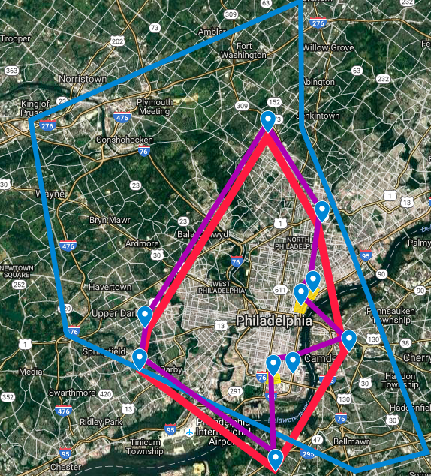
Operations
Current ALDI route
Proposed ALDI route
Walmart Radius
Current ALDI route: 40.5 mi
Proposed ALDI route: 42.8 mi
Notes:
The map here shows you our proposed route in purple and the existing route between current ALDI stores in red. As you can see, accounting for our new proposed locations, the new route is not much longer than the existing one, about 2.3 miles longer. This means that it is highly unlikely that ALDI will need a significant addition to labor to accommodate for its new stores. However, the exact figure Is a calculation that ALDI must make.

Slide 11
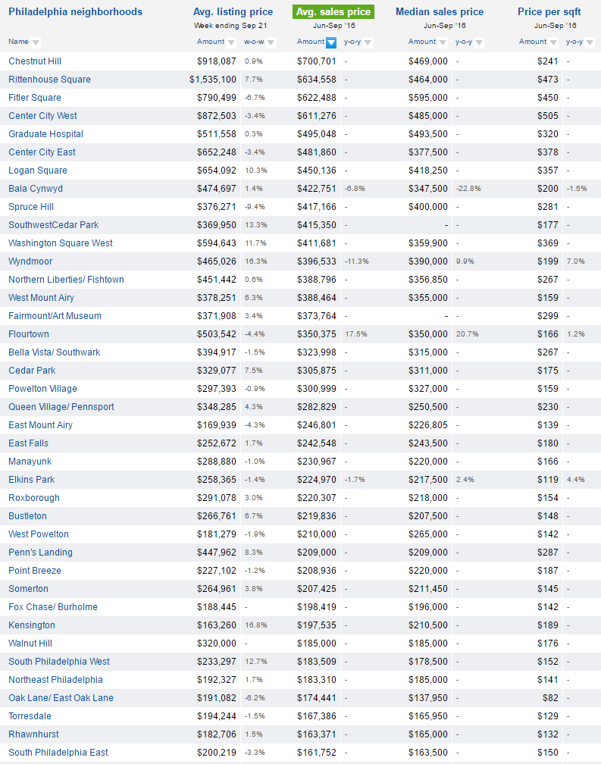
City Cost Considerations
Neighborhood Property Prices
Fishtown: $388,960
Northern Liberties: $356,850
South Philly: $183,509
Suburban Commercial Property is relatively cheaper
Commercial Real Estate Appreciation Rate of 4.55%¹ - Valuable Investment
Note: increased cost of delivering supplies into the city
¹Neighborhood Scout, 2016 (above)
Notes:
https://www.neighborhoodscout.com/pa/philadelphia/rates/#description
http://www.philly.com/philly/infographics/medianincome.html

Slide 12
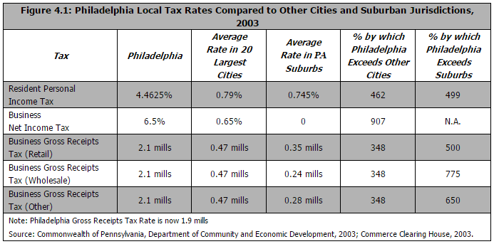
Tax Factors in Large Cities
Philadelphia Example
Higher Business Receipts Tax is a cost of business within the city compared to current suburban locations.
Source Located in Note Below Table | Note: 1 mills = 1% per $1,000

Slide 13
Work Cited
Neighborhood Scout. (2016). Philadelphia PA house prices and rental information - NeighborhoodScout. Retrieved from https://www.neighborhoodscout.com/pa/philadelphia/rates/#description
Philly.com. (2015). Map: Income and Poverty in the Philadelphia Region. Retrieved from http://www.philly.com/philly/infographics/medianincome.html
"Fishtown Neighborhood in Philadelphia, Pennsylvania (PA), 19125 Detailed Profile." Fishtown Neighborhood in Philadelphia, Pennsylvania (PA), 19125 Subdivision Profile. N.p., n.d. Web. 04 Oct. 2016.
"Northern Liberties Neighborhood in Philadelphia, Pennsylvania (PA), 19123 Detailed Profile." Northern Liberties Neighborhood in Philadelphia, Pennsylvania (PA), 19123 Subdivision Profile. N.p., n.d. Web. 04 Oct. 2016.
"South Philadelphia Neighborhood in Philadelphia, Pennsylvania (PA), 19148 Detailed Profile." South Philadelphia Neighborhood in Philadelphia, Pennsylvania (PA), 19148 Subdivision Profile. N.p., n.d. Web. 04 Oct. 2016.
"Abington, PA Demographics." Best Places Demographics. N.p., n.d. Web. <http://www.bestplaces.net/people/zip-code/pennsylvania/abington/19001>.
The Hartman Group. "ALDI Is A Growing Menace To America's Grocery Retailers." Forbes. Forbes Magazine, n.d. Web. 1 Oct. 2016. <http://www.forbes.com/sites/thehartmangroup/2015/04/14/aldi-is-a-growing-menace-to-americas-grocery-retailers/>
Levitte, Max. "Kroger vs. Walmart vs. Aldi: Which Is the Cheapest Grocery Store?" The Huffington Post. TheHuffingtonPost.com, n.d. Web. 04 Oct. 2016. <http://www.huffingtonpost.com/max-levitte/cheapest-place-to-buy-gro_b_5039301.html>.
Cafourek, Andrew"Grocery Shopping in New York City." Become A New Yorker RSS. N.p., 14 Mar. 2011. Web. 04 Oct. 2016. <http://becomeanewyorker.com/grocery-shopping-in-new-york-city/>.
Hurley, Madeline"Supermarkets & Grocery Stores in the US ." IBIS World. N.p., n.d. Web. 2016 <http://clients1.ibisworld.com.libproxy.temple.edu/reports/us/industry/majorcompanies.aspx?entid=1040>.
"Walmart Market Share." IBIS World. N.p., n.d. Web. <http://clients1.ibisworld.com.libproxy.temple.edu/reports/us/industry/majorcompanies.aspx?entid=1092>.

Slide 14
Work Cited
Yueqi Yang. "Philly's Millennial Population Growing Fastest Among 10 Largest U.S. Cities." Philadelphia Magazine. N.p., 02 Nov. 2015. Web. 03 Oct. 2016. <http://www.phillymag.com/business/2015/11/02/philly-millennial-population/>.
Carmichael, Matt. "Where Do Millennials Live?" Where Do Millennials Live? N.p., 14 Jan. 2016. Web. 03 Oct. 2016. <http://www.livability.com/blog/demographics/where-do-millennials-live>.
Gasca, Peter. "8 Shopping Habits of Millennials All Retailers Need to Know About." Entrepreneur. N.p., 7 Dec. 2015. Web. 03 Oct. 2016. <https://www.entrepreneur.com/article/253582>.
Rodrigue, Dr. Jean-Paul. "City Logistics." City Logistics. N.p., 2013. Web. 03 Oct. 2016. <https://people.hofstra.edu/geotrans/eng/ch6en/appl6en/ch6a2en.html>.
Sanicola, Laura. "College Graduates Are Flocking to These Cities." CNBC. CNBC, 05 Apr. 2016. Web. 03 Oct. 2016. <http://www.cnbc.com/2016/04/01/college-graduates-are-flocking-to-these-cities.html>.
Opray, Max. "The Secret behind the Success of Aldi's Store Layout." The New Daily.com.au. The New Daily, 19 Feb. 2016. Web. 04 Oct. 2016.
Castro, Vicky. "Today's Millennial Consumers May Be Picky, But They're Loyal, Too." Inc.com. Inc, 20 Jan. 2015. Web. 04 Oct. 2016.

