Slide 1
Leveraging Lucent’s Network Solutions

Slide 2
Theme
Nokia’s acquisition of Alcatel-Lucent provides the company with an opportunity to lease its fiber optic network to Google Fiber in the U.S.

Slide 3
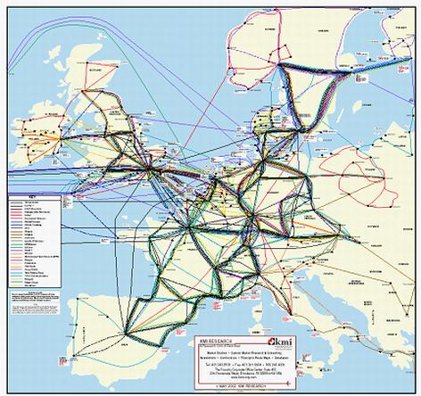
Why Not Europe
Different infrastructure
European Union not Google-friendly (Bird 2015)
(Rutherford 2001)
Notes:
http://www.businessinsider.com/why-does-europe-hate-tech-companies-2015-4

Slide 4
Google’s Encroachment On The Telecommunication Industry
Founded Google Fiber in 2011
Operating in 8 U.S. Cities
Provides 100 times faster internet service than competitors
- Google offers 1 gigabyte per second
- 10 megabyte per second competitor average
(GoogleFiber.com 2016)
Notes:
https://fiber.google.com/cities/kansascity/plans/#plan=small-business

Slide 5
Google’s Expansion Problems: Legal Problems
Slow Expansion
Reached only 8 cities in half a decade (Wehner 2015)
Acquired only 200,000 of its 5 million customer goal (Wehner 2015)
Legal landscape is not friendly to intrusions
(Frankle 2016)
Notes:
Charter sues Louisville, says city is favoring Google Fiber and AT&T …
AT&T sues Nashville in bid to stall Google Fiber | Ars Technica
http://www.bizjournals.com/louisville/news/2016/05/25/where-at-ts-lawsuit-against-the-citystands.html
http://www.businessinsider.com/google-fiber-is-succeeding-and-cable-companies-are-starting-to-feel-the-pressure-2015-4

Slide 6
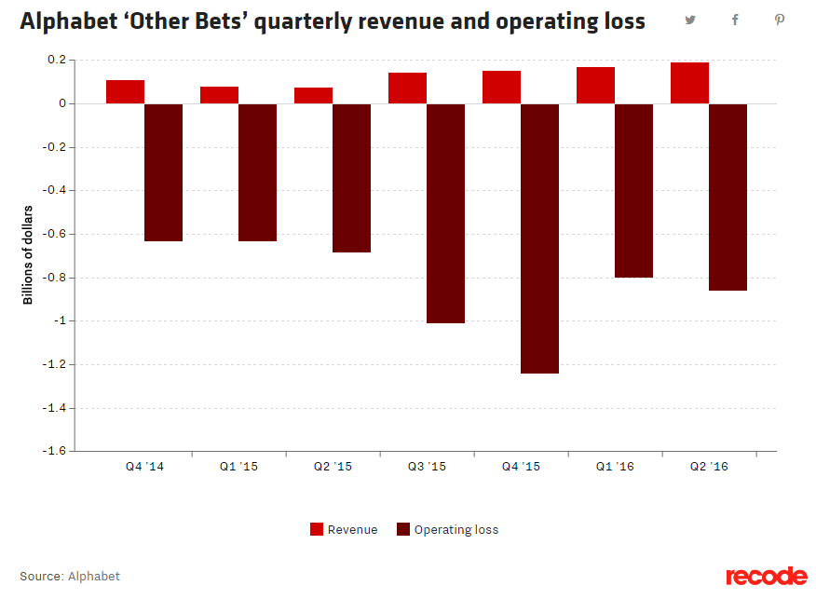
Google’s Expansion Problems: Financial Problems
Google must lay out its own fiber network in order to compete (Yarow 2013)
Arduous process that requires high installation costs
Already spent $130 million per city, with a total $1.044 Billion spent this year (Rosenbaum 2016)
Notes:
http://www.itscosts.its.dot.gov/its/benecost.nsf/DisplayRUCByUnitCostElementUnadjusted?ReadForm&UnitCostElement=Fiber+Optic+Cable+Installation+&Subsystem=Roadside+Telecommunications+
http://www.
cnbc.com/2016/08/15/googles-fiber-wants-to-reach-more-cities-but-costs-weigh.html
http://www.businessinsider.com/the-cost-of-building-google-fiber-2013-4

Slide 7
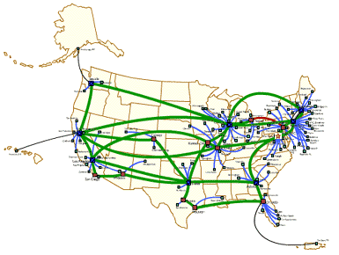
Nokia’s New Positioning
Alcatel-Lucent Cable and Fiber Optic Network
BytePile.com
Notes:
http://www.bytepile.com/network.php
Nokia now has control over Alcatel’s national fiber optic network, which can be used for internet and TV services.
It regularly rents out this infrastructure to other telecommunication companies like verizon, At&t, and Sprint
http://fortune.com/2015/04/16/nokia-alcatel-lucent/
Our proposal is for Nokia to let Google run its fiber optic service on our infrastructure and provide the tech giant with consulting services regarding maintaining their own infrastructure

Slide 8
Nokia’s New Positioning
Alcatel-Lucent constantly leases out its infrastructure
LTE and communications related cables are awarded to the big 3 telecommunications firms (Alcatel-Lucent 2010)
Fiber and internet networks infrastructure is used by small local infrastructure providers or government entities (Alcatel-Lucent 2010)
Notes:
https://networks.nokia.com/solutions/wireline/fiber-access

Slide 9
Reasons For Google To Cooperate
Google Major Products and Services
Internet Advertising
Internet Services
Software Development
Computer Hardware
Fixed Networks
Cloud Platforms
Digital Media
Nokia Major Products and Services
Digital Health Solutions
Tech and Network IP Licensing
VR Capturing
Mobile Networks
Fixed Networks
Cloud Services
Network Applications/Analytics
(Rosenberg 2016) (Nokia.com 2016)
Notes:
After Nokia’s restructuring there is very little overlap between the two.
Not really competitors, and can actually complement each other, because Google runs its business on the infrastructure of companies like Alcatel Nokia
http://www.investopedia.com/articles/investing/020515/business-google.asp

Slide 10
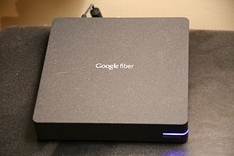
Reasons For Google To Cooperate
Bypass regulatory difficulties
Avoid installation costs by using existing infrastructure
Tap into a revenue source
Google can focus funds on ‘last mile gap’
Acquired company WebPass to pivot toward wireless delivery
(Carlon 2016)
(Carlon 2016)
Notes:
http://www.itscosts.its.dot.gov/its/benecost.nsf/DisplayRUCByUnitCostElementUnadjusted?ReadForm&UnitCostElement=Fiber+Optic+Cable+Installation+&Subsystem=Roadside+Telecommunications+
http://www.
cnbc.com/2016/08/15/googles-fiber-wants-to-reach-more-cities-but-costs-weigh.html
http://www.androidauthority.com/google-halving-fiber-workforce-half-moving-wireless-solution-712941/

Slide 11
Operations
Alcatel- Lucent Maintenance Services
Expansion possibilities
Bandwidth Capacity
Notes:
Introductory slide to operations:
When you examine the Operational effects of leasing out fiber to Google, you can see how well equipped to handle expansion Alcatel is. Specifically, the maintenance services Alcatel provides, the high bandwidth capacity it has to easily manage increased traffic, and the alignment of its current fiber with Google’s expansion plans, suggests how leasing fiber to Google is an operationally sound endeavor.
---

Slide 12
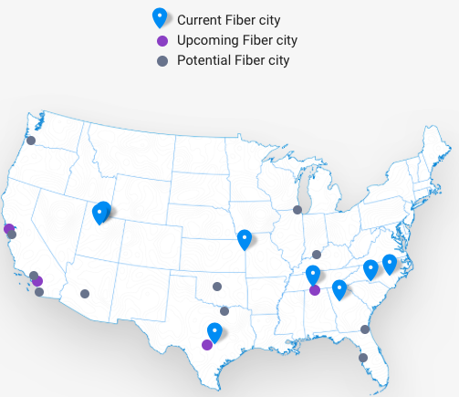
Expansion possibilities
Googlefiber.com, 2016
Notes:
https://fiber.google.com/newcities/
The map on the left, as previously mentioned, shows Alcatel’s cable and fiber optic network, and the map on the right shows the upcoming and potential cities that Google wishes to expand its fiber cable offerings. What’s important is that Alcatel has fiber infrastructure present where Google currently operates and where it wishes to expand. As a result, a potential leasing of fiber cable is highly feasible.

Slide 13
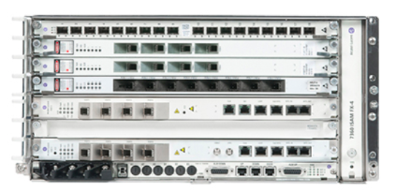
Bandwidth
7360 ISAM FX Shelf
Demand for bandwidth is growing as more people stream content
Google Fiber:1Gb/s
Alcatel- Lucent:2X100Gb/s per slot
4,8, 16 slot backplane
Nokia.com, 2016
Notes:
It’s projected, that over the next 4 years, the overall traffic on fibers is going to grow over 5 times. As a result, there will be a strain placed on all areas of a gigabit network. Nokia’s ISAM FX network is the market’s leading high-capacity fiber access platform. It provides the high capacity needed to power networks today and evolve for increased traffic. In other words, it is future proof for years to come.
2x100Gb/s per slot
---
Sources:
https://resources.alcatel-lucent.com/asset/200391
https://networks.nokia.com/products/7360-isam-fx-shelf
https://networks.nokia.com/solutions/gigabit-networks

Slide 14
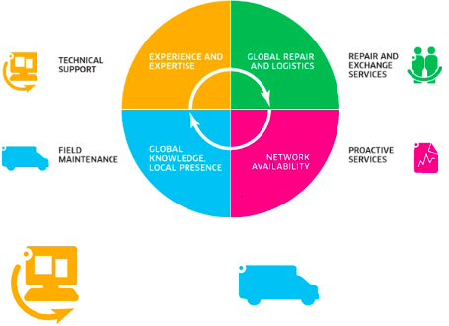
Alcatel-Lucent Maintenance Services
“Downtime is not an option if you want to capitalize on network opportunities.”
Nokia.com, 2016
Notes:
https://networks.nokia.com/services/maintenance-services
The existing expertise and capability that Alcatel houses are invaluable to ensure always-on networks.
The four services Alcatel provides are: technical support, field maintenance, repair & exchange services, and proactive services.
Technical Support
Access to expert engineers
Monthly performance metric report
Repair and Exchange
Defective parts are returned to Alcatel- Lucent for repair or replacement
Field Maintenance
Regular field inspection of equipment and its associated environment
Proactive Services
Creates customer specific KPIs and proactively measures whether the target thresholds are being met

Slide 15
Legal/Political
One Touch Make Ready
Alcatel-Lucent will have to navigate legislation for private wires (Brodkin, 2013)
FCC rules regulate the access to privately owned wires. (Brodkin, 2016)
Fiber to the home (FTTH) comes with its own regulations (Glaser, 2016)
Notes:
http://arstechnica.com/tech-policy/2013/12/why-att-says-it-can-deny-google-fiber-access-to-its-poles-in-austin/
One Touch: http://arstechnica.com/tech-policy/2016/08/google-fiber-stalls-in-nashville-in-fight-over-utility-poles/
FTTH:
http://www.telecomattorneys.com/fibernetworks.html

Slide 16
Legal/Political
Nashville case:
City Metro Council are debating legality of One Touch Make Ready
AT&T finds that this ordinance puts them at risk
AT&T: 20% of Nashville utility poles
NES: 80% of Nashville utility poles
(McGee, 2016)
Notes:
http://www.tennessean.com/story/news/2016/08/13/council-attorney-raises-legal-issues-google-fiber-proposal/88636478/

Slide 17
Financial Considerations for Alcatel-Lucent
Contract Revenue of up to $1 billion for 4 years
Verizon currently has a 4-year, $4 billion deal with Alcatel-Lucent for its LTE network (Alcatel-Lucent 2010)
Additional consulting services revenue of around $20 million (Yarow 2016)
technical support
field maintenance
repair and exchange
proactive services
Notes:
http://www.businessinsider.com/the-cost-of-building-google-fiber-2013-4
https://networks.nokia.com/services/maintenance-services
https://networks.nokia.com/press/2010/002258

Slide 18
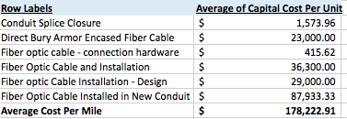
Financial Considerations for Alcatel-Lucent
Legal costs from possible backlash and regulatory navigation for letting Google use Alcatel-Lucent’s infrastructure.
Operational costs from continuing to lay out fiber to expand infrastructure.
Currently an average of $178,222 per mile (USDT 2016)
Maintenance costs from servicing the fiber technology
(USDT 2016)
Notes:
http://www.businessinsider.com/the-cost-of-building-google-fiber-2013-4
https://networks.nokia.com/services/maintenance-services
http://www.itscosts.its.dot.gov/its/benecost.nsf/DisplayRUCByUnitCostElementUnadjusted?ReadForm&UnitCostElement=Fiber+Optic+Cable+Installation+&Subsystem=Roadside+Telecommunications+

Slide 19
Risk
Business risk of upsetting current major customers like AT&T, Sprint, and Verizon
Alcatel-Lucent will be catering to overlapping competitors, which poses a conflict of interest
Notes:
Addressing risk of Upsetting current major customers like AT&T, Sprint, and Verizon:
We are renting out a separate part of our business, that does not interfere with the services we currently provide our current big customers
More importantly, Alcatel has been building this infrastructure for a while. Customers know that it would have been used by either us or one of their competitors. Therefore, may actually result in bigger contract from one of the big three telecommunication companies.
If a customer was to leave LTE infrastructure as a result, it would result in an opening for someone else to compete for the coverage we offered.

Slide 20
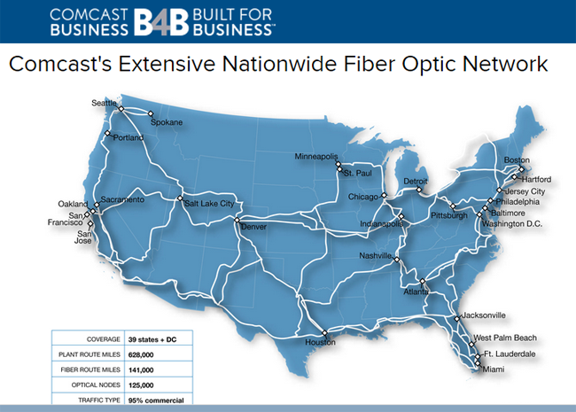
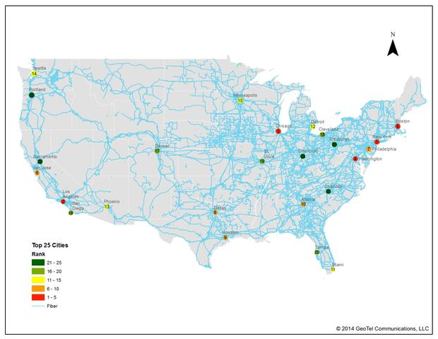
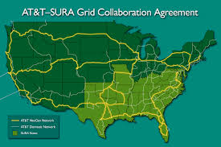
Nature of the Industry
(Barford 2009)
(Powell 2015)

Slide 21
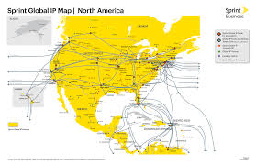
Nature of the Industry
(Barford 2009)

Slide 22
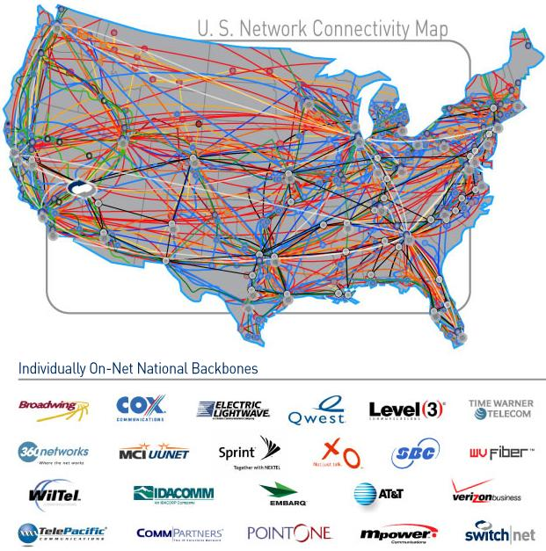
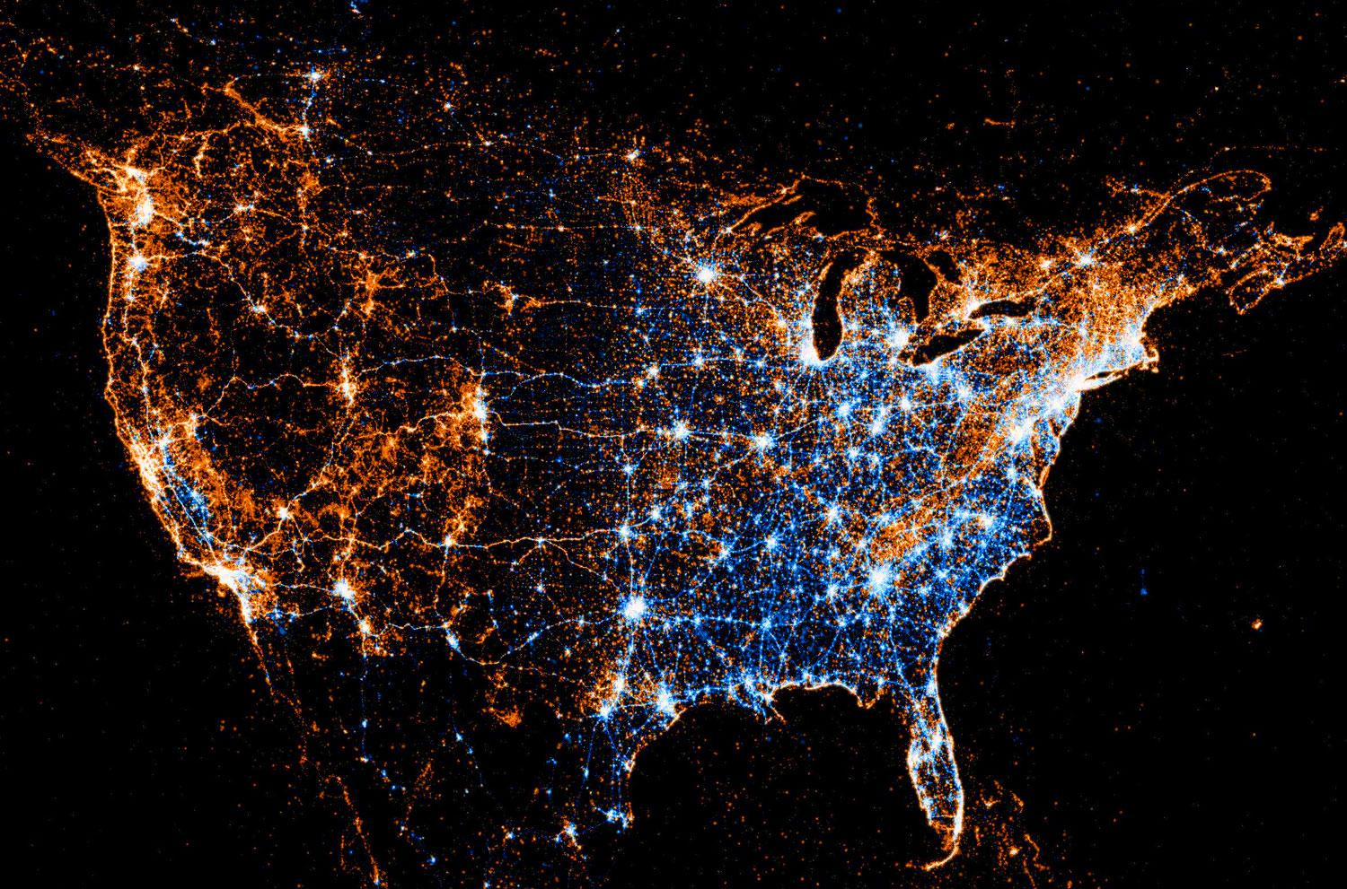
Nature of the Industry
(FOA.org 2016)

Slide 23
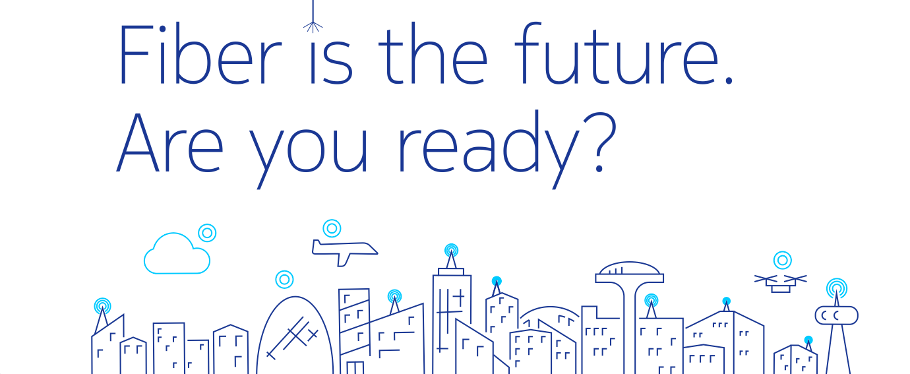

Slide 24
References (Financials)
Alcatel-Lucent. "Verizon Wireless Awards Alcatel-Lucent Contract Expected to Be Worth US$4 Billion for Ongoing 3G Network Expansion and LTE Build out." Nokia Networks, 2010, networks.nokia.com/press/2010/002258.
Nokia. "Maintenance Services." Nokia Networks, 2016, networks.nokia.com/services/maintenance-services.
USDT. "RITA | ITS | Costs: Unit Cost Components for Fiber Optic Cable Installation." RITA | ITS | Welcome to the Costs Database, 2016, www.itscosts.its.dot.gov/its/benecost.nsf/DisplayRUCByUnitCostElementUnadjusted?ReadForm&UnitCostElement=Fiber+Optic+Cable+Installation+&Subsystem=Roadside+Telecommunications+.
Yarow, Jay. "The Cost Of Building Google Fiber." Business Insider, 8 Apr. 2013, www.businessinsider.com/the-cost-of-building-google-fiber-2013-4.

Slide 25
References (Legal)
AT&T vs Google: Brodkin, Jon. "Why AT&T Says It Can Deny Google Fiber Access to Its Poles in Austin." Ars Technica. N.p., 16 Dec. 2013. Web. 4 Nov. 2016. <http://arstechnica.com/tech-policy/2013/12/why-att-says-it-can-deny-google-fiber-access-to-its-poles-in-austin/>.
Nashville: Brodkin, Jon. "Google Fiber Stalls in Nashville in Fight over Utility Poles." Ars Technica. N.p., 01 Aug. 2016. Web. 4 Nov. 2016. <http://arstechnica.com/tech-policy/2016/08/google-fiber-stalls-in-nashville-in-fight-over-utility-poles/>.
FTTH: "Legal And Regulatory Issues Arising From Fiber-To-The-Home Networks In Master-Planned Communities." Telecom Attorneys. N.p., n.d. Web. 4 Nov. 2016. <http://www.telecomattorneys.com/fibernetworks.html>.
One Touch Make Ready: McGee, Jamie, and Joey Garrison. "Council Attorney Raises Legal Issues with Google Fiber Proposal." The Tennessean. N.p., 13 Aug. 2016. Web. 5 Nov. 2016. <http://www.tennessean.com/story/news/2016/08/13/council-attorney-raises-legal-issues-google-fiber-proposal/88636478/>.

Slide 26
References (Operations)
Expansion Plans." Expansion Plans – Google Fiber. N.p., 2016. Web. 09 Nov. 2016.
<https://fiber.google.com/newcities/>.
"Gigabit Networks." Nokia Networks. Nokia, 21 Oct. 2016. Web. 09 Nov. 2016. <https://networks.nokia.com/solutions/gigabit-networks>.
"Maintenance Services." Nokia Networks. Nokia, 11 Jan. 2016. Web. 09 Nov. 2016. <https://networks.nokia.com/services/maintenance-services>.
Nokia Gigabit Express. Nokia, n.d. Web. 09 Nov. 2016.
<https://resources.alcatel-lucent.com/asset/200391>.
"7360 ISAM FX." Nokia Networks. N.p., 18 Aug. 2016. Web. 09 Nov. 2016. <https://networks.nokia.com/products/7360-isam-fx-shelf>.

Slide 27
References (Introduction)
Bird, Mike. "Why Europe Hates American Tech Companies." Business Insider. Business Insider, Inc, 02 Apr. 2015. Web. 09 Nov. 2016.
Brodkin, Jon. "AT&T Sues Nashville in Bid to Stall Google Fiber." Ars Technica. N.p., 23 Sept. 2016. Web. 09 Nov. 2016. <http://arstechnica.com/tech-policy/2016/09/att-sues-nashville-in-bid-to-stall-google-fiber/>.
Frankel, Daniel. "Charter Sues Louisville, Says City Is Favoring Google Fiber and AT&T." Http://www.fiercecable.com. N.p., 04 Oct. 2016. Web. 09 Nov. 2016. <http://www.fiercecable.com/cable/charter-sues-louisville-says-it-has-unlevel-playing-field-against-google-fiber-and-at-t>.
"Network." BytePile.com - Network. N.p., n.d. Web. 09 Nov. 2016. <http://www.bytepile.com/network.php>.
"Plans and Pricing." Google Fiber. N.p., n.d. Web. 09 Nov. 2016. <https://fiber.google.com/cities/kansascity/plans/#plan=small-business>.
Rosenbaum, Eric. "Google's Speedy Fiber Runs into Reality of Huge Cable Costs." CNBC. CNBC, 15 Aug. 2016. Web. 09 Nov. 2016. <http://www.cnbc.com/2016/08/15/googles-fiber-wants-to-reach-more-cities-but-costs-weigh.html>.
Carlon, Kris. "Google Reportedly Cutting Fiber Workforce in Half, Moving to Wireless Solution." Android Authority. N.p., 27 Aug. 2016. Web. 09 Nov. 2016. <http://www.androidauthority.com/google-halving-fiber-workforce-half-moving-wireless-solution-712941/>.

Slide 28
References (Introduction)
Rosenbaum, Eric. "Google's Speedy Fiber Runs into Reality of Huge Cable Costs." CNBC. CNBC, 15 Aug. 2016. Web. 09 Nov. 2016. <http://www.cnbc.com/2016/08/15/googles-fiber-wants-to-reach-more-cities-but-costs-weigh.html>.
Rutherford, Jay. "Technological Connectivities of European Cities?" GaWC Research Bulletin 181. KMI, 2001. Web. 09 Nov. 2016. <http://www.lboro.ac.uk/gawc/rb/rb181.html>.
Wehner, Mike. "Google Fiber Is Succeeding and Cable Companies Are Starting to Feel the Pressure." Business Insider. Business Insider, Inc, 15 Apr. 2015. Web. 09 Nov. 2016. <http://www.businessinsider.com/google-fiber-is-succeeding-and-cable-companies-are-starting-to-feel-the-pressure-2015-4>.
Yarow, Jay. "It's Surprisingly Inexpensive For Google To Build Its Cable-Destroying Google Fiber Network." Business Insider. Business Insider, Inc, 08 Apr. 2013. Web. 09 Nov. 2016. <http://www.businessinsider.com/the-cost-of-building-google-fiber-2013-4>.

Slide 29
References (Risk)
" Fiber Optic Resources For STEM Teachers." Fiber Optics Association. N.p., n.d. Web. 09 Nov. 2016. <http://www.thefoa.org/PPT/>.
Barford, Paul. "InterTubes: A Study of the US Long-haul Fiber-optic Infrastructure." Wisc.edu. N.p., 2009. Web.
Powell, Rob. "Comcast Climbs Up a Rung on the Business Ladder." Telecom Ramblings RSS. N.p., 6 Sept. 2015. Web. 09 Nov. 2016. <http://www.telecomramblings.com/2015/09/comcast-climbs-up-a-rung/>.
Rosenberg, Eric. "How Google Makes Money." Investopedia. N.p., 05 Aug. 2016. Web. 09 Nov. 2016. <http://www.investopedia.com/articles/investing/020515/business-google.asp>.

