Slide 1

Phoenix Foundation's Human Resources:
Personnel Policy
Presented by: Sasha K. Buddle
06/27/2012

Slide 2

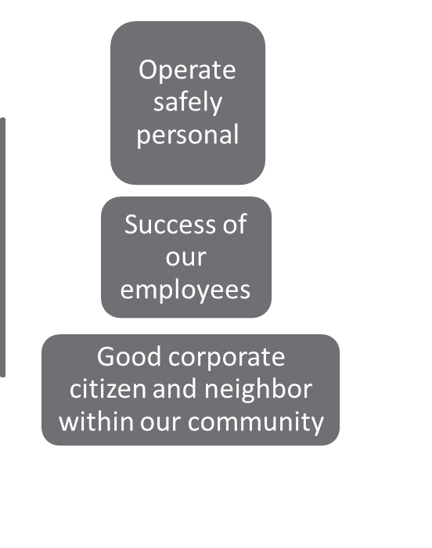



Welcome to the team!
ues
Val
Honesty
Respect
Loyalty
Expertise
Integrity

Slide 3
Contents:
Corporate Policies:
Administration
Compensation
Work Schedule
Conduct in the Work Place
Time off
Benefits
Employee Improvement Programs
Ending your Career at Phoenix Foundation

Slide 4



Administration
Americans with Disabilities
Access to Personnel Files
Background Information

Slide 5
Compensation and Work Schedule
Employment Status
Full Time 37.5 – 40 hrs/wk
Exempt
Non-exempt
Part Time 20-25 hrs/wk

Slide 6


Conduct in the Work Place
Gifts, Entertainment and Favors
Harassment Prevention
Drugs and Alcohol

Slide 7

Paid and Unpaid Time off
Eligibility for Paid Time off
Requesting paid Time
Unplanned absences

Slide 8
Benefits
Medical Benefits
Dental Benefits
401(k) Savings Plan

Slide 9


Employee Education and Development Programs
Training and Education
Tuition Reimbursement

Slide 10

Moving on from Phoenix Foundation
  Voluntary Separation
  Involuntary Separation
  Exit Process

