Slide 1
Group G: Jacob Andrews, Dante Bieri, Shuyue Ding, Leah Herman, Justin Teyssier

Slide 2
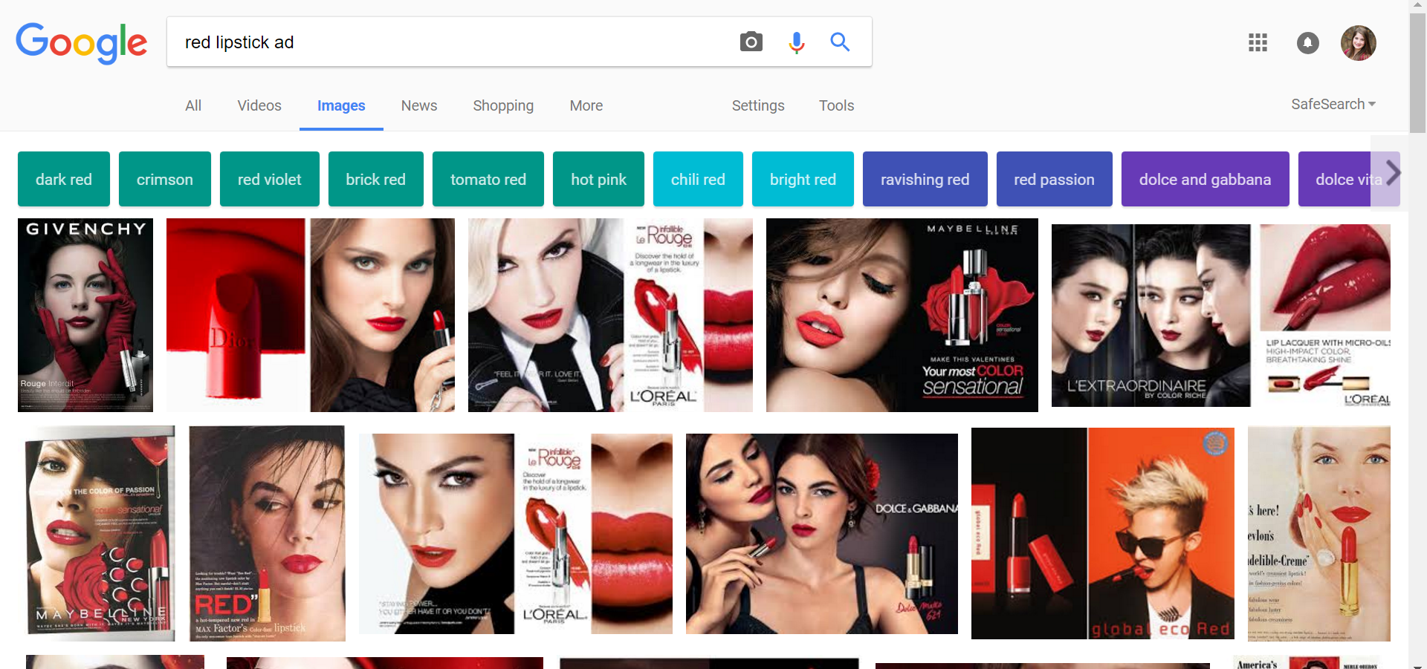
What’s Wrong?

Slide 3
mission statement: Develop technology enabled web tools for a true, virtual representation of their cosmetics for people of any shade
Big Idea?
Notes:
To enable prospective clients the ability to get a true sense of how the cosmetics will look based on their skin tone
To enable prospective clients the ability to see the model move, blink and act realistically while wearing Pound Cake cosmetics
Determine what types of prospective clients are utilizing this service and what is important to them b. As few words as possible
We noticed that people of color do not have a visual representation of their skin tones across any major brand; we want to make skin-tone representation with lipstick a reality. People of color are used to buying makeup that does not show up on their lips, and does not create a beautiful contrast with their skin tone, so our goal is to represent Pound Cake lipsticks properly on every skin tone.
c. You tell the story
Through the representation of our personas and their individual wants and needs, we will show you a prototype that positively aligns with Pound Cake’s mission and their customer needs.

Slide 4
Stakeholders
Camille & Johnny
Current User
Administrator
Prospective user

Slide 5
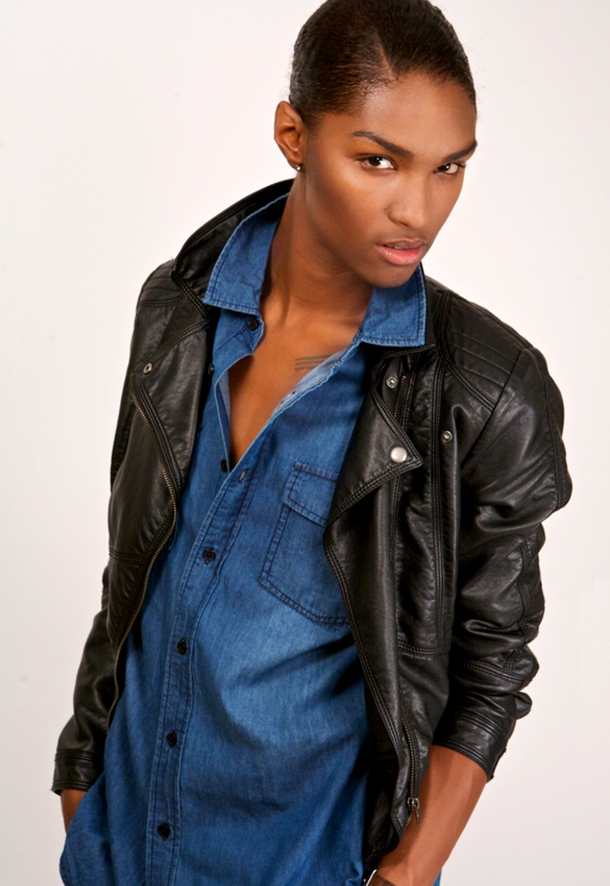
PGP: They/Them
Birthday: 11/4/81
Skin tone: Warm
Morgan Walker:
Social AwareNess: Fairly Active
Make-up use:Somewhat experienced
Age: 35
Occupation:Professor of gender studies
Location: Philadelphia
Marital Status: Married
Children: 2
Income: $65,000
Education: Penn
Hobbies: Acting, Drag Shows, volunteering
Quote: “I can never find the right color for my skin tone!”
Complete the Quiz

Slide 6
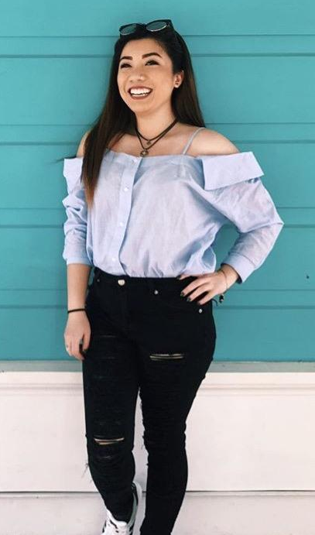
PGP: She/Her
Birthday: 4/27/96
Skin tone: Medium
Mina Kwong:
Social Awareness: Somewhat Active
Make-up use: Very Experienced
Age: 21
Occupation: Student
Location: North Philadelphia
Marital Status: Single
Income: $25,000
Education: Temple
Hobbies: Photography, Exploring,Shopping, Makeup
Quote: “My friends have to drag me out of Sephora”
Upload a Photo

Slide 7
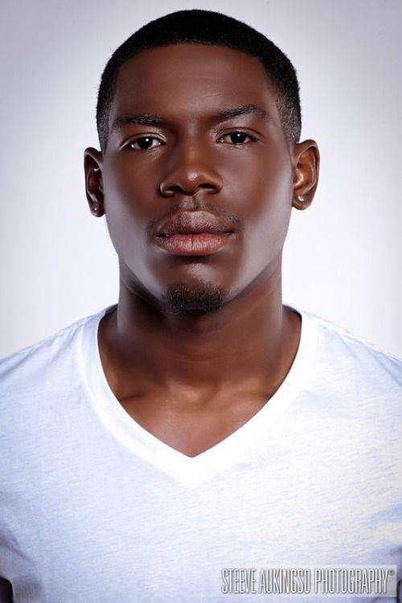
PGP: He/Him
Birthday: 2/16/92
Skin tone: Rich
Andre Jones:
Social Awareness: Extremely Active
Make-up use: Inexperienced
Age: 25
Occupation: Manager, H&M;
Part-time web consultant
Location: West Philadelphia
Marital Status: Dating
Income: $35,000
Education: Some College
Hobbies: Fashion, Social Activism, Blogging
Quote: “It’s more important to look good than to feel good!”
Administrator
Notes:
Make him an administrator??

Slide 8
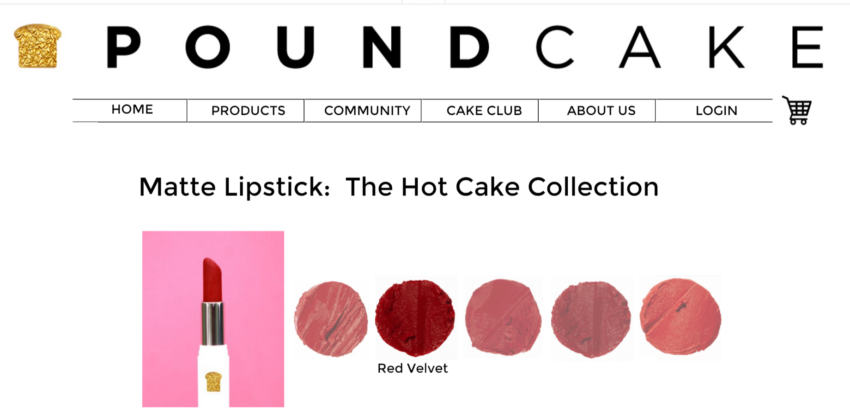
Let’s cut the cake...

Slide 9
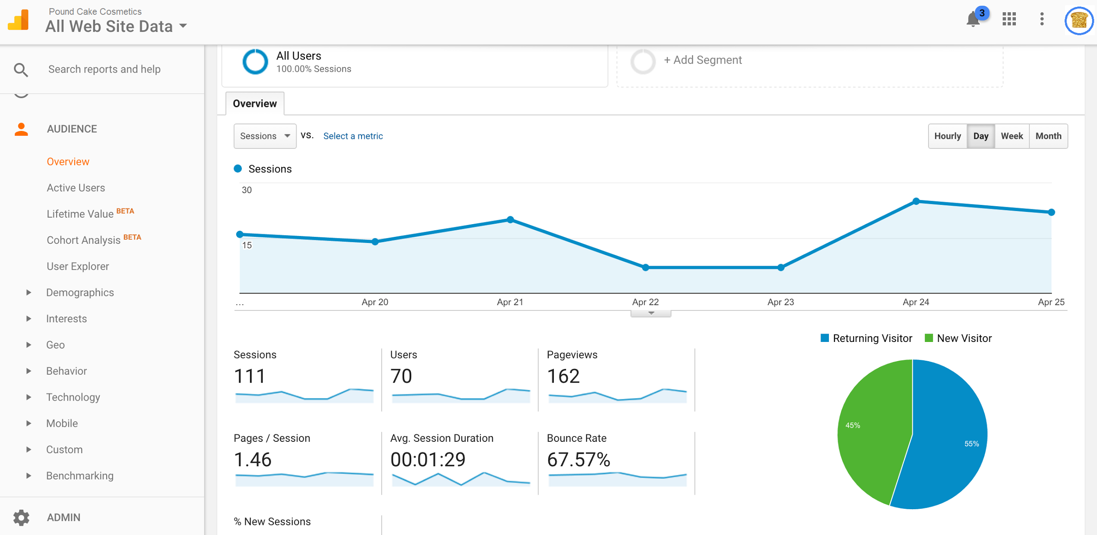
Google Analytics

Slide 10
Let’s enjoy the cake...
Cloud Capability
Easy to use
Content Management
Low Maintenance and Upkeep
One part-time employee
Customer Participation
Notes:
Enjoying the cake

Slide 11
$11,000 for a Web Developer
(10 weeks x 20 hours per week x $55 hourly rate)
Making the cake...
$3,100 for Cloud Services
(based on researched estimates)
1 employee
(2-3 hours/week)
Web Budget: $15,000
Total Expenses: $14,100
Notes:
Maintenance free for you
One or two people 1-2 hours per week
Approving photos customer faqs
Making the cake

Slide 12
Questions?

