Slide 1
High Paying City Departments
--OpenDataPhilly--
Sakeena A McLain-Cook
Gabriella C Baldini
Xiaoxu Liu
Calvin Vuong
Shuyue Ding
Notes:
https://www.opendataphilly.org/dataset/employee-salaries-overtime
Slide 1 will list your group members and the title of your presentation.

Slide 2
Scenario
Looking for a job after/before graduation
Better with higher salaries
What departments have the highest-paying jobs overall?
(City Government of Philadelphia)
Notes:
Ding and Sakeena:
Question:What department has highest salaries job? (element : department, job, salaries, )
It is important because when we looking for a job, we can better determine which agency to work for.
Analysis use : average , mode, mid, comparion
Slide 2 will describe the scenario. What question do you want to answer and why is it important?
Ding: Speech notes: Most of us need to find a job either before or after graduation. Of course, the more salaries the better it will be. So, It comes the question, What department has highest salaries job?

Slide 3
Key Elements
Departments
Jobs
Salaries
Notes:
Key elements (describe data): department, job, salaries,
Slide 3 will describe the data. What are the key elements and how did you get it?
Ding: speech notes: There are three key elements departments, jobs, and salaries, and they all come from the dataset “Employee_Salaries.

Slide 4
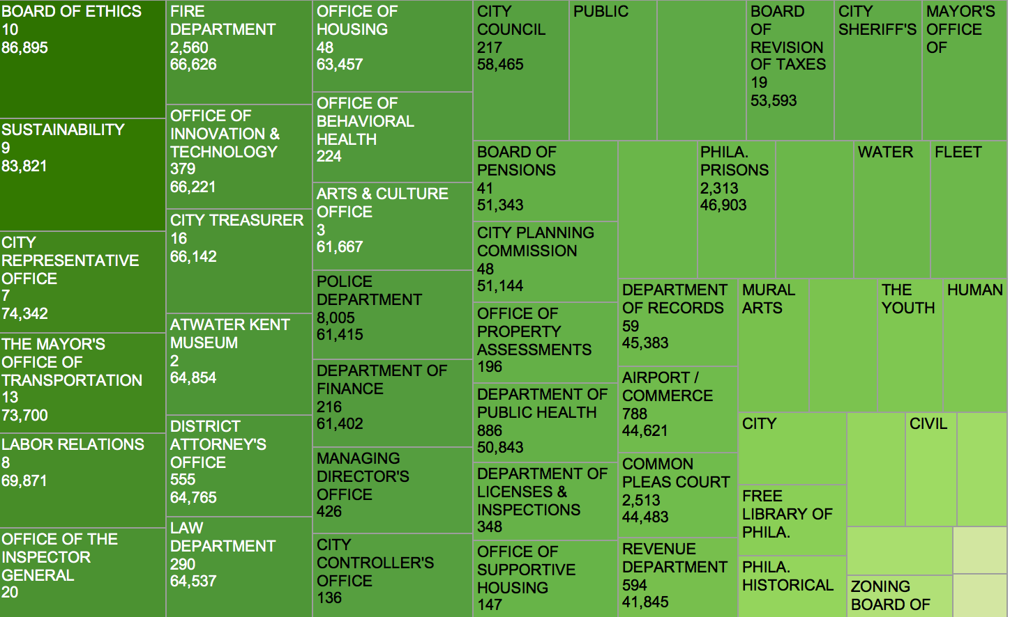
BAD
DATA
Notes:
Explanation after talked to professor: First of all, we consider this dataset has bad data. It looks like the board of ethics has the overall highest job; however, when we go back to the excel file, we found out that this answer is wrong because this department only have 10 jobs. When we looked at the dataset, many other departments have jobs with zero annual salaries, so that cause the bad data.
Bad or Dirty Data refers to information that can be erroneous, misleading, and without general formatting.
Ding and Sakeena:
1.Outlier salaries --clean data
The first thing is to clean data---make a graph like we did in assignment #3 , find the outliers and clean it, and then analysis data.
Slides 4 and 5 will describe the analysis and the results. Make good use of data visualizations.
Ding: Speech notes: we want to find out is there any outliers in this dataset, so we made a scatterplot. It looks like that one is an outlier. however , when we filtered the job title, we found out that this person Sam GULINO is the only one who has this job, so there is no way we consider this is an outlier. (we do not have other people who did the same job to compare with, it is possible that medical examiner is a very high salary job.)

Slide 5
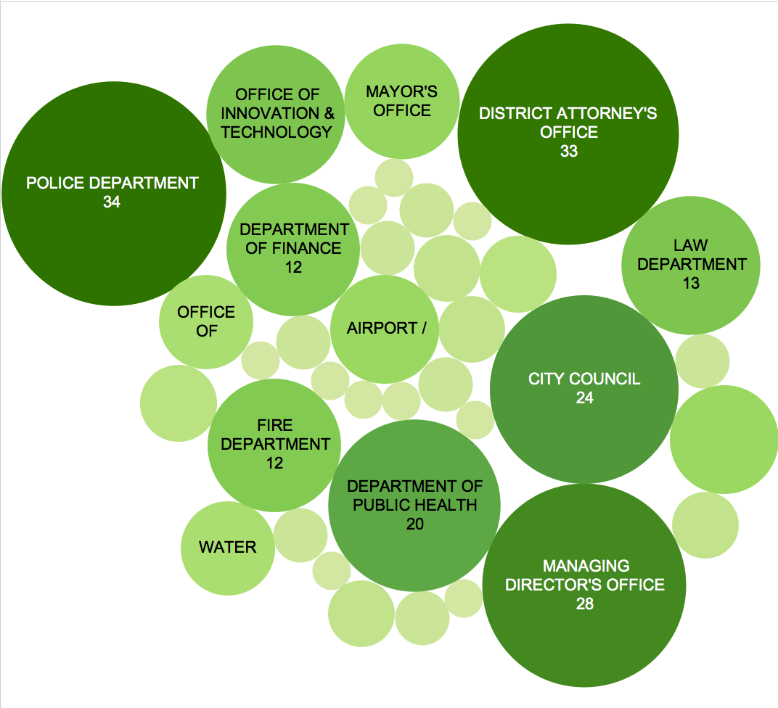
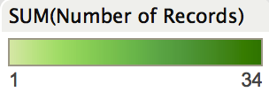
Comparing
Notes:
Explanation after talked to professor: If we consider equal or higher than the 120,000 dollars is high salary, then we have many department fall into. We can see from this graph, Police department has 34 job which over 120,000 dollars annually, which we considered has the highest overall salaries.
May be use mode/mid because mean is sensitive with outliers.
Ding and Sakeena:
2.Compare about same job with different salaries. (don’t know how to do it. I think there is no way to show it on the screen, because too much title/jobs)
3.Same department, highest and lowest salaries, different job
1.In department: Highest average salary-Board of ethics
2.in board of ethics, the salaries comparing.
Explanation after talked to professor: If we consider equal or higher than the 120,000 dollars is high salary, then we have many department fall into. We can see from this graph, Police department has 34 job which over 120,000 dollars annually, which we considered has the highest overall salaries.

Slide 6
Conclusion
Graduation---Difficult to get very high paying jobs
Known---departments have more high paying jobs than others
Higher chance---Promotion with over $120,000 salaries
Notes:
Conclusion
Almost no way to have very high salaries before or right after graduation----right now we know that in City Government of Philadelphia, what departments have more high paying jobs than others----if we choose those department, we can have higher chance to get a job with over $120,000 salaries when we get promotion.
Choosing the departments that rank high in annual salaries can’t ensure people get high salaries right after graduation, but people who choose these departments have a higher chance to get high salaries than people who choose other departments.
About infographics: Why is the key message so important? It’s a reader attention span problem similar to consumer product packaging on a crowded store shelf, articles in a newspaper, or a pile of job candidate resumes. Most readers are going to read an infographic for only a few seconds. They’re skimming, and this is how the majority of readers will interact with your infographic. An infographic designer needs to approach the design process with this fact in mind. A rule of thumb is that the design needs to clearly communicate the key message to the readers in less than five seconds. This is the 5-second rule, and comes from my own web analytics of millions of page views on the CoolInfographics.com site over the last five years. Most of the page view duration times are 5–10 seconds, and a good infographic design needs to successfully communicate its key message to the readers within that time. That way the infographic can communicate its main point to all the readers, even when they are skimming and they don’t take the time to read the entire infographic.
Another way to approach this idea is to focus all the information in the infographic to tell one story really well. Don’t try to tell a bunch of small stories. One of the secrets to any type of clear communication is to keep the information focused and eliminate any data that isn’t directly related. Infographic designs that visualize data just because it’s available become cluttered, and the readers don’t know what data to focus on.

Slide 7
Reference
D. (2016, April 4). Employee Salaries & Overtime - OpenDataPhilly. Retrieved April 17, 2016, from
https://www.opendataphilly.org/dataset/employee-salaries-overtime
( OpenDataPhilly)
Notes:
References , ch 6
D. (2016, April 4). Employee Salaries & Overtime - OpenDataPhilly. Retrieved April 17, 2016, from https://www.opendataphilly.org/dataset/employee-salaries-overtime

