Slide 1
Park Towne Place
By: Shiting Liu, Wenting Lu, Zhengxuan Guo

Slide 2
Investment Goals and Objectives
Rate of return =12%
U.S. Treasury bond rate of (2.6%)ten year
9.4 % risk premium
NPV>0 and IRR>12%.

Slide 3
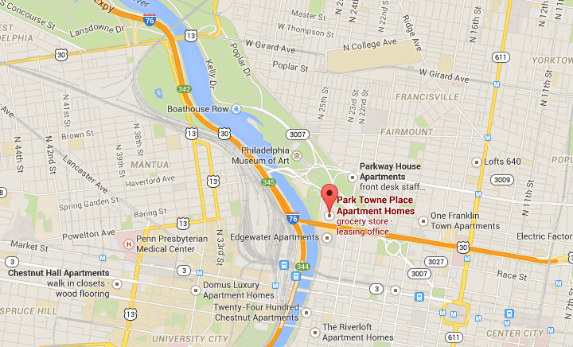
Location
Located in the Center City area of Philadelphia
Just 1.5 miles from SEPTA Subway and 30th Street Station
Near I-676 and I-76
Also in the School District of Philadelphia
Provide complimentary shuttle service

Slide 4
Property Description
A historic apartment complex located in the Logan Square
Offering upscale high rise living in Center City Philadelphia
It was listed on the National Register of Historic Places in 2011.
Facilities and Amenities
Underground parking garage
Swimming pool
Fitness center
On-site recycling
Laundry facility each floor
Upgraded kitchen and bath
Free Wi-Fi
24-hours security
Shuttle Bus (Center City/University City/Shopping Mall)

Slide 5
Apartment Overview
Year built: 1957-1959s Number of buildings: 4
Number of floors: 18 Total apartment units: 957
Gross size: 10 acres
Access: take I-76 E to I-676 E (Vine Street Expressway) to Benjamin Franklin Parkway / 22nd street exit. At the first light, make a left onto 22nd street to Park Towne Place drive. Make next available left hand turn into the property follow the signs for the Leasing Center located in the South Building.

Slide 6
National Trends
US Department of Energy provides the current crude oil price is 74.36 dollar per barrel
Industrial production growth rate: 4%
Net Exports: 1.575 trillion
Inflation rate: 1.7%
Interest Rate (Fed Funds Rate): 0.25%
Gross Domestic Product (GDP): 17.54 trillion
Taxes on income, profits and capital gains: 56.51% of revenue
Commercial bank prime lending rate: 3.3%
Stock of domestic credit: 16.97 trillion

Slide 7
Regional Trends
Philadelphia county is the economic and cultural center of the Delaware Valley
Population: 1,553,165 in 2013
Philadelphia Area Employment: 1,898,260
Employment increased 0.9%
Increasing in education and health service, trade, transportation and public services, business services
Decreasing in government, manufacturing, and information jobs
Median household income: $60,482 in 2013 ↓ 0.81%

Slide 8
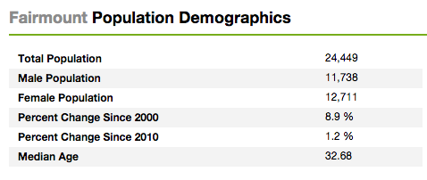
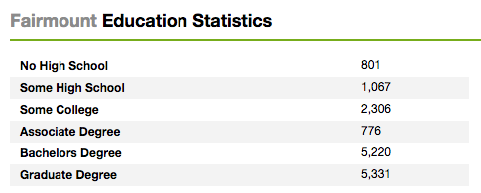
Neighborhood Trends

Slide 9
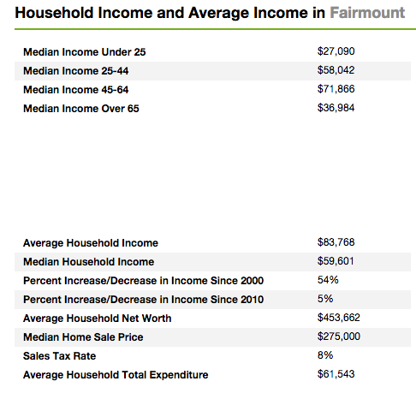
Neighborhood Trends

Slide 10
Competition Analysis

Slide 11
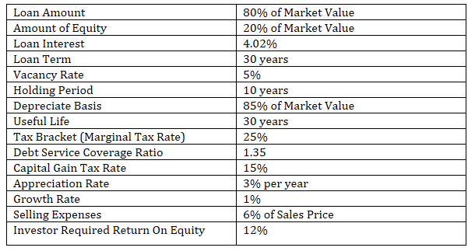
Project Assumptions

Slide 12
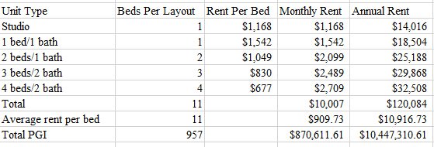
Net Operating Income
Potential Gross Income (PGI):

Slide 13
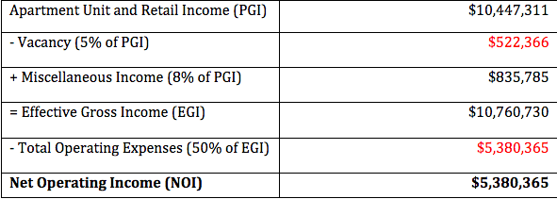
Net Operating Income (NOI)

Slide 14
Market Value
Band of Investment Cap. Rate Method
Underwriters’ Method

Slide 15
Band of Investment Method

Slide 16
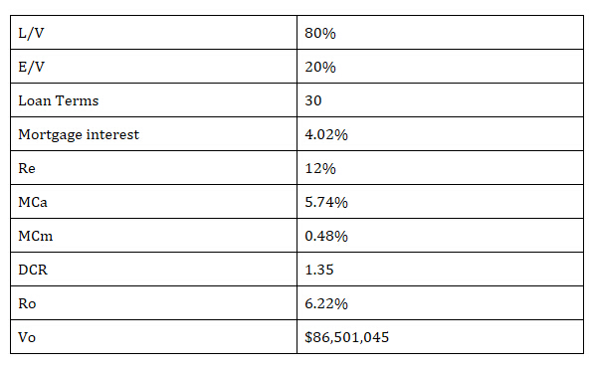
Underwriter’s Method

Slide 17
Amortization
Annual Debt Service
= Total of Loan * Mortgage Constant
= $65,380,538 * 5.74% = $3,752,843
Interest (1st year)
= Total of Loan * Loan Interest
= $65,380,538 * 4.02% = $2,628,298
Principle (1st year)
= Annual Debt Service - Interest (1st year)
= $3,752,843 - $2,628,298 = $1,124,545
Balance of Loan (1st year)
= Total of Loan - Principal (1st year)
= $65,380,538 - $1,124,545 = $64,255,993

Slide 18
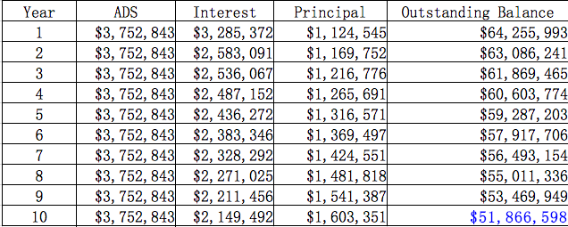
Amortization

Slide 19
Depreciation

Slide 20
After Tax Cash Flow
The NOI is expected to grow at 1% per year

Slide 21
After Tax Equity Reversion

Slide 22
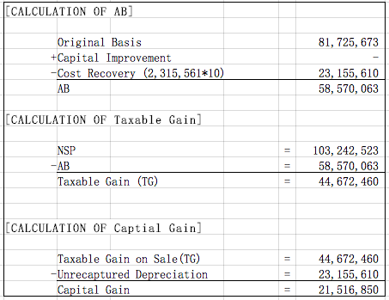
Capital Gain (ATER)

Slide 23
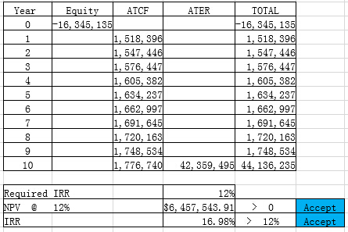
NPV & IRR Calculation

Slide 24
Sensitive Analysis
Assume 0% change in NOI for After Tax Cash Flow

Slide 25
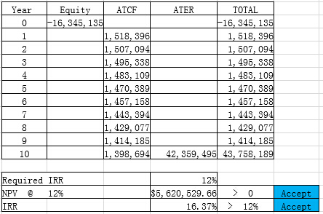
New NPV & IRR Calculation

Slide 26
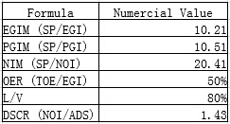
Rules of Thumb

Slide 27
Rules of Thumb
EGIM: it will take approximately 10.21 years of EGI to cover the purchase price
PGIM: uses 10.51 years of PI to payback
NIM: it will take approximately 20.41 years to cover the sales prices with NOI
OER: shows 50% TOE
L/V: is at a rather highly leveraged side of 80%
DSCR: is in a typical range for a large income property

Slide 28
Risk Analysis
Type of Risks:
Business Risk: Vacancy rate, Rental rate, Miscellaneous income, and
Operating expenses
Financial Risk: Leverage & Interest Rate
Controlling Risk:
Risk premium
Diversify portfolio
Study of market data

Slide 29
Investment Decision
Invest Park Towne Place:
NPV. > 0
IRR (16%/17%) > 12%
Rules of Thumb

Slide 30
Works Cited

