Slide 1
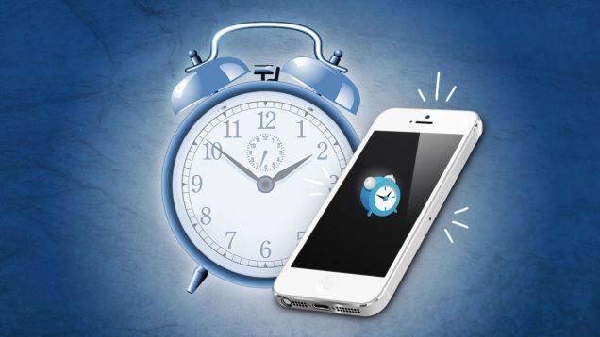
COMMUT3R
By: Emily Dryden, Brooke Hirst, Andrew Rudoi, Evan Tini

Slide 2
Problem
Currently people arrive late to:
Doctor appointments
School/Work
Meetings
Social events
Flights
People arrive late due to:
Weather
Traffic
Misinterpretations of current conditions
Didn’t leave themselves enough time for their morning routine

Slide 3
Solution: COMMUT3R
COMMUT3R integrates information from:
A person’s calendar
Traffic and weather applications from a user’s device
Google maps
NBC10
WeatherChannel
COMMUT3R takes this information and generates alarms that notify the user of when he/she needs to leave their current location to arrive at their destination on time.

Slide 4
How does it work?
A user purchases the app for a one-time fee of $0.99
Hosted locally on user’s device
Configured for iOS and Android
No hardware, software, or databases needed
No data is collected by COMMUT3R
The app integrates information from various apps on the device to create a service
Ensures users’ privacy

Slide 5
What is the Outcome?
Current
People use their own assumptions to anticipate traffic conditions, causing them to arrive late to events when their assumptions are wrong.
Future
Users will increase their punctuality since the app will notify them when they need to leave their current location, in order to make it to their event at the specified start time.

Slide 6
What is the Performance?
Current
People purchase and consult with many traffic/weather apps to help them anticipate current road conditions and travel times.
Future
People will only need to use one app, COMMUT3R, to anticipate traffic and weather conditions into their commutes.
People spend time in the morning watching the news and listening to the radio to help them understand what the current traffic conditions are like.
Users will also have to remember to specify their event’s correct address and start time in their calendar.

Slide 7
What is the Cost?
Current
People spend time listening to the news and radio in order to learn about current traffic conditions.
Future
Users will have to pay a one-time fee of $0.99 to purchase the app.
Users will save time in their day because they will no longer need to pay close attention to the news and radio in order to anticipate traffic conditions.
People commonly arrive late to events because of unexpected traffic conditions.
Users will increase their punctuality.

Slide 8
What is the Risk?
Current
People will arrive late to events whenever they misinterpret traffic and weather conditions.
Future
Users’ phone battery may die, which would cause the app to not run.
Users may put in the wrong address, causing the app to calculate an alarm to the wrong address and, in turn, result in the user arriving late to an event.
People may put in the wrong address to their traffic/weather/GPS apps, causing the app to calculate an incorrect travel time and, in turn, resulting in the user arriving late to an event.
The radio and/or news station information might not be the latest up to date information the user needs.
The app will interpret weather and traffic conditions for the user, which will increase their punctuality and eradicate the risk for misinterpretation.
The app will refresh on the user’s specified frequency, which will adjust the user’s alarm if traffic or weather changes.

Slide 9
Financial Analysis
 | Year 1 | Year 2 | Year 3
Development Costs | $20,000 | - | -
Developer Wages | $25,000 | - | -
Licenses/Legal | $20,000 | $10,000 | $10,000
Maintenance/Enhancements | - | $25,000 | $25,000
Total Costs | $65,000 | $35,000 | $35,000
Breakeven Sales ($0.99 per user) | 65,657 apps sold | 35,354 apps sold | 35,355 apps sold
Projected Sales ($0.99 per user) | 100,000 apps sold | 200,000 apps sold | 400,000 apps sold
Projected Revenue | $99,000 | $198,000 | $396,000
Projected Profit | $34,000 | $163,000 | $361,000

Slide 10
Why will it be successful?
Currently, there is no traffic/weather/GPS app on the market that offers all of COMMUT3R’s capabilities:
Proactively anticipates traffic and weather conditions in real-time
Incorporates users’ morning routine times into wake up alarms
Notifies a user of when he/she needs to leave their current location, in order to arrive at their event location on time
COMMUT3R is a low cost/high quality app that will increase its users’ productivity and punctuality, as well as lower their stress levels.
COMMUT3R also respects its users’ privacy and, therefore, does not collect data about its users like other applications do.

Slide 11
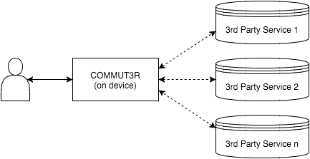
Systems Architecture

Slide 12
Prototype Walkthrough and Questions?

